Slide 1
DeepSeek-AI
February 18, 2025
DeepSeek-V3:
Technical Breakdown
A comprehensive breakdown
for adult beginners

Slide 2
Table of
Contents
Introduction and Overview
03
Core Architecture
08
Multi-Token Prediction
18
Infrastructure & Training
23
FP8 Mixed Precision Training
30
Pre-Training & Data
38
Post-Training Methodology
43
Evaluation Results
49

Slide 3
SECTION 01
Introduction and Overview
Exploring the evolution, core capabilities, and architectural advancements of DeepSeek-V3.

Slide 4
What is DeepSeek-V3?
DeepSeek-V3
Technical Overview
671B Parameters
MoE Architecture
DeepSeek-V3 is a cutting-edge AI language model with a
massive architecture of 671 billion parameters. Unlike
traditional models that use their entire "brain" for every
task, it uses a smart design called Mixture-of-Experts (MoE).
This allows it to activate only 37 billion parameters (about
5.5%) for each specific token it processes. This selective
activation makes it highly efficient, processing information
rapidly while maintaining intelligence levels comparable to
the most powerful closed-source AI systems available today.
This design significantly reduces computational costs while
delivering state-of-the-art performance.
Training Efficiency
The model learned from a vast dataset of 14.8 trillion
diverse tokens, creating a robust knowledge base. Despite
this massive scale, training was remarkably efficient,
requiring only 2.788 million H800 GPU hours. This is
achieved through advanced engineering like FP8 mixed
precision training. This technique reduces memory usage and
computation costs without sacrificing accuracy. The result
is a training process that was completely stable, with no
irrecoverable errors or rollbacks throughout the run,
proving the robustness of the DualPipe algorithm.
Elite Performance
DeepSeek-V3 breaks the barrier between open and closed AI
models. Benchmarks show it rivals top proprietary systems
like GPT-4o and Claude 3.5 Sonnet. The model excels in
complex tasks such as mathematics, coding, and logical
reasoning. Unlike many large models that suffer from
instability, V3's training saw no loss spikes. This
reliability, combined with its "active" parameter efficiency,
makes it a cost-effective powerhouse for real-world
applications and research advancement. It demonstrates
that open models can lead the industry.

Slide 5
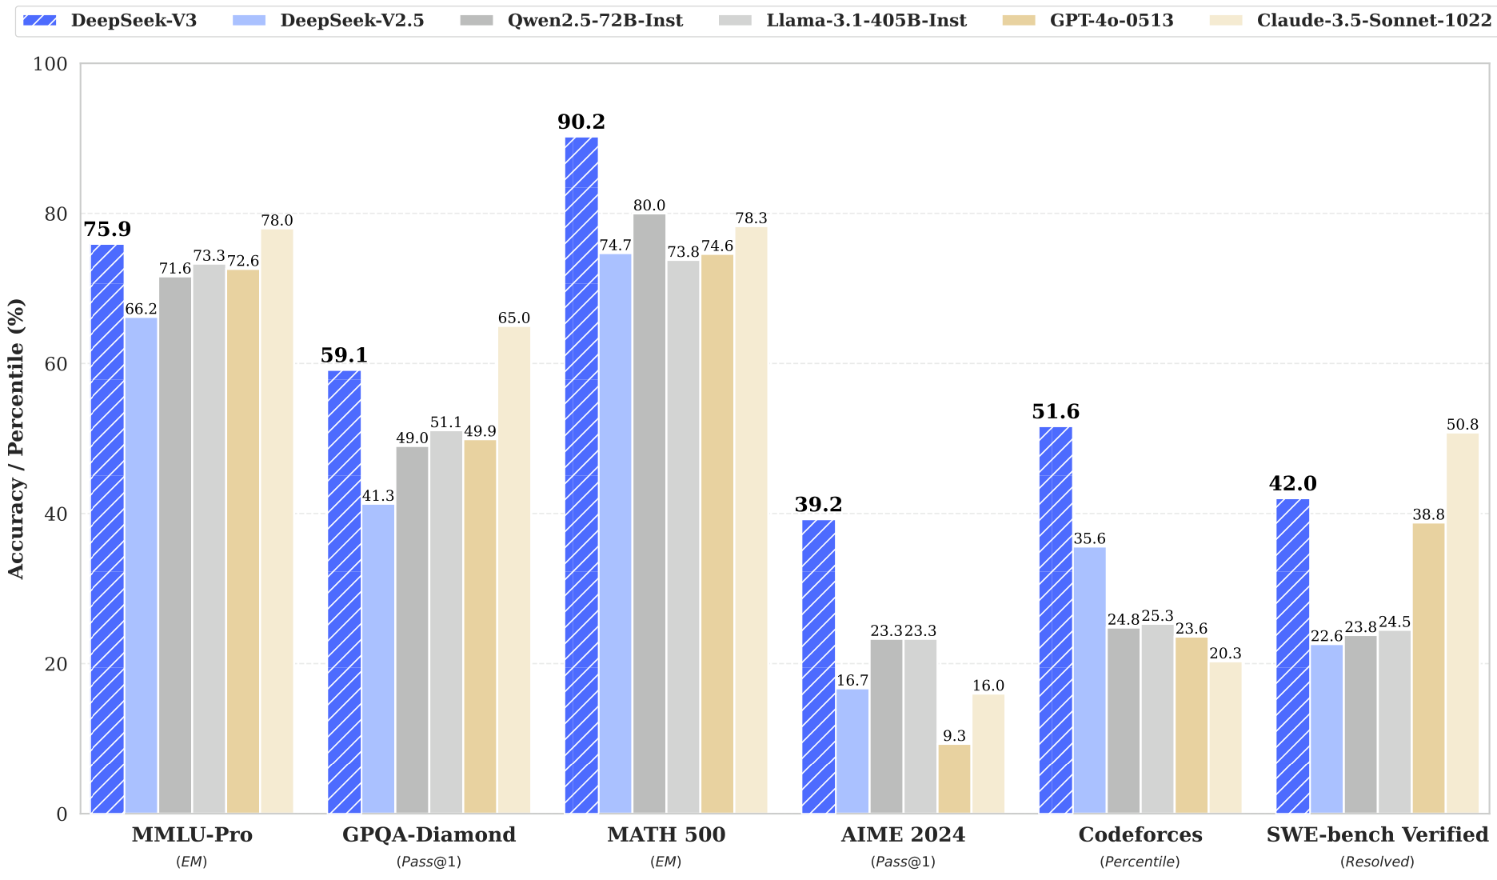
Introduction and Overview
Training Cost
and Efficiency
Training massive AI models usually costs tens of
millions. DeepSeek-V3 achieved elite status for
just $5.576M USD, redefining efficiency.
Total Project Cost
$5.576 Million
Includes pre-train,
context extension,
and post-training
phases. Based on a
$2/hr rental rate.
Compute Resources
2.788 Million
H800 GPU Hours
utilized over a
cluster of 2,048
units. The entire
process was stable.
Benchmarking Results
DeepSeek-V3 outperforms top models despite the low cost.
It scores 90.2% on MATH 500 and 51.6% on Codeforces,
beating GPT-4o in these domains. In broad knowledge
tests like MMLU-Pro, it achieves 75.9%, cementing its
place as a leading open-source model.

Slide 6
Introduction and Overview
Key Technological Innovations
Foundational Architecture
DeepSeek-V3 builds on two proven core technologies to
balance speed and cost efficiently.
Multi-Head Latent Attention
MLA optimizes memory usage during inference. It enables
faster processing without sacrificing model quality.
DeepSeekMoE System
This expert system routes tasks to specific model parts.
Only 37B of 671B parameters activate per token.
FP8 Precision Training
We use 8-bit floating point numbers for calculations.
This lower precision speeds up learning significantly
while maintaining accuracy on a massive scale.
DualPipe Algorithm
To handle data flow, we designed the DualPipe system.
It overlaps computation with communication time, hiding
delays between chips. This ensures the hardware stays
fully utilized throughout the training process.
Multi-Token Prediction
Standard models predict one word at a time. MTP trains
the model to predict multiple future words at once.
This strengthens reasoning and speeds up generation.
Load Balancing Strategy
We pioneered an auxiliary-loss-free method to manage
expert workload. It balances tasks across the model
without artificially forcing assignments, preserving
maximum performance and efficiency.

Slide 7
DeepSeek-V3: Technical Breakdown
Top Scores
Math: 90.2
MMLU: 75.9
Code: 51.6
AIME: 39.2
Math Dominance
On the MATH 500 benchmark,
DeepSeek-V3 achieves a score of 90.2,
surpassing competitors like GPT-4o
(74.6) and Claude-3.5 (78.3).
This tests the model's ability to
solve complex mathematical problems.
Coding Capabilities
In the Codeforces coding challenge,
the model reached the 51.6 percentile.
This confirms strong logic and
programming skills, far ahead of
many open-source alternatives.
Competitive Analysis
DeepSeek-V3 beats major open models
like Llama-3.1 and matches top
proprietary systems. It excels in
technical tasks while maintaining
high general knowledge (75.9 MMLU).
Efficiency & Cost
Training required only 2.788M
H800 GPU hours, a very low cost for
a massive 671B parameter model.
The process was remarkably stable
with no loss spikes or rollbacks
needed during the entire run.

Slide 8
SECTION 02
Core Architecture
DeepSeekMoE and Multi-Head Latent Attention.

Slide 9
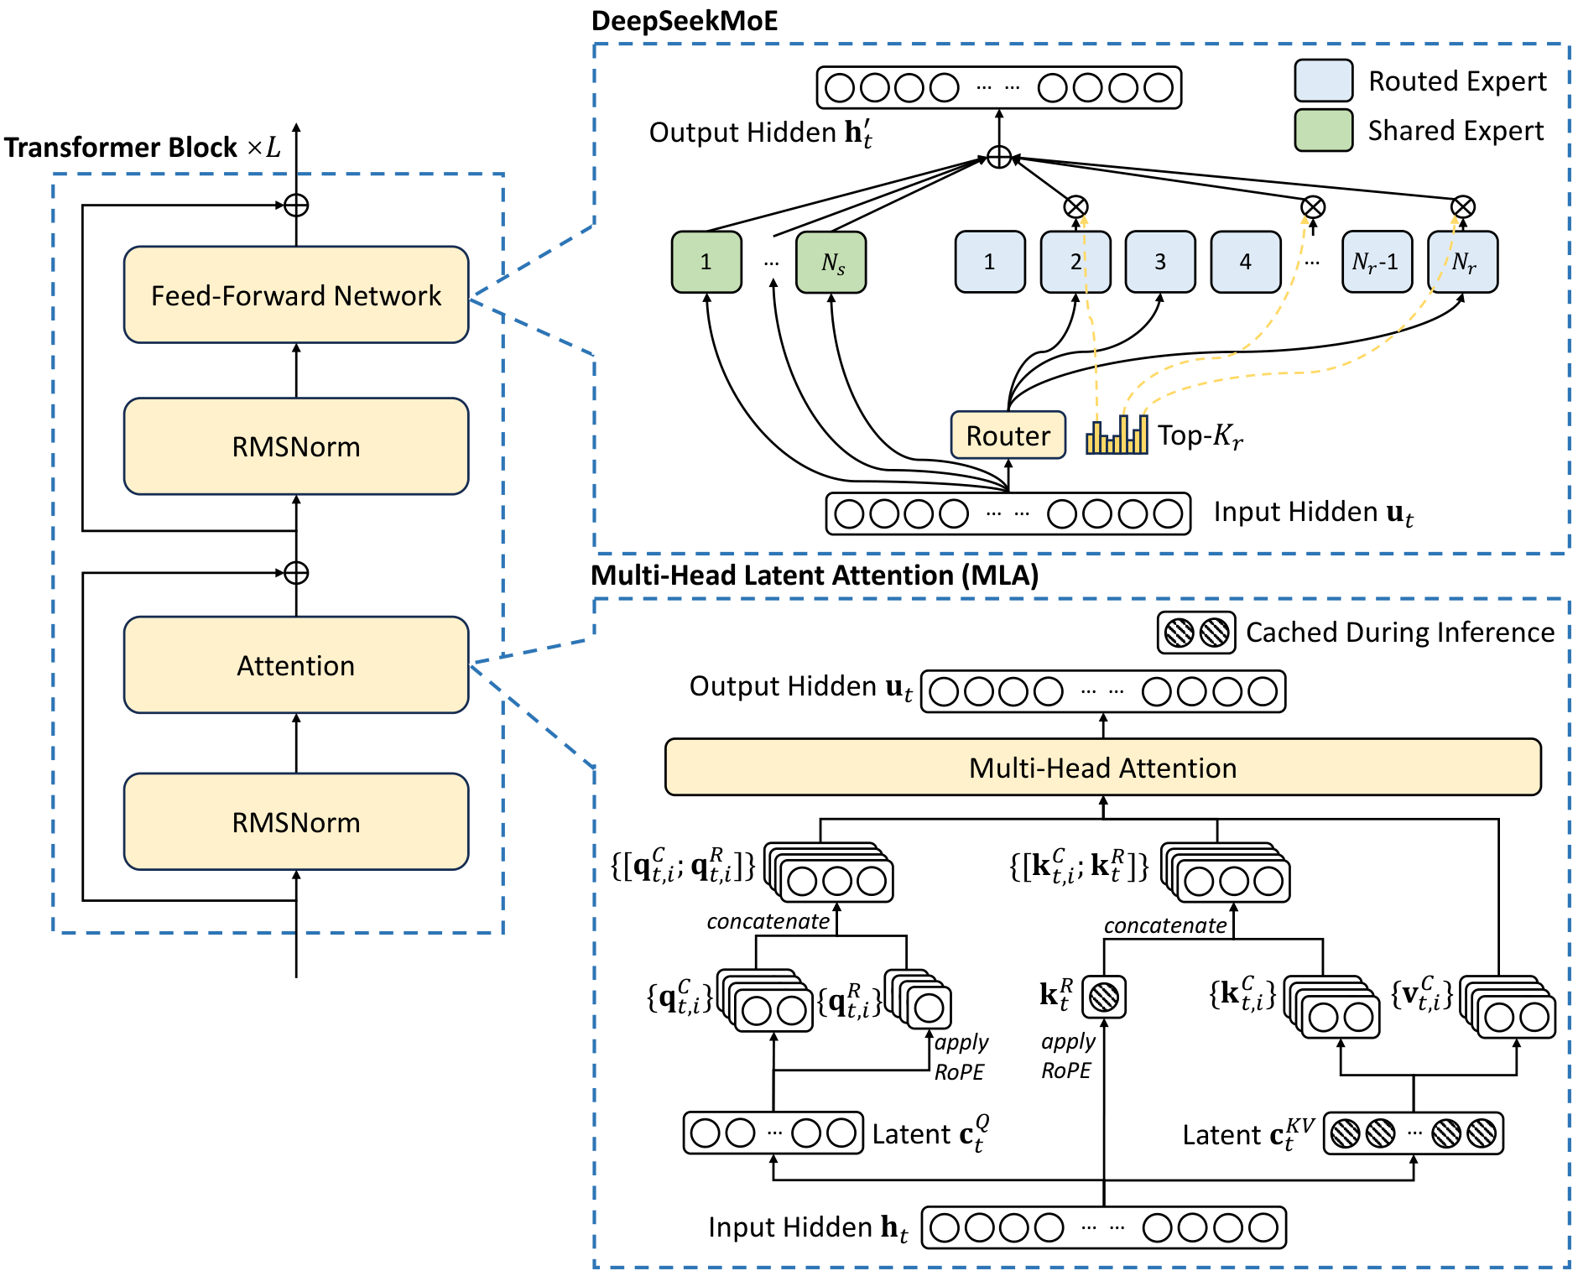
DeepSeek-V3 optimizes the standard Transformer block for efficiency.
DeepSeekMoE
Feed-Forward
Network
Multi-Head Latent Attention
MLA processes context by creating
compact Latent Vectors (circles).
This reduces data stored in the
Cached During Inference state,
marked by striped circles. This
efficiency speeds up answers.

Slide 10
Core Architecture
Understanding
Latent
Attention
(MLA)
The Memory Bottleneck
Standard AI models need massive memory to store
context, known as the Key-Value (KV) Cache.
This limits efficiency when analyzing long files.
The DeepSeek Solution
DeepSeek-V3 uses Multi-Head Latent Attention to
compress this memory into a compact latent
vector, reducing storage needs significantly.
A Simple Analogy
Think of MLA like zipping a large file before
storing it. It takes up much less space while
keeping all the vital information accessible.
Visualizing Figure 2
Only the compressed blue vectors in the
diagram are cached. This compression
allows DeepSeek to process very long
documents faster than older models.

Slide 11
Core Architecture
Multi-Head Latent Attention (MLA)
The Memory Challenge
Generating long text requires remembering past information.
Standard models store this in a huge Key-Value (KV) Cache.
As the text gets longer, this cache fills up computer memory.
This bottleneck slows down generation and limits context.
MLA Compression
DeepSeek-V3 uses Multi-Head Latent Attention (MLA).
It compresses the heavy Keys and Values into a smaller
compressed latent vector using low-rank matrices.
Think of this like zipping a large file to save space.
Decoupled RoPE
Position data tells the model the exact order of words.
MLA separates this Rotary Positional Embedding (RoPE).
It tracks word positions in a standalone, decoupled path.
This ensures precise ordering without bloating the
compressed content memory.
Key Outcomes
This architecture significantly reduces the KV cache size.
This allows the model to handle much longer documents.
Crucially, it maintains comparable performance to
standard attention mechanisms despite the compression.

Slide 12
Core Architecture
DeepSeekMoE:
Mixture-of-Experts
Expert System Design
Unlike a single giant brain, the model uses
many fine-grained sub-networks called
experts. This allows precise task matching.
Shared vs. Routed
DeepSeek uniquely splits experts into types.
Shared Experts are always active to
retain general knowledge and common sense.
Routed Experts are selectively picked
by a router only for specific, complex tasks.
The Efficiency Gain
This separation ensures the model always
has context but only spends energy on
specialized details when strictly necessary,
reducing compute costs significantly.

Slide 13
Core Architecture
The Load Balancing
Challenge
In MoE systems, work often gets assigned
unevenly.
Some "experts" get overwhelmed while others sit
idle. This unbalanced load wastes computing
resources and slows down the training process.
Traditional fixes use an auxiliary loss penalty
to force even distribution. However, this added
constraint distracts the model from learning,
which ultimately reduces prediction accuracy.
DeepSeek-V3 required a new approach: achieving
load balance without the performance penalty.
They pioneered an auxiliary-loss-free method to
ensure efficiency without compromising quality.

Slide 14
Core Architecture
Auxiliary-Loss-Free Strategy

Slide 15
Core Architecture
Core Terms
Expert Load
Bias Value
Gamma Speed
Top-K Route
Dynamic Adj
No Penalty
The Problem
Traditional AIs use artificial penalties
to force balance. This hurts accuracy.
The Solution
DeepSeek-V3 monitors the expert load
in real-time across every batch.
It adds a dynamic bias value
to each expert's score.
Dynamic Updates
If an expert is too busy, the system
lowers its bias to reduce traffic.
If idle, it raises the bias.
Smart Routing
Crucially, this bias only affects
where data is sent (routing).
The actual processing steps still
use the original, pure scores.
This preserves the model's logic.
Key Results
We achieve a perfectly balanced
workload across thousands of GPUs.
This yields better performance than
older methods with loss penalties.

Slide 16
Core Architecture
A sequence-wise loss prevents
single sentences from
overloading experts.
This ensures stability
without slowing training.

Slide 17
Core Architecture
Architecture
Summary
Hybrid Design
The model uses MLA to maximize memory
efficiency and DeepSeekMoE for speed.
Model Structure
It is built with 61 Transformer layers.
The internal width is 7168 dimensions.
Efficient Scale
Total size reaches 671 billion parameters.
However, only 37 billion activate per
token. This is like a massive library where
you only consult relevant books for answers,
keeping the system light but knowledgeable.

Slide 18
SECTION 03
Multi-Token Prediction
Simultaneous future token generation for enhanced training efficiency and inference speed.

Slide 19
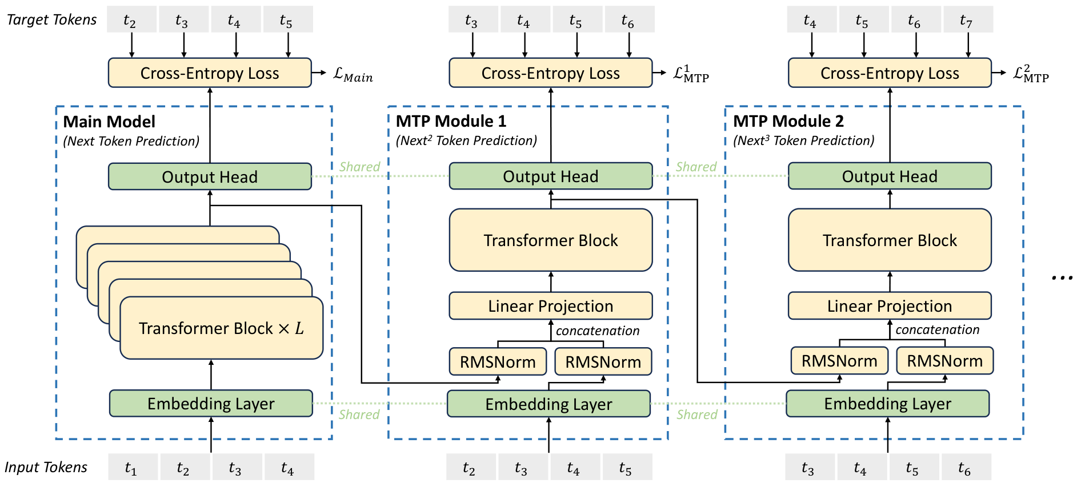
Multi-Token Prediction
Predicting Ahead
Standard models work like autocomplete, guessing
only the next word. Multi-Token Prediction asks the
model to predict several future words at once.
This forces it to plan ahead rather than just guess.
The diagram shows the Main Model focusing on the
immediate step. MTP Modules (1 & 2) then look
further ahead. Green dotted lines show Shared
layers, meaning all parts learn from the same core.
Why do this? It creates denser training signals,
letting the AI learn faster from less data. This
boosts data efficiency and teaches the model to
understand structure, not just word probability.
DeepSeek uses a sequential chain, not isolated
guesses. Each module passes insights to the next
via the causal chain. This ensures future
predictions stay grounded in the full context.

Slide 20
Multi-Token Prediction
MTP Implementation Strategy
Core Objectives
Inspired by Gloeckle et al., MTP extends prediction scope.
It densifies training signals to improve data efficiency.
Models can pre-plan representations for future tokens.
Sequential Design
Unlike parallel heads, we use sequential modules.
This maintains the complete causal chain at each step.
Architecture Flow
The Main Model predicts the immediate next token.
MTP Module 1 predicts the subsequent token.
MTP Module 2 predicts the token after that.
Shared Resources
To save memory, the Embedding Layer is shared.
The Output Head is also shared across all modules.
Input Combination
At each depth, the model combines two specific inputs.
First, the representation from the previous depth.
Second, the embedding of the current target token.
Processing Logic
Inputs are concatenated and passed to a linear projection.
A dedicated Transformer Block processes this state.
Standard Inference
MTP modules are mainly for training improvements.
They can be discarded so the main model runs alone.
This ensures normal operation without extra cost.
Speculative Speedup
Alternatively, modules are used for speculative decoding.
This repurposes training modules to reduce latency.

Slide 21
Multi-Token Prediction
MTP Training
Objective
Calculating Error
The model predicts multiple future tokens at once. For each
prediction, we calculate a Cross-Entropy Loss score.
This score measures the 'error' between the model's guess
and the actual correct word in the training data.
We calculate this for every prediction depth ($k$). This
means we check accuracy for the 1st future token,
the 2nd future token, and so on, up to the full
sequence length ($T$). It quantifies uncertainty.
A lower loss means the model is confident and accurate.
Balancing Objectives
Instead of focusing only on the immediate next word,
the system computes the average MTP loss across all
future prediction depths. Crucially, this average is
multiplied by a weighting factor ($λ$). This mathematical
dial allows researchers to balance the difficulty.
It ensures the new multi-token task aids the model
without overpowering the primary goal of next-token
prediction. This combination creates a robust,
stable training objective for DeepSeek-V3.
Inference Strategy
This objective serves as 'resistance training' for the AI.
It forces the model to plan ahead, strengthening the core.
However, during actual use (Inference), we can
discard the MTP modules. The main model functions
independently and normally, retaining the benefits.
Alternatively, we can repurpose these modules for
Speculative Decoding. This technique uses the draft
predictions to verify multiple tokens at once,
significantly speeding up text generation latency.

Slide 22
Multi-Token Prediction
MTP
in
Inference
Usage Flexibility
Uniquely, the Multi-Token Prediction (MTP)
modules used in training are not required
for the final model to work. We can discard
them completely. However, keeping them unlocks
Speculative Decoding: a method to draft
future words and verify them efficiently.
Performance Gains
This strategy uses the extra modules to predict
2 tokens ahead. Our evaluation shows the
second token is accepted 85-90% of the
time. This high success rate speeds up text
generation, making the model 1.8 times
faster (Tokens Per Second) than normal.

Slide 23
SECTION 04
Infrastructure & Training
Cluster Optimization & FP8 Training Framework

Slide 24
Infrastructure & Training
Hardware Cluster Setup
Core GPU Infrastructure
DeepSeek-V3 is trained on a massive cluster of
2,048 NVIDIA H800 GPUs. These powerful chips
act as the "brain" of the operation. To manage
this scale, GPUs are organized into individual
units called nodes. Each node houses exactly
8 GPUs working in parallel.
Intra-Node Connectivity
Inside each node, speed is paramount. The
8 GPUs are connected using NVLink and
NVSwitch technology. This functions like a
super-highway, allowing chips to exchange
data instantly and unifies memory access
within the computing node.
Global Interconnects
To connect separate nodes, we utilize
InfiniBand (IB) interconnects. While NVLink
handles local traffic, IB manages the long-
distance communication across the cluster.
This high-speed networking is vital for
synchronizing the entire system.
Why It Matters
Training a large model requires massive
coordination. The infrastructure supports
efficient data flow, ensuring that communication
overheads do not slow down the learning
process. This allows DeepSeek-V3 to train
rapidly on vast datasets.

Slide 25
Infrastructure & Training
The Communication
Bottleneck
The 1:1 Traffic Jam
DeepSeek-V3 uses a specialized architecture called
Mixture-of-Experts (MoE). This requires data to
constantly jump between different GPU nodes. This
creates a bottleneck with a roughly 1:1 ratio of
calculation to data transfer. Essentially, the
system spends as much time waiting for data to
arrive as it does working.
The DualPipe Solution
To fix this, engineers created DualPipe.
Standard systems stop working to wait for data.
DualPipe overlaps these processes. It performs
calculations for one task while simultaneously
sending data for the next. This 'hides' the
transfer time behind useful work, achieving
near-zero communication overhead.

Slide 26
Infrastructure & Training
DualPipe
Algorithm
Concept
The Efficiency Challenge
DeepSeek-V3 uses many GPU chips that must work
together. Normally, chips stop working to share data,
wasting about 50% of the total training time. This
1:1 ratio of work-to-waiting is a major bottleneck.
The DualPipe Solution
DualPipe is a smart schedule that overlaps these
tasks. It splits data into forward and backward
passes that run simultaneously. While one part
calculates, another part sends data, making good use
of every second.
Why It Matters
By hiding the data transfer time behind the
calculation time, the communication overhead
becomes invisible. This allows the system to scale
up massively without slowing down, achieving
near-zero wasted time.

Slide 27
Infrastructure & Training
DualPipe
Scheduling
The Pipeline Challenge
Traditional AI pipelines suffer from bubbles—idle
gaps where GPUs wait for data to arrive.
Bidirectional Solution
DualPipe employs a bidirectional schedule, feeding
data from both ends of the pipeline at once.
This keeps hardware utilization constantly high.
Hiding Latency
By splitting tasks into parts like Attention and
MLP, we overlap work. We compute and send data
at the same time, achieving near-zero overhead.

Slide 28
Infrastructure & Training
Pipeline
Performance
Comparison
Reducing Idle Time
Older methods like 1F1B often leave GPUs
waiting in idle gaps called "bubbles."
DualPipe overlaps tasks to eliminate these
delays, speeding up the training process.
Memory Trade-off
This speed requires holding 2x parameters,
meaning two copies of the model sit in
memory. While heavier, this cost is well
within the capacity of modern hardware.
Seamless Scaling
Crucially, efficiency stays high as data
volume grows. Neither the wasted time nor
memory usage spikes when adding more
micro-batches to the pipeline.

Slide 29
Infrastructure & Training
Cross-Node
Communication
Bandwidth Strategy
DeepSeek-V3 optimizes data flow between network types. The
internal NVLink connection offers 160 GB/s bandwidth,
roughly 3.2x faster than the external InfiniBand network.
To prevent bottlenecks, the system limits each token to at
most 4 nodes. This keeps traffic on the slower network
manageable while maximizing local speed.
Smart Routing Path
Tokens travel a specific path to ensure speed. First, data
moves via external network to a GPU on the target node.
Once it arrives, it is instantly forwarded via NVLink
to the specific GPU hosting the required expert. This
two-step process avoids blocking and ensures that tokens
reach their destination efficiently.
System Efficiency
Routing is managed by custom software kernels that overlap
communication tasks. This requires only 20 SMs to fully
utilize bandwidth. As a result, tokens can select an
average of 3.2 experts per node without delays. The system
scales efficiently, supporting up to 13 routed experts
while maintaining consistent communication costs.

Slide 30
SECTION 05
FP8 Mixed Precision Training
Accelerating large-scale model training with fine-grained 8-bit floating point arithmetic.

Slide 31
First successful validation of 8-bit training on a massive scale.
Most AI uses heavy 16-bit math.
We use efficient 8-bit numbers.
This doubles calculation speed.
It also halves memory usage.
Error remains below 0.25%.

Slide 32
FP8 Mixed Precision Training
Mixed Precision Framework
Heavy math runs in FP8
Sensitive parts keep BF16
Master weights stay FP32
Ensures speed & stability

Slide 33
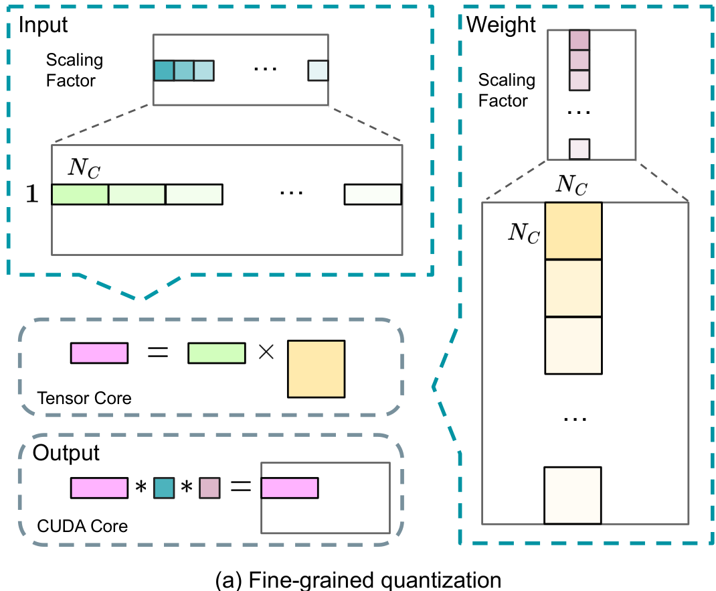
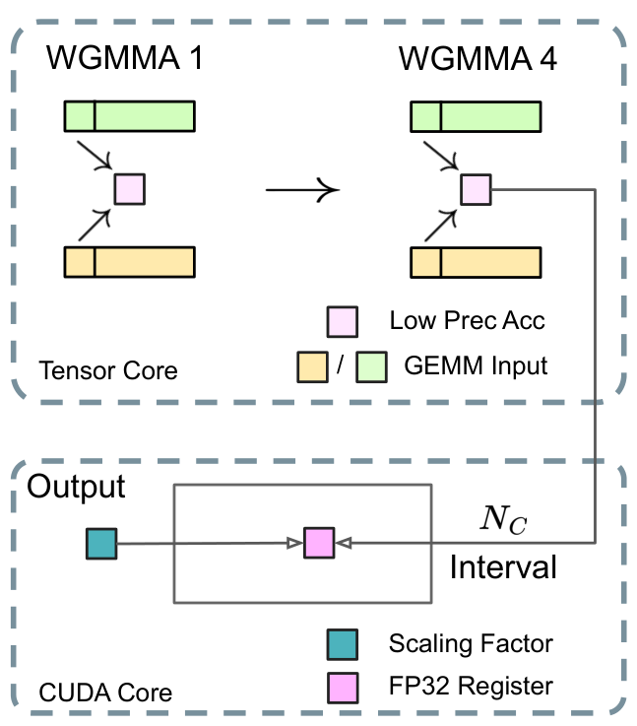
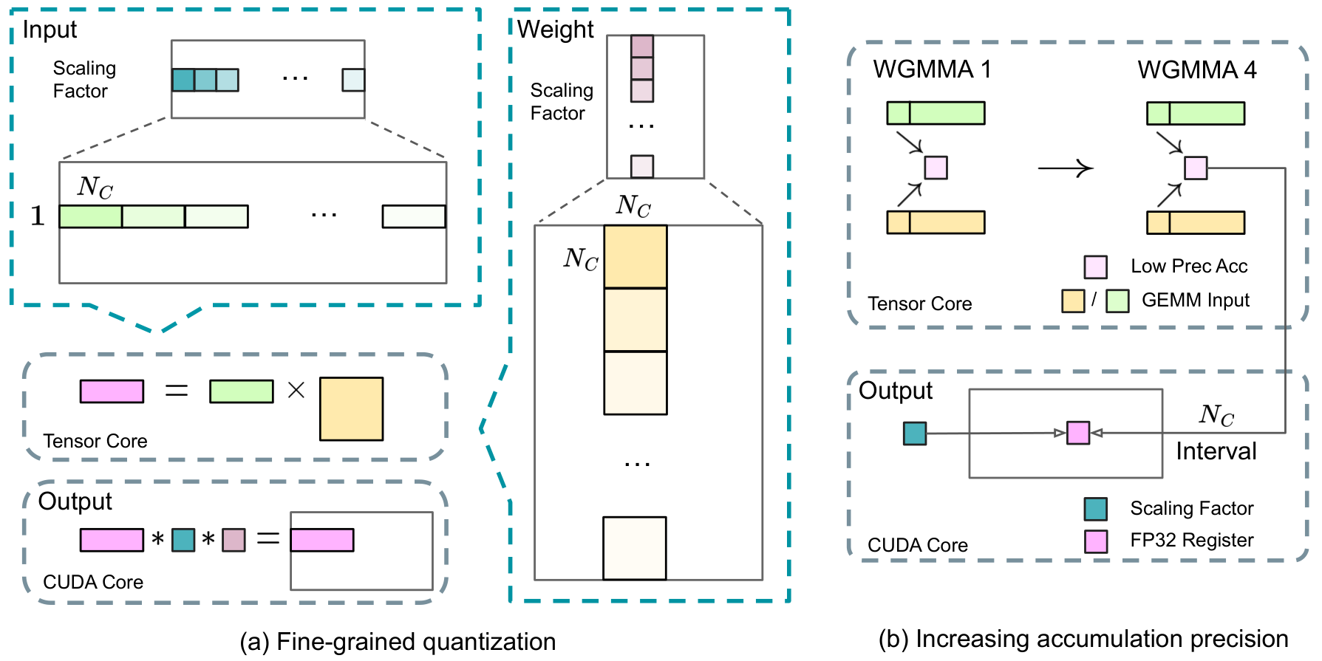
FP8 Mixed Precision Training
FP8 range is limited,
so outliers cause errors.
We use fine-grained
quantization to fix this.
Inputs scale per 128,
weights: 128x128 blocks.
This local scaling
adapts to data spikes,
preserving precision.

Slide 34
FP8 Mixed Precision Training
The Precision
Accumulation Risk
The Accuracy Gap
Standard FP8 operations on H800 GPUs retain only about
14 bits of precision. This is far below the needed FP32.
Impact on Training
For large models, this limitation creates a
2% relative error.
This severely constrains training accuracy.
CUDA Core Promotion
We promote partial results to CUDA Cores for higher
precision, rather than relying only on Tensor Cores.
The Interval Strategy
Every 128 elements, we copy partial sums to FP32 registers.
This restores full FP32 precision to the accumulation.
Parallel Execution
The system uses overlapping to mask latency. While one
warpgroup promotes data, another executes math.
Minimal Overhead
This design maintains high Tensor Core utilization.
We get improved precision with minimal speed cost.

Slide 35
FP8 Mixed Precision Training
Low-Precision
Storage Strategy
Optimizer Efficiency
Training AI requires an "optimizer" to track learning
progress. DeepSeek switches these states from heavy
FP32 (32-bit) to lighter BF16 (16-bit) format.
This change reduces memory usage significantly without
hurting performance. However, critical master weights
remain in standard FP32 to ensure the model remains
numerically stable throughout the process.
Cached Activations
"Activations" are temporary data saved during training.
To save memory, these are normally compressed into
FP8 format. However, sensitive areas like the Linear
operator after Attention require more precision.
For these specific cases, a custom E5M6 data format is
used. This specialized storage method strikes a balance
between high memory efficiency and exact calculation.
Communication Flow
Moving data between GPUs creates a bottleneck. To fix
this, data sent to "Experts" is quantized to FP8
before transmission, reducing bandwidth load. Also,
inputs for the SwiGLU operator are cached while
outputs are recomputed later to save space. Critical
combine steps stay in BF16 to preserve precision.

Slide 36
FP8 Mixed Precision Training
Validating FP8
Accuracy
Verification Strategy
To ensure 8-bit training works, the team ran
ablation studies (comparisons) against the standard
BF16 baseline method to measure accuracy.
They trained models with up to 230 billion parameters
on roughly 1 trillion tokens of real data.
Key Findings
The results show that FP8 precision matches the
high-precision baseline performance almost exactly.
The relative loss error remains consistently below
0.25%, well within normal training randomness.
The Verdict
This confirms that doubling computational speed
does not come at the cost of model quality.

Slide 37
FP8 Mixed Precision Training
Hardware
Suggestions for
Future AI Chips
Dedicated Network Units
Current chips use valuable compute cores (SMs) for networking.
DeepSeek lost 20 of 132 cores on H800s just to manage data.
Future chips should offload this to a specific co-processor.
Unified Architecture
Engineers currently manage internal and external links
separately.
Unifying these into one interface would simplify programming.
Native Quantization
Advanced training uses fine-grained scaling
for better accuracy.
Current chips lack support, forcing slow
external data copying.
Tensor Cores should handle these scaling factors natively.
Better Accumulation
Current FP8 hardware lacks precision when adding up results.
It uses only 14 bits, forcing slow workarounds on other cores.
Future designs must support higher native precision.
Fused Memory Operations
Quantizing data on the fly currently wastes memory bandwidth.
Systems read and write the same data multiple times.
Fusing steps into one atomic operation boosts efficiency.
Direct Transposed Reads
Training requires rotating data matrices frequently.
Doing this currently requires clumsy extra memory steps.
Chips should allow reading rotated data directly from memory.

Slide 38
SECTION 06
Pre-Training & Data
Dataset curation and scaling strategies.

Slide 39
Pre-Training & Data
Data
Construction
Dataset Scale
Training consumed 14.8 trillion tokens.
The diverse corpus prioritizes English and
Chinese while minimizing data redundancy.
Enhanced Reasoning
To improve logic, we increased the ratio of
mathematical and programming samples.
This strengthens complex problem solving.
Gap-Filling Strategy
We used Fill-in-Middle to help the model
predict missing text segments using context.
This applies at a rate of 0.1 (10%).

Slide 40
Pre-Training & Data
671B Parameters
37B Active Size
61 Model Layers
14.8T Tokens
Architecture Specs
The model uses 61 Transformer layers with a hidden
dimension of 7168. It employs 128 attention heads for
processing, each with a dimension of 128.
Mixture-of-Experts
We replace standard networks with MoE layers containing
1 shared expert and 256 routed experts. Only 8 experts
activate per token. This efficient design allows 671B
total parameters while keeping active usage at just 37B.
Optimizer Settings
We employ the AdamW optimizer with a weight decay of 0.1
to maintain stability. Tokenization uses an extended
vocabulary of 128K tokens to improve multilingual data
compression and efficiency during training.
Data & Sequence
The model is pre-trained on 14.8 trillion tokens. We set a
max sequence length of 4K to capture context. We also
predict one extra token ahead to speed up generation.
Warmup Phase
The learning rate increases linearly to 2.2×10⁻⁴ in the
first 2,000 steps. This helps stabilize the model early
in training. The rate remains constant until the model
consumes 10T tokens of the dataset.
Decay Schedule
We use a cosine decay curve to lower the rate to
2.2×10⁻⁵ over 4.3T tokens. A specialized schedule
is applied for the final 500B tokens of training.

Slide 41
DeepSeek-V3: Technical Breakdown
Long
Context
Scaling
Memory
To
128K
Tokens
Memory Limits
Think of the context window as the
model's short-term memory. At first,
DeepSeek-V3 held only 4K tokens,
about 3,000 words. This limited its
ability to track long documents.
The Upgrade
To read whole books, engineers used
a two-stage process. First, they
trained it to handle 32K tokens.
Then, they pushed limits further to
128K tokens. This massive upgrade
allows it to process entire code
repositories in a single pass.
The YaRN Method
To stretch the window without losing
focus, the team used YaRN. This
technique recalibrates how the AI
measures distance between words,
ensuring it doesn't get confused
when processing massive sequences.
Validation Results
To prove it works, they used the
"Needle In A Haystack" test. They
hid a specific fact in a huge text.
Figure 8 shows the results: the
solid green block means 100%
success. The model found the
hidden fact every time, up to the
full 128K limit.

Slide 42
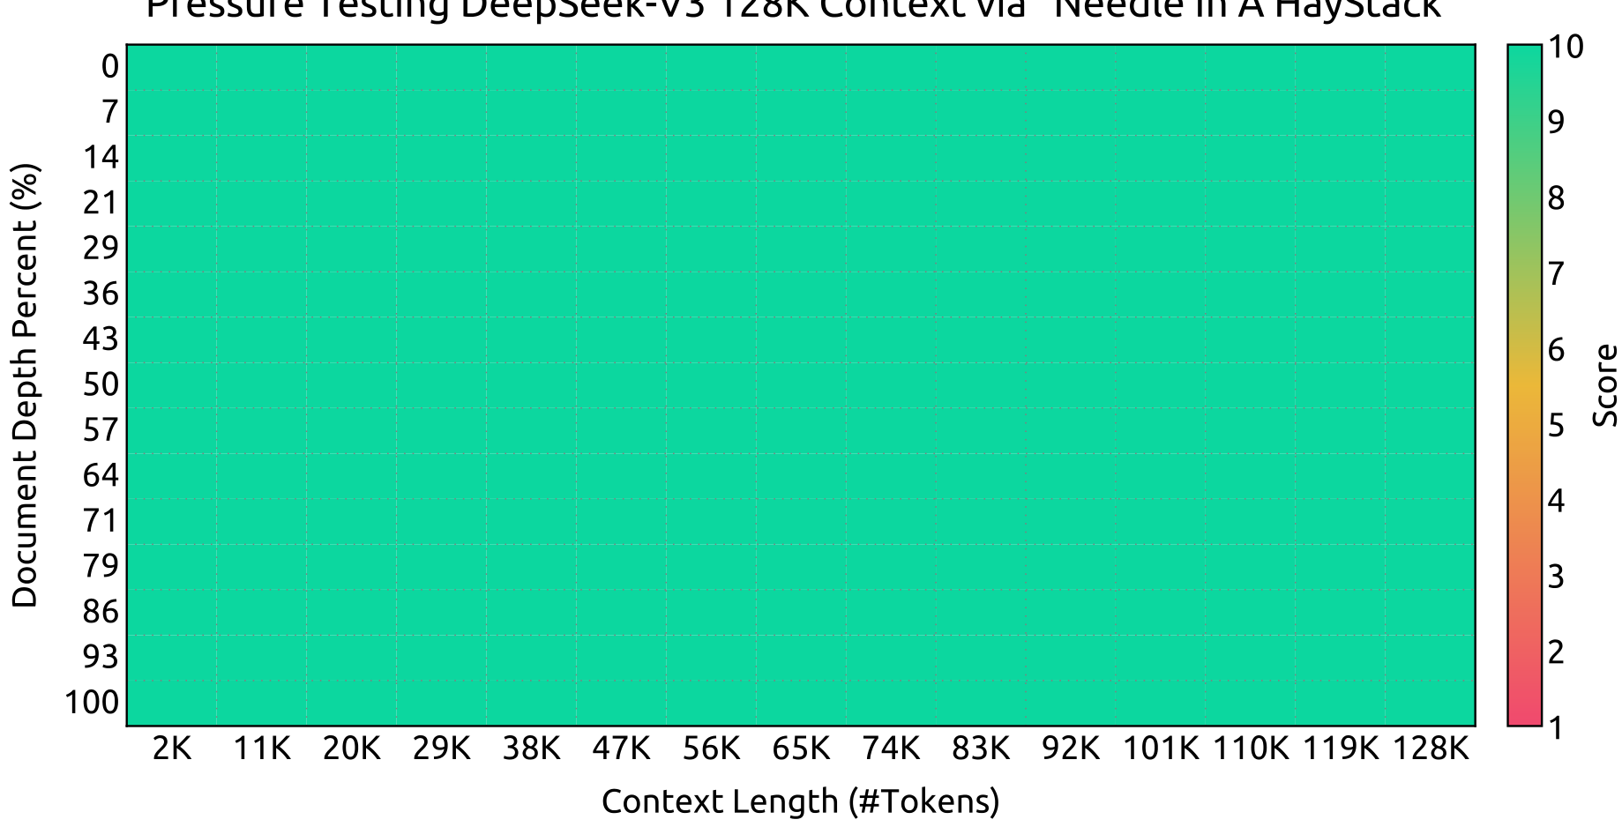
Pre-Training & Data
Validating
Long Context
DeepSeek-V3 was tested using the 'Needle In A
Haystack' method to verify its ability to find
hidden facts across 128,000 tokens of text.
The Challenge
Locating a random
fact hidden inside
a massive text
block, like a
needle in a
haystack.
Key Metrics
X-Axis: Context
Length (2K-128K)
Y-Axis: Depth
Percent (0-100%)
Green: Perfect
Accuracy (10/10)
Results Analysis
The chart displays a solid block of green, indicating
flawless retrieval scores. Whether a fact is hidden at
the start (0%) or end (100%) of a document,
DeepSeek-V3 finds it perfectly. This consistency holds
true up to the maximum context of 128K tokens.

Slide 43
SECTION 07
Post-Training Methodology
DeepSeek-V3: Technical Breakdown

Slide 44
Supervised Fine-Tuning (SFT)
1.5M Training Items
Instruction Tuning
Multi-Domain Data
Tailored Creation
Reasoning Data
We utilize the DeepSeek-R1 model to generate data for logic,
code, and math tasks. While R1 is accurate, its raw outputs
often suffer from overthinking and poor formatting issues.
Optimization Goal
The objective is to combine R1's deep reasoning accuracy with
the clarity and conciseness of standard formats. This ensures
the model answers correctly without unnecessary length.
The Expert Pipeline
We train a specific expert model using Reinforcement Learning
to serve as a data generator. This intermediate model learns
to incorporate reflection mechanisms into its responses.
Rejection Sampling
We do not use all generated data. Through rejection sampling,
we filter outputs to keep only the best responses. This step
guarantees the final dataset is both high-quality and lean.
Non-Reasoning Data
For creative tasks like writing, we use DeepSeek-V2.5.
Human annotators then verify this data to ensure specific
cultural nuances and accuracy standards are fully met.
Training Settings
We fine-tune for 2 epochs. Rates decay from 5E-6 to 1E-6.
Samples are packed efficiently, but we use sample masking
to prevent information bleeding between unrelated examples.

Slide 45
DeepSeek-V3: Technical Breakdown
Teacher:
Student:
Result:
Smarter
Reasoning
The Expert Model
DeepSeek-R1 acts as a specialist
model. It excels at complex tasks
like advanced math and coding by
using deep thinking patterns.
Distillation Process
Instead of raw data, V3 learns from
R1's outputs. R1 generates high-
quality solutions to hard prompts.
V3 treats these solutions as training
material, effectively learning how
to reason without needing R1's full
computational overhead.
Balancing Quality
R1 can overthink or be too verbose.
We filter this data to ensure V3
learns accuracy while keeping
answers clear and concise.
Measurable Gains
Distilling knowledge from R1 proved
highly effective. On the MATH-500
benchmark, accuracy jumped from
74.6% to 83.2%.
Code Improvements
Coding tasks saw similar boosts.
LiveCodeBench scores rose from
31.1% to 37.4% pass rate.
The Length Trade-off
Better reasoning requires more
words. Math responses doubled in
length (769 to 1,510 tokens).
Why It Matters
This proves smaller models can
inherit reasoning skills from
expert models, a key path for
future AI efficiency.

Slide 46
Post-Training Methodology
Reinforcement Learning Strategy
Core Concepts
Reinforcement Learning (RL) acts like a teacher grading a
student. The goal is to align the AI's behavior with human
values using a system called a Reward Model. When the AI
generates a high-quality answer, it gets a positive score,
encouraging it to repeat that behavior. DeepSeek-V3 uses
two distinct grading methods to handle different types of
questions: one for facts and one for creativity.
Rule-Based Rewards
This method is used for tasks with definitively correct
answers, such as math problems or coding challenges.
Since these have clear rules (e.g., 2+2 always equals 4),
we can automatically verify results. For coding, we use a
compiler to check if the code runs successfully. This
approach is highly reliable and resistant to errors because
the grading criteria are strict and objective.
Model-Based Rewards
Used for open-ended tasks like creative writing where no
single correct answer exists. Here, a separate AI model acts
as a judge to evaluate response quality based on human
preferences. It assesses subjective factors like tone, style,
and helpfulness. This allows the system to handle nuanced
queries that rigid rules cannot measure effectively.
Ensuring Reliability
Sometimes AI tries to trick the grader to get a high score
without doing the work, known as "reward hacking."
To prevent this, we train the Reward Model using
Chain-of-Thought data. This means the grader evaluates the
reasoning steps, not just the final output. This ensures
the AI is truly solving the problem rather than just
guessing what the user wants to hear.

Slide 47
Post-Training Methodology
Group Relative Policy
Optimization (GRPO)

Slide 48
Post-Training Methodology
The Model
Judges Its
Own Work
To Learn
The Feedback Challenge
In math or coding, we can easily check if an answer is
correct using software tools. However, for creative
writing or general questions, there is no simple "true"
or "false" button. Humans cannot manually rate every
single answer an AI generates because it would take
too much time. This creates a training bottleneck.
The Solution
Instead of relying on humans, DeepSeek-V3 learns to
judge its own quality.
Constitutional AI Method
DeepSeek-V3 uses a "constitution" of human values as a
guide. When training, the model generates multiple
possible responses to a question. It then acts as a
judge, reviewing its own answers against these rules.
The Voting Process
The model votes on which of its responses is best. This
self-vote becomes the reward signal, allowing the
system to reinforce good behaviors autonomously.
Notable Results
This method transforms unstructured text into clear
rewards. The research shows this produced notable
alignment effects, improving how well the model
follows human intent in subjective tasks.
Self-Improvement Loop
By serving as a "versatile processor" for feedback,
the LLM creates a cycle of growth. It enables
self-improvement in general scenarios where
traditional hard-coded rewards are impractical.

Slide 49
SECTION 08
Evaluation Results
Performance benchmarks and comparative analysis.

Slide 50
Evaluation Results
DeepSeek-V3
Benchmark
& Evaluation
Overview
Multilingual Foundation
The base model is pre-trained on a vast corpus dominated
by English and Chinese. Consequently, our benchmarks
focus heavily on these languages while incorporating
multilingual datasets to verify cross-lingual skills.
Key Testing Domains
We evaluate across diverse categories
using standard sets:
• Knowledge: Tests like MMLU and C-Eval assess general
understanding across STEM and humanities subjects.
• Reasoning: Tests like GSM8K (Math) and HumanEval
(Code) measure rigorous logical and technical skills.
Methodology & Comparison
Evaluation uses both Perplexity (prediction accuracy)
and Generation (response quality) for fairness.
Performance is benchmarked against state-of-the-art
open models like Qwen2.5 72B and LLaMA-3.1 405B.

Slide 51
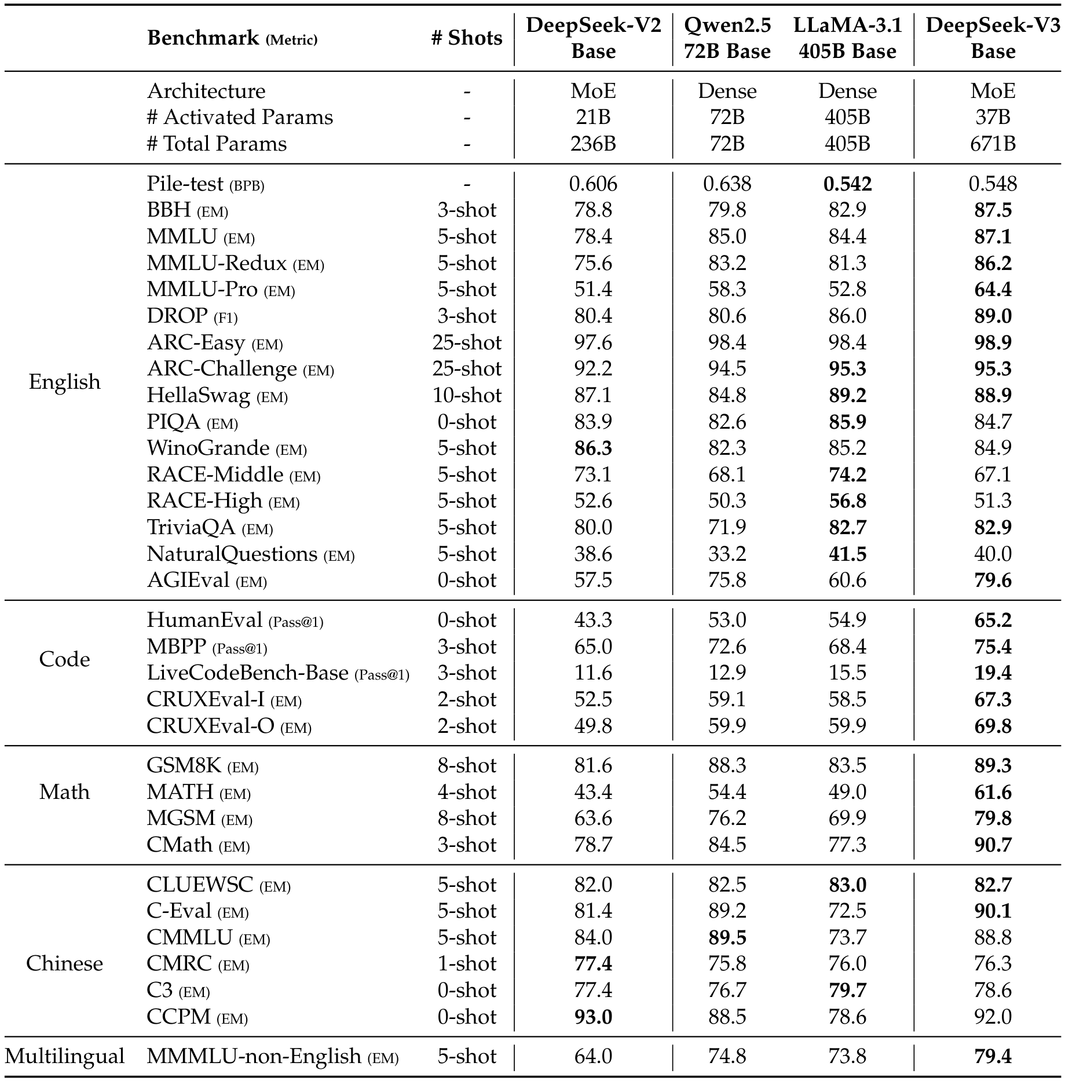
Evaluation Results
Base Model
Performance
VS LLaMA-3.1
DeepSeek-V3 Base
outperforms the
massive LLaMA model
in most benchmarks.
Smart Architecture
Uses a mixture-of-
experts (MoE) design.
Activates just 37B
parameters per token,
vs LLaMA's 405B.
Math Dominance
Scores 61.6% on the
hard MATH benchmark,
far surpassing the
49.0% of LLaMA.
Coding Power
On HumanEval code
tests, it reaches
65.2% accuracy,
clearly beating
LLaMA's 54.9%.

Slide 52
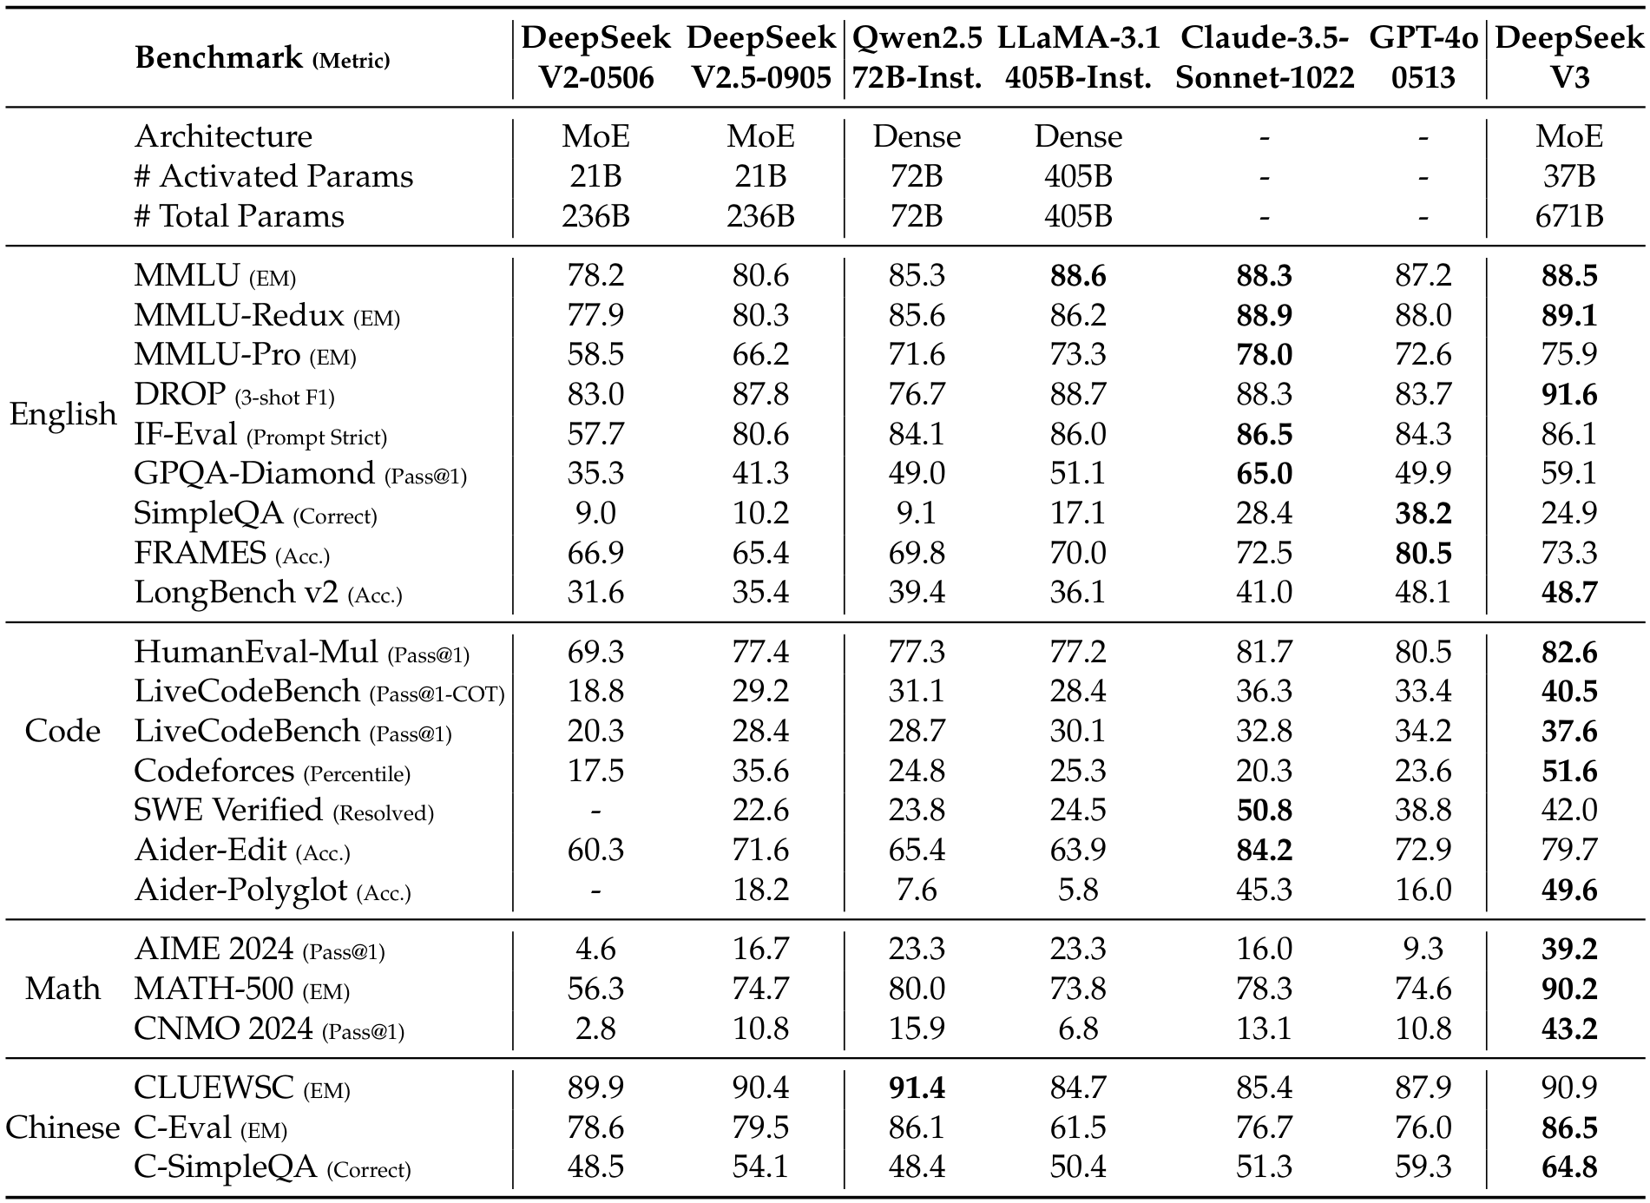
DeepSeek-V3 beats GPT-4o and Claude-3.5 in Math and Code tasks.
Market Leader
Math Score: 90.2
Code Score: 82.6
Beats GPT-4o
Beats Claude
Top Open Source
Chat Optimized

Slide 53
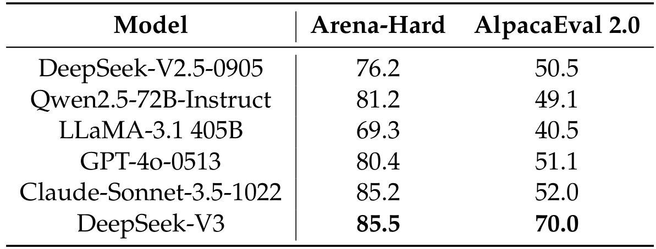
Evaluation Results
Top Performance
Arena Score: 85.5
Alpaca Score: 70.0
Beats GPT-4o
Creative Benchmarks
Tests like Arena-Hard mimic real user prompts to rate
quality. DeepSeek-V3 scores 85.5, becoming the first
open-source model to surpass the 85% threshold.
Competitive Advantage
It outperforms GPT-4o (80.4) and Claude-3.5 (85.2)
on Arena-Hard. On AlpacaEval 2.0, it achieves 70.0,
leading competitors like LLaMA-3.1 (40.5) by a wide
margin. This reflects a 20% improvement over previous
versions, proving its ability to handle nuanced tasks.

Slide 54
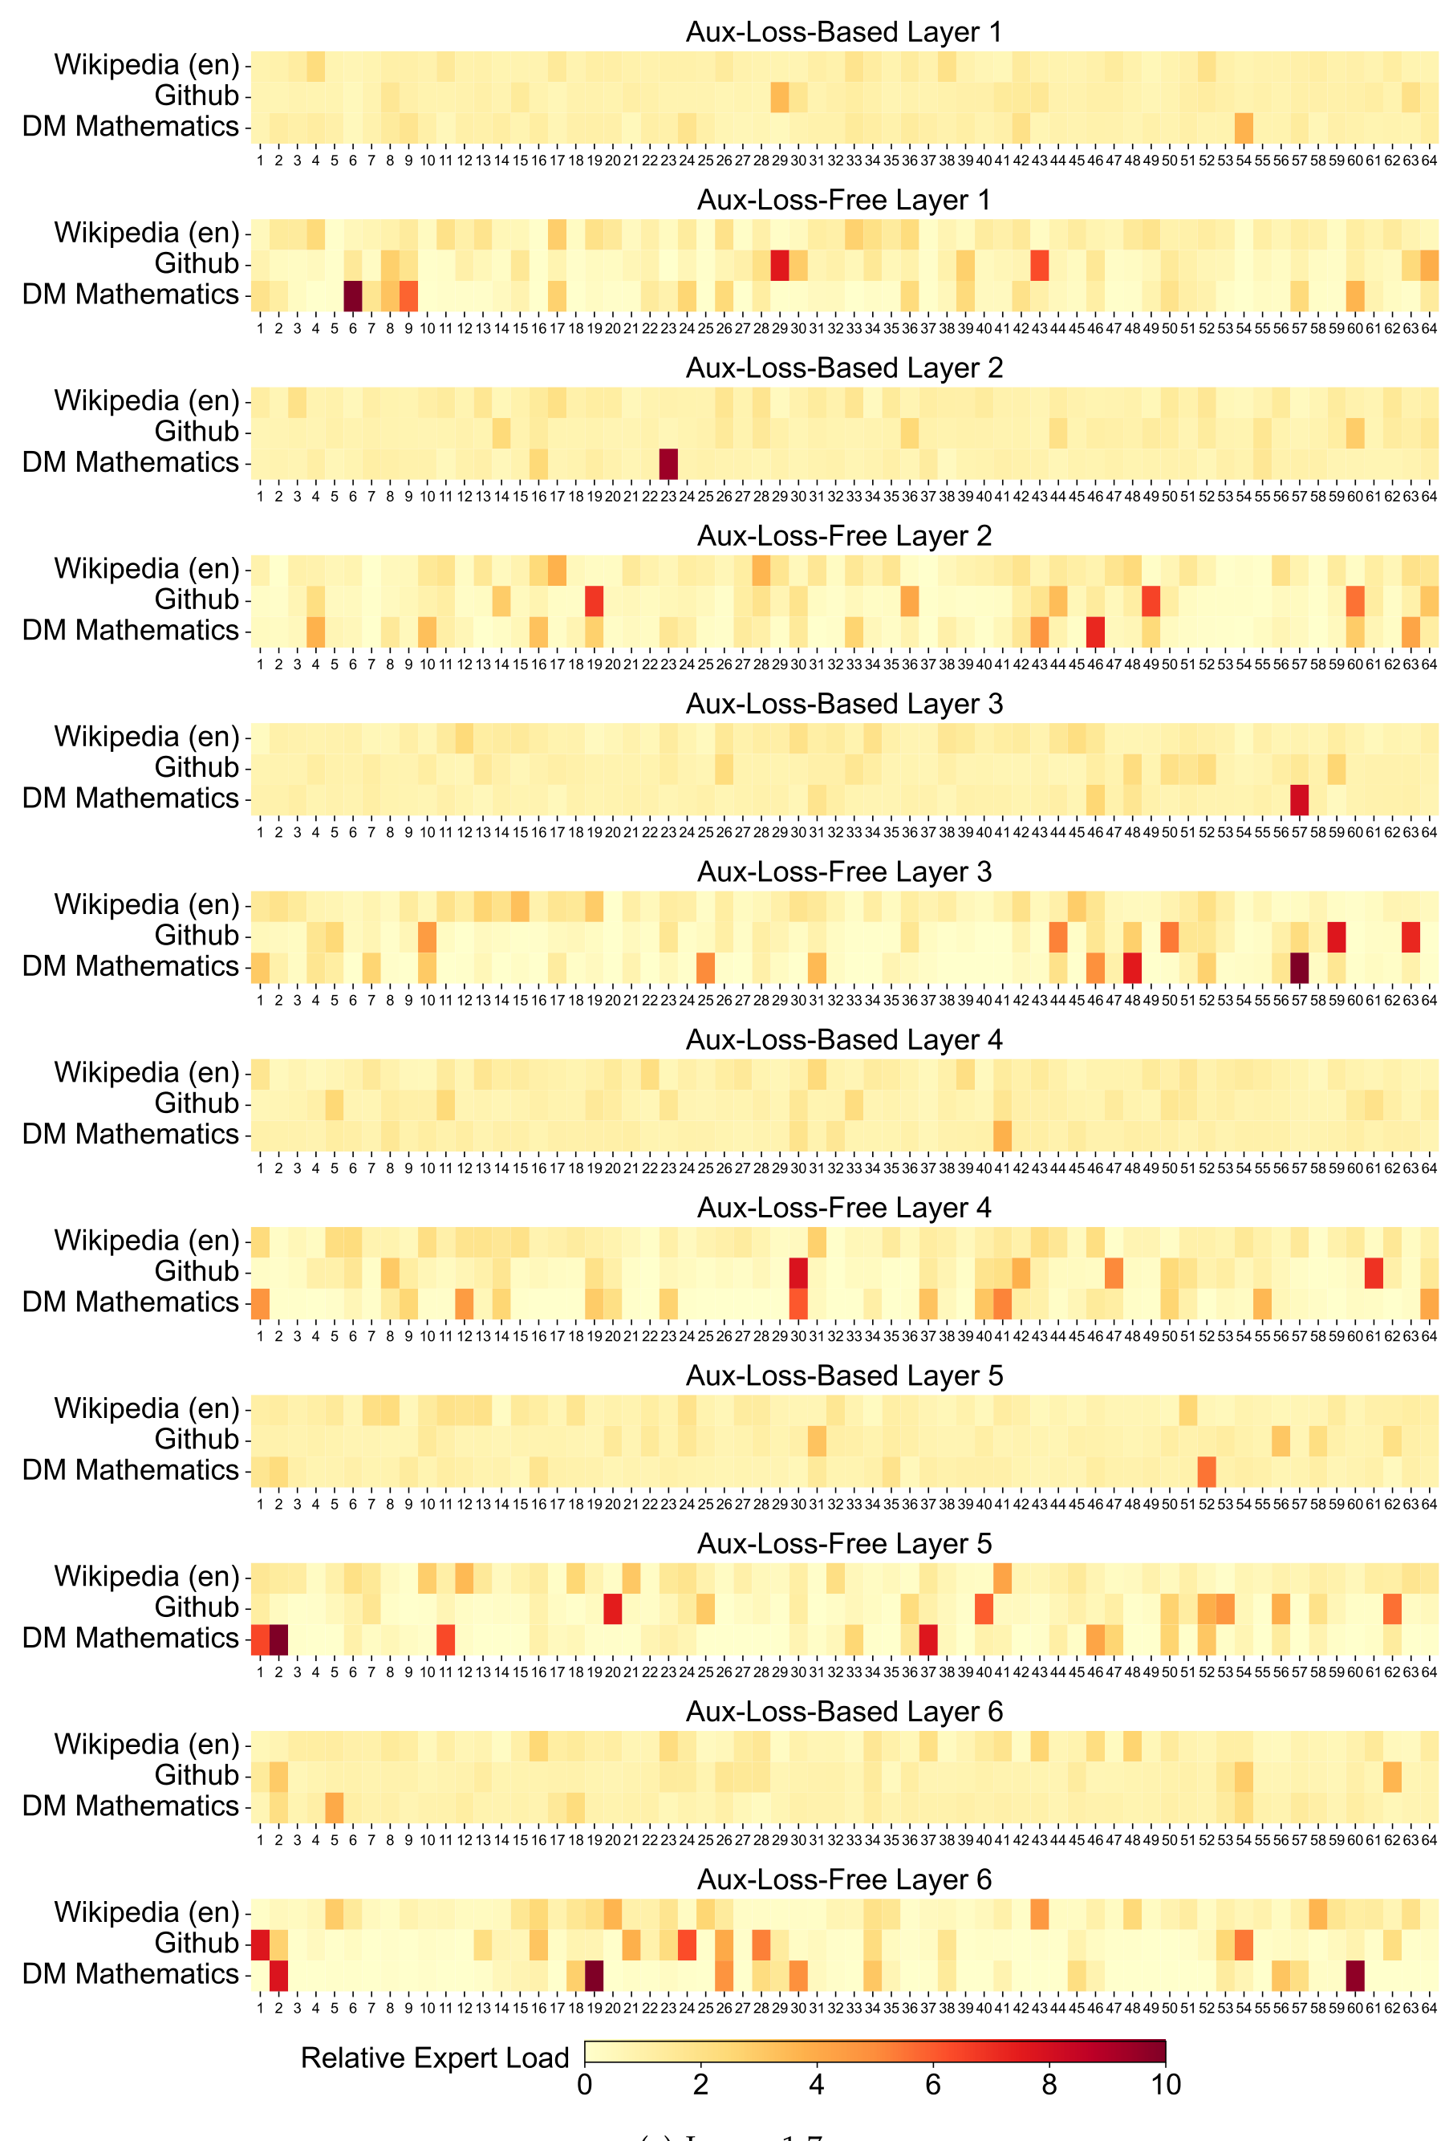
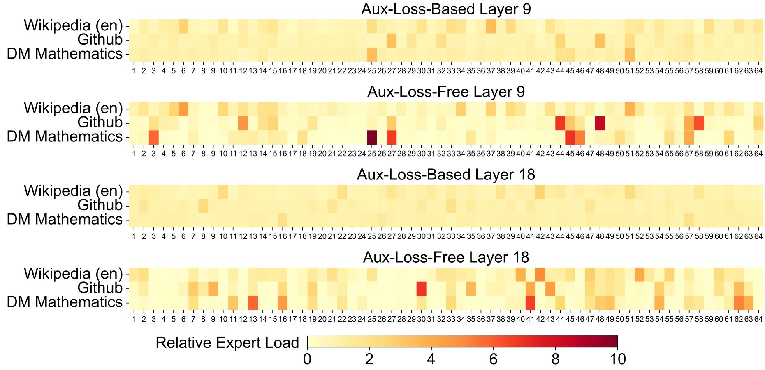
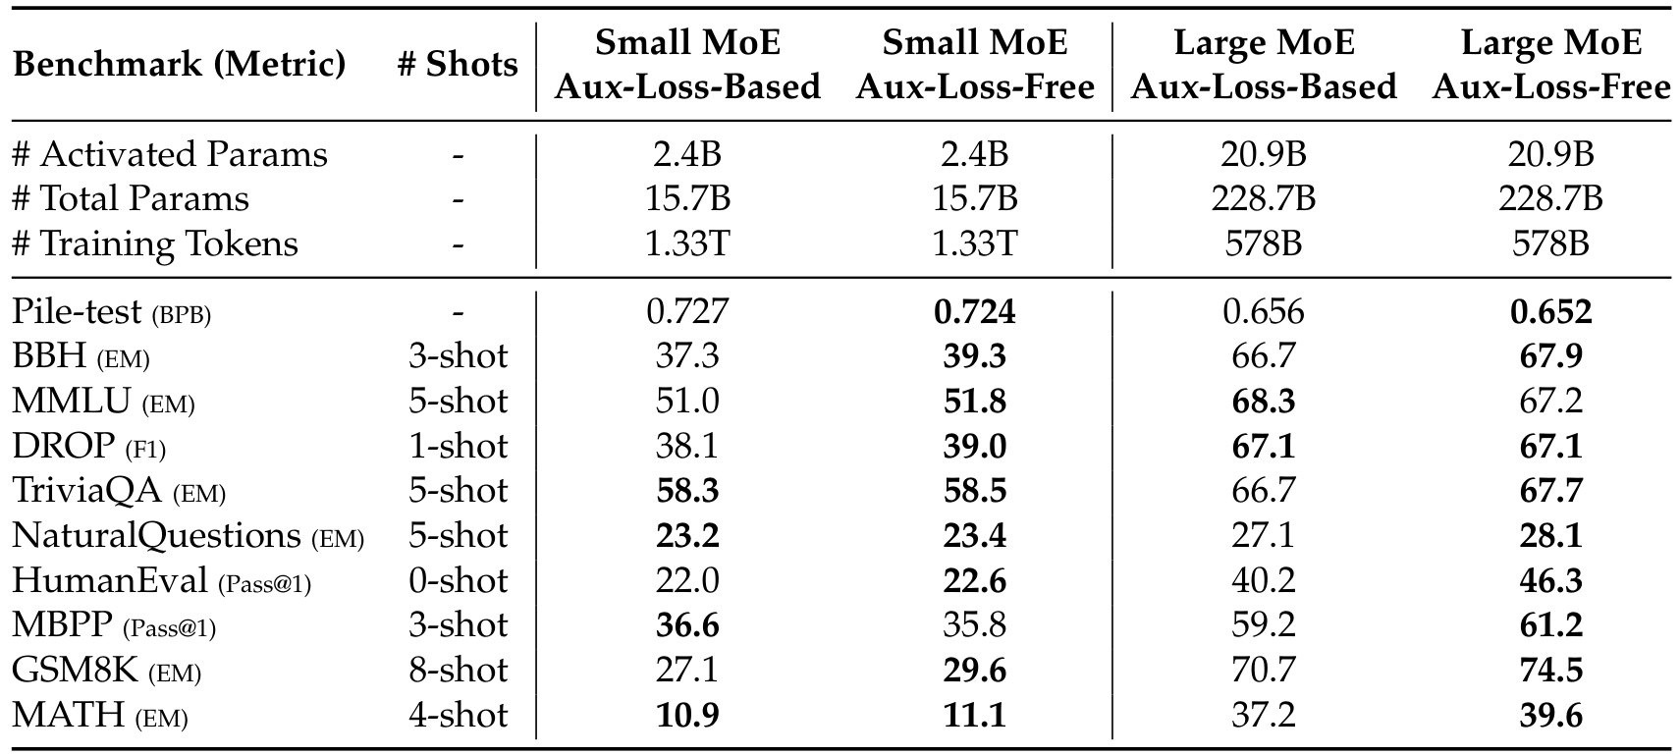
Evaluation Results
Expert
Specialization
The "Equal Work" Rule
Standard models force equal usage across
all experts using "auxiliary loss".
Yellow maps show this flat distribution.
Unlocking Expertise
Removing this rule allows experts to
specialize. Red "hot spots" show experts
focusing deeply on Math or Code.
Performance Impact
This focus improves model accuracy.
Benchmarks show higher scores in hard
tasks like GSM8K (Math) & HumanEval.

Slide 55
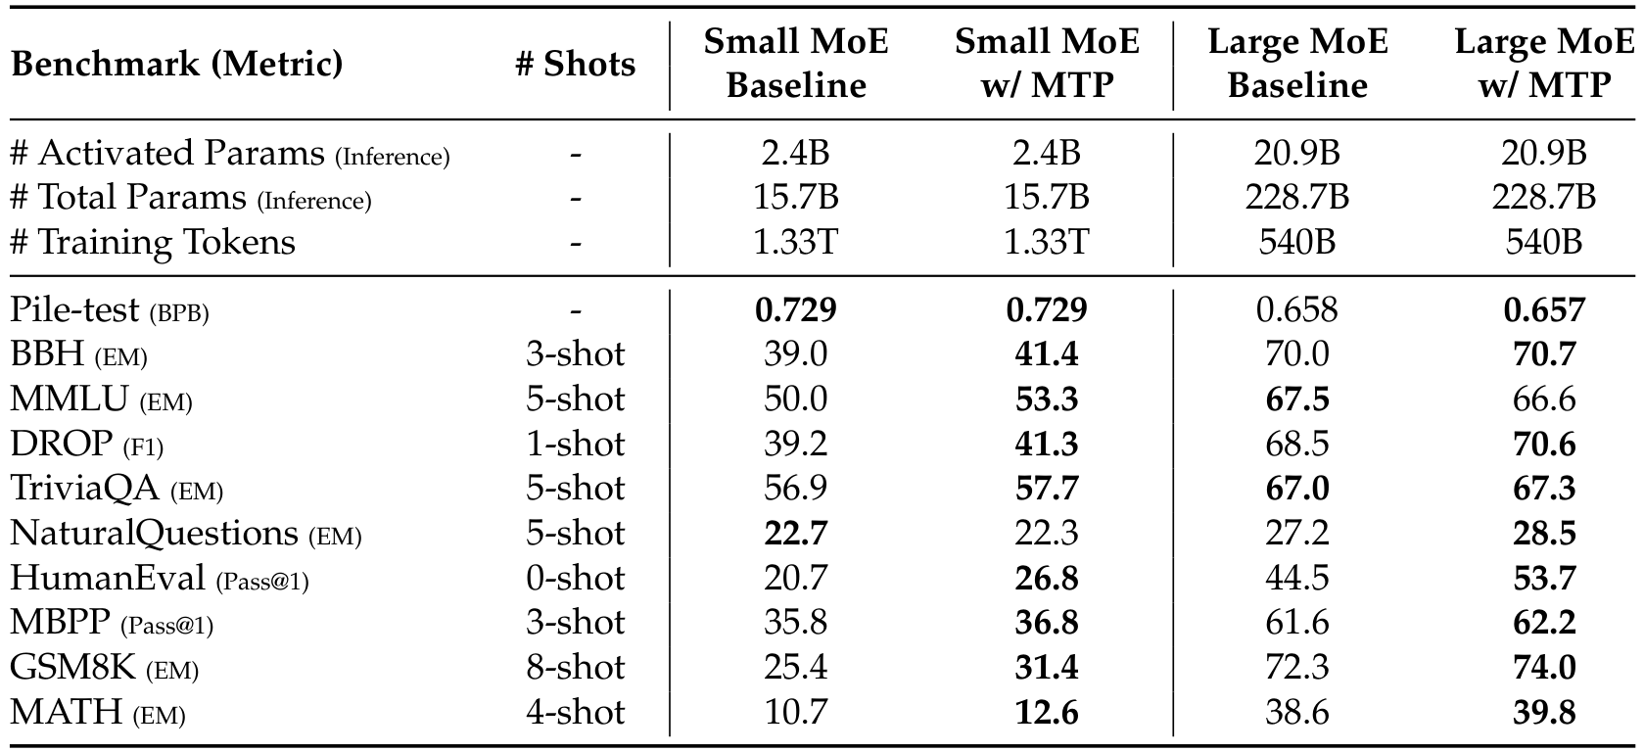
Ablation data confirms Multi-Token Prediction improves model scores.

