Slide 1
Mamba: Linear-Time Sequence Modeling
Linear-Time Sequence Modeling with Selective State Spaces

Slide 2
Table of Contents
The Sequence Modeling Challenge
03
The Core Innovation: Selection
06
Hardware-Aware Implementation
10
Mamba Architecture
13
Synthetic Task Evaluation
16
Language Modeling Performance
19
Long-Sequence Domains: DNA & Audio
22
Speed and Efficiency
27

Slide 3
SECTION 01
The Sequence Modeling Challenge
Mamba: Linear-Time Sequence Modeling

Slide 4
The Sequence Modeling Challenge
The Problem
with
Foundation
Models
Transformer Dominance
Foundation Models like GPT power modern AI apps.
They rely on the Transformer architecture to map
complex patterns in language, images, and speech.
The Efficiency Bottleneck
Transformers suffer from quadratic scaling costs.
Doubling the input size quadruples the workload.
This makes analyzing long data wildly expensive.
Finite Context Windows
Models are limited to a finite context window.
Long inputs like DNA sequences or books get cut.
Mamba enables linear scaling and 5x faster speed.

Slide 5
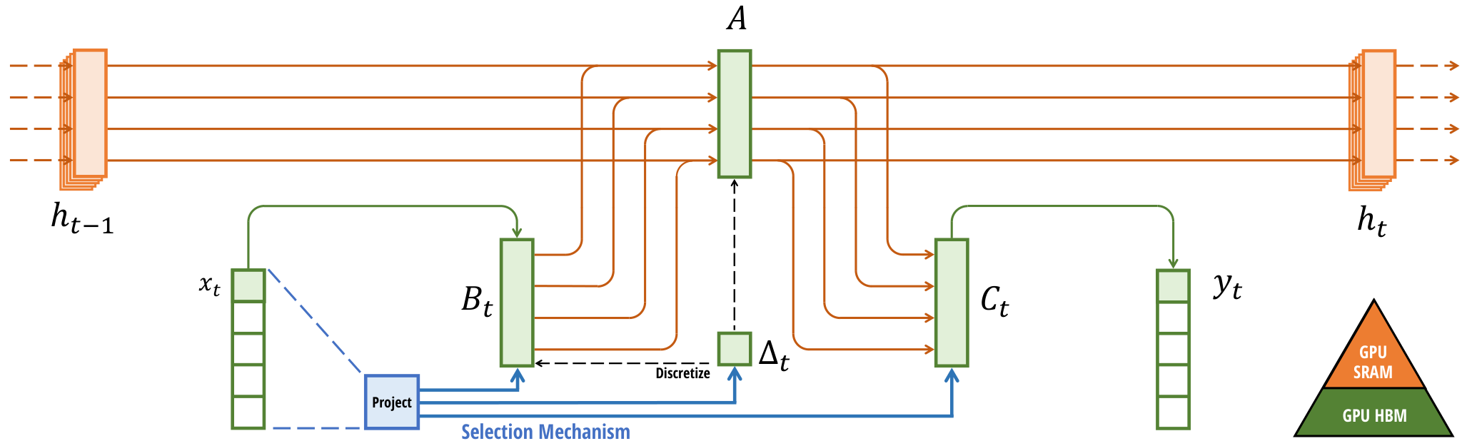
Hardware-aware selection filters data to ensure linear scaling.

Slide 6
SECTION 02
The Core Innovation:
Selection
Mamba: Linear-Time Sequence Modeling

Slide 7
The Core Innovation: Selection
Limits of Linear Time Invariance (LTI)
Understanding LTI Systems
LTI models apply the same rules at every time step. Their
processing logic remains constant, treating all inputs equally
regardless of context. This is like a static filter.
The Fixed State Problem
Because the logic is fixed, the model cannot adjust based on
specific inputs. It lacks the ability to reason about content
dynamically or update its state selectively.
Efficiency vs. Effectiveness
LTI models are highly efficient and offer fast training speeds.
However, this speed comes at a cost. They struggle to compress
complex context into their limited, fixed state.
The Compression Bottleneck
Effective models must condense history into a compact form.
LTI models fail here because they cannot selectively choose
what data to remember and what to forget.
Failure Example: Copying
LTI models solve simple copying tasks where data patterns are
predictable. However, they fail at Selective Copying tasks.
In these tasks, the spacing between relevant data points
varies randomly. Static kernels cannot model this varying
distance effectively.
Missing Content Awareness
They lack the content awareness needed to filter out
irrelevant noise (white tokens) and keep data (colored tokens).
The Selection Gap
The fundamental flaw is an inability to select information.
Standard LTI models pass data through fixed transitions
without input-dependent reasoning.
Why Static Kernels Fail
From a convolutional view, static kernels cannot adapt to
varying input spacings. They treat every time step with the
same importance, failing to focus on the signal amidst noise.

Slide 8
The Core Innovation: Selection
THE
CENTRAL
PROBLEM:
COMPRESSING
CONTEXT
INTO
SMALLER
STATES
The Core Principle
Sequence modeling is fundamentally
about compressing vast context into a
manageable, smaller state.
The Transformer Issue
Transformers are effective but slow.
They do not compress context at all.
Instead, they store a history called
a KV cache containing every prior
input. This yields high accuracy but
requires heavy computing power.
The Recurrent Limit
Recurrent models (RNNs) are efficient.
They force all history into a fixed,
finite state. This allows for fast,
constant speed. However, they fail to
retain complex details over time.
The Efficiency Trade-off
A perfect model needs two conflicting
traits: a small state for speed, but a
rich state for accuracy. Traditional
models force a choice between them.
Innovation: Selectivity
Mamba solves this with selectivity.
This mechanism gives the model the
ability to focus on relevant data and
actively filter out irrelevant noise.
Content-Awareness
Unlike static models that treat all
inputs the same, Mamba adjusts its
processing based on the content. It
compresses only what matters most.

Slide 9
The Core Innovation: Selection
Mechanism:
Input-Dependent
Dynamics
Defining Selection
Selection is the ability to focus on or
filter out specific inputs. Mamba makes
parameters Delta, B, and C functions
of the input, rather than static values.
Input-Dependent Dynamics
This means the model's rules change at
every time step. It can effectively
reset its state to ignore irrelevant
history, unlike fixed filters.
The Gating Analogy
This mimics gating mechanisms in
traditional RNNs (LSTMs). It combines
this context-aware reasoning with
the efficiency of modern systems.

Slide 10
SECTION 03
Hardware-Aware
Implementation
Efficient computation via IO-aware tiling.

Slide 11
Hardware-Aware Implementation
The Computational
Challenge
The Efficiency Dilemma
Previous sequence models relied on a mathematical shortcut
called convolutions to process data in parallel. This only
works if model rules stay constant. Mamba's key innovation,
Selection, changes parameters at every time step. This
dynamic behavior breaks the convolution shortcut, forcing
us to use recurrent mode, which calculates
results step-by-step. While flexible, this loses the massive
parallel speedup that standard GPUs provide for
convolutional models.
The Memory Bottleneck
To be effective, recurrent models maintain a hidden state to
remember history. In Mamba, this state is 10-100x larger than
the input data itself. A naive implementation would need to
save this massive matrix (size B, L, D, N) to memory at
every single step. For long sequences, this requires huge
bandwidth, far exceeding what modern High Bandwidth Memory
(HBM) can handle efficiently. Materializing the full state
is simply too slow for practical training.
Sequential Processing Limits
Recurrence is inherently sequential: you must finish step 1
before starting step 2. This limits parallelization on GPUs,
which prefer doing thousands of tasks at once. The real
cost isn't just calculation, but moving data back and forth
to memory (IO). To fix this, we need a hardware-aware
algorithm that keeps calculations in the GPU's ultra-fast
cache (SRAM), avoiding the slow main memory bottleneck.

Slide 12
Hardware-Aware Implementation
Hardware-Aware
State Expansion
Kernel Fusion Strategy
Computing on GPUs is limited by data movement speed.
We fuse the scan and discretization steps into one
operation to keep data in fast SRAM cache.
This avoids accessing slow High Bandwidth Memory (HBM).
Result: Memory I/O is reduced significantly, yielding a
20-40x speedup in the scan operation.
Parallel Scan Speed
Sequential recurrence is too slow for modern hardware.
We replace it with a parallel associative scan algorithm.
This allows the model to compute long sequences
efficiently, avoiding the bottleneck of loops.
Performance: The scan is up to 7x faster than
standard attention
at a sequence length of 32K.
Memory Efficiency
Saving all intermediate states for backpropagation
consumes too much memory.
We use recomputation: states are not stored, but
quickly re-calculated during the backward pass.
This reduces memory costs to match
FlashAttention implementations.

Slide 13
SECTION 04
Mamba Architecture
Linear-Time Sequence Modeling

Slide 14
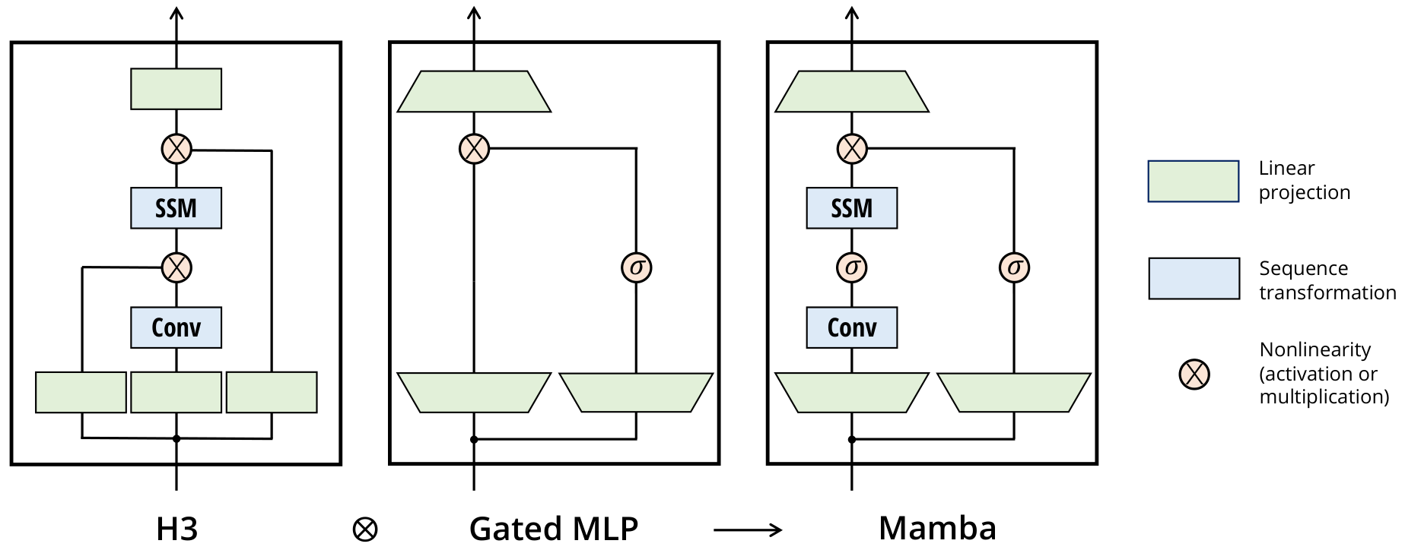
Mamba Architecture
Simplified Block
Design
Merging Architectures
The visual illustrates combining the H3 block (sequence
modeling) with the Gated MLP (neural network standard).
This fusion creates the unified Mamba block.
Visual Mechanics
As shown in the Mamba diagram, the input splits into
two branches. The left path uses Conv and SSM layers
to process history (blue boxes). The right path acts as
a gate using SiLU activation (labeled σ).
Homogenous Stacking
We repeat this single block throughout the deep network,
simplifying the complex mix used in Transformers.

Slide 15
Mamba Architecture
Mamba Block Design
Mamba combines the H3 block (state space)
and Gated MLP (neural network) designs.
Homogenous Design
Unlike prior models, Mamba repeats this
single unified block structure homogenously.
Vs. H3 Architecture
Mamba replaces the first multiplicative
gate with a fast activation (SiLU/Swish).
Vs. Gated MLP
Mamba adds an SSM to the main branch,
giving the block sequence transformation
capabilities that standard MLPs lack.

Slide 16
SECTION 05
Synthetic Task Evaluation

Slide 17
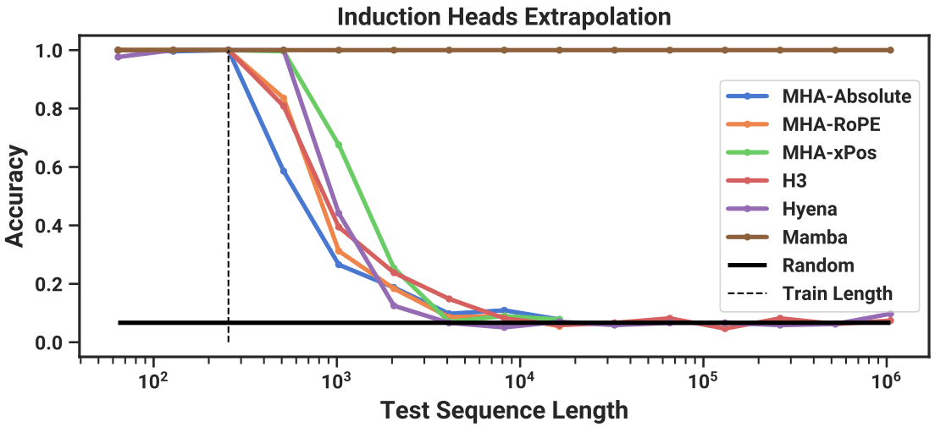
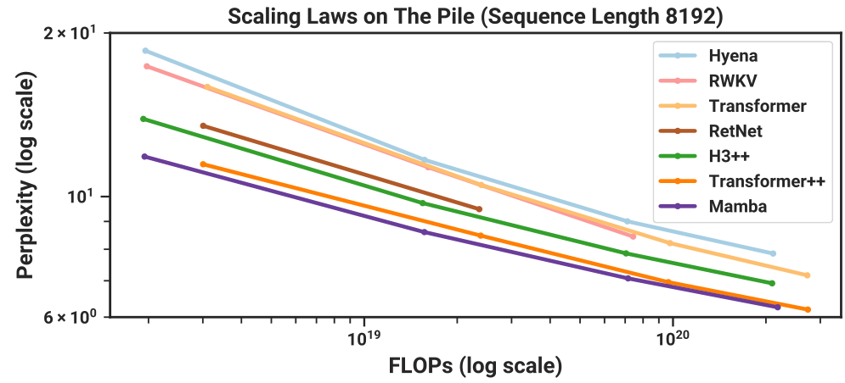
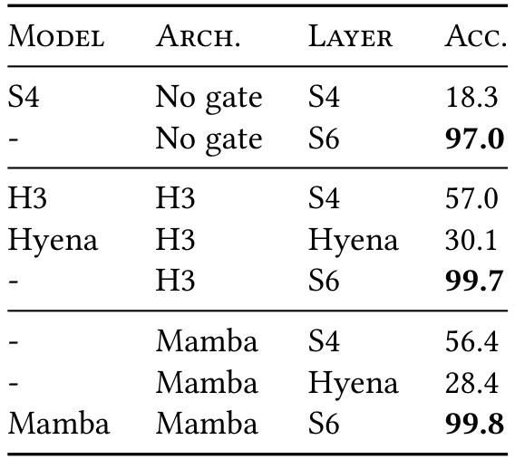
Synthetic Task Evaluation
Solving Selective Copying
The Challenge
Filter out noise
Copy valid tokens
LTI Failures
S4 (18%) & Hyena
(30%) fail the task.
Perfect Generalization
Mamba maintains 1.0 accuracy on sequences up to
1 million tokens, far beyond training length.
This confirms content-aware reasoning capability.
Mamba's Success
S6 layer achieves
99.8% accuracy.

Slide 18
Synthetic Task Evaluation
Perfect Length
Extrapolation
to 1 Million
Context Tokens
The Induction Heads Task
We evaluate models using a task called Induction Heads.
It tests associative recall: the ability to copy data from
history based on context clues. This predicts learning skill.
Real-World Analogy
Imagine reading a book. If you see the name "Harry Potter",
you should predict "Potter" the next time you see "Harry".
A good model remembers this connection indefinitely.
The Extrapolation Challenge
Models were trained on short sequences of just 256 tokens.
We then tested them on massive sequences up to 1 million.
This tests if they can handle data they have never seen.
Why This Is Difficult
Generalizing requires extrapolating 4000x longer than the
training data. Most architectures fail immediately when
going beyond 2x their training length.
Mamba's Superior Performance
Mamba solves this task perfectly. It maintains 100% accuracy
all the way to 1 million tokens, a huge breakthrough.
Other methods crash as soon as the sequence gets long.
The Selective Mechanism
Mamba uses a selective SSM layer to control its memory.
It selectively remembers the relevant key token while
ignoring all irrelevant noise, enabling infinite recall.

Slide 19
SECTION 06
Language Modeling Performance
Scaling laws and zero-shot downstream evaluations.

Slide 20
Language Modeling Performance
Scaling Laws:
Pretraining
Results
The Experiment
We trained models on "The Pile" dataset, scaling
sizes from 125 million to 1.3 billion parameters.
The goal was to measure how performance improves
as models grow larger and more complex.
Key Discovery
Mamba is the first attention-free model to
match the performance of Transformer++, the
strongest modern recipe used in models like GPT-3.
Historically, efficient models sacrificed quality
for speed. Mamba eliminates this compromise.
Performance Trend
Mamba outperforms other efficient baselines like
RWKV and Hyena. Critically, it maintains this
accuracy even as the sequence length grows,
proving it can handle long documents effectively
without the computational cost of Transformers.

Slide 21
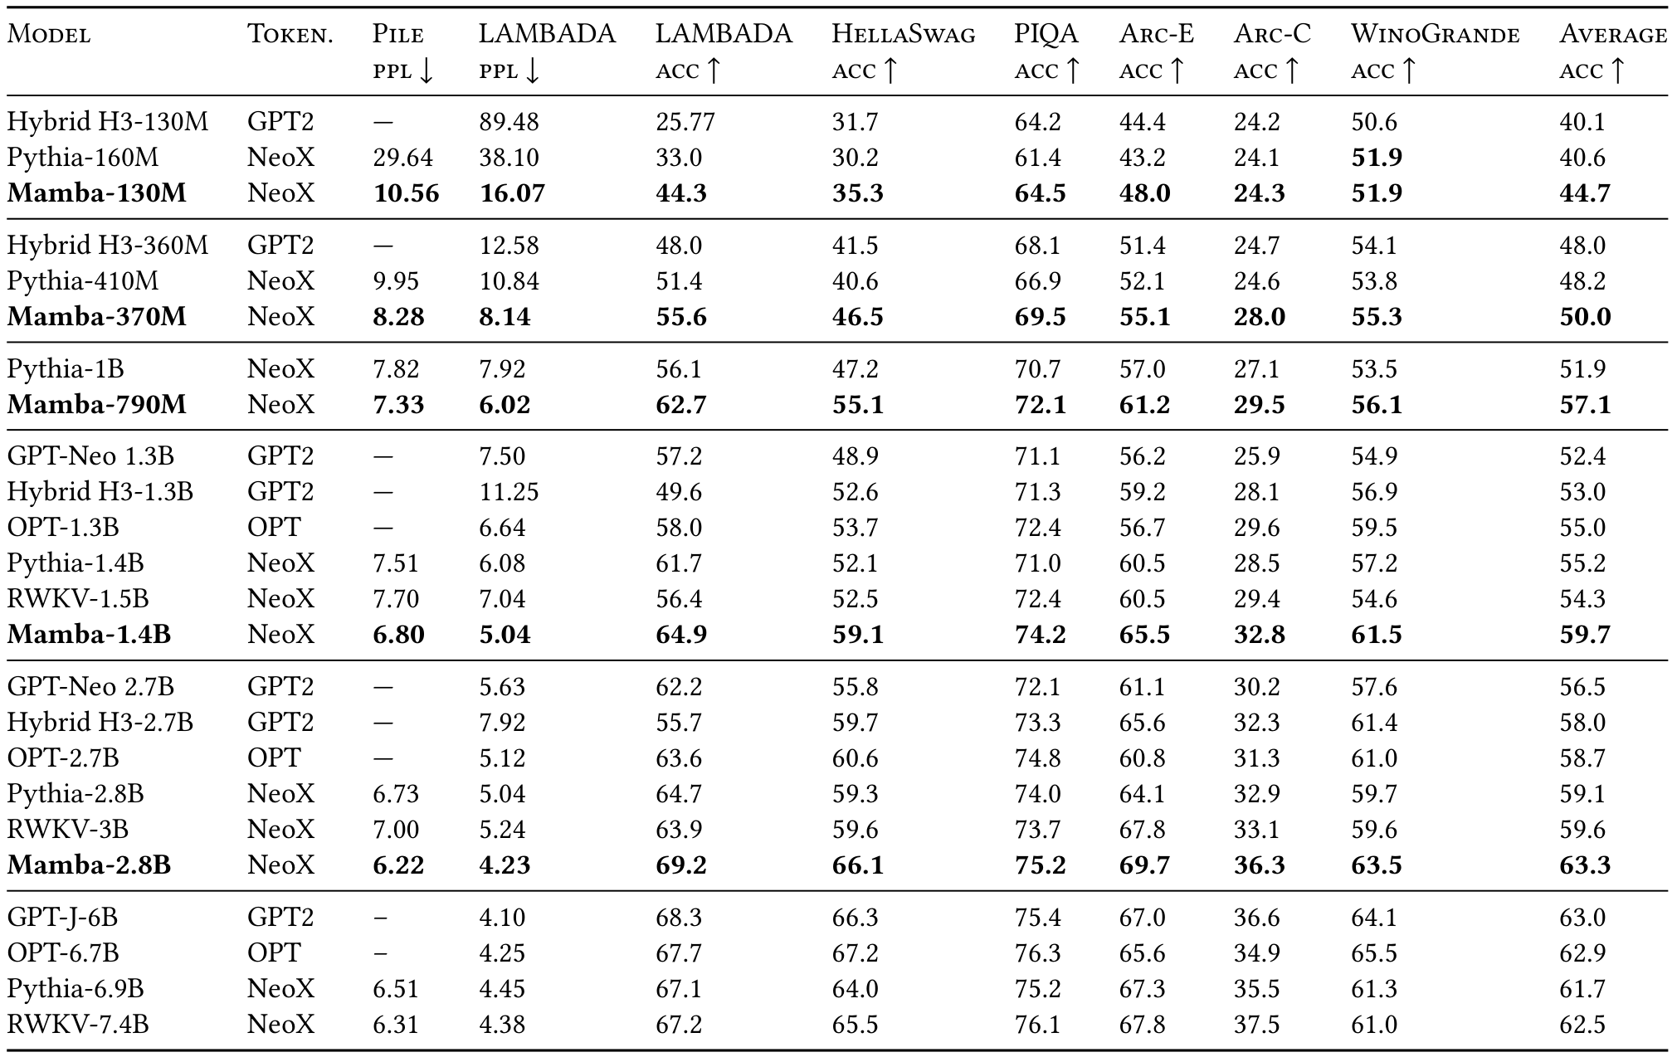
Language Modeling Performance
Zero-Shot
Downstream
Evaluation
Consistently Superior
Mamba models outperform all open-source
baselines of similar size on every
single task. For example,
Mamba-2.8B scores 63.3% accuracy,
beating Pythia-2.8B (59.1%) and
RWKV-3B (59.6%).
Efficient Powerhouse
Mamba matches Transformers twice its
size. The 2.8B model even beats the
massive GPT-J-6B (63.0%).

Slide 22
SECTION 07
Long-Sequence Domains:
DNA & Audio

Slide 23
Mamba: Linear-Time Sequence Modeling
Scaling Context
to 1 Million
DNA Tokens
The DNA Challenge
Genomic analysis requires reading massive sequences
to find patterns. Models must process millions of
biological "letters" at once to capture context.
Experiment Setup
Researchers pretrained models on the Human Genome.
They scaled context lengths from 1,024 up to
1 million tokens, a scale impossible for
standard attention-based AI models.
Performance Results
Mamba's performance improves smoothly as the
context grows. It effectively utilizes long-range
information across 1M tokens of DNA data.
Competitor Comparison
In contrast, the HyenaDNA model gets worse as
sequences get longer. Without a selection mechanism,
it aggregates noise rather than signal from the
massive input sequence.
Why It Matters
Mamba achieves linear scaling, making massive
1M-token inputs computationally feasible. This is
prohibitively slow for quadratic Transformer models.
Selective Processing
The model selectively filters information, focusing
on signal while ignoring noise. This solves the
long-sequence failure mode of prior LTI models
like HyenaDNA.

Slide 24
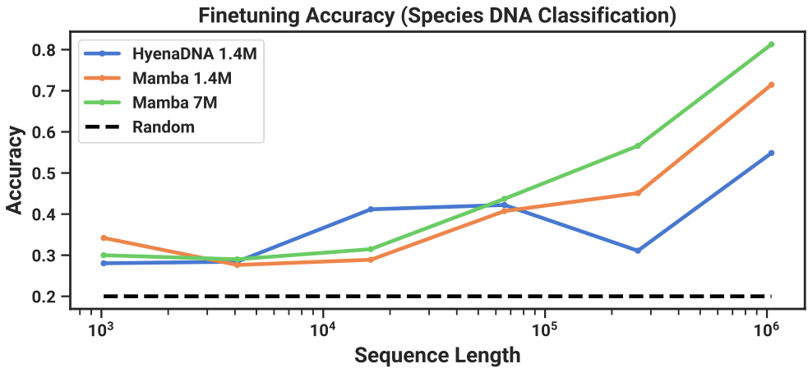
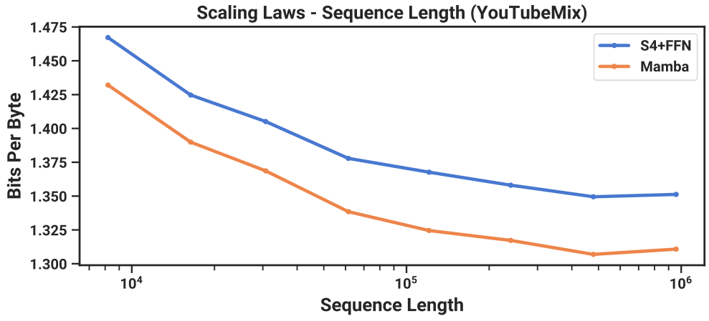
Long-Sequence Domains: DNA & Audio
The Challenge
Classify 5 species
with 99% shared DNA
Key Results
Mamba hits 82%
at 1M seq length.
HyenaDNA lags
at 55% accuracy.

Slide 25
Long-Sequence Domains: DNA & Audio
Audio Waveform
Pretraining
Piano Music Study
We trained models on the YouTubeMix dataset,
containing four hours of solo piano audio.
The goal: predict the next split-second of
sound based on what came before.
Beating the Baseline
We compared Mamba to SaShiMi, the prior
state-of-the-art. We measured accuracy using
Bits Per Byte (lower is better).
Long-Context Results
Mamba consistently achieves lower error rates.
Crucially, as the music sequence gets longer
(up to 1 million steps), Mamba's lead
grows larger, proving its long-term memory.

Slide 26
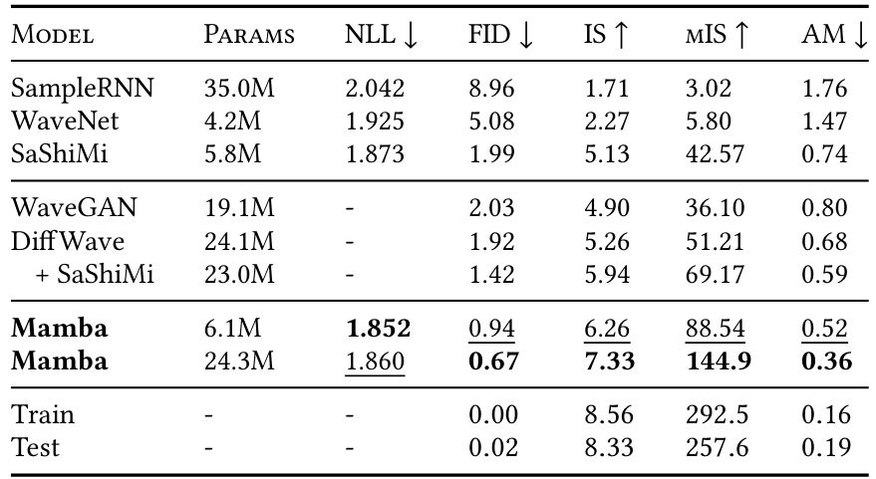
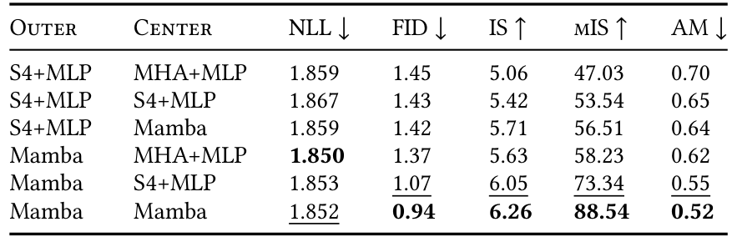
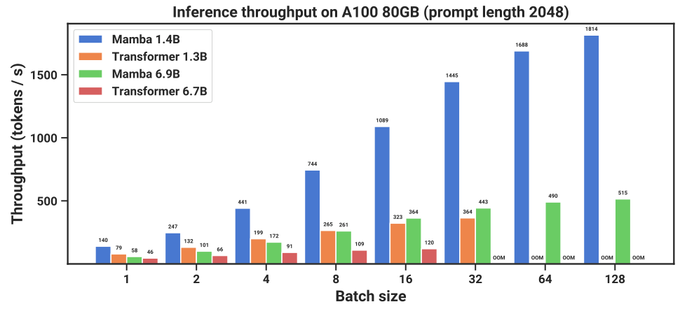
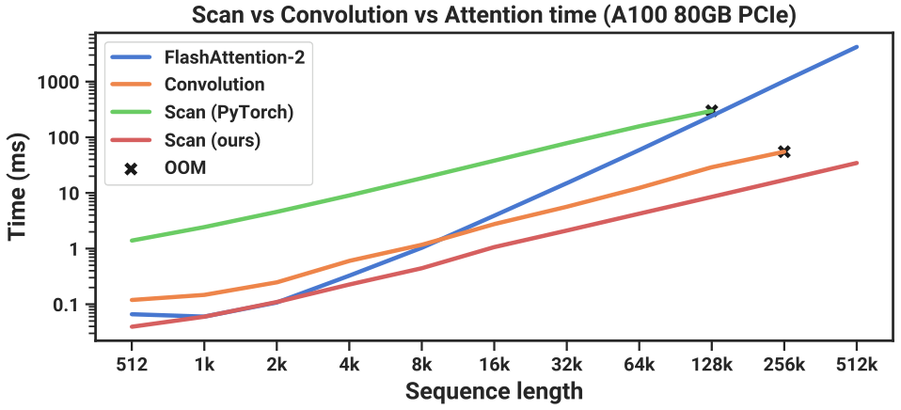
Long-Sequence Domains: DNA & Audio
Using the SC09 speech dataset, Mamba
outperforms larger Diffusion models.
It generates higher quality audio.
Quality Metric:
FID (Lower is best)
Mamba: 0.67
Others: >1.90
Small Mamba (6M)
beats DiffWave.
FID: 0.94 vs 1.92.
Larger Mamba hits
0.67 FID score.
Superior quality,
less compute.

Slide 27
SECTION 08
Speed and Efficiency
Mamba: Linear-Time Sequence Modeling

Slide 28
Speed and Efficiency
Training
Efficiency:
Scan vs.
Attention
Speed Benchmark
Researchers tested Mamba's Scan operation
against FlashAttention-2, the leading
method for fast AI training.
The Tipping Point
Attention slows as sequences get longer. Beyond
a length of 2,000 tokens, Mamba becomes
significantly faster than the best alternatives.
Massive Scaling
Against standard tools (PyTorch), Mamba runs
up to 20-40x faster. This efficiency
unlocks training on much larger datasets
without requiring massive supercomputers.

Slide 29
Speed and Efficiency
No Memory
Bottleneck
4-5x Faster
Throughput
The Memory Barrier
Traditional Transformers must store a Key-Value (KV) cache.
This memory preserves every past word but grows constantly.
Eventually, the cache fills the GPU memory, limiting speed.
The Mamba Solution
Mamba compresses all context into a fixed-size state.
It requires no growing cache, so memory usage stays low.
This removes the bottleneck that slows down long sequences.
Constant Generation
Standard models get slower as the conversation gets longer.
Mamba avoids this by generating each step in constant time.
Efficient Scanning
The core mechanism is a hardware-efficient scan operation.
It runs up to 40x faster than standard PyTorch scans.
It even beats optimized FlashAttention-2 on long texts.
Higher Throughput
Because it needs less memory, Mamba handles larger batches.
This results in 4-5x higher throughput than Transformers.
Size Advantage
Benchmarks reveal a stunning efficiency breakthrough.
A large 6.9B Mamba runs faster than a tiny 1.3B model.
Even with 5x more parameters, Mamba wins on speed.

Slide 30
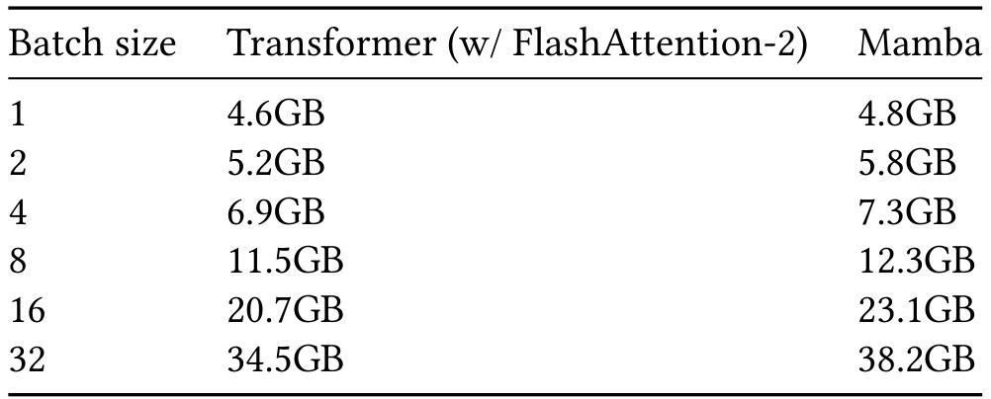
Mamba tracks optimized Transformers, using 38.2GB at batch size 32.

Slide 31
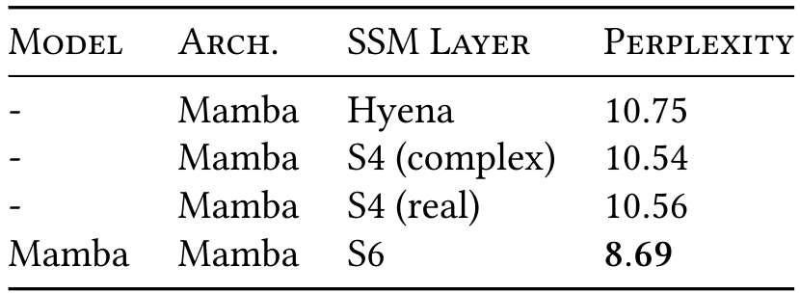
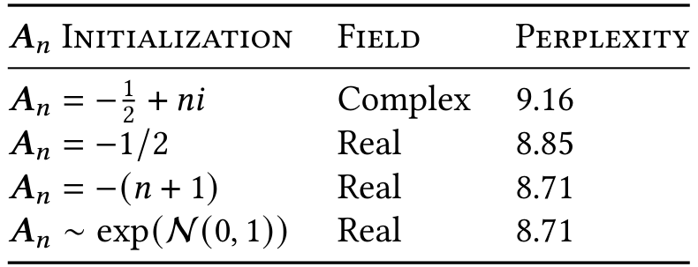
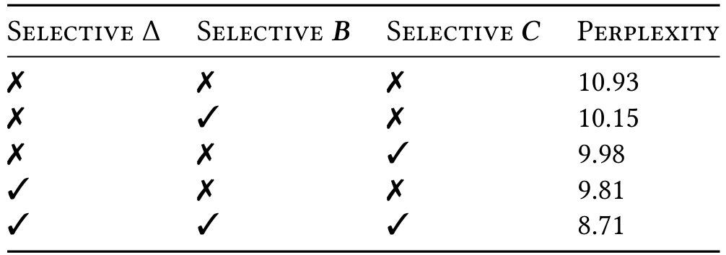
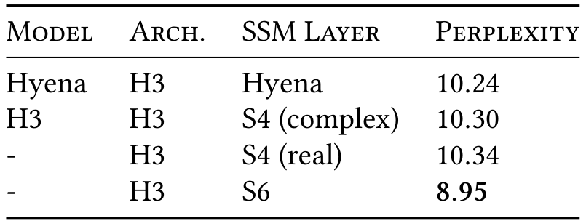
Speed and Efficiency
Ablation studies show the Selective SSM (S6) layer drives performance, lowering perplexity from ~10.3 to 8.69.
SSM Layer Comparison
Selective Parameters
Initialization Strategy
Mamba S6 Performance

Slide 32
SECTION 09
Conclusion
Summary of Key Findings & Future Directions

Slide 33
Conclusion
Mamba: Summary
and Impact
Core Innovation
Mamba introduces a selection mechanism to State Space
Models. This enables context-dependent reasoning, allowing
the AI to filter irrelevant data. Unlike Transformers, it
scales linearly with sequence length. This ensures the model
remains efficient and fast even when processing extremely
long inputs, avoiding the slowdowns of older architectures.
Performance & Versatility
The model achieves state-of-the-art results across diverse
domains like text, genomics, and audio. It matches or exceeds
strong Transformer baselines without using attention. This
success makes Mamba a strong candidate for a
general-purpose backbone, capable of powering foundation
models for many different data types.
Trade-offs & Future
While Mamba excels on discrete data, its design may impede
performance on continuous signals like raw audio waveforms.
Additionally, evaluations were limited to small models.
Future work must verify if Mamba maintains its advantage at
the 7B parameter scale required for modern Large Language
Models to function effectively.

