Slide 1
Carnegie Mellon University
Princeton University
Albert Gu
Tri Dao
Mamba: Linear-Time
Sequence Modeling
with Selective State Spaces

Slide 2
Table of
Contents
The Context & The Problem
03
Understanding State Space Models (SSMs)
08
The Core Innovation: Selection
14
Engineering Mamba: Algorithm & Architecture
21
Empirical Evidence: Language & Genomics
28
Empirical Evidence: Audio Modeling
36
Conclusion & Future Outlook
41

Slide 3
SECTION 01
The Context &
The Problem

Slide 4
The Context & The Problem
The Current State of AI Foundation Models
The Era of Transformers
Foundation Models (FMs) like GPT-4 drive modern AI. These
systems are sequence models processing streams of data like
text or genetic code. Nearly all current FMs rely on a single
design: the Transformer. It revolutionized AI by treating data
as connected sequences rather than isolated points.
The Power of Self-Attention
The core engine is self-attention. Imagine reading a sentence
and instantly connecting every word to every other word to find
meaning. This enables dense information routing within a
window, capturing complex relationships like how a pronoun
refers back to a name mentioned paragraphs earlier.
The Quadratic Cost Problem
Transformers suffer from quadratic scaling. If you double the
length of the text, the computational work doesn't just double;
it quadruples. This makes processing long documents, like books
or DNA sequences, exponentially slower and expensive. The
attention mechanism becomes a massive bottleneck.
The Context Window Wall
Due to high costs, Transformers have a finite context window.
They can only remember a set amount of recent text. Once data
exceeds this limit, earlier information is cut off. While
fixes exist, they often hurt the model's accuracy. The model
cannot reason about anything outside this limited view.

Slide 5
The Context & The Problem
The Computational
Cost of Attention
The Memory Barrier
Imagine reading a novel but having to re-read every previous
page before reading the next word. This is how Attention
works. It maintains a massive KV Cache that stores the
entire history explicitly without summarizing it.
Efficiency vs. Effectiveness
Attention is highly effective because it remembers
everything. However, it is inefficient because it does not
compress context at all. This forces the model to juggle
millions of data points for long sequences.
Quadratic Training
Because the model compares every token to every other token,
the math gets heavy. Training is quadratic. If you double
the input length, the computational cost quadruples.
Inference Bottlenecks
Generating text is also costly. As a conversation grows,
the model must process an ever-expanding history file.
This causes slow linear-time inference per step,
creating a bottleneck for real-time applications.
The Core Trade-off
The fundamental challenge is managing memory effectively.
Standard RNNs are efficient. They compress context into a
small finite state. This makes them fast, but they
often forget earlier details, limiting their accuracy.
The Solution: Selectivity
To fix this, we need a mechanism that acts like a filter.
It should compress context into a smaller state by keeping
relevant data and discarding noise. This principle of
selectivity allows for linear-time efficiency.

Slide 6
The Context & The Problem
Alternative
Approaches: State
Space Models (SSMs)
What are SSMs?
Structured State Space Models (SSMs) represent a promising
class of architectures for sequence modeling. They can be
interpreted as a combination of Recurrent Neural Networks
(RNNs) and Convolutional Neural Networks (CNNs). Drawing
inspiration from classical state space models (like the
Kalman filter), they compute efficiently as either a
recurrence or a convolution. This duality gives them unique
properties for handling time-series data and sequences.
The Speed Advantage
The defining feature of SSMs is their efficiency. While
Transformers suffer from quadratic scaling (slowing down
significantly as sequence length increases), SSMs enjoy
linear or near-linear scaling in sequence length. This
makes them incredibly fast for inference and training on
long inputs. They also possess principled mechanisms for
modeling long-range dependencies, capturing relationships
across vast distances in data without performance loss.
The Core Limitation
However, a critical weakness prevented their adoption.
Historically, SSMs have not performed as well as Attention
on important modalities like language. The core issue was
an inability to perform content-based reasoning. Unlike
Transformers, which route information selectively based on
context, standard SSMs applied fixed dynamics. They could
not selectively propagate or forget information along the
sequence depending on the current token, limiting their
effectiveness on discrete data types like text.

Slide 7
Mamba: Linear-Time Sequence Modeling
Core Design:
Selective
State
Key Result:
5x Higher
Throughput
vs Models
The Transformer Problem
Transformers drive modern AI but
suffer from quadratic scaling. As
context grows, they become incredibly
slow and computationally expensive.
The Selection Innovation
Mamba introduces Selective State
Spaces. This mechanism lets the
model filter irrelevant information
and remember key data indefinitely.
Unlike prior models, parameters
change based on the input token.
Hardware-Aware Design
Mamba uses a specialized algorithm
to maximize speed on GPUs (A100).
It avoids slow memory access (IO)
between memory levels, running
up to 3x faster than baselines.
Performance at Scale
The architecture achieves linear
scaling with sequence length.
It delivers 5x higher throughput
than Transformers. A Mamba-3B
model matches the quality of
Transformers twice its size.

Slide 8
SECTION 02
Understanding State Space Models (SSMs)
Foundations of continuous-time systems and discretization.

Slide 9
Understanding State Space Models (SSMs)
From Continuous
Systems to
Discrete Models
Continuous Roots
State Space Models (SSMs) are inspired by continuous physics
equations. They map a 1-dimensional function (like a sound
wave) to an output through a hidden "latent state".
Mathematical Map
This creates a map of how data evolves continuously over
time. It handles signals like audio naturally, rather than
forcing them into artificial steps prematurely.
The Digital Bridge
While math is continuous, computers are discrete. To run
these models on chips, we use a process called discretization.
It converts continuous parameters into digital steps.
Zero-Order Hold (ZOH)
A key technique used is the Zero-order hold. It takes a
snapshot of the continuous signal and holds that value
steady until the next step, bridging the analog-digital gap.
Why This Matters
This foundation gives SSMs deep connections to continuous
systems, offering properties like "resolution invariance."
The model can adapt to different data sampling rates.
Efficient Computation
Once discretized, the model can be computed as a
global convolution (fast parallel training) or a
linear recurrence (efficient step-by-step inference).

Slide 10
Understanding State Space Models (SSMs)
Dual View:
Recurrence vs.
Convolution
Training Efficiency
The convolutional mode processes entire
sequences in parallel. By seeing the
whole input at once, it enables rapid
learning on massive datasets.
Fast Inference
The recurrent mode handles inputs
one token at a time. It uses a small
memory state to generate text efficiently,
step-by-step during actual use.
The Core Trade-off
Standard models allow both modes because
their rules are fixed (Linear Time Invariant).
Mamba adds Selection to improve reasoning,
but this removes the parallel training
mode found in traditional SSMs.

Slide 11
Understanding State Space Models (SSMs)
Linear Time
Invariance (LTI)
Pros and Cons
What is LTI?
It means model dynamics are constant.
The system applies fixed parameters to
every input, never changing its rules.
Key Advantage: Speed
Constant dynamics allow global convolutions.
This enables parallel training, processing
entire sequences effectively at once.
Key Limit: Reasoning
LTI cannot do content-based reasoning.
It treats all data as equal, failing to
filter noise or select key details.

Slide 12
Understanding State Space Models (SSMs)
The
Compression
Trade-off
in
Sequence
Modeling
The Core Problem
Sequence modeling requires compressing a huge amount of
context (like a long document) into a smaller state.
Transformers: No Compression
Transformers are effective because they don't compress
data. They keep a full history (the KV cache).
This makes them accurate but computationally expensive.
RNNs: Fixed State Efficiency
Recurrent models like RNNs are efficient. They compress
context into a fixed-size state. This ensures fast,
constant-time inference. However, limited state capacity
means they often forget earlier critical details.
The Goal: Smart Selectivity
We need a balance. Mamba introduces Selectivity.
It lets the model choose what to remember or ignore,
combining Transformer quality with RNN efficiency.

Slide 13
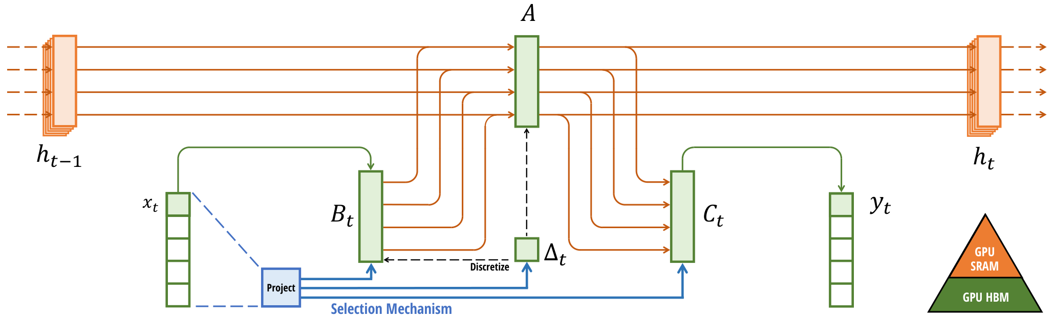
Understanding State Space Models (SSMs)
Selective State
Space Dynamics
Input-Dependent
Hardware Aware
Core Architecture
Input x_t enters the system and updates the hidden
state h_t. This state acts as the model's memory.
Selection Mechanism
The blue Project path lets input x_t change the
parameters (B_t, C_t, Δ_t) in real-time. This filters
irrelevant info and focuses on relevant data.
Hardware Efficiency
To maintain speed, large calculations use fast GPU SRAM
(orange), avoiding slow HBM memory access.

Slide 14
SECTION 03
The Core Innovation:
Selection
Selective State Spaces for Efficient Sequence Modeling

Slide 15
The Core Innovation: Selection
Why Standard Models Fail at Selection
The Compression Problem
Sequence modeling fundamentally requires compressing context
into a smaller state. Transformers avoid this by keeping
a full history cache, which is effective but computationally
expensive. Recurrent models are efficient due to fixed
states, but they limit how well context is preserved.
The LTI Limitation
Standard State Space Models (SSMs) are Linear Time Invariant.
This means their dynamics are constant over time. They
process every input using the exact same rules, regardless
of content. They cannot dynamically choose to remember
specific words while ignoring irrelevant ones.
Failure Case Study
In the Selective Copying task, a model must ignore noise to
remember relevant tokens. Standard models fail here because
they lack content-awareness. Because their mechanics are
static, they cannot adjust their focus to capture data
spaced irregularly across the sequence.
The Solution: Selectivity
We propose Selectivity: the ability to filter inputs into the
sequential state. A selective model can reset its state to
ignore irrelevant data or open its gates to remember key
information. This dynamic approach allows for efficient
processing without significant data loss.

Slide 16
The Core Innovation: Selection
The Solution: Input-Dependent Parameters
From Static to Dynamic
Traditional State Space Models use static parameters that apply
the same rules to every input. This rigidity treats all data
equally, limiting performance. Mamba innovates by making these
parameters functions of the input. This transforms the model
from "time-invariant" to "time-varying," allowing processing
rules to adapt dynamically based on the current data token.
The Power of Selectivity
This adaptation enables selectivity, the ability to distinguish
signal from noise. Mamba can explicitly decide to focus on or
ignore specific inputs at each step. By filtering out
irrelevant data, it solves the compression bottleneck seen in
older models. It remembers relevant context indefinitely while
discarding unnecessary details, mimicking human attention.
Restoring Content-Awareness
Previous linear models failed at content-aware reasoning, unable
to prioritize data by meaning. Mamba restores this ability,
matching the power of Attention mechanisms. It analyzes the
content of the current token to update its hidden state.
This allows it to solve complex tasks like "Selective Copying"
where the model must memorize specific colored tokens only.
How It Works
Mamba replaces fixed values for parameters Delta, B, and C
with linear projections computed directly from the input.
Instead of sharing one rule for the whole sequence, these
values change for every token. This seemingly simple change
allows the model to compress context efficiently. It combines
Transformer expressiveness with the fast, linear-time
inference of Recurrent Neural Networks.

Slide 17
The Core Innovation: Selection
Synthetic
Task 1:
The
Copying
Problem
Standard Copying
In the standard Copying Task, the
spacing between inputs and outputs
is constant and predictable.
Think of a conveyor belt moving at
a fixed speed. To recall an item,
you just look back a fixed amount
of time (e.g., exactly 10 seconds).
Traditional LTI models (like CNNs)
solve this easily. They use static
filters that simply "look back"
a set distance. They do not read
the content to make decisions.
Because the pattern is rigid, these
models are fast and efficient,
but they cannot adapt if the
timing changes even slightly.
Selective Copying
Real data is rarely so rigid.
In the Selective Copying task, the
relevant data is hidden among
random "noise" or irrelevant info.
The spacing varies randomly.
You cannot just look back 10 steps
because the answer might be at
You need content-awareness: the
ability to analyze the input.
The model must decide: "Is this
token important? Should I store it?"
Standard models fail here. They
cannot choose what to remember.
They apply the same filter blindly,
treating noise and signal the same.
They lack the mechanism to select
information based on its value.

Slide 18
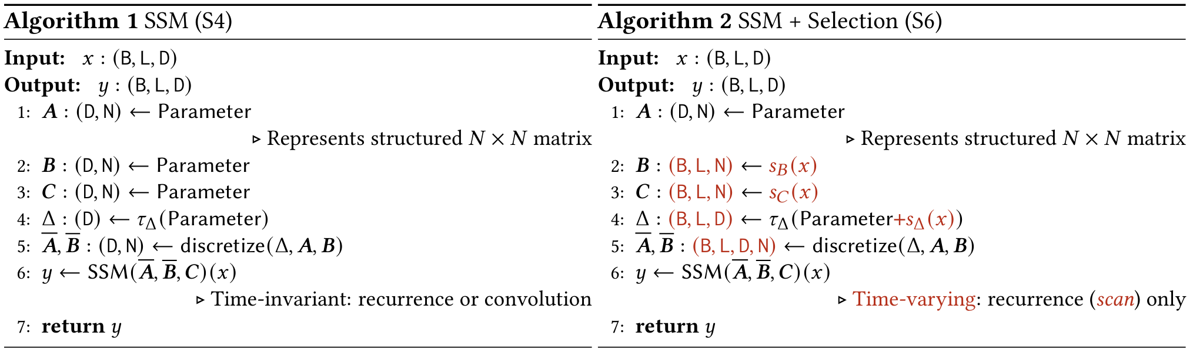
The Core Innovation: Selection
Visual Analysis:
Selective Copying
The Selective Task
The top diagram compares standard copying to selective
copying. We want to store colored blocks (data)
while ignoring white blocks (noise). Standard
models cannot distinguish them, processing all equally.
Algorithmic Change
Compare Algorithm 1 (static) with Algorithm 2.
In Alg 2, red text highlights that parameters
B, C, & Delta become functions of input x.
This creates a time-varying system that can
update its state based on content to filter noise.

Slide 19
Synthetic Task 2: Induction Heads
Induction Heads explain
how LLMs learn from context.
Task: Associative Recall.
Recall 'Potter' after 'Harry'.
Mamba solves this perfectly,
even at 1M+ sequence length.

Slide 20
The Core Innovation: Selection
Visual Analysis
: Induction
Heads
The Logic of Associative Recall
The diagram illustrates Induction Heads, a task where the
model must recall specific information from its context.
This ability allows models to complete patterns they have
seen before, similar to how human memory works.
Step-by-Step Visualization
1. The Cue: The model sees a blue block and needs to
predict what comes next (marked by the question mark).
2. The Search: It looks back in the sequence to find the
previous appearance of that same blue block.
3. The Retrieval: It observes that a black block appeared
immediately after the blue cue in the past.
4. The Copy: It copies the black block to the current
position, correctly solving the puzzle.
Why This Matters for LLMs
This mechanism is how language models maintain coherence.
If a model sees "Harry", it looks back to find "Potter".

Slide 21
SECTION 04
Engineering Mamba:
Algorithm & Architecture

Slide 22
Engineering Mamba: Algorithm & Architecture
The Computational Challenge
Selection varies model dynamics
breaking fast convolution.
Recurrence is too slow for
large state dimensions.
Goal: Linear-time training.

Slide 23
Engineering Mamba: Algorithm & Architecture
Hardware-Aware
Algorithm:
The Parallel
Scan
The Efficiency Challenge
GPUs are designed for parallel tasks. Sequential models like
RNNs are slow because they wait for memory (HBM) access at
every step. This 'IO cost' is the main limit on speed.
The Parallel Solution
Mamba replaces sequential work with a parallel scan.
It calculates prefix sums concurrently, allowing the model
to utilize the full parallel compute power of the GPU,
bypassing the sequential limitations of traditional RNNs.
Kernel Fusion
To minimize slow memory access, Mamba fuses operations.
Instead of moving data back and forth to HBM, it loads
parameters once into the GPU's ultra-fast SRAM cache.
SRAM Execution Steps
1. Load parameters (Delta, A, B, C) to SRAM.
2. Perform discretization and recurrence in fast SRAM.
3. Write only the final result back to HBM.
This reduces memory IOs by the factor of the state dimension.
Massive Speedup
This hardware-aware design yields a 20-40x speedup over
standard scans. At sequence length 32K, it is 7x faster
than standard Attention mechanisms.
Memory Strategy
To avoid memory blowup, Mamba uses recomputation.
Intermediate states aren't stored; they are re-calculated
during the backward pass. This matches the memory footprint
of FlashAttention, enabling training on large sequences.

Slide 24
Engineering Mamba: Algorithm & Architecture
The Memory
Challenge
The Storage Problem
Training an AI model involves a 'backward pass' where the
system reviews its performance to learn from errors.
Normally, this requires saving every intermediate step of
the calculation into the GPU's High Bandwidth Memory (HBM).
However, Mamba's internal state is complex and massive.
Storing the full state for every step in a long sequence
creates a data footprint that exceeds available RAM.
This 'memory blowup' makes standard training impossible.
The Recomputation Fix
To solve this, researchers use a technique called
recomputation. Instead of saving massive intermediate
states, the system deliberately deletes them to save space.
When the learning phase needs these values, the chip simply
calculates them again from scratch.
Why it works: Modern GPUs are 'bandwidth bound'.
Moving data from memory is slow, but doing math is fast.
It is actually faster to re-do the math on the processor
than to fetch terabytes of saved data from storage.
FlashAttention Parity
We extend this efficiency to other parts of the model too,
discarding large temporary values like activation outputs.
The Outcome: Mamba achieves the exact same memory
efficiency as FlashAttention—the gold standard for
optimized Transformers. This is a critical breakthrough.
It allows us to train on extremely long sequences (like
entire books) using standard hardware resources.
Additionally, minimizing memory reads makes the process
up to 7x faster than standard attention mechanisms.

Slide 25
Engineering Mamba: Algorithm & Architecture
Mamba simplifies models by
merging SSMs and MLPs.
These unified blocks are
stacked homogenously
like Transformers, using
SiLU gates for efficiency.

Slide 26
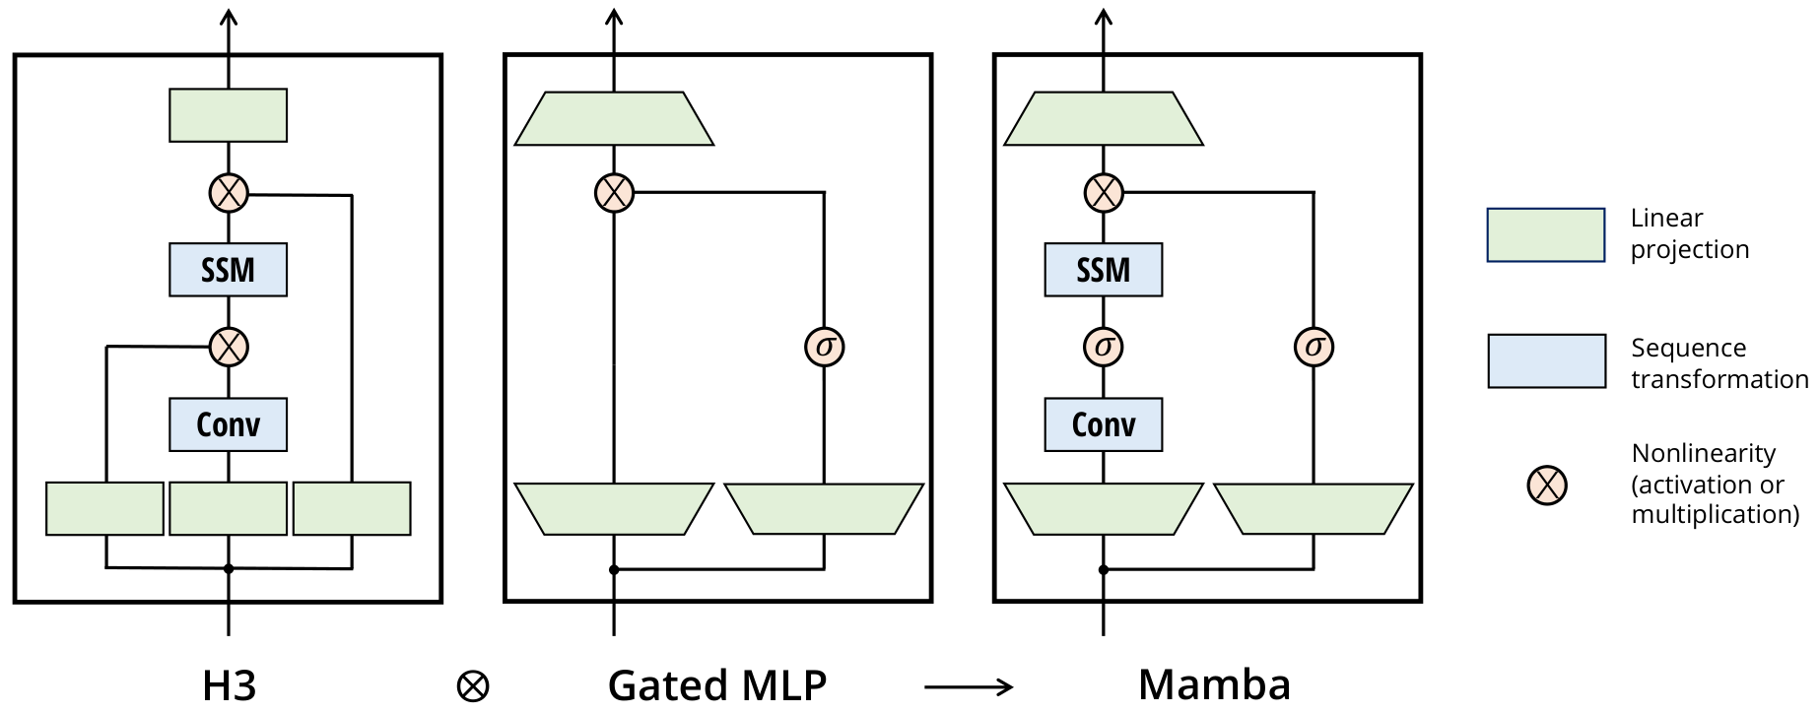
Architecture Comparison: H3 vs. Mamba
The Mamba Block
Mamba (right) simplifies the architecture by repeating
a single homogeneous block. It modifies the H3 design
by replacing the first multiplicative gate with a
SiLU activation function. It also integrates the SSM
directly into the main branch, removing the need for
separate, interleaved MLP blocks found in transformers.
This creates a streamlined flow where the sequence
transformation and gating happen in a unified path.
H3 & MLP
Integration
Mechanistic Benefits
The architecture enables selective processing of data.
Like RNN gating, Mamba can screen out irrelevant noise
(e.g., filler words like "um") by resetting its state.
This contrasts with global convolutions that carry all
history. The result is efficient, linear-time modeling
that improves performance as context length increases.
The diagram (left) displays the H3 block and Gated MLP.
H3 provides the basis for sequence modeling, while MLPs
are ubiquitous in modern networks. Mamba's innovation is
to mathematically combine these (H3 ⊗ Gated MLP) into a
single, unified architecture rather than stacking them.

Slide 27
Mamba: Linear-Time Sequence Modeling
Simplified
SSM
Architecture
Dimension Expansion
The model expands its internal dimension (D) by a factor (E).
We fix this expansion factor to E=2 in all experiments.
Parameter Efficiency
Most parameters reside in the linear projections, not the
inner core. Specifically, 2ED² are used for input projections.
This design matches the parameter count of a standard
Transformer architecture, ensuring efficiency.
Activation Function
We utilize the SiLU / Swish activation function. This is a
mathematical gate that controls how information flows through
the network, filtering data effectively.
Industry Standard
This choice transforms our block into the popular SwiGLU
variant. This aligns Mamba with leading models like PaLM
and LLaMa, ensuring modern performance standards.
Normalization Strategy
We include an optional LayerNorm step to stabilize training.
Normalization keeps numerical values stable as the model
learns. This is motivated by the RetNet architecture.
Unified Structure
Traditional models mix different block types. We simplify
this by combining components into one homogeneous stack.
This creates a cleaner, more consistent design.

Slide 28
SECTION 05
Empirical Evidence:
Language & Genomics

Slide 29
Empirical Evidence: Language & Genomics
Scaling Laws:
Reading the Data
Reading the Charts
The X-axis measures FLOPs (computing cost).
The Y-axis tracks Perplexity (model confusion).
Lower curves mean smarter, faster AI.
Standardized Testing
Models scaling from 125M to 1.3B parameters
were trained on The Pile, a massive text
dataset used to benchmark modern AI systems.
A Historic Breakthrough
Mamba matches the Transformer++ standard.
It is the first attention-free model to
achieve this top-tier accuracy efficiently.

Slide 30
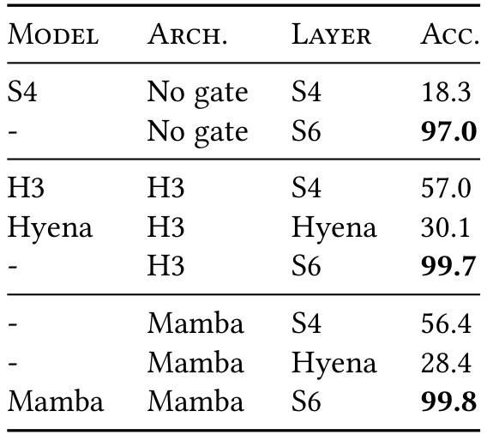
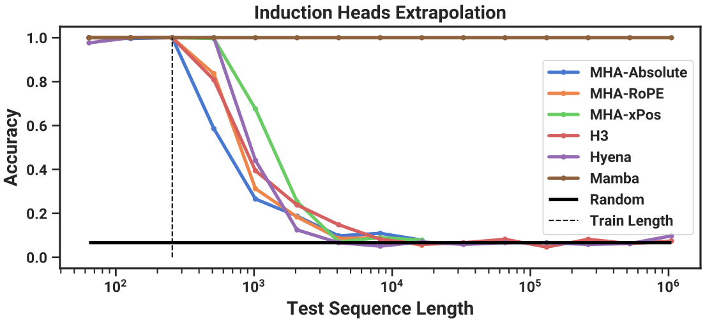
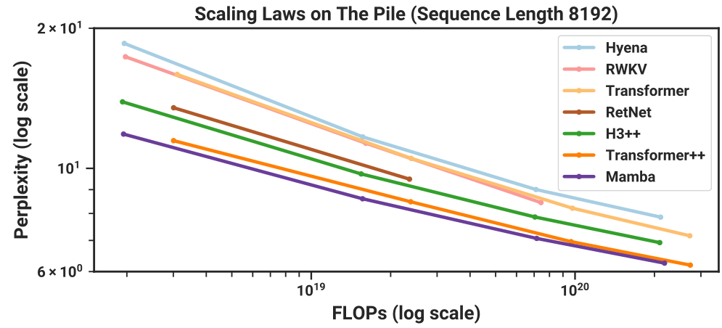
Empirical Evidence: Language & Genomics
Scaling Laws:
Mamba vs.
Transformers
Matches Strongest
Transformers
Lowest Perplexity
Linear Scaling
Perfect Length
Extrapolation
1M Token Context
Zero Accuracy Loss
Mamba holds 1.0 accuracy up to 1M sequence length.
Others fail after 256 tokens, the training limit.
The S6 layer is critical, achieving 99.8% accuracy.
Solves induction head tasks where others fail.
Mamba (purple) is best.
Matches Transformer++.
Gap widens vs Hyena.
Validates scaling laws.

Slide 31
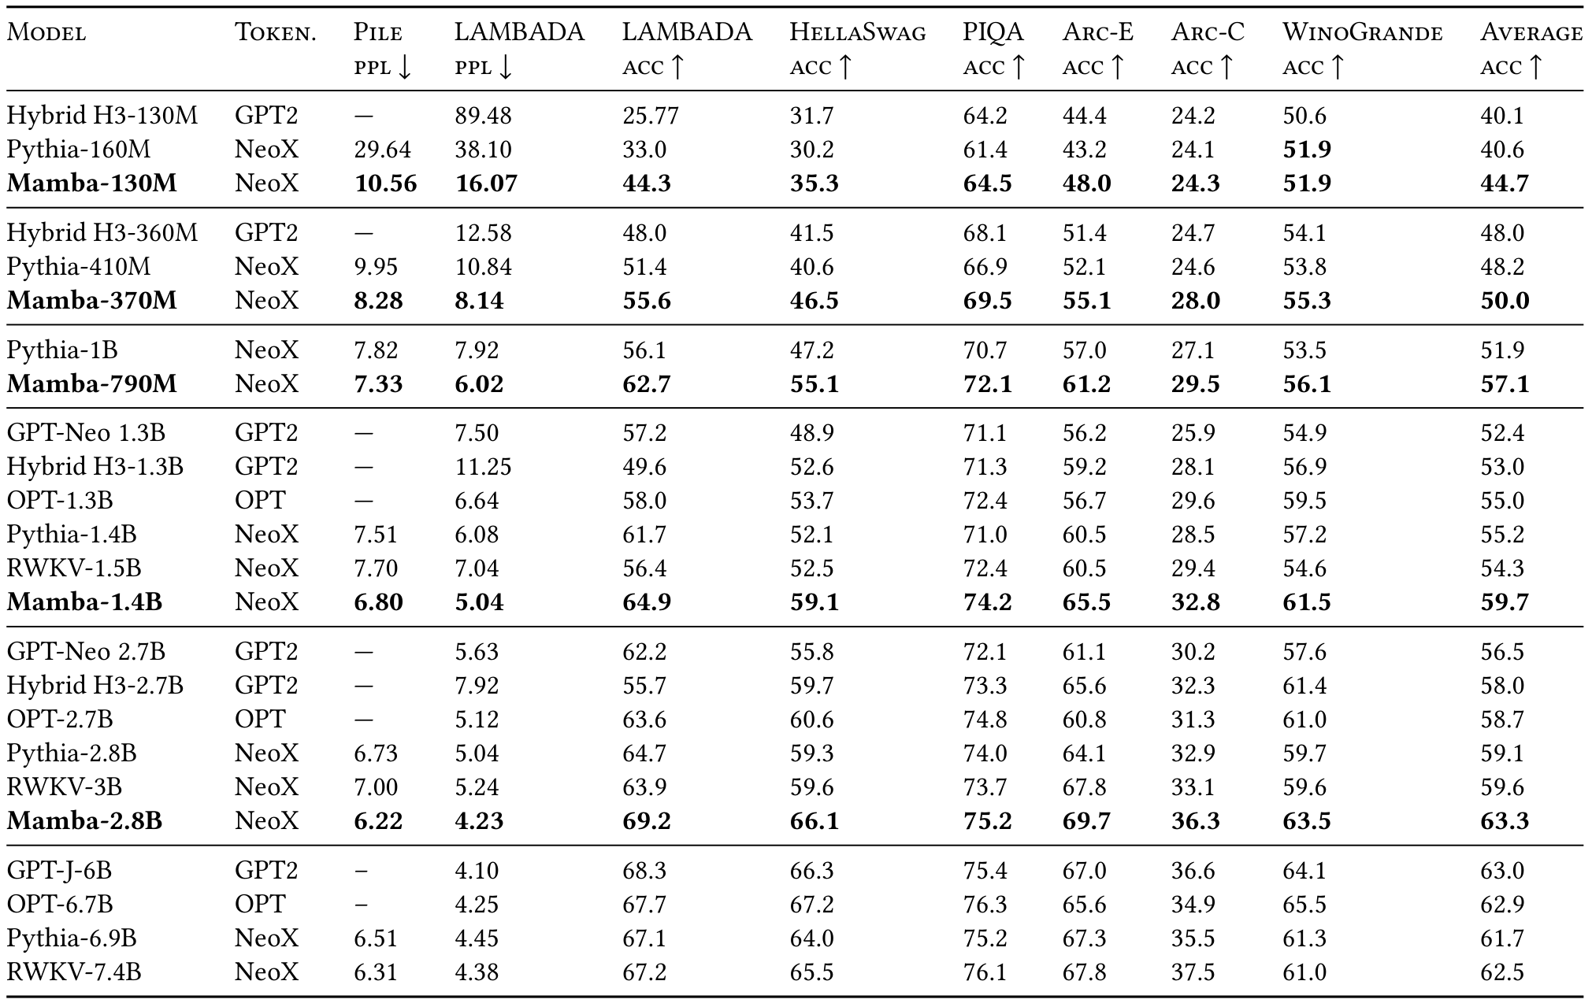
Empirical Evidence: Language & Genomics
Zero-Shot
Downstream
Performance
Mamba achieves best-in-class performance across
evaluations, outperforming same-size open
source models like Pythia and RWKV.
Better Prediction
Mamba makes fewer
errors (perplexity).
Lower is better.
Mamba-790M: 7.33
Pythia-1B: 7.82
Higher Accuracy
Mamba leads on
reasoning tasks.
Higher is better.
Mamba-130M: 44.7%
Hybrid H3: 40.1%
Matching Larger Models
Mamba models match the performance of Transformers
twice their size. For example, Mamba-2.8B (63.3%)
surpasses the larger GPT-J-6B (63.0%) and
Pythia-6.9B (61.7%) on average accuracy.
This efficiency enables powerful linear scaling.

Slide 32
Empirical Evidence: Language & Genomics
Genomics:
Modeling DNA
Sequences
Modeling DNA
We treat DNA as a string of discrete tokens
using the four bases: A, C, G, and T. This
lets AI model biology just like human language.
Scaling on HG38
Tests on the Human Genome (HG38) show Mamba
scales better than HyenaDNA and Transformer++
as model size grows from 200K to 40M params.
Efficiency Gains
Mamba matches the accuracy of rival models
while requiring 3x to 4x fewer parameters.
Long Contexts
Mamba handles massive inputs up to
1 million tokens. Unlike HyenaDNA,
which degrades, Mamba filters noisy data
via selection to improve as context grows.

Slide 33
Empirical Evidence: Language & Genomics
Long Context in Genomics
The DNA Challenge
We tested models on human genome sequences
ranging up to 1 million tokens. This is a
massive context window for any AI system.
Superior Scaling
Results show Mamba improves as input grows.
It effectively utilizes the full 1M context
to better predict genetic patterns.
Why Mamba Wins
HyenaDNA struggles with noise aggregation.
Mamba uses a selection mechanism to
filter data, ensuring accuracy at scale.

Slide 34
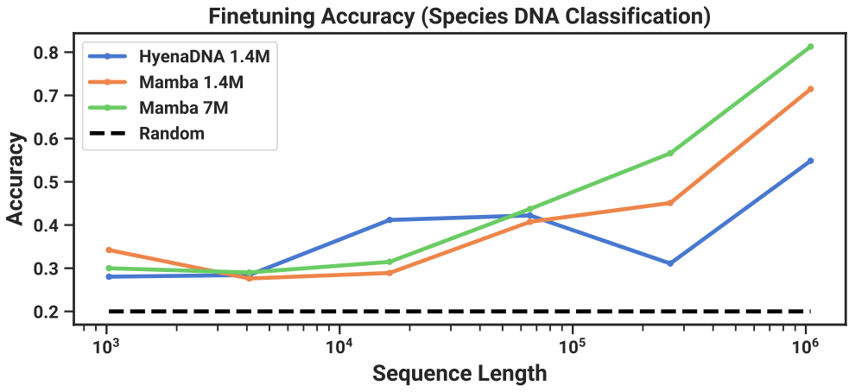
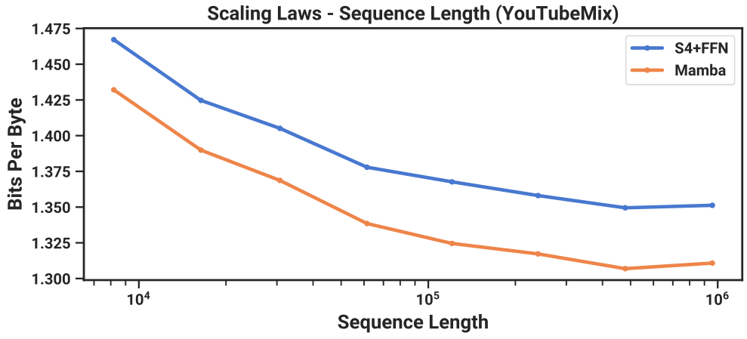
Scaling to 1M length lets Mamba classify species with 82% accuracy.
The Challenge
Identify 5 apes
with 99% same DNA.
Chart Data
Random line: 20%.
Mamba hits 82% at
1M sequence length.
Hyena trails: 55%.

Slide 35
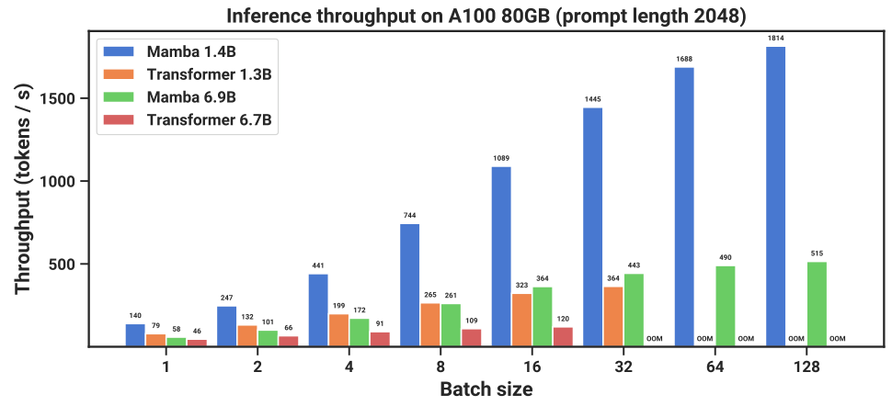
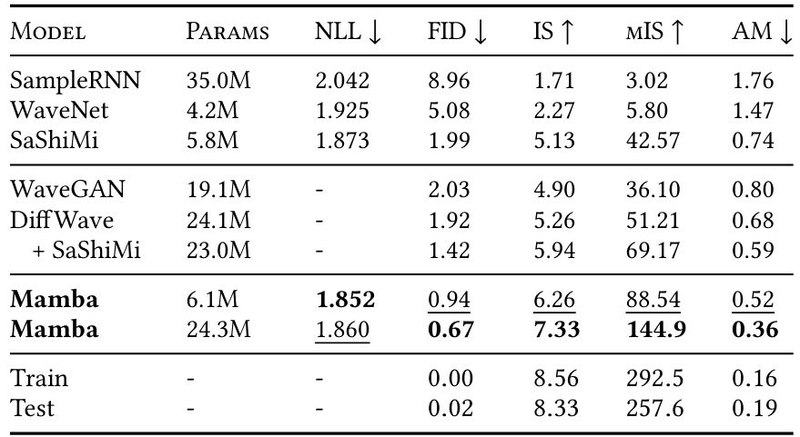
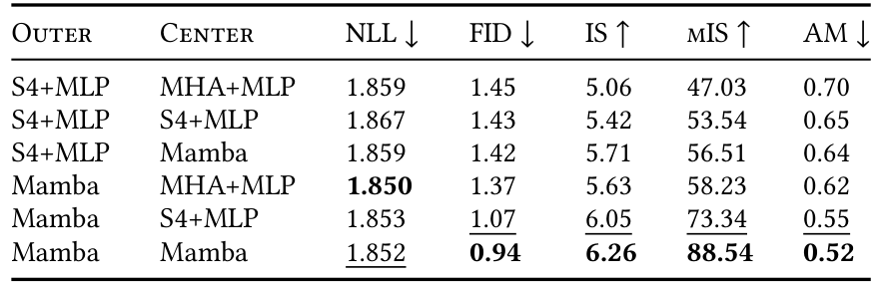
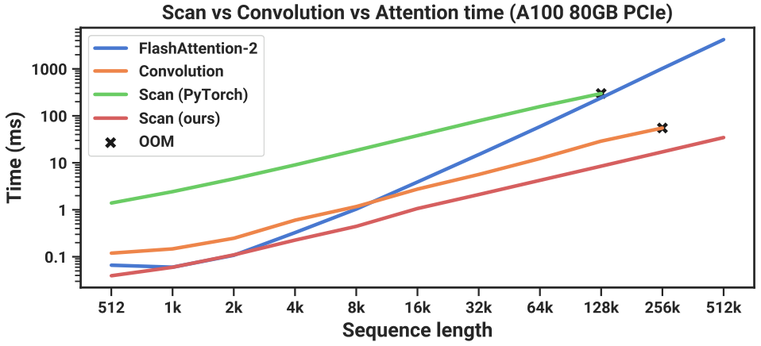
Speed and Throughput Benchmarks
The efficient scan operation runs 40x faster than
standard PyTorch implementations. It outperforms
FlashAttention-2 beyond sequence lengths of 2,000 steps.
Mamba achieves 4-5x higher
throughput than Transformers.
A 1.4B model processes
1,814 tokens/s vs just 364.
Linear scaling prevents
memory overload (OOM).

Slide 36
SECTION 06
Empirical Evidence:
Audio Modeling

Slide 37
Empirical Evidence: Audio Modeling
Audio Modeling Findings
Mamba outperforms SaShiMi
on YouTubeMix piano audio.
Achieves better BPB scores
improving consistently to
1 million sequence length.

Slide 38
Unconditional generation of digits 'zero' through 'nine' on SC09.
Task: Generate spoken digits.
Mamba beats DiffWave (24M).
Despite having only 6M params, it
improves fidelity drastically.
FID drops to 0.94 (vs 1.92),
setting a new state-of-the-art.

Slide 39
Empirical Evidence: Audio Modeling
Ablation
Study
Dataset
vs
Center
Blocks
Understanding Ablations
In AI research, an ablation study tests
taking a machine apart to test each
component individually. We used the
SC09 audio dataset to evaluate
different architectures.
The Test Structure
The model uses a backbone with two
distinct zones based on sequence length:
1. Outer Blocks: Handle long sequences.
2. Center Blocks: Handle compressed
data layers.
We swapped different technologies into
these zones to find the best fit.
Comparing Technologies
We tested three core architectures:
- S4 (Previous State-Space Model)
- MHA (Multi-Head Attention)
- Mamba (New Selective Model)
Note: MHA was too slow for Outer
blocks due to 16,000-step sequences.
Key Results
As shown in Table 5, the pure Mamba
design (Mamba in both zones) won.
It achieved the best quality score:
FID of 0.94 (lower is better).
This proves Mamba handles long audio
better than hybrid approaches.

Slide 40
Empirical Evidence: Audio Modeling
Mamba vs. Prior
Audio Models
Study Overview
Researchers compared Mamba against SaShiMi, a
state-of-the-art audio model. They used the
YouTubeMix dataset, consisting of 4 hours of
solo piano music, to test waveform generation.
Understanding the Metric
Performance is tracked via Bits Per Byte (BPB).
Think of this like a golf score: lower is better.
It measures how efficiently the model compresses
audio data while retaining high fidelity.
Key Results
As sequence length increases from 8,192 to
1 million, both models improve. However, Mamba
consistently achieves lower BPB. Crucially, the
performance gap widens at longer lengths,
proving Mamba handles long-context continuous
data better than prior architectures.

Slide 41
SECTION 07
Conclusion & Future Outlook
Summary of contributions and future directions.

Slide 42
Conclusion & Future Outlook
Summary: The
Selection
Advantage
The Content Problem
Standard models handle every piece of data the same way. This
causes them to lose track of important context in text.
The Selection Solution
Mamba uses a selection mechanism to solve this. It
looks at the current input to decide what to remember or
forget. This mimics how humans focus on relevant details.
Linear Scaling
Transformers become much slower as data grows. Mamba scales
linearly, meaning 2x more data takes only 2x the time.
Inference Speed
The system achieves 5× higher throughput than
Transformers. It runs efficiently without heavy Attention
blocks, unlocking analysis of massive sequences.
Top Performance
Despite being faster, Mamba matches Transformers that are
twice its size. You get high quality with lower cost.
Future Applications
It serves as a general foundation for many fields. It excels
in genomics, audio, and video where context is long.
The architecture removes the trade-off between speed and
accuracy.

Slide 43
Conclusion & Future Outlook
Implications: Beyond Language
Universal Foundation
Mamba is designed as a general backbone for
AI systems. It acts as a versatile engine to
power models across diverse scientific fields.
Genomics & Multimedia
It excels in emerging modalities like DNA,
audio, and video. These fields require reading
incredibly long streams of continuous data.
Efficiency at Scale
Mamba uses linear scaling to handle massive
inputs. It processes million-length sequences
efficiently, unlocking new research avenues.

Slide 44
Mamba: Linear-Time Sequence Modeling
Transformer
Replacement?
Matches
Accuracy
Linear
Efficiency
Scales to
7B+ Params
Core Finding
Mamba matches the performance of strong
Transformer models but uses a simpler
architecture. It is a top candidate
to become the new general backbone for
sequence modeling systems.
Linear Speed
Traditional models slow down with long
inputs. Mamba scales linearly, meaning
it remains fast and efficient even as
data length increases significantly.
This is vital for long-context tasks
like DNA analysis and video processing.
Scaling Up
Current tests used small models. Future
work involves scaling Mamba to
7 billion parameters (7B+) to compete
with open-source giants like Llama.
This will prove if efficiency holds at
massive scales.
Ecosystem & Tools
Researchers must now verify if Mamba
supports the rich ecosystem of tools
available for Transformers, such as
fine-tuning, complex prompting, and
instruction following capabilities.

