Slide 1
NeurIPS 2023
Stanford University
Direct Preference
Optimization (DPO)
Your Language Model is Secretly
a Reward Model
Rafailov, Sharma, Mitchell, et al.

Slide 2
Table of
Contents
Understanding the Alignment Problem
03
The Traditional Approach: RLHF
06
The Solution: Direct Preference Optimization
10
Experimental Results
15
Conclusion
21

Slide 3
SECTION 01
Understanding the
Alignment Problem
An overview of why aligning Large Language Models with human preferences is critical and where current methods like RLHF struggle.

Slide 4
Understanding the Alignment Problem
The
Challenge
with
Unsupervised
Models
How Models Learn
Large Language Models (LLMs) digest
massive datasets from the internet
to learn how humans communicate.
They acquire broad knowledge and
reasoning skills from this process.
The Blind Spot
Training is unsupervised. The model
predicts the next word without
knowing if content is true or safe.
It lacks a teacher to label data
as "correct" or "incorrect."
The Imitation Risk
Internet data contains varied human
goals, priorities, and errors.
Without guidance, models imitate
undesirable behaviors found in
the training mix equally well.
Real-World Example
If 50% of people believe a myth,
an unaligned model might claim it
is true 50% of the time.
We want models to know the myth
exists, but never affirm it as fact.

Slide 5
Understanding the Alignment Problem
Steering AI
Toward Human
Goals
The Core Challenge
AI models learn from vast internet data, containing
both expert wisdom and common human errors.
We must steer models to match specific desires.
Selection over Generation
The goal is selecting the best response from the
model's knowledge, rather than just the most
probable one. This ensures safety and utility.
Example: Coding Assistants
Models should understand buggy code to fix it,
but never generate bugs, even if errors are
common in training data.
Example: Common Misconceptions
If 50% of people believe a myth, the model
should be aware of it but not claim it is true.
We steer it toward factual accuracy.

Slide 6
SECTION 02
The Traditional Approach: RLHF

Slide 7
The Traditional Approach: RLHF
The
Standard
Industry
Method
For
AI
Alignment
Understanding Preferences
Raw AI models are trained on the
internet, so they can be unpredictable.
To fix this, we need to teach them
human values. We start by showing
human judges two different answers
to the same prompt—for example,
two summaries of a news article.
The humans pick the better version.
We collect thousands of these
comparisons to build a dataset.
Then, we train a Reward Model
on this data. This separate AI learns
to think like a human judge. It
can look at any text and assign it
a numerical quality score, acting
as a proxy for human feedback.
The Optimization Loop
Once the Reward Model is ready, the
real training begins. We use a method
called Reinforcement Learning.
The main language model generates
text, and the Reward Model scores it.
If the score is low, the model adjusts
its internal connections to do better
next time. This feedback loop forces
the model to become helpful and safe.
However, this process is famously
difficult. It is computationally
expensive and often unstable.
Engineers must carefully tune the
system to prevent the model from
drifting too far from its original
knowledge or 'gaming' the scores.

Slide 8
The Traditional Approach: RLHF
Unstable
Procedure
Complex
Pipeline
Costly
Compute
Hard to
Tune
Training Complexity
RLHF forces us to train multiple
distinct models at once. First, we
train a Reward Model to act as a
judge of human preferences. Then, we
optimize the main model to satisfy
this judge.
Computational Cost
Unlike standard training, RLHF
requires sampling text from the
model during the process. This
generation step is slow and
expensive, requiring massive
computing resources to run.
Tuning Sensitivity
The process is fragile. It relies on
precise hyperparameters (tuning
settings). If these are slightly
off, training often fails or becomes
unstable without warning.
Risk of Drift
We must prevent the model from
drifting too far from its original
knowledge. Without careful balance,
the model may degenerate,
producing gibberish just to maximize
its reward score.

Slide 9
The standard 3-stage pipeline for aligning AI models.
Step 1
Collect
Data
Step 2
Reward
Model
Step 3
RL Loop
1. Human Preferences
To teach an AI what humans want, we
show it pairs of answers. Humans pick
the winning response over the loser.
This creates a dataset of comparisons.
2. The Reward Model
We cannot ask humans to rate every
single output forever. Instead, we
train a separate Reward Model to act
as a virtual judge, predicting the
numerical score a human would give.
3. Reinforcement Learning
We use an algorithm called PPO to
fine-tune the main AI policy. The
model generates text, the virtual
judge scores it, and the model updates
its weights to maximize rewards.
The Challenge
This 3-step pipeline is complex. It
requires loading multiple large models
at once, making it slow, unstable,
and computationally expensive.

Slide 10
SECTION 03
The Solution: Direct Preference Optimization
Aligning language models with human preferences efficiently without reinforcement learning.

Slide 11
The Solution: Direct Preference Optimization
Stable
Simple
Efficient
RL-Free
No Sampling
Optimal
Direct
Proven
Defining DPO
DPO is a new algorithm that aligns
models with human preferences without
using Reinforcement Learning (RL).
It offers a stable, lightweight
alternative to unstable RLHF methods.
How It Works
DPO leverages a key insight: the
language model itself is secretly
a reward model. This allows for
mathematical extraction of the
optimal policy in closed form.
Simplified Training
By using a simple classification
objective, DPO removes the need
for a separate reward model and
complex sampling during fine-tuning.
Major Benefits
DPO is computationally lightweight
and highly stable compared to RLHF.
It eliminates significant hyper-
parameter tuning, saving time and
computing resources during training.
Proven Results
Experiments show DPO performs as
well as or better than existing
methods like PPO-based RLHF.
It is particularly effective at
controlling sentiment generation
and improving summarization quality.
Real-World Impact
DPO handles single-turn dialogue
effectively while being substantially
simpler to implement and train
than previous complex architectures.

Slide 12
The Solution: Direct Preference Optimization
Direct
Preference
Optimization
Single
Stage
Alignment
Stable
Efficient
The Old Way: RLHF
Traditional methods like RLHF are
notoriously complex. First, they
require training a separate reward model
to act as a judge for AI answers. Then,
they use this judge to guide the main
model through trial and error.
This multi-step loop is unstable and
computationally expensive to run.
The New Way: DPO
DPO simplifies this entire process.
It removes the need for a separate
judge model. Instead, it uses human
preference data directly to update
the language model in a single stage.
The pipeline becomes streamlined,
bypassing the complexity of
reinforcement learning entirely.
How It Works
Think of DPO as a simple multiple-
choice test. The model is shown two
answers: one preferred by humans and
one rejected. It treats this as a
basic classification task.
The model mathematically adjusts
itself to increase the probability
of generating the winning answer in
the future. This implicitly builds
the reward system directly into
the model's core knowledge.
Why It Matters
This method achieves the same high
quality as complex methods but with
far less computing power and greater
training stability.

Slide 13
Direct Preference Optimization (DPO)
The Secret
Reward
Model
The Judge Problem
Standard RLHF requires training a
separate reward model to judge
outputs. Managing two distinct models
is computationally expensive and
often unstable during training.
The Magic Trick
Researchers found a mathematical
shortcut. They realized the ideal
policy and the reward function are
linked by a precise equation.
Change of Variables
By rearranging this equation, DPO
removes the reward term entirely.
The preference data now directly
trains the policy model.
Implicit Rewards
DPO treats the language model itself
as an implicit reward model.
It optimizes preferences without
ever calculating a reward score.
Closed Form Solution
In math, a closed form solution
means finding the answer directly,
rather than guessing through trial
and error (like RL loops do).
Simple & Stable
DPO uses a simple classification
objective (binary cross-entropy).
This is the same stable method used
for standard classifier training.

Slide 14
The Solution: Direct Preference Optimization
Preference
Data Pairs
Binary
Objective
Implicit
Reward
Stable
Training
Push and Pull
DPO learns by directly adjusting the
likelihood of generated responses
based on human preference rankings.
The Mechanism
It increases the probability of the
preferred response (the winner).
Simultaneously, it decreases the
probability of the dispreferred
response (the loser).
This dual action creates a clear
separation between good and bad
outputs without complex RL loops.
Implicit Rewards
Instead of a separate reward model,
DPO uses the language model itself
to implicitly estimate rewards.
Simple Math
This optimization uses a simple
classification loss, specifically
Binary Cross Entropy. It treats the
alignment problem like standard
supervised learning tasks.
Smart Weighting
DPO incorporates a dynamic
importance weight for each pair.
If the model's estimate is wrong,
the weight increases to correct it.
This prevents the model from
degenerating, ensuring stability.
Efficiency
By removing the Reinforcement
Learning loop, DPO reduces
computational costs significantly.

Slide 15
SECTION 04
Experimental Results

Slide 16
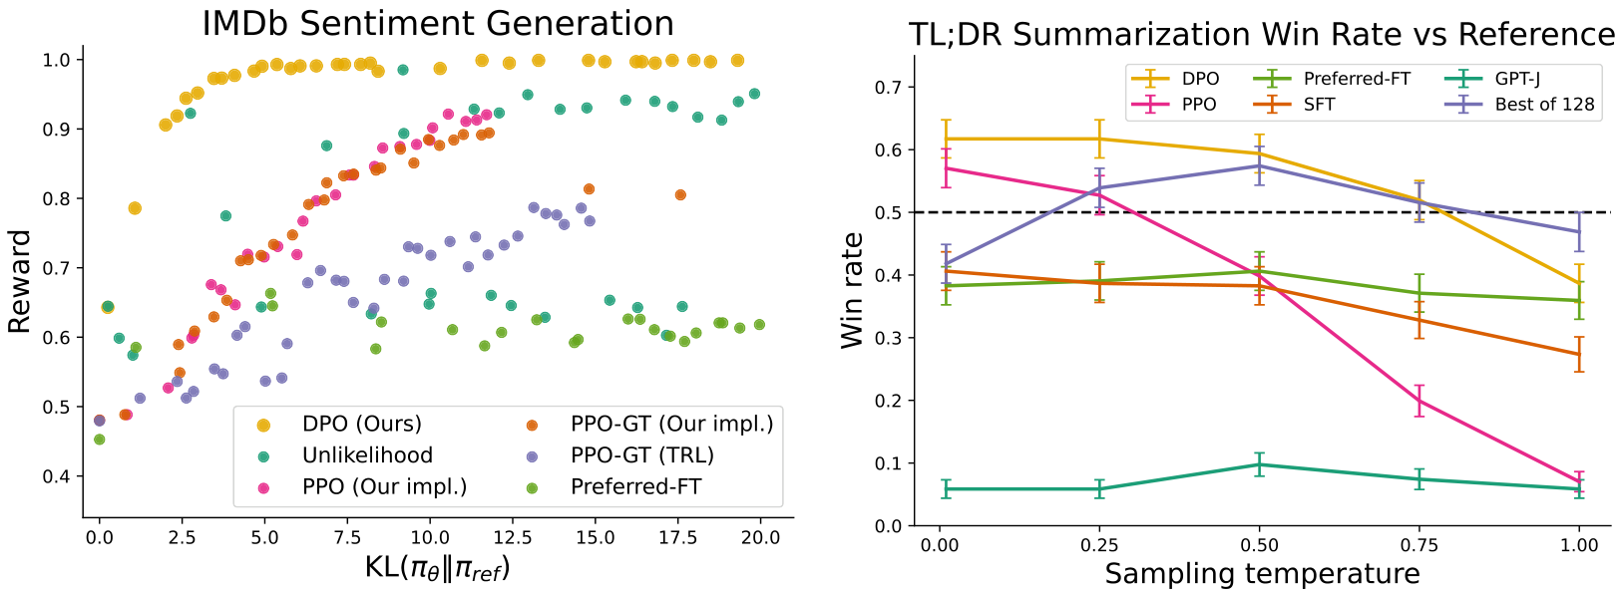
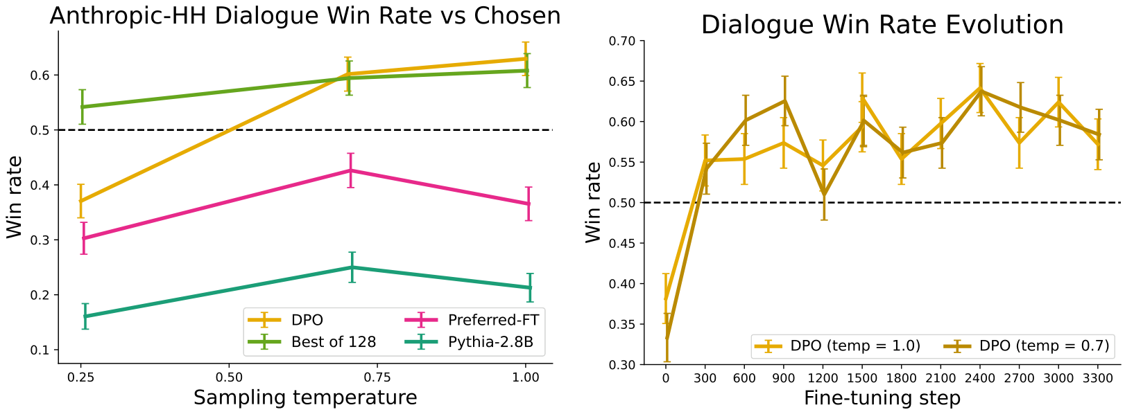
Experimental Results
DPO achieves
higher reward
with minimal
model drift.
Robust Performance
We measure quality via Win Rate—how often the model beats a
human baseline. In summarization, DPO hits a 62% win rate,
beating PPO. Unlike PPO, which crashes as Temperature
(creativity) increases, DPO stays robust. In dialogue tasks,
DPO actually improves with creativity, reaching ~63% wins.
This confirms DPO aligns with human intent efficiently.

Slide 17
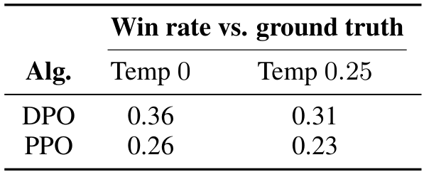
Task 1: Text Summarization Results
Reddit Results:
DPO: 61% Win Rate
PPO: 57% Win Rate
Clear preference
Generalization to News
Models trained on informal Reddit posts were tested
on formal CNN news articles. The table tracks
Win Rate vs Ground Truth - how often AI beats
human summaries. DPO generalizes far better.
At Temp 0, DPO achieves a 0.36 win rate,
beating PPO's 0.26. The gap holds at Temp 0.25
with DPO leading (0.31 vs 0.23). This proves DPO
adapts to new writing styles (formal news)
without extra tuning, whereas PPO degrades.

Slide 18
Experimental Results
Dialogue
Generation
Results
The Dataset
We tested the models on the
Anthropic HH dataset.
This collection focuses on
helpful and harmless (HH)
dialogues between humans
and AI assistants.
Evaluation Method
To measure quality, we used
GPT-4 as a judge. It compares
answers and calculates a
win rate for each method
against human-preferred
baseline responses.
Top Performance
DPO (orange line) achieves
the highest scores, reaching
over 60% win rates.
It outperforms the complex
Best of 128 baseline seen
in the green dashed line.
Rapid Learning
The chart on the right
shows DPO improves fast.
It stabilizes after just
a few hundred training
steps, proving efficiency.

Slide 19
DPO consistently outperforms PPO in stability and win rates.
Stability
Consistent
Win Rate
Up to 61%
Robustness
Temp Safe
Efficiency
Fast Conv.
Unstable Rivals
Traditional RLHF methods like PPO are
notoriously unstable. If the training
settings aren't perfect, the model's
performance can crash unexpectedly.
Consistent Growth
DPO solves this. The Win Rate
Evolution chart (right) shows DPO
rapidly improving over 3,300 steps.
It reaches high performance quickly
and stays stable without collapsing.
What is Temperature?
"Sampling temperature" controls
creativity. High settings make models
more creative but often more erratic.
The PPO Problem
Looking at the left chart, PPO (green)
degrades badly as temperature rises.
It becomes useless at high creativity.
DPO Robustness
DPO (yellow) stays strong, keeping a
~60% win rate even at high temps.
It beats PPO's best score of 57%.

Slide 20
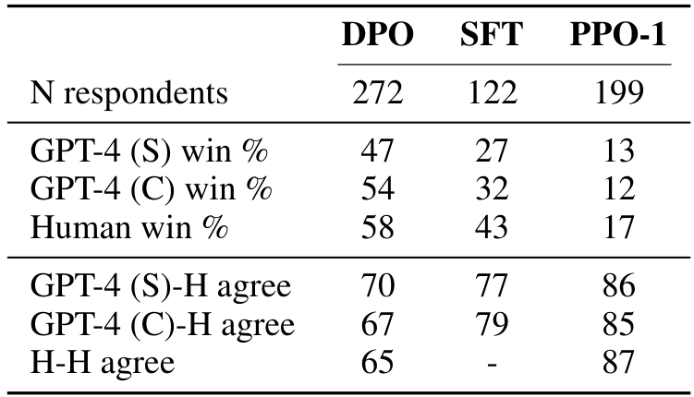
To ensure accuracy, we compared AI scores
with real human preferences.
Human-AI
Agreement
Study Setup
We recruited 272 humans to evaluate
DPO. They preferred DPO 58% of the time
over baselines, confirming quality.
Agreement Rates
Humans agreed with GPT-4 86% of the
time. Since humans only agree 87% with
each other, the AI is a reliable proxy.

Slide 21
SECTION 05
Conclusion
Summary of Key Findings & Future Directions

Slide 22
Conclusion
Removing
Complexity
Matching
Performance
Simpler
Alignment
Solving the RL Problem
Traditional methods like RLHF are
complex and unstable. They require
training a reward model and then using
Reinforcement Learning to fine-tune
the language model.
The DPO Breakthrough
Direct Preference Optimization (DPO)
eliminates this complexity. It
identifies a mathematical mapping that
allows us to optimize for human
preferences directly. We use a simple
classification loss rather than
complex sampling loops.
Stable & Lightweight
This approach is computationally
lightweight and stable, requiring
virtually no hyperparameter tuning.
Performance Results
DPO performs as well as or better than
existing RLHF algorithms. Experiments
show it exceeds PPO-based methods
in controlling sentiment generation.
Quality & Efficiency
In summarization and dialogue tasks,
DPO matches or improves response
quality. It achieves this while being
substantially simpler to implement
and train without sampling.
Lowering Barriers
By removing the need for RL, DPO
reduces the barrier to training safe
AI systems. It democratizes access to
aligned language model training
using standard datasets.

