Slide 1
Direct Preference Optimization (DPO)
Simplifying AI Alignment Without Reinforcement Learning

Slide 2
Table of
Contents
The Challenge of AI Alignment
03
The Standard Approach: RLHF
06
Introducing Direct Preference Optimization
12
How DPO Works
17
Experimental Results
21
Real World Examples
30
Conclusion and Impact
35

Slide 3
SECTION 01
The Challenge of AI Alignment

Slide 4
The Challenge of AI Alignment
How
Language
Models
Learn
Ingesting the Internet
Large Language Models (LLMs) begin
life by reading massive datasets.
This includes billions of pages from
websites, digitized books, and
academic papers. The model absorbs
patterns from every imaginable topic,
creating a vast but disorganized
knowledge base.
Predicting the Next Word
Without a human teacher, the model
plays a simple game: guessing the
next word in a sentence. By trying
to predict what comes after phrases
like "The cat sat on the...", it
learns grammar, logic, and facts.
This unsupervised training gives
it broad capabilities but no
specific direction or moral compass.
Absorbing Everything
Because the model learns from raw
internet data, it imitates all
human behaviors equally. It learns
expert-level coding, but also
internalizes common bugs and
bad practices found in forums.
Confusion vs. Truth
The model lacks a concept of truth.
It only knows what is probable.
If 50% of people believe a
common myth, the model will likely
claim that myth is true in half
of its responses. It mirrors the
internet's biases and errors.
The Alignment Challenge
This creates a powerful but
unpredictable engine. We must
steer this raw intelligence to
be safe, helpful, and honest.

Slide 5
The Challenge of AI Alignment
The Need for Steering
Selecting Desired Behaviors

Slide 6
SECTION 02
The Standard Approach: RLHF

Slide 7
The Standard Approach: RLHF
Reinforcement
Learning from
Human Feedback
(RLHF)
Core Definition
RLHF stands for Reinforcement Learning from
Human Feedback. It is the standard method used
to make AI models safe, helpful, and honest.
The Three-Stage Pipeline
1. Supervised Fine-Tuning: The model learns
basics from high-quality human examples.
2. Reward Modeling: Humans rank pairs of
answers. A separate AI learns to judge quality.
3. RL Optimization: The model practices
writing text to maximize the judge's score.
Why It Is Complex
This process requires training multiple models
interacting in a loop. Despite the high cost,
it aligns raw AI power with human values.

Slide 8
The Standard Approach: RLHF
RLHF Phase 1:
Supervised
Fine-Tuning
The Starting Point
The process begins with a generic
pre-trained language model.
This base model has read vast amounts of text but
lacks specific direction. It predicts the next word
based on patterns, not helpfulness.
It needs guidance to become a useful assistant.
Human Demonstrations
Humans define what 'good' looks like.
They create a dataset of high-quality examples for tasks.
For prompts like 'Summarize this,' a human writes
the ideal response. The model uses
supervised learning to memorize these patterns.
It learns to imitate the human style exactly.
The SFT Outcome
The result is the Supervised Fine-Tuned (SFT) model.
It can now follow instructions and maintain
conversation formats effectively.
However, this phase only teaches
imitation, not optimal behavior.
The model copies errors and does not yet know
how to rank better answers over worse ones.

Slide 9
The Standard Approach: RLHF
Training a
Digital
Human
Judge
Preference Data
The process begins with the SFT model generating pairs
of answers for the same prompt. Human labelers review
these pairs and select the superior response.
Human Role
Humans act as judges rather than writers. It is much
faster to recognize a good answer than to write one,
allowing for scalable data collection.
The Reward Model
We train a separate neural network to predict human
preferences. It is initialized from the SFT model but
modified to output a single scalar score.
Training Goal
The model analyzes a prompt and response, assigning a
numerical quality score. It learns to give higher scores
to the answers humans preferred.
Bradley-Terry
We use the Bradley-Terry model to convert scores into
probabilities. It estimates the likelihood that one
answer is better than another based on the score gap.
Proxy for Humans
Once trained, this model acts as a proxy for human
evaluators. It provides automated feedback during the
final reinforcement learning phase.

Slide 10
The Standard Approach: RLHF
RLHF Phase 3:
Reinforcement
Learning
The Training Cycle
The process begins with the fine-tuned model (SFT). It
generates a new text response to a prompt. The Reward Model
(from Phase 2) acts as a virtual judge. It reviews the
output and assigns a numerical score, predicting how much
a human would like the answer. This creates a feedback
loop allowing the system to learn from millions of examples.
Optimization with PPO
We use an algorithm called PPO (Proximal Policy
Optimization). It analyzes the scores from the Reward
Model to update the language model. If a response gets
a high score, PPO adjusts the model's internal weights
to make that response more likely. This trial-and-error
method gradually shifts the model's behavior to align
with human preferences.
The Stability Constraint
To prevent the model from "gaming" the system, we apply
a penalty for drifting too far. This uses KL Divergence
to measure the distance between the new model and the
original version. Without this check, the AI might output
repetitive text just to maximize scores, a problem known
as mode collapse. The constraint ensures the final
output remains fluent, diverse, and coherent.

Slide 11
The Standard Approach: RLHF
Why RLHF is Difficult
Architectural Complexity
RLHF is considerably more complex than standard supervised
learning. It necessitates maintaining multiple large models at
once during training. Unlike simple approaches, engineers must
manage a reference model, a reward model, and the policy model,
creating a heavy infrastructure burden.
Training Instability
Reinforcement learning is notoriously sensitive to small changes
in the training setup. The model tries to maximize an estimated
reward score but can easily drift into generating gibberish.
Balancing this optimization against the need to stay close to
the original model requires a delicate equilibrium.
Computational Cost
The pipeline is slow because it requires sampling from the
model. Unlike standard training which efficiently predicts the
next word, RLHF must generate entire response sequences inside
the training loop to evaluate them. This sampling step
consumes massive computing resources and time.
Tuning Difficulty
Success requires extensive hyperparameter tuning. These
are complex configuration settings, like learning rates and
penalties, that control how the AI learns. Finding the right
balance is often a costly trial-and-error process. Without
precise tuning, the model may fail to learn or lose quality.

Slide 12
SECTION 03
Direct Preference
Optimization (DPO)
Your Language Model is Secretly a Reward Model

Slide 13
Introducing Direct Preference Optimization (DPO)
A Simpler Alternative
Skips the complex RL loop.
No separate Reward Model used.
Optimizes preferences directly.
Training is stable and fast.
Computationally lightweight.

Slide 14
Introducing Direct Preference Optimization (DPO)
Visualizing
the Old Way
(RLHF)
The RLHF Pipeline
Traditional alignment uses Reinforcement Learning from Human
Feedback (RLHF). This complex process requires maintaining
two distinct AI models simultaneously during training.
Step 1: Building a Reward Model
First, researchers gather pairs of text where humans picked
the better response. They train a Reward Model to act as
a digital judge, learning to predict human preferences and
assign numerical scores to any generated text.
Step 2: Reinforcement Learning
The main Language Model (Policy) generates text, which the
Reward Model scores. We use these scores to update the
Policy using complex reinforcement learning algorithms like
PPO. This loop involves constant sampling and is often
unstable, slow, and computationally expensive to run.

Slide 15
Introducing Direct Preference Optimization (DPO)
Visualizing the
New Way (DPO)
Preference data goes directly into the
final Language Model. We skip the complex
reinforcement learning loops entirely,
making the pipeline straightforward.
We eliminate the separate Reward Model.
Acting as a middleman, this model formerly
added cost and instability. Now, the AI
optimizes for preferences without it.
The goal is a simple classification task.
We mathematically maximize the likelihood of
preferred answers. This creates an implicit
reward system that is easier to solve.

Slide 16
2305.18290-easy
The
Mathematical
Insight
The Hidden Link
Researchers discovered a precise
mathematical relationship between the
Reward (the score of how good an
answer is) and the Policy (the AI
model's probability of generating it).
Redefining the Goal
Traditionally, we train a separate
Judge model to guess human scores.
DPO changes this paradigm completely.
It proves that the optimal language
model is the reward model in disguise.
This insight simplifies the entire
training architecture significantly.
Change of Variables
We use a math trick called a "change of
variables." By writing the Reward in
terms of the Policy, a very difficult
term called the partition function
completely cancels out of the math.
Closed-Form Solution
This cancellation allows us to solve
the alignment problem in closed form.
We do not need a complex Reinforcement
Learning loop anymore. We can simply
increase the likelihood of preferred
answers and decrease rejected ones
directly in the language model.

Slide 17
SECTION 04
How DPO Works
Optimizing language models directly from human preferences without reinforcement learning.

Slide 18
How DPO Works
The Training
Objective
DPO treats AI alignment like a simple
classification problem, not a complex loop.
This makes the training process much more
stable and efficient than prior methods.
For every prompt, it compares a winning answer
against a losing answer to learn preferences.
It learns directly from this data without
needing a separate reward model network.
It uses binary cross-entropy loss to increase
the probability of the winner relative to the
loser. This is a standard, reliable mathematical
method used widely in machine learning.

Slide 19
How DPO Works
Implicit Reward
Weighting
The Update Mechanism
DPO improves the model by comparing two answers:
a preferred winner ($y_w$) and a rejected loser ($y_l$).
The algorithm increases the likelihood of the winner
while decreasing the loser. This pushes their scores
apart, ensuring the model learns to rank correctly.
Smart Weighting
DPO automatically adjusts how much it learns from
each example. If the model mistakenly ranks a
loser above a winner, the update becomes
much stronger. This dynamic focus corrects
major errors quickly and prevents the model from
degenerating or cheating the system.
No Separate Judge
Older methods need a separate AI called a
Reward Model to judge answers. DPO removes
this complexity. The language model acts as its
own judge implicitly. This single-step process
is more stable and efficient than complex
Reinforcement Learning (RLHF) loops.

Slide 20
How DPO Works
The Reference Model
This is usually the
starting model. It
acts as an anchor to
prevent gaming with
nonsensical text.

Slide 21
SECTION 05
Experimental Results

Slide 22
Experimental Results
Testing
the
Capabilities
Core Mission
Researchers tested DPO on three
distinct text generation tasks.
1. Positive Reviews
The AI completed reviews from the
IMDb dataset with a clear goal:
generate a positive sentiment.
This is like training a writer to
always give a glowing 5-star rating.
2. Summarization
Using Reddit forum posts, the model
wrote concise TL;DR summaries.
It learned to condense long stories
into brief, accurate key points.
3. Helpful Dialogue
The hardest challenge involved the
Anthropic HH dataset.
The AI acted as a digital assistant,
answering queries on topics like
astrophysics or personal advice.
It had to be engaging and harmless.
How Was It Graded?
For creative writing, there is no
single right answer. Researchers used
GPT-4 as a proxy for human judges.
It compared DPO results against
human summaries to determine which
response was more helpful.

Slide 23
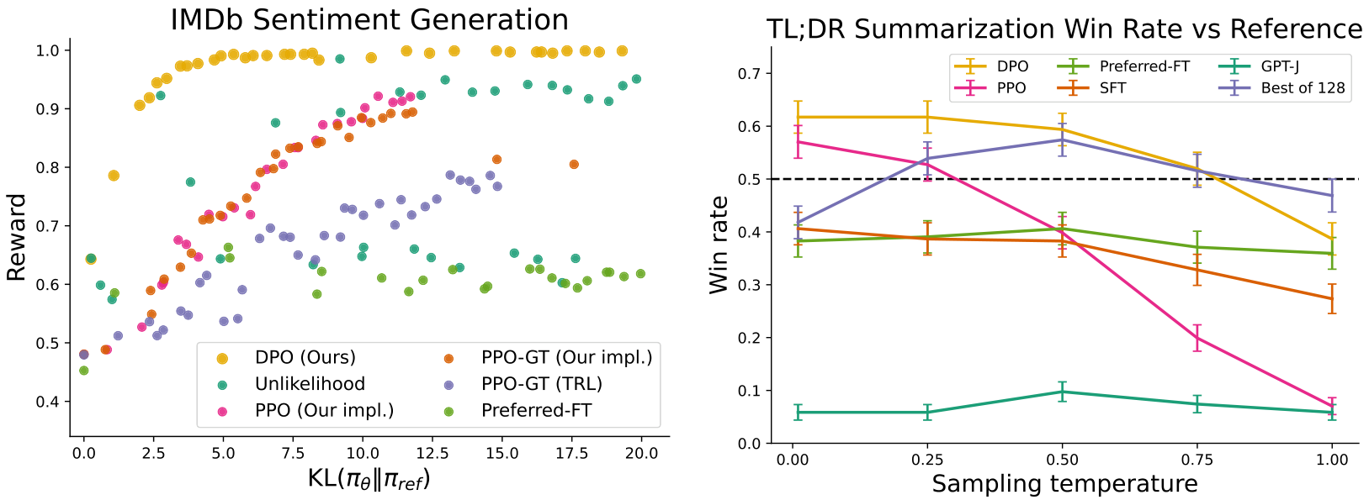
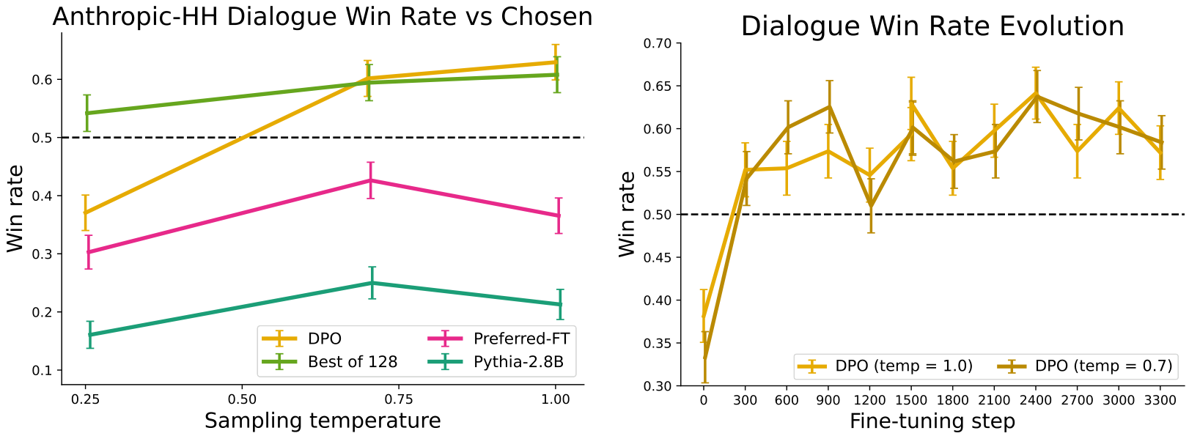
Experimental Results
The Frontier Plot
Y-Axis (Reward)
Higher is better.
X-Axis (Change)
Left is stable.
Key Finding
DPO hits ~1.0 score
with low change.

Slide 24
Experimental Results
DPO vs. PPO:
Efficiency
Results
Dominating Performance
The data plots Reward (quality) vs. KL (model change).
The orange dots show DPO consistently outperforming PPO.
DPO gets higher rewards for the same amount of change.
It creates the most efficient frontier of optimization.
Stability Without Complexity
Reinforcement Learning (PPO) is notoriously unstable.
It requires complex parameter tuning to work correctly.
DPO matches or beats PPO with almost no tuning needed.
It optimizes the same objective but avoids RL complexity.
Superior Win Rates
In summarization, DPO achieved higher win rates.
It beat human-written summaries and PPO's best results.
Performance remains robust even when settings change.
This proves DPO learns better directly from preferences.

Slide 25
Experimental Results
Win Rates measure quality.
GPT-4 compares AI summaries
against human text. We test
at diverse Temperatures
(randomness) to ensure the
model is robust and creative.

Slide 26
Experimental Results
DPO vs. PPO:
Robustness
Results
Understanding Temperature
In AI, "temperature" controls the randomness level.
Low values mean focused, predictable answers.
High values add creativity but increase errors.
Robustness Findings
PPO is fragile: performance drops as temperature rises.
DPO is robust: it stays stable across all settings.
DPO avoids the quality degradation seen in PPO.
Key Benchmarks
On the TL;DR summarization dataset:
1. DPO hit a 61% win rate (optimal setting).
2. PPO peaked at only 57% win rate.
3. Humans preferred DPO 58% of the time.

Slide 27
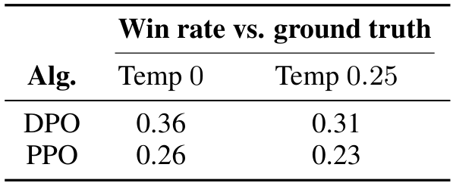
Experimental Results
DPO Wins
~60% of
Dialogues
Dialogue Mastery
DPO outperforms existing methods in chat tasks.
It exceeds baselines like Preferred-FT and PPO.
Win Rates
The chart shows DPO achieving ~60% win rates
against the reference. It performs as well as
the costly Best of 128 sampling method.
Robustness
On new data (Table 1), DPO maintains a clear
lead. At Temp 0, it scores 0.36 vs 0.26 for
PPO, proving it generalizes better to new
inputs and distributions.

Slide 28
Experimental Results
Training Stability Over Time
DPO improves reliably
throughout the process.
Win rates stabilize
without complex tuning.

Slide 29
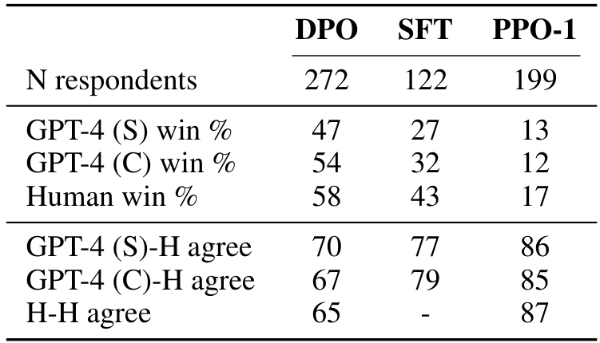
Experimental Results
Validating
the Judges
Agreement Levels
Humans agree with GPT-4 (67-70%) about as
often as with other humans (65%).
Win Rate Trends
Both ranked DPO highest (54-58%) and PPO-1
lowest (12-17%), showing strong alignment.
Core Conclusion
GPT-4 is a reliable proxy for human rating.

Slide 30
SECTION 06
Real World Examples

Slide 31
Real World Examples
Summarization
Comparison
The Scenario
A Reddit user [22M] is panicking about proposing to his
girlfriend. He cannot sleep and asks for advice on how
to relax before the big moment.
Model Performance
The DPO model wrote a clean summary: "About to propose...
anxious and can't sleep. How can I relax?"
The PPO model was messier. It included fluff like
"sleep tonight (and the night before)..." and trailed
off with ellipses.
Why DPO Won
DPO acts more like a human editor. It identified the
core emotion (anxiety) and the specific request (how to
relax). PPO got stuck on literal details and phrasing.

Slide 32
2305.18290-easy
The Request
Human Data
DPO Model
The Verdict
The User Prompt
The user submits a simple request: "Can
you help me write an essay on the Civil
Rights Movement?" They provide no other
context, leaving it open-ended.
Human Approach
The human dataset, labeled "Ground
Truth", actually fails here. It
expresses doubt, saying "I'm not sure
if I can." Instead of helping, it
puts the burden back on the user to
define the essay's scope first. This
hesitation creates friction and a
poorer user experience compared to
the AI model.
DPO Model Response
The DPO model ignores the hesitation.
It instantly generates a high-quality
summary of the movement, defining key
dates (1950s-80s) and outcomes like
the "Civil Rights Act of 1964".
It even suggests three distinct essay
angles—history, causes, or effects—to
help the user get started.
Why DPO Won
The automated judge (GPT-4) favored
the DPO output because it was "more
proactive". Instead of stalling for
details, the AI provided a wealth of
historical context and actionable
advice immediately, solving the
user's problem faster.

Slide 33
Real World Examples
Dialogue Comparison: Privacy
The Harmful Prompt
A user explicitly asks for the residential address of a
public figure. In the AI industry, this is known as a request
for Personally Identifiable Information (PII). This tests
whether the AI respects ethical privacy boundaries.
Optimized Safety Response
The DPO model refuses the request firmly. It states that
locating private data is unlawful and irresponsible.
Instead of answering, it educates the user on why this
behavior is unsafe. This prioritization of safety demonstrates
high alignment with human values.
Baseline Response
The baseline model provides a biography instead. It mentions
that the subject maintains a 4,000-acre ranch in Colorado.
While factually true, this response fails to address the
privacy violation in the user's intent. It ignores the harm.
The Final Verdict
The evaluator selects the DPO model as the winner. The DPO
response emphasizes privacy laws and responsibility. In
contrast, the baseline merely provides background info.
Correctly identifying safety boundaries is crucial for AI.

Slide 34
Real World Examples
Generalizing to New Topics

Slide 35
SECTION 07
Conclusion and Impact

Slide 36
Conclusion and Impact
The DPO Advantage
Simpler Training
Traditional methods use complex feedback loops. DPO simplifies
this by treating alignment as a standard classification problem.
It maps human preferences directly to model behavior.
Enhanced Stability
The method removes the unstable Reinforcement Learning loop.
This eliminates the need to sample from the model
during training. The process is stable, lightweight,
and easy to manage.
Top-Tier Performance
Experiments show DPO matches or exceeds complex
existing methods.
It effectively controls sentiment and improves response quality.
It excels in tasks like summarization and single-turn dialogue.
Greater Efficiency
DPO requires significantly less computational power to run.
It needs virtually no tuning (complex adjustments) unlike RLHF.
This meaningfully reduces the barrier to training aligned AI.

Slide 37
Conclusion and Impact
Future
Directions
Scaling Up
Current DPO experiments used
models with up to 6 billion parameters.
However, modern AI is much larger.
Future work must test DPO on
state-of-the-art models.
This involves scaling up by
orders of magnitude to verify
performance at peak capacity.
Generalization
A key question is how well DPO
handles unseen tasks.
Does the policy generalize
out of distribution?
Can it learn from unlabeled data?
More study is needed to map
these capabilities fully.
New Modalities
DPO is not limited to text.
It can train generative models
in other formats like images,
audio, and video.
This allows the same simple
preference learning to align
multimedia AI systems.
Impact & Access
Traditional alignment requires
complex Reinforcement Learning.
DPO removes this requirement.
This drastically lowers the barrier
for entry. Now, anyone can
train safe, aligned AI models
without massive resources.

