Slide 1
Guanzhi Wang, Yuqi Xie, Yunfan Jiang,
Ajay Mandlekar, Chaowei Xiao, et al.
NVIDIA, Caltech, UT Austin, Stanford
UW Madison | October 2023
VOYAGER: Open-Ended Agent
with Large Language Models
An overview of the first LLM-powered
lifelong learning agent in Minecraft

Slide 2
Table of Contents
Introduction to Embodied AI
03
Component 1: Automatic Curriculum
07
Component 2: The Skill Library
11
Component 3: Iterative Prompting
15
Performance and Results
20
Analysis and Future Outlook
25

Slide 3
SECTION 01
Introduction to Embodied AI
Overview of autonomous agents in open-ended worlds.

Slide 4
Introduction to Embodied AI
The Challenge
of Open-Ended
Exploration
Traditional AI relies on primitive actions,
making planning hard. Reinforcement Learning
struggles to explore systematically without
clear goals or rewards.
Minecraft is a unique testbed with no fixed
storyline. Agents must navigate 3D terrain,
gather resources, and unlock a tech tree of
tools to progress endlessly.
Lifelong learning agents must propose tasks
that match their skill level. They master
basics like mining first, then store these
skills to solve complex future challenges.

Slide 5
Introduction to Embodied AI
Introducing
VOYAGER
VOYAGER is the first AI agent powered by
Large Language Models that learns forever
inside Minecraft. It masters diverse skills
and explores worlds without human help.
Unlike older AIs using basic motor controls,
VOYAGER uses GPT-4 to write executable code.
This lets it build a growing library of
complex behaviors, like crafting tools.
The agent discovers 3.3x more unique items
and travels 2.3x longer distances than
prior agents. It reaches tech milestones
up to 15.3x faster than the state of the art.
It relies on an automatic curriculum
to maximize exploration. The system
uses feedback to fix its own errors,
improving its code library over time.

Slide 6
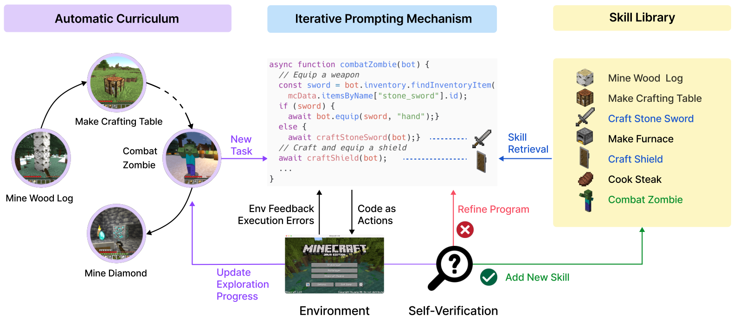
System Architecture Overview
Code Generation
VOYAGER uses an LLM to generate executable code, such as
async function combatZombie(bot), providing precise control.
This allows for complex, temporally extended behaviors.
Skill Integration
To solve new tasks, the system performs Skill Retrieval from
the library. For example, fighting a zombie requires
retrieving Craft Stone Sword and Craft Shield.
Continuous Improvement
The mechanism refines its code based on execution errors,
constantly improving the agent's programmatic capabilities.
Automatic
Curriculum
Feedback & Verification
Generated code operates directly in the Minecraft
Environment, producing immediate physical results.
The Self-Verification module evaluates these outcomes.
Error Correction
If a task fails (indicated by a Red X), the system uses
Env Feedback and errors to Refine Program logic.
Skill Mastery
Success (indicated by a Green Check) triggers the
Add New Skill process, storing the verified program
in the library for future reuse in similar situations.
Adaptive Curriculum
The system proposes tasks tailored to the agent's current
state, ensuring a smooth learning curve. It starts with
basics like Mine Wood Log and advances to Make Crafting Table.
Eventually, it assigns complex challenges like Combat Zombie
and Mine Diamond to maximize exploration diversity.

Slide 7
SECTION 02
Component 1:
Automatic Curriculum

Slide 8
Component 1: The Automatic Curriculum
GPT-4 suggests adaptive tasks
based on inventory and biome.
It teaches mining wood before
diamonds, ensuring a bottom-up
path to lifelong learning.

Slide 9
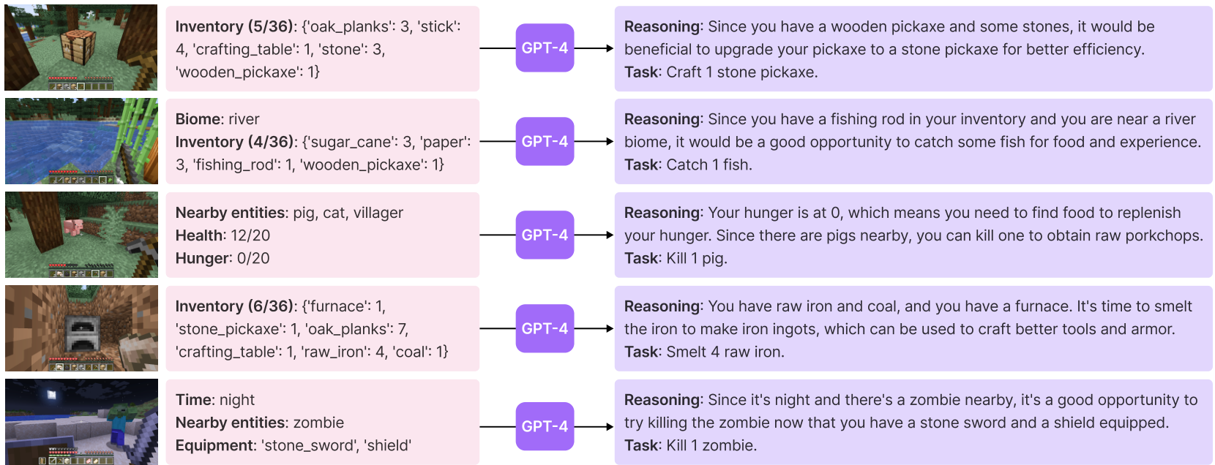
Curriculum Task Generation
Contextual
Goal
Generation
Cycle
How It Works
The system acts as an AI manager that constantly analyzes
the agent's surroundings. It reviews the inventory, nearby
entities, and biome data to propose logical next steps.
Adaptive Logic
Unlike static tutorials, this curriculum is dynamic. It
adapts to what the agent currently possesses, ensuring
tasks are challenging but always achievable.
Visual Examples
The diagram illustrates this logic. If the agent holds a
wooden pickaxe and stone, the AI suggests crafting a
stone pickaxe for better mining efficiency.
Survival Awareness
The AI prioritizes needs. When hunger is 0/20 and pigs
are nearby, it prompts hunting. If near a river with a
rod, it suggests catching fish.

Slide 10
Component 1: Automatic Curriculum
Smart
Data
Loading
Prevents
Info
Overload
0-15 Tasks
Warm-Up Strategy
Complex agents can fail if overwhelmed
by data. VOYAGER uses a warm-up
schedule to introduce information
gradually based on task completion.
Basic Skills (0-7 Tasks)
At 0 tasks, the agent only sees
essentials: core tools (axe,
pickaxe), nearby blocks, and its
current position. This simplifies
early decision making.
At 5 tasks, it begins to detect
nearby entities. By 7 tasks, it
gains access to its full inventory,
expanding its interaction options.
Advanced Learning
As the agent proves competence, more
context is revealed. At 10 tasks,
it learns about the specific Biome
and recalls blocks recently seen.
Full Mastery (15 Tasks)
The full system prompt is unlocked
after 15 completed tasks. This
includes critical survival metrics:
Health, Hunger, and Time.
This phased approach acts like a
tutorial, ensuring the agent masters
basics before managing complex states.

Slide 11
SECTION 03
Component 2:
The Skill Library

Slide 12
Component 2: The Skill Library
Building a Skill Library
Code as Memory
Voyager stores skills as executable code, not neural weights.
This acts like a digital notebook of successful actions that
can be read, executed, and edited by the agent at any time.
Solving Forgetfulness
Traditional AI suffers from catastrophic forgetting, erasing
old knowledge to learn new things. Voyager keeps everything.
Key-Value Storage
Skills are stored as pairs. The Value is the executable code,
while the Key is a description of what that code does.
Vector Indexing
Descriptions are converted into mathematical vectors. This
allows the AI to search by meaning (e.g., finding "combat"
skills when facing an enemy) rather than exact keyword matches.
Compositional Skills
Complex tasks are solved by combining simple ones. To make a
Diamond Pickaxe, Voyager chains Mine Wood and Smelt Iron.
This mimics how humans build expertise over time.
Temporal Extension
Code programs can represent actions that take time to finish,
like waiting for crops to grow or furnaces to smelt ore.
Context-Aware Retrieval
When the agent gets a new task (e.g., "Craft Iron Pickaxe"),
it compares the task description against its existing library.
Rapid Adaptation
It retrieves the top-5 relevant skills automatically. This
jumpstarts learning, as the agent doesn't start from scratch
but adapts existing programs to solve the new problem.

Slide 13
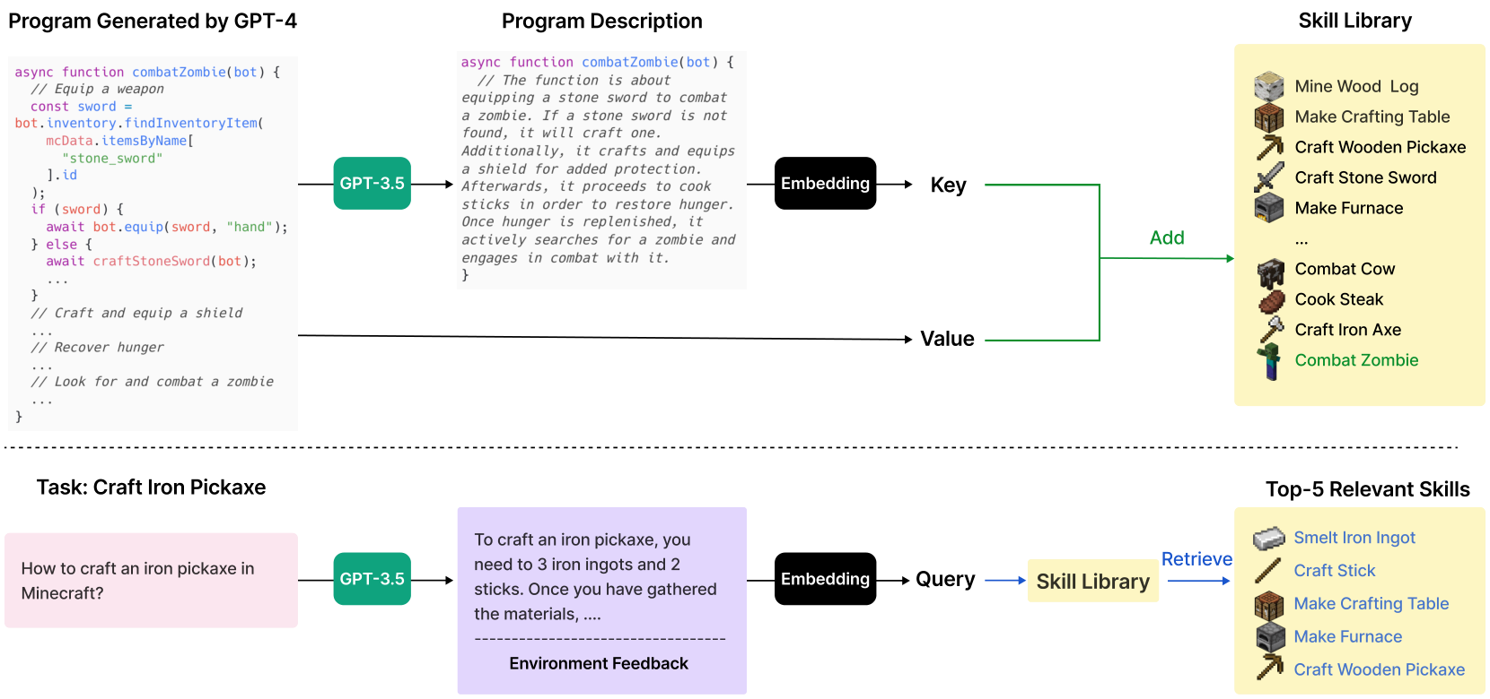
Component 2: The Skill Library
Skill Library
When learning a new skill like Combat Zombie,
GPT-4 writes the code. GPT-3.5 then creates a
summary describing the function, such as
"equip stone sword," to create a readable index.
This text description is embedded into a vector
to serve as the Key, while the code is the Value.
This pairing allows the system to store and
organize skills based on their meaning.
When faced with a task like Craft Iron Pickaxe,
the agent generates a query. GPT-3.5 suggests
steps (e.g., "need 3 iron ingots"), which are
embedded to search the library for help.
The database retrieves the Top-5 Relevant Skills
based on the query. For this task, it finds
useful prerequisites like Smelt Iron Ingot and
Make Furnace to assist code generation.

Slide 14
Component 2: The Skill Library
Why Code is Better Than Controls
The Limitation of Controls
Most embodied agents operate using low-level motor controls.
This requires outputting precise parameters like mouse coordinates
or joint angles for every single step. This is inefficient.
Imagine trying to build a house by defining every muscle
movement in your arm. This makes learning long-horizon tasks
extremely difficult because the search space is too vast.
Voyager's Code Approach
Voyager innovates by using executable code APIs as actions.
Instead of coordinates, it calls functions like mineBlock or
craftItem. This abstracts away the mechanical details.
This method leverages the vast knowledge of
Large Language Models,which are trained on code.
The agent acts at a semantic level,
issuing high-level commands just like a human player would.
Readable & Editable
A critical advantage is that code is inherently interpretable.
Humans can inspect the generated programs to understand exactly
why a specific action failed or succeeded during a task.
If a skill fails, the LLM can analyze the error message and
edit the code to fix it. This enables a self-correcting cycle.
Black-box neural networks cannot offer this level of clarity.
Handling Complexity
Programs can naturally represent temporally extended actions.
Code structures like conditions (if/else) and loops allow
the agent to handle complex logic and decision-making.
For example: "While inventory is full,
deposit items into chest."
This "compositionality" allows simple skills to be combined
into sophisticated behaviors needed for open-ended worlds.

Slide 15
SECTION 04
Component 3:
Iterative Prompting
VOYAGER: An Open-Ended Embodied Agent with Large Language Models

Slide 16
Component 3: Iterative Prompting
The Coding
Challenge
The One-Shot Problem
LLMs often produce buggy code on the first try.
Without running it, they cannot catch syntax
errors or logic flaws preventing task success.
Self-Correction Loop
Voyager executes the code in the game. It
observes the outcome and uses that real-world
feedback to refine the script iteratively.
Multimodal Feedback
It learns from execution errors, game data like
inventory counts, and a self-verification agent
that acts as a critic to confirm success.

Slide 17
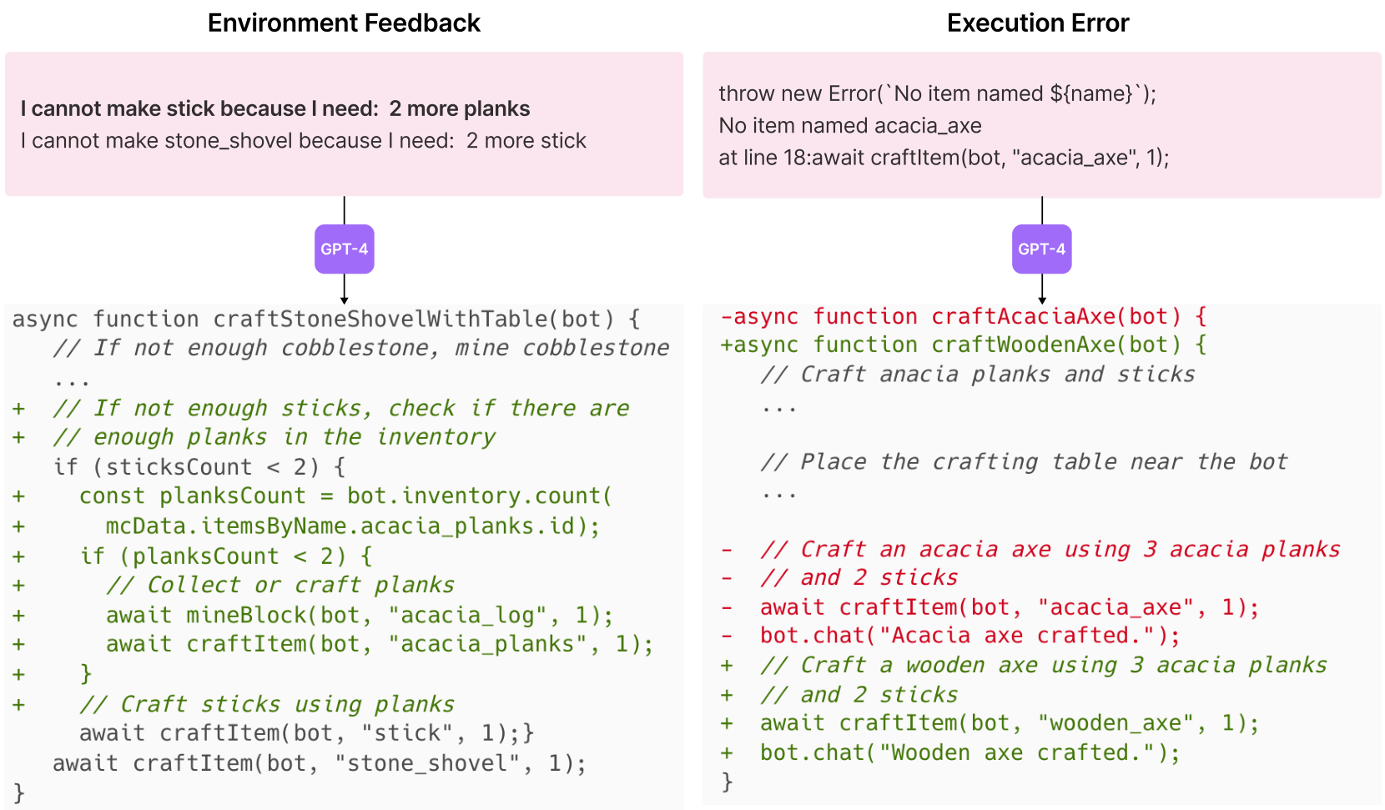
Component 3: Iterative Prompting
Environment
Feedback
Learning from Errors
The agent reads errors directly, like the
"need: 2 more planks" message shown above.
Self-Correction
It also catches bugs. In the visual, it
sees "No item named acacia_axe" and
rewrites code to use "wooden_axe" instead.

Slide 18
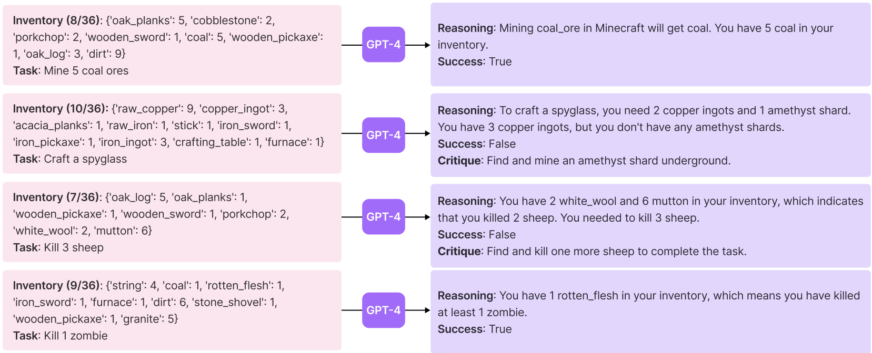
Component 3: Iterative Prompting
The Critic Agent
The Critic Role
A separate GPT-4 instance reviews
the agent's inventory. It acts as a judge
to verify if the goal was actually met.
Verifying Success
For Mine 5 coal ores, it finds
5 coal in the inventory. It confirms
the goal is met with Success: True.
Detecting Failure
For Craft a spyglass, it sees
copper but no amethyst shards.
It outputs Success: False.
Actionable Feedback
It gives a fix: Find and mine an
amethyst shard. This critique
helps the agent learn and self-correct.

Slide 19
Component 3: Iterative Prompting
The Iterative
Improvement Loop
Mechanism Overview
VOYAGER writes computer code to solve open-ended tasks.
Instead of guessing, it executes the code in the game
to see real results. If the attempt fails, the system
analyzes the error messages to understand the mistake.
This feedback loop allows it to refine its approach
iteratively, just like a human programmer debugging
software until it works perfectly. This process transforms
static code generation into dynamic, embodied learning.
Feedback Sources
The agent relies on two distinct types of error data.
Environment Feedback explains game constraints, such
as needing "2 more planks" to craft a specific tool.
It acts as a guide for missing resources. Meanwhile,
Execution Errors catch technical bugs, like trying
to use an invalid item name (e.g., "acacia_axe").
This precise technical feedback ensures the next
code attempt fixes the exact problem encountered.
The Role of the Critic
A separate AI agent acts as a dedicated Self-Verification
critic. It objectively checks if the task was actually
completed successfully by analyzing the agent's state.
If the task fails, the critic provides suggestions
for improvement. Once a skill is verified as correct,
it is saved to the Skill Library. This allows VOYAGER
to recall complex behaviors later, building a massive
repertoire of capabilities without relearning them.

Slide 20
SECTION 05
Performance and Results
VOYAGER: An Open-Ended Embodied Agent with Large Language Models

Slide 21
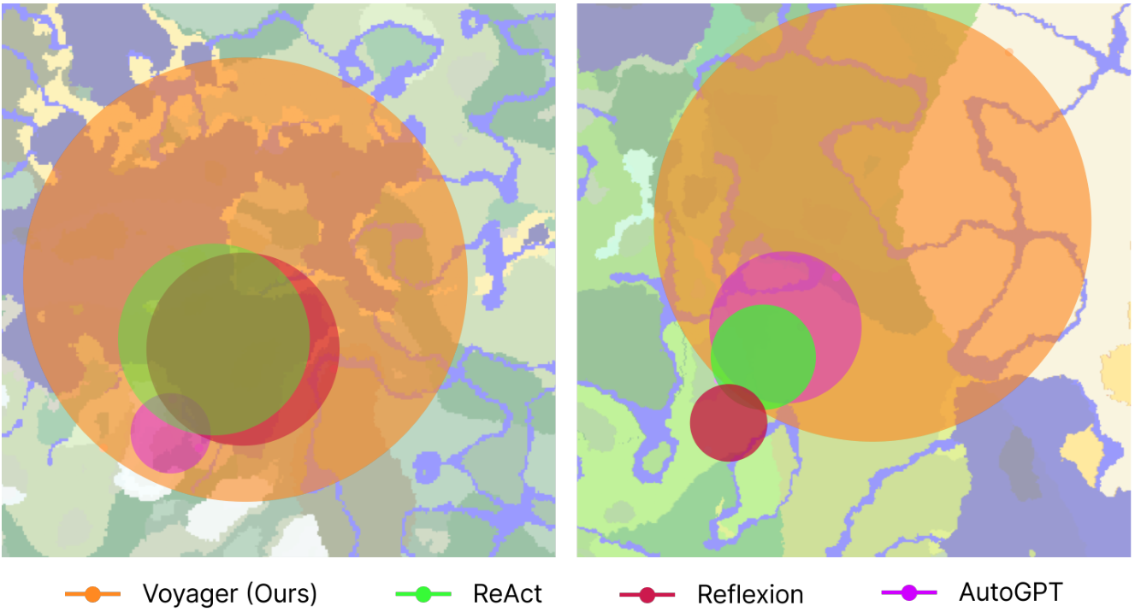
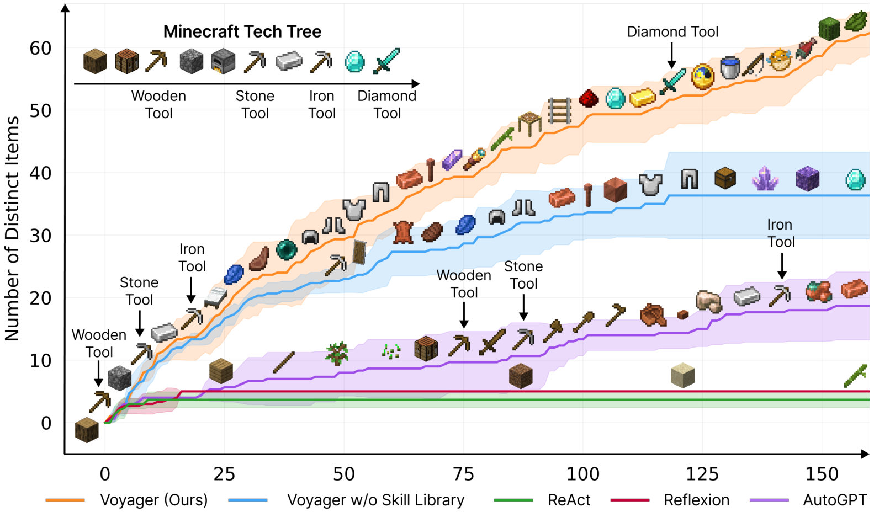
Performance and Results
Exploration and
Discovery
Superior Growth
Voyager finds 63
unique items in
160 iterations.
Baseline Limits
AutoGPT plateaus
at 22 items.
ReAct fails early.
Map Coverage
Voyager travels 2.3x
longer distances.
It traverses diverse
terrains while others
remain stuck locally.
Tech Tree Speed
Unlocks Diamond
tools 15.3x faster.
Only Voyager
completes the
full tech tree.

Slide 22
Performance and Results
Mastering the
Tech Tree
The Tech Tree Challenge
The "Tech Tree" tests an agent's ability to
craft tools in order: Wood, Stone, Iron,
and Diamond. This requires complex skills.
Unprecedented Success
Voyager is the only AI agent to unlock the
Diamond Tool level, proving its
superior systematic planning capabilities.
Speed Comparisons
Versus AutoGPT, Voyager unlocks Wooden
Tools 15.3x faster, Stone Tools
8.5x faster, and Iron 6.4x faster.
Baseline Limitations
Standard models like ReAct and Reflexion
failed to unlock any tools in the tests.

Slide 23
Performance and Results
Map Traversal and
Coverage
Superior Navigation
Voyager successfully travels 2.3x longer
distances than standard AI baselines. Unlike
older models that get stuck in small loops,
it moves continuously to explore new areas.
Diverse Terrain
The visual map shows the agent's path across
complex landscapes. It traverses diverse
terrains like oceans and mountains, while
other agents remain confined to limited local
regions, effectively trapping them.
Discovery Impact
Wide exploration is critical for acquiring
new knowledge. By covering more ground, the
agent discovers distinct items and resources
that static agents miss. This leads to
better long-term performance.

Slide 24
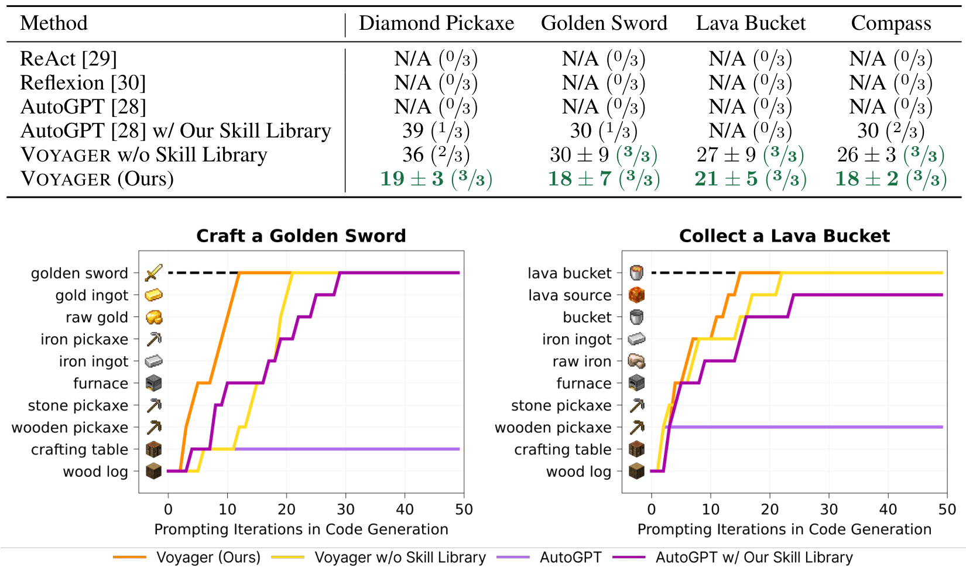
Performance and Results
Zero-Shot
Generalization
Experimental Results
Voyager solves 100% of tasks (3/3 trials).
Baselines (ReAct, AutoGPT) fail (0/3).
Visual Analysis
The orange line (Voyager) is the fastest.
It crafts a Golden Sword in ~18 steps.
Skill Library
Library acts as a plug-and-play tool.

Slide 25
SECTION 06
Analysis and Future Outlook
VOYAGER: An Open-Ended Embodied Agent with Large Language Models

Slide 26
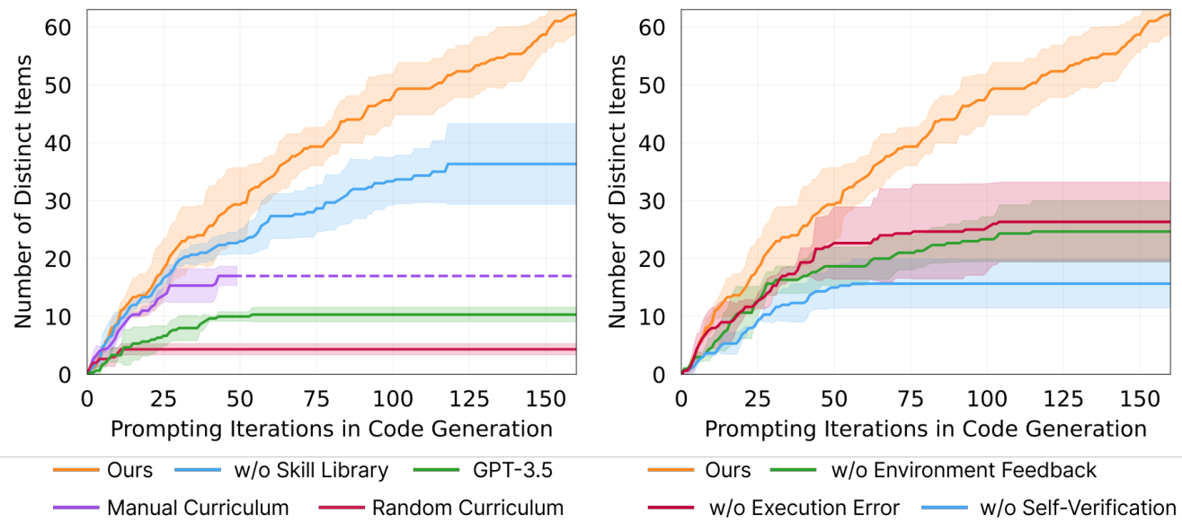
Analysis and Future Outlook
Critical Feedback Loop
The agent relies on three distinct feedback mechanisms.
Self-Verification is Key
This is the most vital component. Removing it causes a
massive 73% drop in discovery, capping at ~16 items.
It acts as a judge, deciding when a task is truly complete.
Other Mechanisms
Removing Environment Feedback or Execution Error handling
also hurts performance, capping results at ~26 items.
The full system achieves ~58 items by using all signals.
Curriculum &
Skill Library
Model Performance
The underlying LLM capability limits the agent's potential.
GPT-4 Superiority
GPT-4 significantly outperforms GPT-3.5 in coding tasks.
It discovers 5.7x more unique items over the same period.
While GPT-3.5 plateaus at ~10 items, GPT-4 continues
to learn, reaching nearly 60 items in the simulation.
Code Generation
Better coding allows the agent to solve complex tasks
that simpler models fail to comprehend or execute.
Automatic Curriculum
Replacing it with a random one causes a 93% drop in items.
Skill Library Importance
Removing the library causes learning to plateau early.
Agents stall at ~36 items, failing to reach the full ~58.

Slide 27
Analysis and Future Outlook
Learning from
Human Feedback
While Voyager currently operates on text alone,
it can integrate human input to build complex
3D structures. This capability bridges the gap
until future multimodal models arrive.
Humans act as a visual critic, correcting
mistakes just like the agent's internal checks.
They fix spatial errors in 3D designs that
the text-only agent cannot see or perceive.
Humans also serve as a curriculum guide by
breaking hard tasks into easy steps. This
method successfully built a Nether Portal
and a detailed House within the game.

Slide 28
Analysis and Future Outlook
Limitations and
Future Work
High Operating Costs
VOYAGER relies on GPT-4, which is
15x more expensive than GPT-3.5.
This cost is necessary for high-
quality code generation.
AI Hallucinations
The agent may invent impossible
items like a 'copper sword'. It also
misuses cobblestone as fuel.
System Inaccuracies
Self-checks can fail. The agent
might not recognize spider string
as proof of victory, causing it
to get stuck in a loop.
Future Outlook
Researchers aim to fine-tune
open-source LLMs to lower costs
and fix specific game errors.

