Slide 1
NVIDIA, Caltech, UT Austin, Stanford, UW Madison
October 2023
VOYAGER: An Autonomous
AI Agent in Minecraft
An Open-Ended Embodied Agent
with Large Language Models

Slide 2
Table of
Contents
Introduction: Quest for Lifelong Learning AI
03
How VOYAGER Works: System Architecture
08
Component 1: The Automatic Curriculum
12
Component 2: The Skill Library
18
Component 3: Iterative Prompting Mechanism
24
Performance and Results
30
Generalization and Ablation
38
Conclusion and Future Outlook
43

Slide 3
SECTION 01
Introduction
The Quest for Lifelong Learning AI

Slide 4
Introduction: The Quest for Lifelong Learning AI
The Challenge of
Embodied AI
Defining Embodied AI
Embodied agents control physical or virtual bodies, like
robots or game characters. They must interact with complex
environments rather than just processing static text data.
The "Forgetting" Problem
A major challenge is creating lifelong learners. Most
current AI cannot carry knowledge forward. It fails to
accumulate skills over time, struggling to generalize
past lessons to new, unforeseen situations.
Why Use Minecraft?
Minecraft imposes no fixed storyline, offering a unique
playground with endless possibilities. Agents must
navigate procedurally generated 3D terrains and unlock
technology trees using gathered resources.
The Human Learning Curve
Humans learn progressively. Beginners start by mining wood
and cooking food before advancing to complex tasks like
crafting diamond tools or combat.
The Goal: Self-Improvement
An effective agent should propose suitable tasks based on
its current level. It must refine skills based on feedback
and commit mastered behaviors to memory for future reuse.
Introducing VOYAGER
VOYAGER is the first agent to use code as action. It uses
an automatic curriculum to maximize exploration and
builds a permanent skill library without human help.

Slide 5
Introduction: The Quest for Lifelong Learning AI
Why Minecraft
Is The Perfect
Testing Ground
Limitless Potential
Most AI research uses simple games like Chess or Atari that
have fixed rules. Minecraft differs by offering an endless,
procedurally generated world with no predefined story or
fixed end goal. Instead, the agent faces a unique 3D
landscape every time, requiring it to understand physics
and geometry. This lack of structure creates a massive
complexity gap compared to traditional tests. The AI
cannot just react; it must demonstrate general intelligence
by setting its own meaningful goals and exploring vast
terrains to discover its purpose.
The Technology Tree
Minecraft requires unlocking a hierarchical system of
discovery known as a tech tree. An agent cannot simply
jump to end-game content. It must first gather basic
resources, like wood, to craft primitive tools. These
wooden tools allow it to mine stone, which unlocks
furnaces and iron tools. This progression mimics human
civilization, requiring long-term planning and logical
reasoning. The agent must manage its inventory and
understand that tool A is needed to acquire resource B,
creating complex dependency chains.
Autonomous Learning
To master this open world, an AI must operate like a
lifelong human learner. It needs to propose tasks that
are suitable for its current state, such as learning to
harvest sand before attempting to battle monsters.
Crucially, it must refine skills based on feedback.
If an attempt fails, it must analyze the error and try
a new approach. Successful behaviors are stored in a
memory library for future use. Finally, the agent must
continually explore the world, seeking out novel
challenges without human intervention or guidance.

Slide 6
Introduction: The Quest for Lifelong Learning AI
VOYAGER: The First
Lifelong Learning
Agent in Minecraft
Autonomous Discovery
VOYAGER is the first LLM-powered embodied agent that learns
continuously. Unlike standard bots that follow fixed rules,
it writes executable computer code to perform complex actions.
It explores the world, unlocks technologies, and gathers
resources entirely on its own without human intervention.
This code-based approach allows it to reason and plan
over long periods, bypassing model fine-tuning needs.
Three Core Modules
The system relies on three distinct components to function:
1. Automatic Curriculum: Proposes progressively harder tasks
based on the agent's current exploration state.
2. Skill Library: Stores complex behaviors as code for
future reuse (e.g., fighting spiders or mining iron).
3. Iterative Prompting: Uses GPT-4 to refine code based
on execution errors and environmental feedback.
Superior Performance
VOYAGER significantly outperforms prior state-of-the-art
agents like AutoGPT, ReAct, and Reflexion in testing.
- Unlocks 3.3x more unique items on the tech tree.
- Travels 2.3x longer distances during exploration.
- Achieves key milestones up to 15.3x faster.
While other agents stall at stone tools, VOYAGER unlocks
diamond technology and generalizes to new worlds.

Slide 7
Introduction: The Quest for Lifelong Learning AI
The Concept
of 'Code
as Action'
Traditional Limits
Old AI uses primitive actions like mouse
clicks. This makes long tasks hard to manage.
VOYAGER's Innovation
VOYAGER uses executable code as actions.
It writes Python functions like mine_log() to
perform complex behaviors automatically.
Why Code Works
Code handles long-term tasks naturally.
One function represents minutes of key
presses, making exploration efficient.
Skill Composition
Code allows combining skills. VOYAGER
mixes simple moves into complex scripts,
mimicking how humans learn and play.

Slide 8
SECTION 02
How VOYAGER Works:
System Architecture
VOYAGER: An Autonomous AI Agent in Minecraft

Slide 9
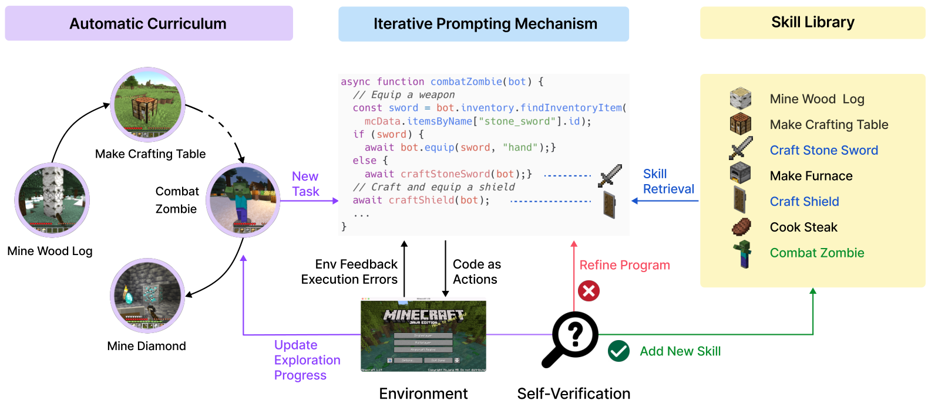
Visualizing the VOYAGER System
Skill Archive
Saves success
for future use
in new tasks.
1. Automated Curriculum
The system proposes tasks like Mine Diamond based on
exploration progress, ensuring tasks are challenging
but achievable, maximizing discovery in the open world.
2. Coding & Retrieval
To solve tasks, the Iterative Prompting Mechanism
writes code. It uses Skill Retrieval to access the
Skill Library, reusing tools like Craft Stone Sword.
3. Execution & Learning
Code runs in the Environment. Self-Verification checks
results. Errors trigger Refine Program updates, while
success triggers Add New Skill to save the program.

Slide 10
How VOYAGER Works: System Architecture
1. Automatic
Curriculum
2. Skill
Library
3. Iterative
Prompting
Automatic Curriculum
The curriculum acts as an exploration
manager. It analyzes the agent's state
to propose suitable open-ended tasks.
It ensures the agent learns basics like
mining wood before complex goals like
crafting diamond tools.
Skill Library
This database stores mastered behaviors
as executable code. When VOYAGER solves
a task, it saves the action program to
memory. This allows it to retrieve and
reuse complex skills, like combat,
without relearning them from scratch.
Iterative Prompting
This mechanism serves as the execution
engine. It writes code to control the
agent's actions. If code fails, it uses
error messages and feedback to self-
correct and refine the program until
the specific task is successfully done.
Catastrophic Forgetting
Traditional AI often forgets old skills
when learning new ones. VOYAGER avoids
this by storing skills as compositional
code. This builds a permanent, growing
toolkit of capabilities over time.

Slide 11
How VOYAGER Works: System Architecture
The Learning Loop
Step 1: Automatic Curriculum
To explore the open world, the agent needs a plan. The
automatic curriculum acts as a teacher, proposing
suitable tasks based on the agent's current state.
Smart Task Generation
It uses GPT-4's knowledge to suggest goals like
"Mine Diamond" only after basic skills are mastered.
This approach fosters curiosity and maximizes exploration
progress without requiring human intervention.
Step 2: Coding & Action
The agent uses an iterative prompting mechanism to
generate code actions. Instead of simple motor commands, it
writes executable programs that represent complex actions.
Step 3: Feedback Loop
The environment provides immediate feedback. If execution
fails, the agent reads the error trace and refines its
code to try again. This cycle repeats until self-verification
confirms the task is successfully completed.
Step 4: Skill Library
Once a task is successfully completed, the working code is
saved to the skill library. This acts as a long-term
memory, allowing the agent to retrieve behaviors like
"Craft Stone Sword" in similar future situations.
Lifelong Learning
Complex skills are synthesized by composing programs.
VOYAGER reuses these skills to solve harder tasks, building
a growing database of abilities like a human player would.

Slide 12
SECTION 03
Component 1: The Automatic Curriculum
Maximizing open-ended exploration and discovery.

Slide 13
Component 1: The Automatic Curriculum
Solving the
Exploration
Problem
The Open-Ended Challenge
In games like Minecraft, there is no fixed plot or end goal.
A standard AI agent often wanders aimlessly because it
lacks intrinsic motivation to learn complex skills.
Why Traditional AI Fails
Random exploration is inefficient in vast 3D worlds. Hard-
coded goals are too rigid to adapt to procedural terrain.
Agents need to propose their own tasks to succeed.
GPT-4 Powered Curriculum
Voyager uses GPT-4 to act as a mentor. It analyzes the
agent's state (inventory, health, location) to propose
tasks tailored to its current needs.
Adaptive Learning Path
Instead of a fixed list, the curriculum is "bottom-up."
It adapts in real-time. If an agent finds a desert, it
learns to harvest cactus rather than trees.
Context-Aware Reasoning
The agent creates logical goals based on its situation.
Real-World Examples
If it holds a wooden pickaxe, it suggests crafting a
stone pickaxe for better efficiency.
If it is night with a zombie nearby, the goal becomes
"Kill 1 zombie" to survive.
If hunger is low (0/20), it prioritizes hunting food.

Slide 14
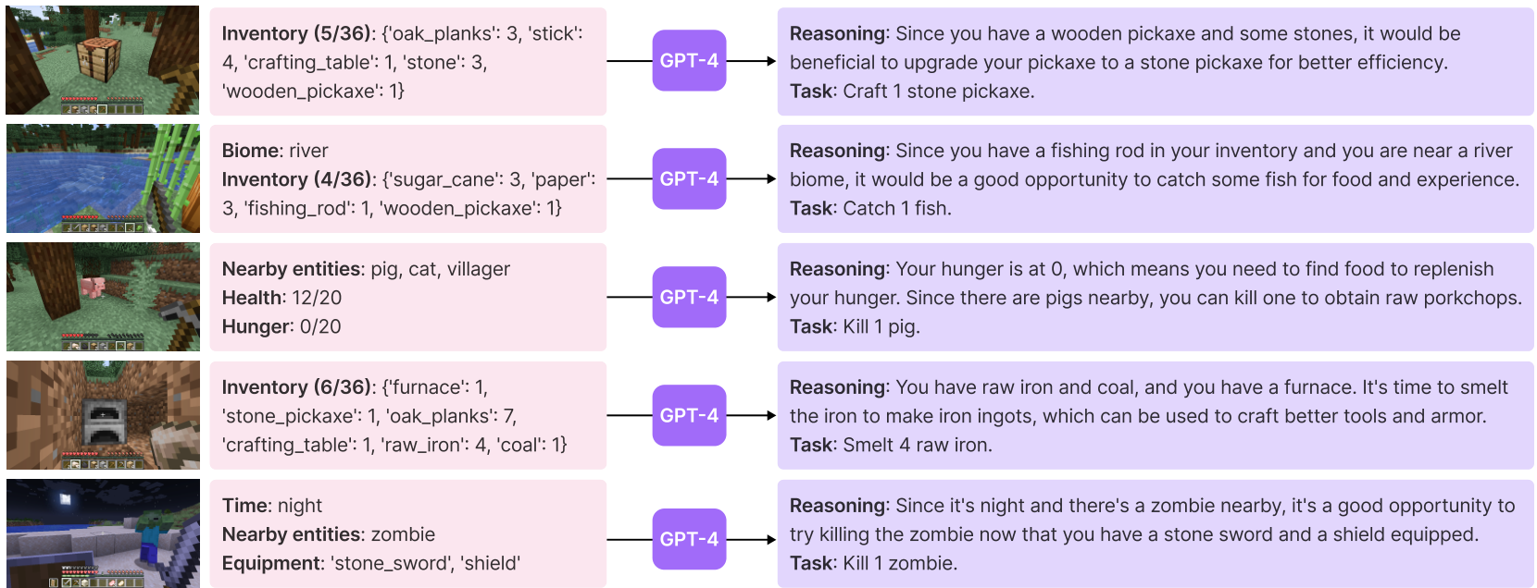
How GPT-4 Proposes Context-Aware Tasks
Agent Reasoning
The agent detects Biome: river and a
fishing_rod in its inventory. GPT-4 infers
fishing provides food, proposing the context-
aware task to Catch 1 fish for experience.
Critical stats like Hunger: 0/20 trigger
survival needs. Since there are pigs nearby,
the system plans to obtain raw porkchops
and outputs the objective: Kill 1 pig.
The agent analyzes inventory like raw_iron
and coal. Recognizing a furnace is
available, it suggests Smelt 4 raw iron
to make ingots for better tools and armor.
Sensing Time: night and a nearby zombie,
the agent checks its stone_sword. GPT-4
identifies a safe chance to reduce threats
and outputs the task: Kill 1 zombie.

Slide 15
Component 1: The Automatic Curriculum
Bottom-Up
Learning
Strategy
Core Philosophy
Just like humans learn to walk before they can run,
Voyager adopts a progressive learning style.
It avoids overwhelming the agent with impossible goals.
How It Works
The system suggests easy tasks first, such as
gathering basic resources. As the agent builds skills,
the curriculum unlocks harder challenges like
crafting complex tools or exploring dangerous caves.
Context Awareness
The curriculum is not a rigid list of steps. It adapts
dynamically to the agent's current state and
surroundings in real-time.
Environmental Logic
If Voyager finds itself in a desert, it prioritizes
desert-specific tasks like harvesting cactus
rather than looking for forest trees. It uses common
sense to match goals with available resources.
Inventory-Based Decisions
Voyager checks its backpack to decide what to do next.
If it holds a wooden pickaxe and stone, it
proposes crafting a stronger stone pickaxe.
Survival Instincts
The agent responds to vital needs logically.
If hunger is high and pigs are nearby, the task
becomes "Kill 1 pig" for food. If it is night
with a zombie nearby, it prepares for combat.

Slide 16
Component 1: The Automatic Curriculum
Curriculum
Prompting
Strategy
Core Directives
The AI receives specific orders to guide its exploration.
Diversity Goal
It is told to discover diverse things to expand knowledge.
Safety Constraints
To prevent failure, tasks must not be too hard.
The agent verifies it has the resources to succeed.
Situational Awareness
The prompt includes the agent's current state.
This covers health, hunger, inventory, and nearby blocks.
Task History
The system tracks successes and failures.
It remembers past errors to avoid repeating them.
This defines the agent's current capabilities.
Active Reasoning
The agent uses self-questioning to analyze context.
It generates Q&A pairs about its surroundings.
Resource Management
We use GPT-3.5 for this context gathering.
This is cheaper than using GPT-4 for simple tasks.

Slide 17
Component 1: The Automatic Curriculum
Warm-Up Schedule
The "Warm-Up" Concept
VOYAGER mimics human learning by starting
simply. A novice player would be confused
by every stats bar appearing at once. This
curriculum hides complex information
initially, revealing it only after the
agent proves competence by finishing
tasks. This prevents early failure.
Phase 1: Basic Skills (0 Tasks)
At the start (0 tasks), the agent enters
a restricted mode. It cannot see its
health or hunger yet. It only sees a
core inventory of wood, stone, and
basic tools. It knows its position
and nearby blocks to navigate, but
ignores distractions to focus on basics.
Phase 2: Exploration (5-7 Tasks)
Complexity increases as skills improve.
After 5 tasks, the agent perceives
nearby entities—learning to interact
with animals or mobs. After 7 tasks,
the filter lifts on its backpack,
revealing the full inventory. This allows
it to manage diverse resources.
Phase 3: Survival (10-15 Tasks)
The final stage introduces pressure.
At 10 tasks, the agent learns about
its biome. At 15 tasks, critical
status bars appear: health, hunger,
and time. Now proficient, the agent
must balance completing tasks with
staying alive and fed.

Slide 18
SECTION 04
Component 2:
The Skill Library
VOYAGER: An Autonomous AI Agent in Minecraft

Slide 19
Component 2: The Skill Library
Building a Database of Skills
The Agent's Long-Term Memory
Imagine playing a complex game but forgetting the controls
every day. To prevent this, Voyager builds a Skill Library.
This database acts as a permanent memory bank for the AI.
It stores successful actions as reusable computer programs.
This allows the agent to master basic tasks like mining wood
once and recall them forever without re-learning.
Saving Success as Code
Whenever Voyager successfully completes a new task, it saves
the solution. The executable code is the "value" stored.
To organize this library, a separate AI (GPT-3.5) writes a
short description of the code, serving as the searchable "key."
For example, code for fighting is tagged with Combat Zombie.
This structured indexing makes future lookups instant.
Smart Skill Retrieval
When facing a complex challenge like Craft Iron Pickaxe,
the agent doesn't guess randomly. It queries its library.
It searches for "relevant" past skills that might help.
The system retrieves the top-5 relevant skills, such as
"Smelt Iron Ingot" or "Craft Stick" to build upon.
It ignores unrelated data like "Combat Zombie" for this task.
From Basics to Mastery
The library enables complex behaviors through composition.
Simple skills like "Make Crafting Table" become building blocks.
The agent is told to write generic and reusable code.
This means a function for fighting a zombie can be adapted
later to fight other monsters. This mirrors human learning,
where basic skills combine to solve difficult problems.

Slide 20
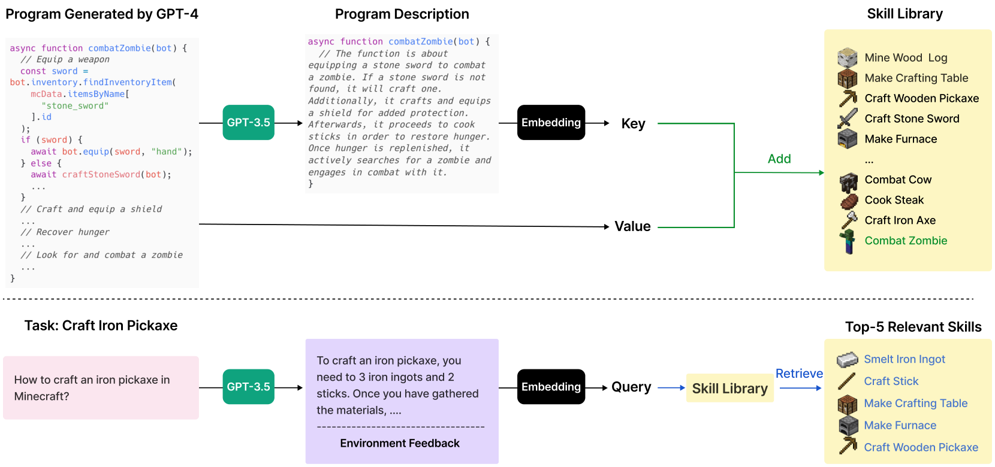
Component 2: The Skill Library
How New Skills
Are Added
The Storage Process
When Voyager creates a new tool, GPT-4 generates
the code, like the combatZombie function shown.
To file this away, GPT-3.5 describes what the code
does in plain text. This description becomes an
embedding vector, acting as the lookup Key.
The actual executable code is stored as the Value.
This pair is added to the Skill Library database.
For example, complex combat tactics are indexed by
their meaning, creating a growing memory bank that
the agent can search to solve future tasks.

Slide 21
Component 2: The Skill Library
Retrieving Skills for New Tasks
Formulating the Search
When given a task like Craft Iron Pickaxe, the agent
creates a search query describing necessary steps,
such as gathering materials or using specific tools.
Finding Relevant Skills
The system scans its library for the Top-5 most useful
past skills. It uses vector matching to identify
abilities that align with the current problem's needs.
Real-World Example
To craft an iron pickaxe, Voyager retrieves specific
learned skills: Make Furnace and Craft Stick.
Combining these simple actions solves the complex task.
When facing a new challenge, Voyager does
not start from scratch. It consults its
memory to find useful past experiences,
similar to how a human recalls basic
skills before attempting a complex job.

Slide 22
Component 2: The Skill Library
Skill Retrieval Accuracy Analysis
VOYAGER relies on a vast library of learned behaviors to solve
new challenges. The system's effectiveness depends entirely on
finding the correct piece of code when needed. Researchers
tested this retrieval system using 309 samples to measure
how often the AI could locate the exact skill required for a
given task from its growing database.
Primary Precision
The system achieved a Top-1 Accuracy of 80.2%. This means
that in four out of five cases, the very first suggestion from
the library was the correct one. This high baseline accuracy
reduces trial and error, allowing the agent to act efficiently
without wasting time searching through irrelevant code.
Reliability & Fallback
To ensure robustness, the system retrieves the top five
potential matches. When looking at this set, accuracy jumps to
96.5%. This indicates the correct solution is almost always
present within the agent's short list of options, effectively
eliminating retrieval failure as a bottleneck for learning.
Implications for Learning
This reliability allows VOYAGER to confidently combine old
skills to synthesize new, complex behaviors. The high retrieval
rate confirms that as the library grows larger, the agent
becomes more capable rather than overwhelmed. Reliable access
to past knowledge is the foundation of lifelong learning.

Slide 23
Component 2: The Skill Library
Skill Composition
in Action
VOYAGER improves by building a library of reusable computer
code. Just as a human programmer writes a function once and
calls it many times, this agent saves successful actions as
skills. For example, instead of writing 50 lines of complex
instructions to fight a zombie every single time, it simply
calls a skill named combatZombie(). This makes the agent
much faster and more efficient over time, as it stops
"reinventing the wheel" for common tasks.
In Minecraft, actions often require patience and time, such
as waiting for iron ore to smelt into ingots inside a
furnace. VOYAGER's skills are temporal, meaning the code is
smart enough to handle these waiting periods. The generated
programs include logic to coordinate sequences of events
that unfold over time. This allows the agent to perform
complex, multi-step behaviors—like gathering materials,
crafting tools, and cooking food—without getting confused.
A major advantage is that skills are stored as readable code.
Humans can examine the code to understand exactly what the
agent learned. When faced with a new task like crafting an
iron pickaxe, the agent queries its library. As shown in
the diagram, it retrieves the top-5 relevant skills—such as
"Smelt Iron Ingot" and "Craft Stick"—to build a solution
by combining past knowledge to solve new challenges.

Slide 24
SECTION 05
Component 3: Iterative
Prompting Mechanism
VOYAGER: An Autonomous AI Agent in Minecraft

Slide 25
Component 3: Iterative Prompting Mechanism
Why LLMs Need
a Feedback Loop
The Zero-Shot Problem
LLMs rarely write perfect code on the first try.
They often make syntax errors or invent
items that don't exist (hallucination).
VOYAGER's Solution
The system uses an iterative loop to fix
mistakes. It writes code, tests it, and uses
error messages to improve the next attempt.
Three Feedback Signals
The agent analyzes three specific inputs:
1. Environment Feedback: Game state
updates like missing items (e.g., need 2 planks).
2. Execution Errors: Python code bugs
caught by the interpreter (e.g., invalid syntax).
3. Self-Verification: A separate AI
critic acts as a judge to confirm task success.

Slide 26
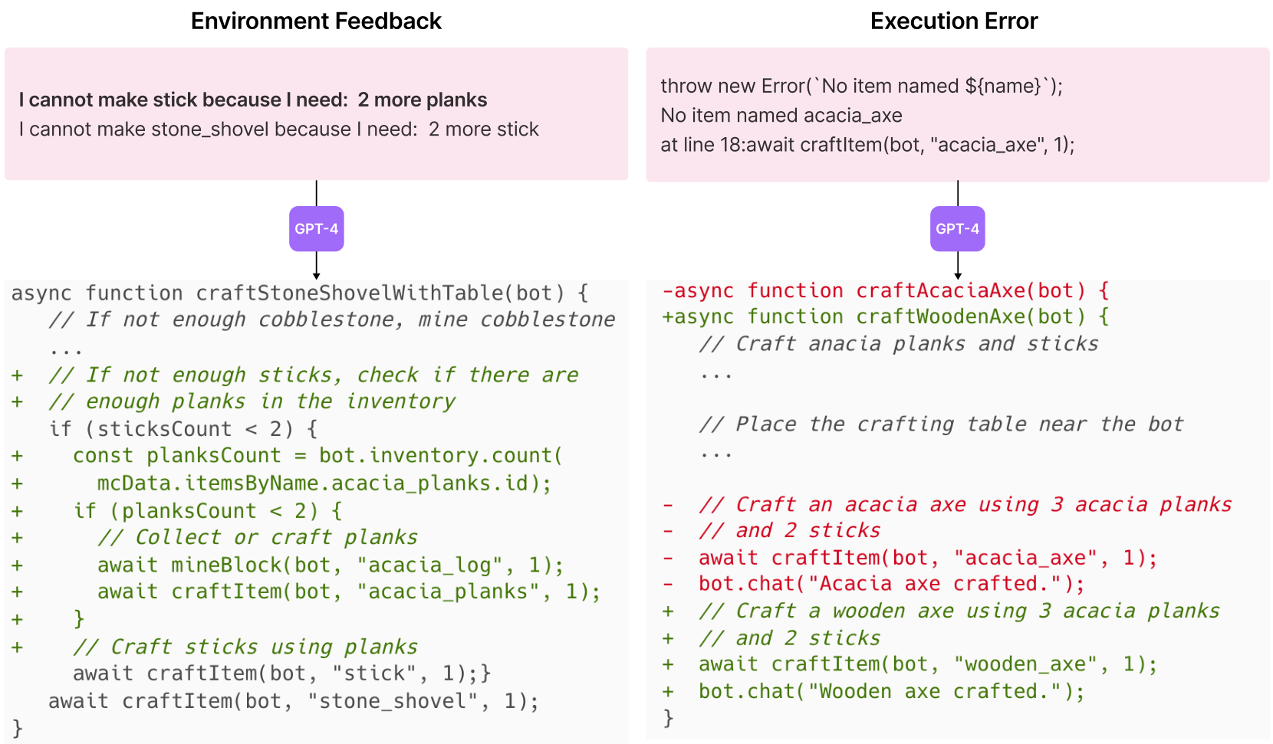
Component 3: Iterative Prompting Mechanism
Environment
Feedback
Core Concept
The environment acts as a teacher. It
explains why tasks fail, offering
specific details to guide the solution.
Visual Example
Figure 5 shows a failed attempt to
craft a stone shovel. The game warns:
"Need: 2 more stick". This exact
feedback guides the AI's next move.
Automated Solution
GPT-4 updates code to mine acacia logs
first, craft planks, and then create
the sticks needed for the shovel.

Slide 27
Component 3: Iterative Prompting Mechanism
Feedback Type 2:
Execution Errors
Defining Execution Errors
These are technical alerts from the program
interpreter. They identify invalid commands
or syntax flaws, acting like a spell-checker
that prevents broken code from running.
Scenario: The "Acacia Axe"
VOYAGER generates code to craft an acacia_axe.
The game engine rejects this, returning a
specific error log: "No item named
acacia_axe" because it does not exist.
Intelligent Debugging
The AI analyzes this feedback. It realizes
its mistake and rewrites the function to
craft a wooden_axe instead, fixing the bug.

Slide 28
Component 3: Iterative Prompting Mechanism
Feedback Type 3:
Self-Verification
A second GPT-4 'Critic'
verifies task success
instead of hard coding.

Slide 29
Component 3: Iterative Prompting Mechanism
Self-verification acts as
a quality control manager.
It provides critiques, like:
Find an amethyst shard.
This prevents the agent
from assuming false success.

Slide 30
SECTION 06
Performance and Results

Slide 31
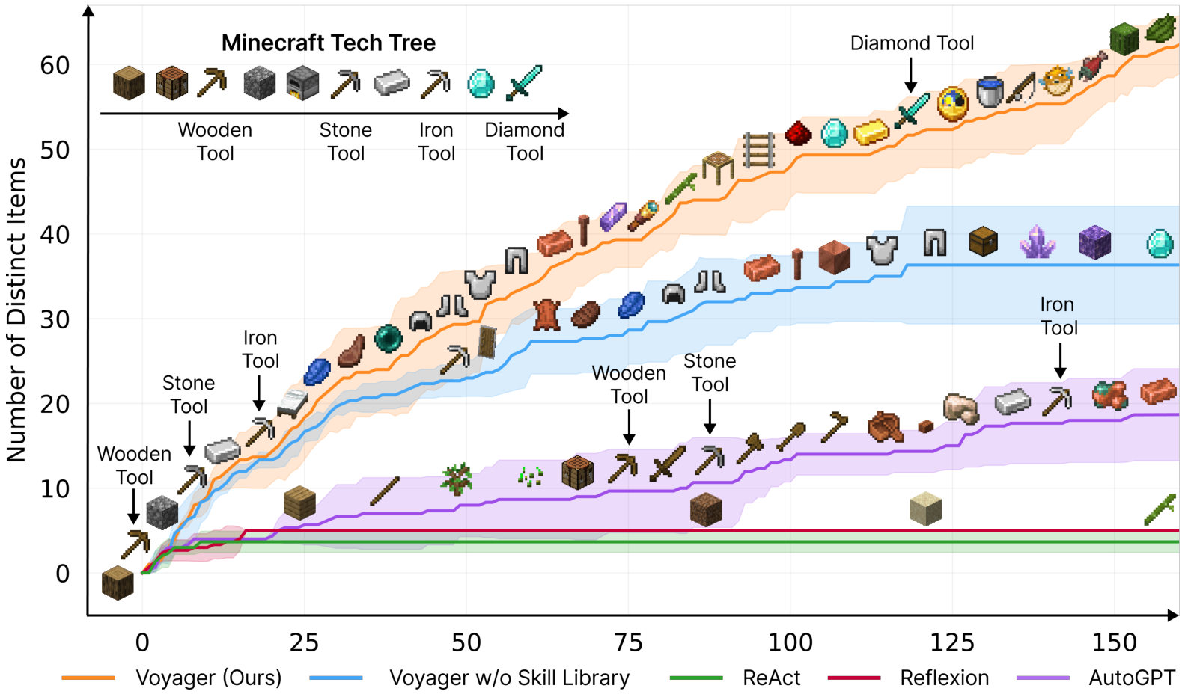
Performance and Results
Discovery
Curve
Visualizing Progress
The graph tracks Distinct Items found.
The X-axis shows time spent playing.
Voyager's Success
The orange line climbs steadily up.
It finds ~63 items and Diamond tools.
Baselines Struggle
AutoGPT (purple) halts at 18 items.
It lacks memory and gets stuck early.
The Skill Library
The blue line removes saved skills.
It plateaus at 37 items, showing that
saved skills are key to discovery.

Slide 32
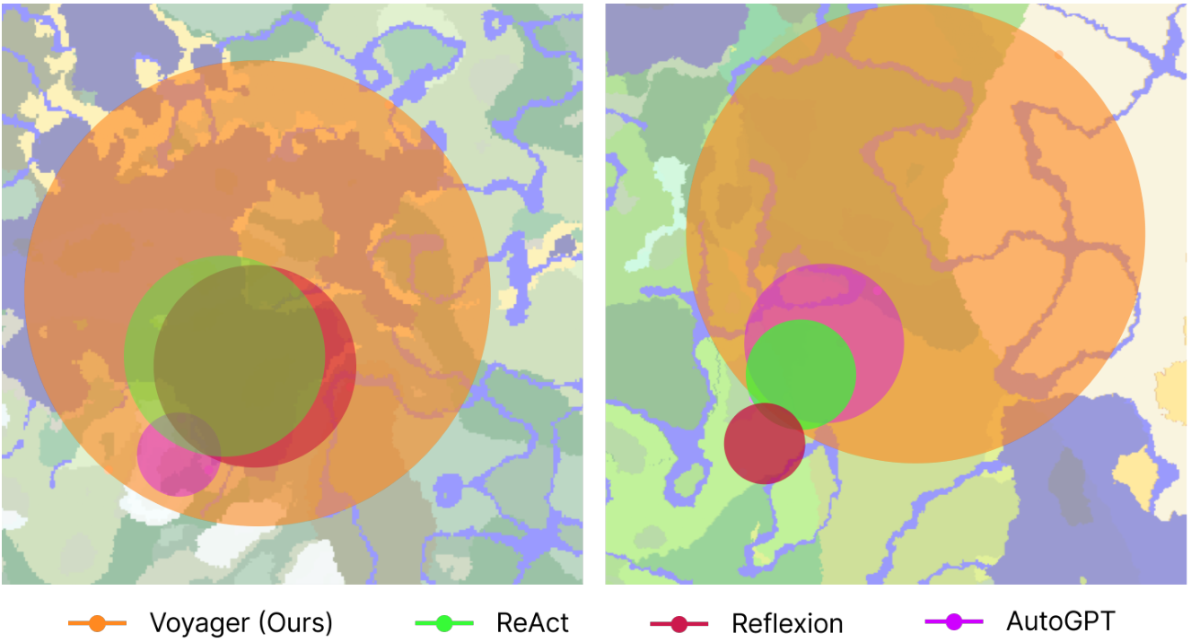
Performance and Results
Tech Tree
Mastery
Speed Multiplier: Voyager unlocks wooden tools
15.3x faster than the next best AI (AutoGPT).
It progresses to stone tools 8.5x faster and
reaches iron tools 6.4x faster.
Exclusive Mastery: Voyager is the only AI
capable of unlocking Diamond tools, the highest
tier. It succeeded in 102 steps, while all
other models failed to reach this level.
Map Coverage: The visual demonstrates area explored.
Voyager (orange) traverses 2.3x longer distances,
covering vast terrain. In contrast, models like
AutoGPT (magenta) remain stuck in small local areas.

Slide 33
Performance and Results
Map
Exploration
Capability
Why Range Matters
Finding advanced resources requires travel.
We measured how much of the world each
agent actually saw and mapped out.
The "Local Loop" Trap
Baselines (colored lines) get stuck. They
wander in small circles near their spawn
point, failing to find new knowledge.
Voyager's Success
Voyager (orange) moves with purpose. It
travels 2.3x longer distances, traversing
diverse terrains to master the game.

Slide 34
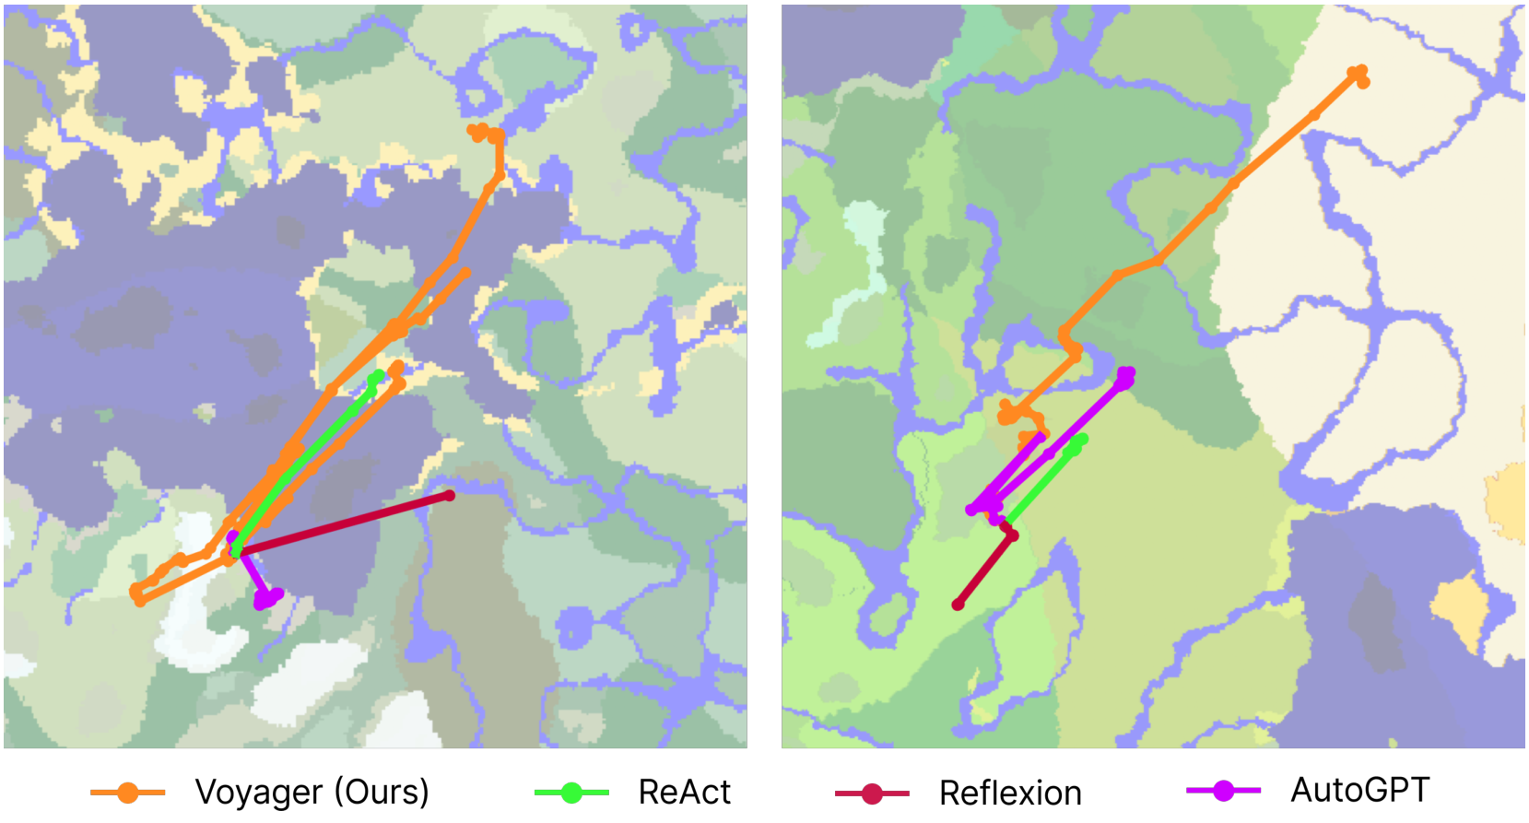
VOYAGER traverses 2.3x longer distances across diverse terrains.
2.3x Longer
Distances
The orange path reveals VOYAGER
navigating complex terrain.
It covers 2.3x more distance than
baselines (green/red) which
often get stuck in local loops.
This long-range travel allows
discovery of rare resources
hidden in distant biomes.

Slide 35
Performance and Results
Discovery Rate
Analysis
Unmatched Exploration
Voyager discovers 63 unique items in 160 turns.
This performance is 3.3x higher than previous
leading AI agents. While other methods quickly
plateau—meaning they stop finding new things—
Voyager maintains a steady, linear learning pace.
The Curriculum Advantage
Finding complex items requires a chain of skills.
Standard agents fail because they lack direction.
Voyager uses an automatic curriculum to guide
itself from basic tools to advanced discoveries,
ensuring it never gets stuck on hard tasks.

Slide 36
Performance and Results
Analyzed
Baseline
Agents
AutoGPT
ReAct
Reflexion
AutoGPT Limitations
AutoGPT automates tasks using GPT-4.
However, it lacks a skill library.
It cannot save code to reuse later,
causing it to get stuck in loops.
It also lacks self-verification,
so it cannot verify its own success.
ReAct Struggles
ReAct uses reasoning traces to plan
actions. This works for text, but
fails in 3D worlds without a guide.
Lacking a curriculum, it wanders
locally and cannot explore far.
Reflexion Flaws
Reflexion learns from execution errors
to improve. Yet, it fails to unlock
even basic tools in our tests.
Reflection is not enough for complex
tasks without structured learning.
Voyager's Success
Voyager combines skills, curriculum,
and iterative prompting to succeed.
It is the only agent to reach the
Diamond Tool level.
It also explores 2.3x further
than any baseline agent.

Slide 37
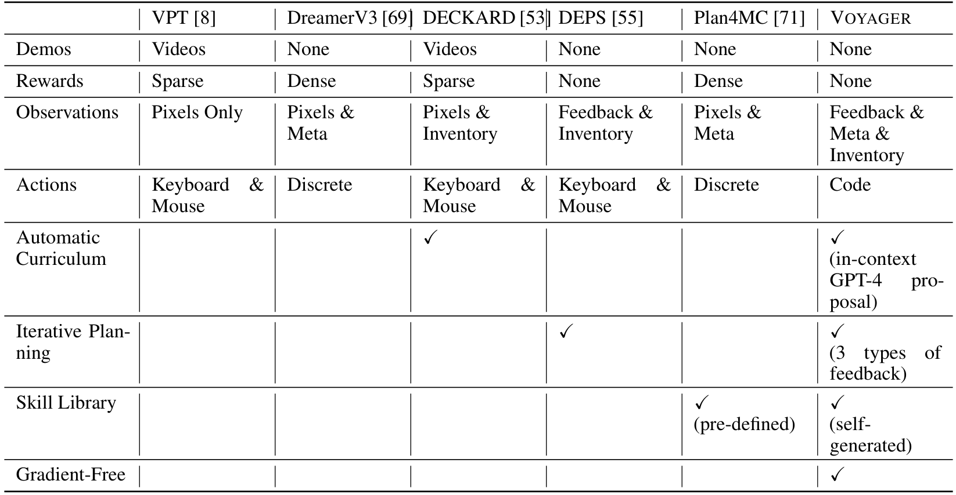
Comparison against five leading Minecraft AI agent architectures.
System-Level
Comparison
Training Efficiency
Traditional systems like VPT require human
videos. DreamerV3 relies on dense
rewards. VOYAGER needs neither. It is
completely gradient-free, meaning it
learns without the costly, slow process of
retraining neural network weights.
This allows for rapid, flexible adaptation.
Cognitive Architecture
VOYAGER is the only system with a self-generated skill library
that expands autonomously. Unlike Plan4MC which uses
pre-defined skills, VOYAGER employs an automatic curriculum
to propose its own tasks via GPT-4.

Slide 38
SECTION 07
Generalization
and Ablation
Evaluating Zero-Shot Performance and Component Impact

Slide 39
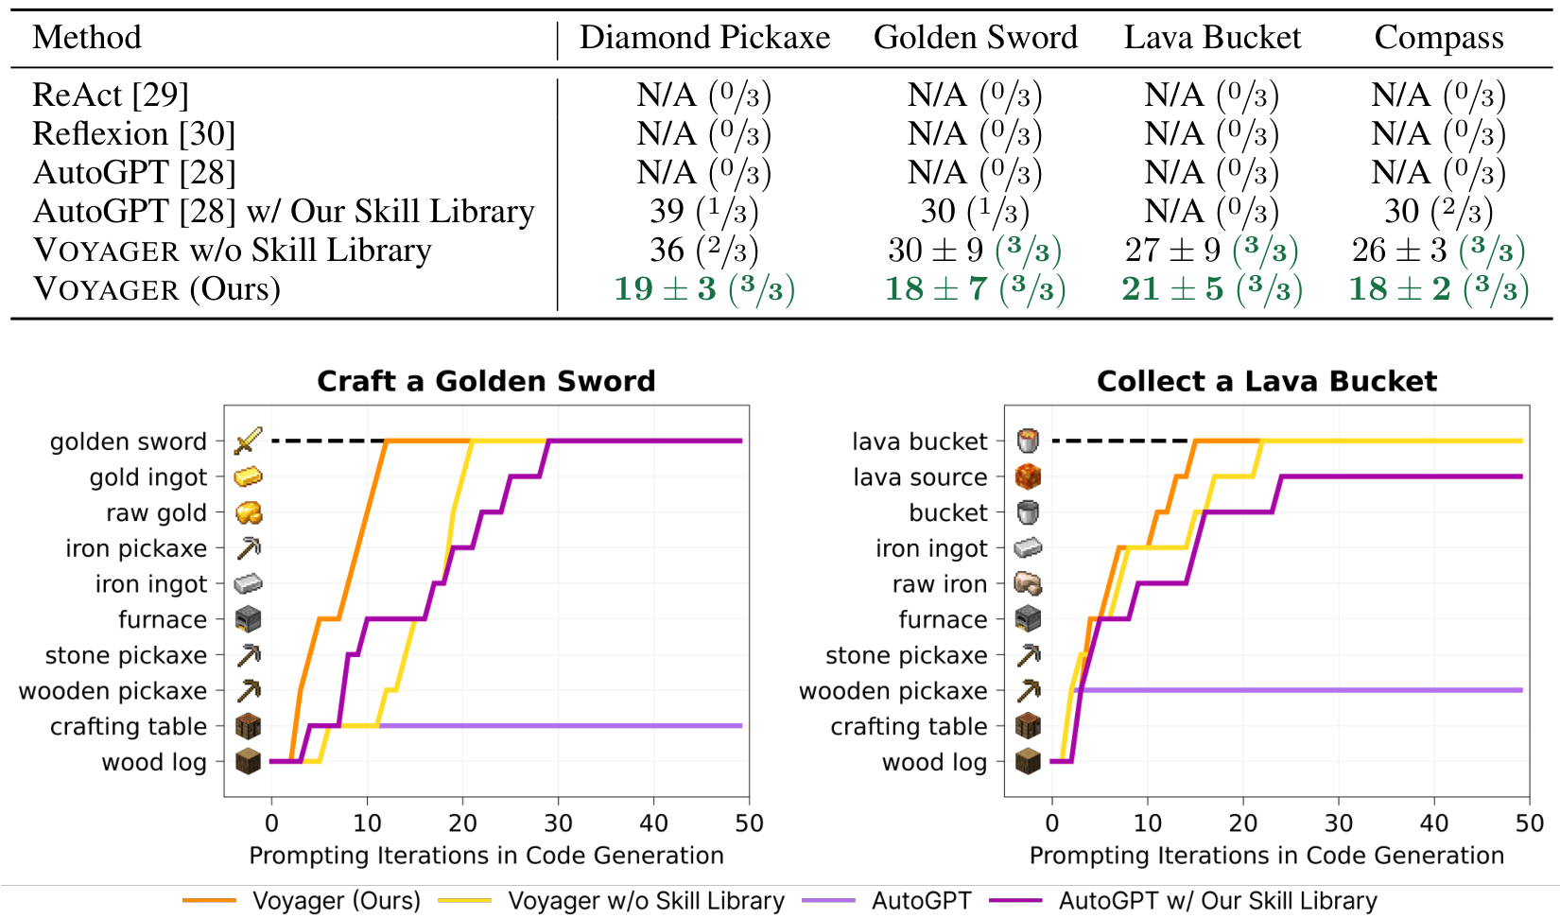
Generalization and Ablation
Zero-Shot
Generalization
Experimental Setup
We wipe the inventory and place the agent in a
fresh world. Baselines like ReAct fail (0/3),
unable to solve unseen tasks like crafting.
Superior Performance
VOYAGER achieves 100% success on all tasks.
It crafts a Diamond Pickaxe in ~19 steps,
while AutoGPT fails completely without help.
Visualizing Progress
Graphs show item acquisition. The orange line
(VOYAGER) climbs fast, solving the Lava Bucket
task in 15 iterations while baselines plateau early.

Slide 40
Generalization and Ablation
Visualizing
Skill Reuse
The graphs track progress on unseen tasks.
VOYAGER (Orange) rapidly climbs steps.
It moves from wood to stone to iron efficiently.
This speed shows it learns without practice.
The Skill Library acts as a shared memory.
It records how to craft items or fight.
This creates a plug-and-play asset.
New agents can reuse this code instantly.
Standard AutoGPT fails here (flat line).
But with VOYAGER's skills, it improves.
The Purple line proves this capability.
External models can use this library too.

Slide 41
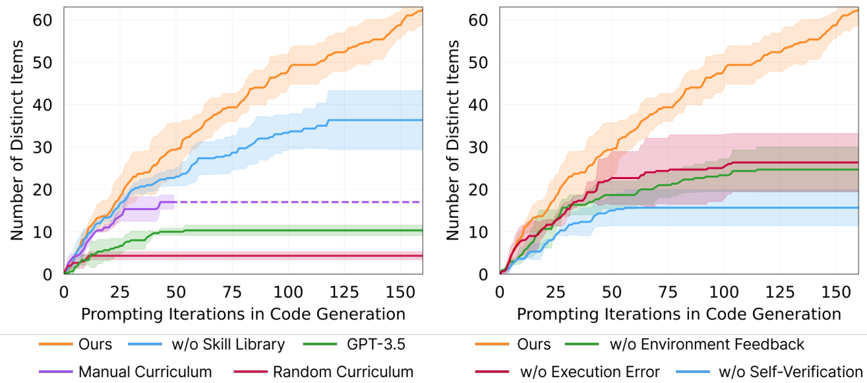
What Matters Most? (Ablation Study)
Breaking Down
The System's
Core Success
Drivers
Testing by Removal
We removed components to measure their true impact.
Curriculum is Key
Using random tasks (red line) caused a 93% drop in
items found. Structured learning is essential.
Skills Prevent Stalls
Without the library (blue line), the agent plateaus
at 36 items, falling short of the 58 items peak.
Feedback Matters
Removing Self-Verification (right chart, blue)
caused a 73% drop, halting progress at just 15 items.

Slide 42
Generalization and Ablation
The Role of Model Quality:
GPT-4 Outperforms GPT-3.5
(5.7x More Unique Items)
VOYAGER's success relies
on high reasoning power.

Slide 43
SECTION 08
Conclusion and Future Outlook
Summarizing Voyager's impact on embodied agents and exploring future directions for LLM-driven lifelong learning and generalization.

Slide 44
Conclusion and Future Outlook
Human Feedback
and 3D
Construction
Bridging the Visual Gap
Current AI models are text-only and lack
visual perception. VOYAGER cannot "see"
its own creations. Human feedback allows
it to build complex 3D structures.
Human as Critic
Humans serve as the verification system.
They provide visual critiques, helping
the agent fix spatial errors it cannot
perceive to refine its code.
Human as Curriculum
Humans break massive tasks into smaller
steps. As shown in the images, this
guided approach helps VOYAGER build
sophisticated items like a Nether Portal
and a House incrementally.

Slide 45
Conclusion and Future Outlook
Limitations and
Future Work
High Costs
GPT-4 is 15x more expensive than GPT-3.5.
Yet, cheaper models cannot match the code
generation quality required for success.
AI Hallucinations
The agent invents fake items like a
"copper sword". It also makes coding errors,
such as using cobblestone as improper fuel.
Perception Limits
VOYAGER is text-only and cannot "see."
It relies on code signals and may miss
success indicators, like killing a spider.
Future Outlook
Future work involves fine-tuning open-source
models to reduce costs and integrating
visual perception to improve accuracy.

