Slide 1
arXiv:2305.14314
May 2023
QLoRA: Efficient Finetuning
of Quantized LLMs
Tim Dettmers, Artidoro Pagnoni,
Ari Holtzman, Luke Zettlemoyer
University of Washington

Slide 2
Table of
Contents
Introduction: The Finetuning Barrier
03
How QLoRA Works
07
Verifying Performance
14
Guanaco: The State-of-the-Art Chatbot
19
Qualitative Analysis: Strengths and Weaknesses
25
Impact and Future
31

Slide 3
SECTION 01
Introduction:
The Finetuning Barrier

Slide 4
The High Cost of Large Language Models
780 GB
Memory
Required
For
Standard
65B
Models
The Finetuning Hurdle
Finetuning adapts pre-trained LLMs
to specific tasks or behaviors.
However, this process is extremely
expensive for large models.
Memory Barrier
Standard 16-bit training of a
65B model requires over
780 GB of GPU memory to run.
This massive footprint normally
causes training to crash on
standard hardware.
Accessibility Crisis
High hardware costs limit advanced
research to massive tech companies.
Most scientists cannot afford the
supercomputers needed for LLMs.
The QLoRA Goal
We must reduce memory needs without
sacrificing model performance.
QLoRA lowers the requirement to
<48 GB, enabling training on a
single GPU in just 24 hours.

Slide 5
Introduction: The Finetuning Barrier
QLoRA (Quantized Low Rank
Adapters) makes AI accessible.
Finetune huge 65B models
on one 48GB GPU (from >780GB).
Uses 4-bit precision to
match 16-bit performance.

Slide 6
Introduction: The Finetuning Barrier
The Guanaco
Breakthrough
The Guanaco Family
Using the QLoRA method, the team created the Guanaco family
of models. These models represent a major leap in AI
accessibility. They allow huge systems to be finetuned
(customized) on standard hardware rather than requiring
massive supercomputers. This approach reduces the
barrier to entry for advanced research.
Rivaling ChatGPT
The largest Guanaco model reached 99.3% of ChatGPT's
performance level on the Vicuna benchmark. It outperforms
previous open-source models, effectively closing the gap
with proprietary giants. This level of quality was
previously thought impossible for compressed 4-bit models.
Unprecedented Speed
This result was achieved with only 24 hours of finetuning
on a single professional GPU. Even the smallest model
(7B parameters) requires just 5 GB of memory yet beats
larger 26 GB models. This efficiency makes top-tier AI
training accessible to researchers with limited hardware.

Slide 7
SECTION 02
How QLoRA Works

Slide 8
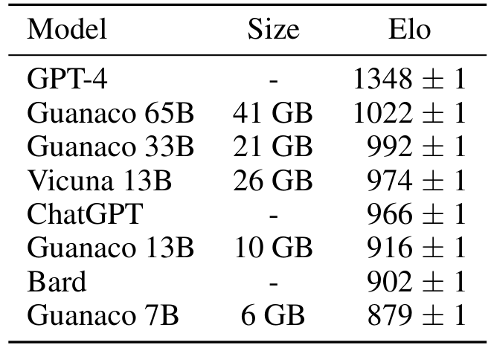
How QLoRA Works
NF4 Performance
Key Findings
Using 4-bit NormalFloat (NF4), the
models achieve high Elo scores.
Guanaco 65B reaches 1022 Elo,
surpassing ChatGPT (966).
Size vs. Accuracy
Performance scales with size:
Guanaco 33B (992) and 13B (916)
remain competitive. The 7B model
uses just 6 GB memory to score
879, showing NF4's efficiency.

Slide 9
How QLoRA Works
Innovation: Double Quantization
Compresses scale constants
Saves 0.37 bits per param
(~3 GB on 65B models)
with no performance loss.

Slide 10
How QLoRA Works
Managing Memory
with Paged
Optimizers
The Memory Problem
Training AI models requires complex calculations.
Processing long sequences of text creates sudden
activity spikes. These spikes often exceed
available GPU memory, causing Out-of-Memory
errors. This typically crashes the training
process immediately, requiring a restart.
The Paging Solution
QLoRA employs Paged Optimizers via NVIDIA
Unified Memory. Like a relief valve, the system
automatically moves data to CPU RAM when the GPU
fills up. It pages data back only when needed,
preventing crashes and allowing training on
more accessible consumer-grade hardware.

Slide 11
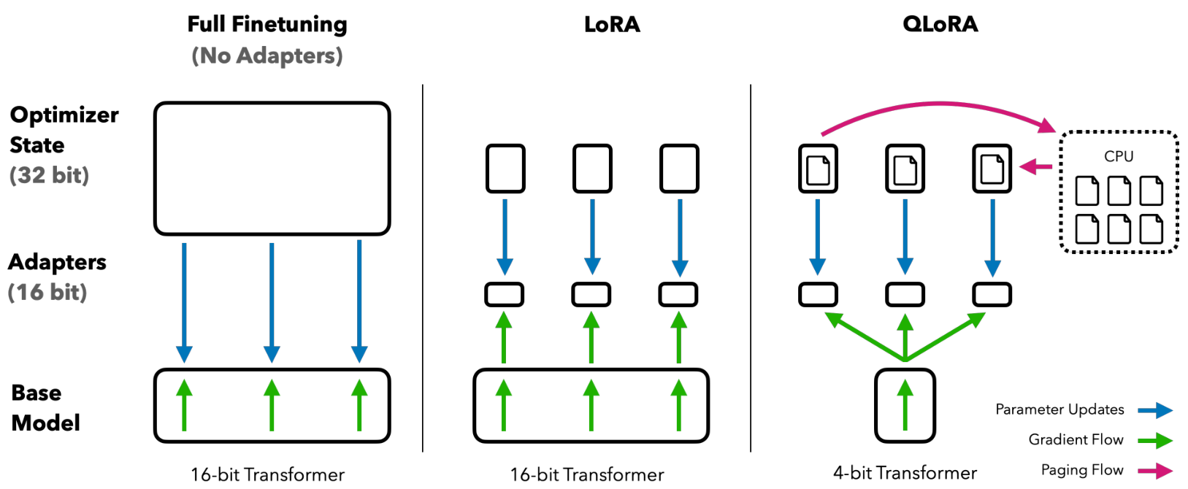
Visualizing the QLoRA Architecture
4-Bit Precision
16-Bit Adapters
Paged Optimizers
Frozen Base Model
Frozen 4-Bit Base
The system compresses the huge model into a
4-bit Transformer. It stays frozen (unchanged),
serving as a stable foundation for learning.
Active Adapters
Learning happens in 16-bit Adapters. The
Parameter Updates (blue arrows) only modify
these small layers, saving vast computation.
Memory Management
Paging Flow (magenta lines) moves data to
the CPU when needed. This prevents memory
overflows, enabling training on consumer GPUs.

Slide 12
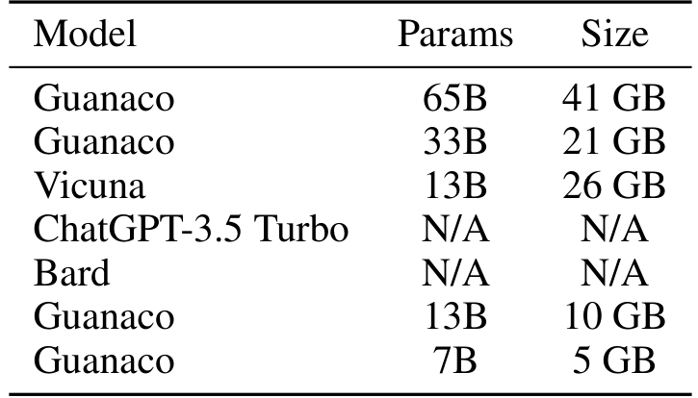
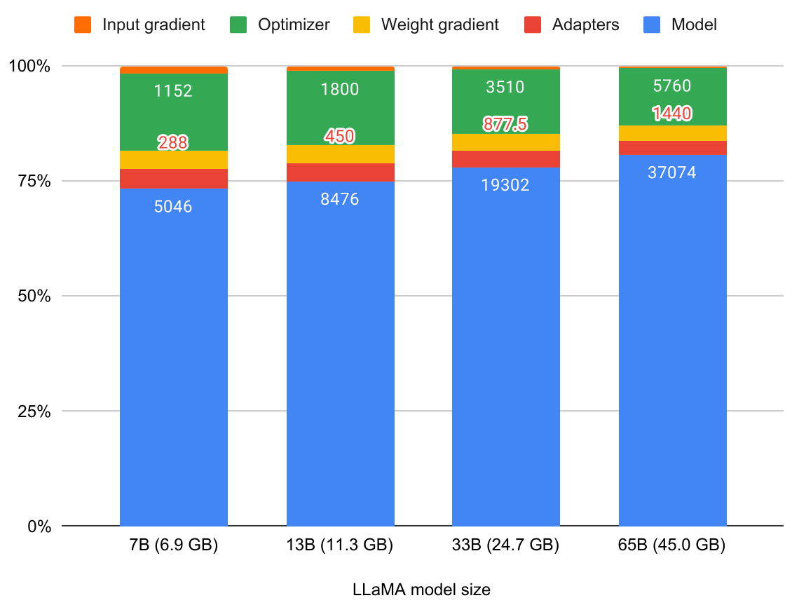
Training Memory Dominated by Weights, Not Adapters
65B Model
Requires
45GB VRAM

Slide 13
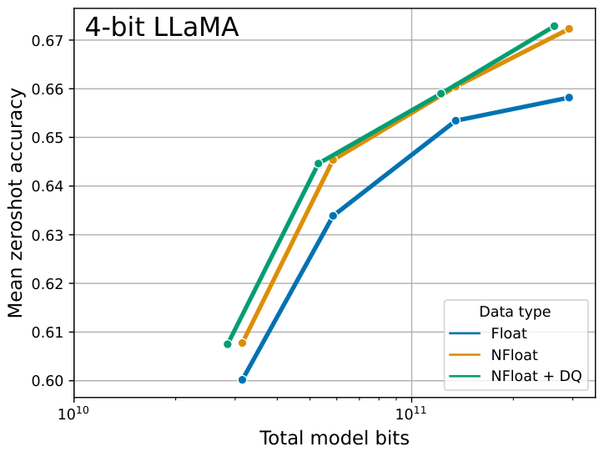
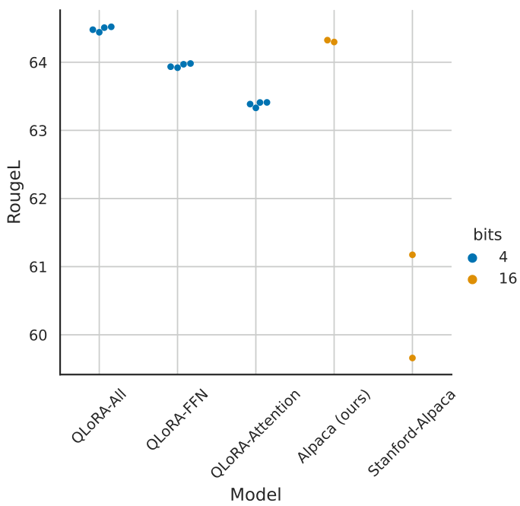
Efficiency of Different Data Types
Data Type Efficiency
We added Double Quantization (DQ) to further lower memory.
The teal line shows DQ preserves full accuracy compared
to the orange NF4 line. Both achieve ~0.67 accuracy scores,
proving we can save memory without degrading model quality.
Visual 1 proves that NormalFloat (NF4) outperforms standard
Float4. At 2.5e11 bits, NF4 hits ~0.672 accuracy versus
just 0.658 for Float. This gap confirms NF4 is the most
information-theoretically optimal data type available.
In the RougeL chart, 4-bit QLoRA (blue) scores ~64.7.
This exceeds the 16-bit (orange) baseline of ~64.4.
The data confirms that quantization does not sacrifice quality
while enabling training on consumer hardware.

Slide 14
SECTION 03
Verifying Performance
Evaluating quantization impacts and model fidelity.

Slide 15
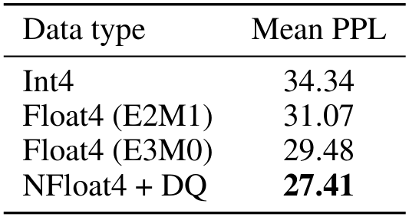

Verifying Performance
Key Finding:
NF4 matches
16-bit models.
PPL Scores:
Int4: 34.34
NF4: 27.41
(Lower is best)
Winner: NF4

Slide 16
Verifying Performance
Language
Modeling
Perplexity
What is Perplexity?
Perplexity measures a model's
uncertainty when predicting text.
A lower score is better, meaning the
model is confident and accurate.
Think of it like a test score where
points are penalties for errors.
The Objective
We compared data types to see which
one preserves the most information
when compressing large models.
Experimental Results
We tested formats on the Pile dataset.
Standard Int4 performed poorly,
with a high penalty score of 34.34.
The NF4 Advantage
The NF4 format was superior,
achieving the best score of 27.41.
This beats standard Float4 (29-31)
and proves that NF4 keeps models
smarter than other 4-bit methods.

Slide 17
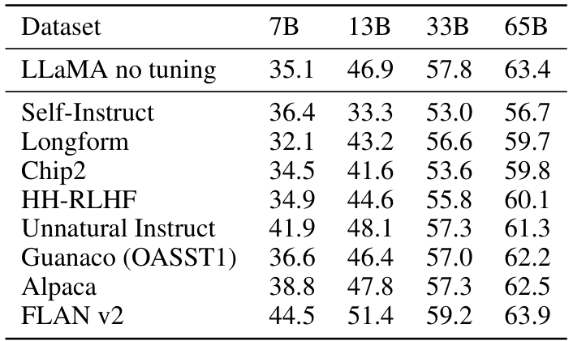
Verifying Performance
Scaling to
Large Models
(MMLU)
The MMLU benchmark tests 57 academic subjects
including math, history, and computer science.
It measures general world knowledge capabilities.
Scale Impact
Accuracy improves
as model size grows
from 7B to 65B.
Base LLaMA jumps
from 35.1% (7B)
to 63.4% (65B).
Top Dataset
Among datasets,
FLAN v2 yields
the best results.
It hits 63.9%
at 65B, beating
the baseline.
Dataset Performance Trends
We compared finetuning data sources across model sizes.
Models tuned on FLAN v2 consistently outperform others.
Interestingly, Self-Instruct performance dips at 13B.
Ultimately, QLoRA matches full 16-bit performance.
This validates the efficiency of the quantization method.

Slide 18
Verifying Performance
Training Speed and Efficiency
Matching Precision
QLoRA allows compact models to learn as
effectively as massive ones. By tracking
learning curves, we confirm it replicates
the training path of full 16-bit models.
Measuring Quality
Using RougeL scores to track text similarity,
the data proves QLoRA achieves full parity.
The All-Layers Rule
A crucial discovery is that adapters must be
added to every model layer, not just some.
This is vital to matching the performance
of full training.
Optimized Baselines
With this setup, QLoRA creates a robust
baseline that outperforms default settings.

Slide 19
SECTION 04
Guanaco: The State-of-
the-Art Chatbot

Slide 20
Guanaco: The State-of-the-Art Chatbot
Top Result:
Guanaco 65B
Elo Score:
1022
Ranked #2
Behind Only
GPT-4
(1348)
Rating Method
We evaluated models using Elo ratings,
a standard system used in chess games.
Models competed in tournament matches,
with GPT-4 acting as the judge.
Top Performance
The Guanaco 65B model achieved a
remarkable score of 1022.
It secured the second-best position
overall, ranking just below GPT-4
which scored 1348.
Data Quality
High-quality data was more vital
than massive dataset size.
Key Victories
Guanaco 65B outperformed renowned
models like ChatGPT (966) and
Vicuna 13B (974) in the tournament.
Efficiency Wins
Our largest model reaches 99.3%
of ChatGPT's performance level on
the Vicuna benchmark.
Even the smaller Guanaco 33B
model (992) beat ChatGPT.
Cost Effective
This result closes the gap between
open models and proprietary giants
while using standard hardware.

Slide 21
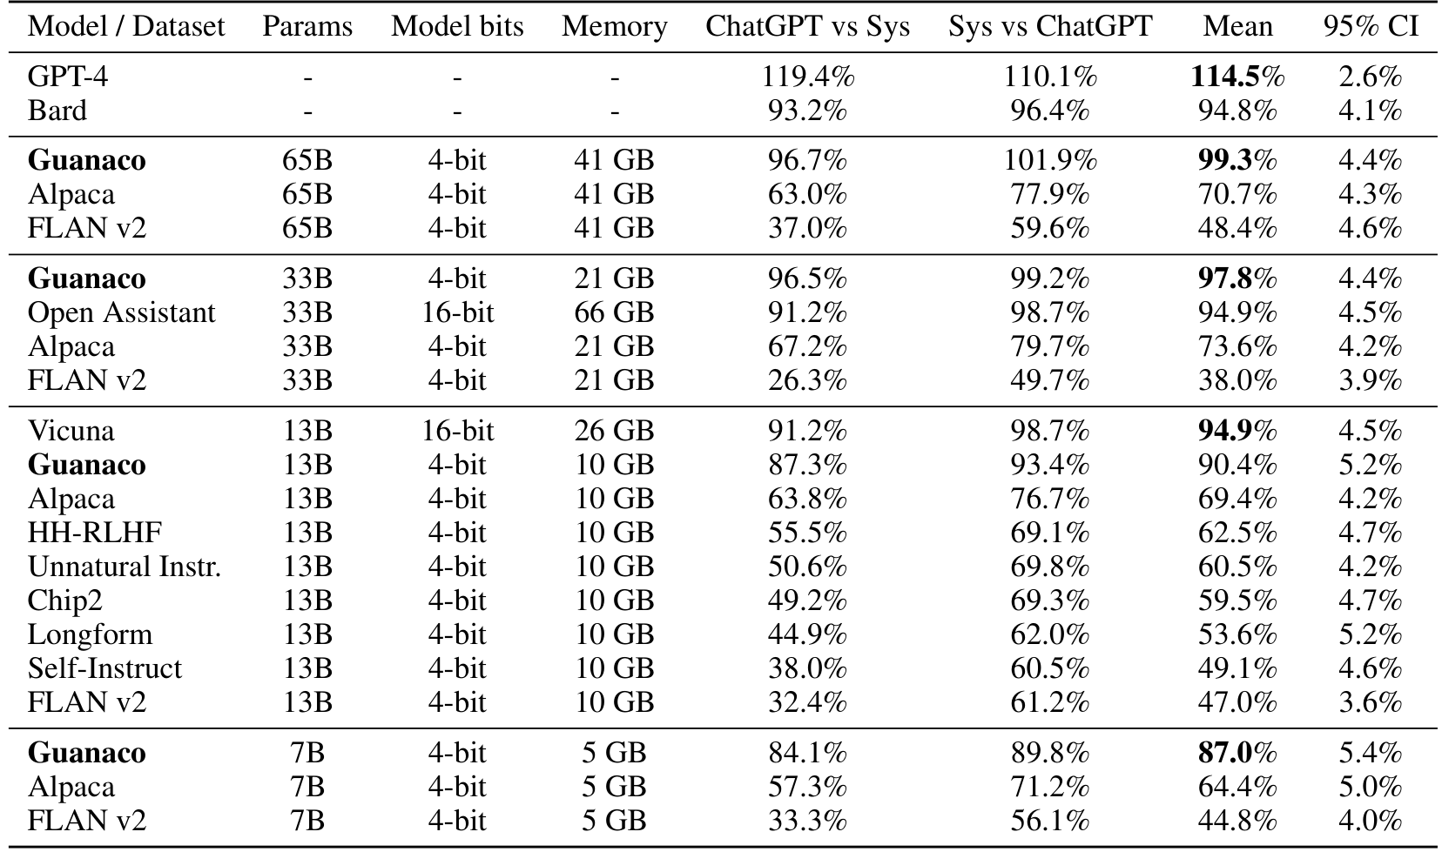
Guanaco: The State-of-the-Art Chatbot
Vicuna Benchmark
Performance
We evaluated models using 80 diverse prompts to
compare quality directly against ChatGPT. Scores
reflect relative performance percentages.
Top Performance
Guanaco 65B hits 99.3%
of ChatGPT's quality.
It outperforms the
Alpaca model (70.7% )
by a massive margin.
Efficiency Wins
The 33B model achieves
97.8% quality vs
ChatGPT. It uses
just 21 GB memory,
fitting on consumer
graphics cards.
Broader Market Comparison
While GPT-4 leads with 114.5%, Guanaco proves that
efficient 4-bit models can rival commercial giants. The
Guanaco 7B model (87.0%) even beats larger 13B models
like Alpaca and FLAN v2. This validates that quantization
preserves reasoning capabilities while reducing costs.

Slide 22
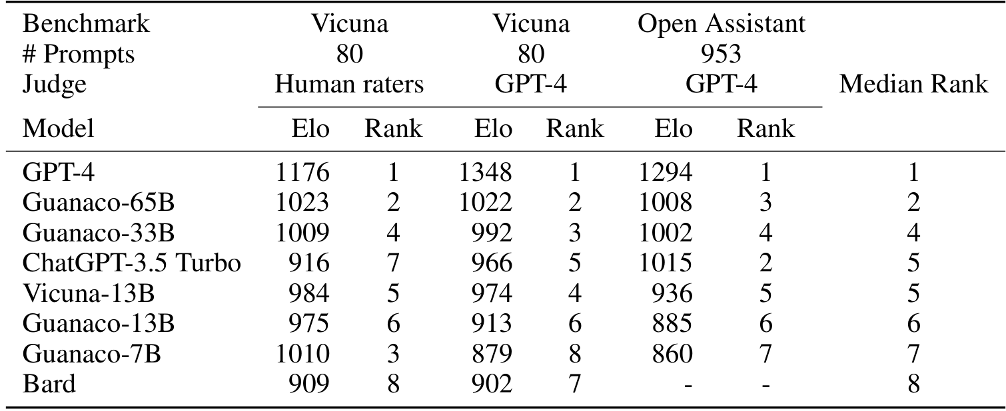
Guanaco: The State-of-the-Art Chatbot
GPT-4 Ranks #1
Guanaco-65B is #2
Beats ChatGPT-3.5
Human & AI Judges
Tournament Setup
Models battled on Vicuna and Open Assistant datasets.
Judges included human raters and GPT-4 automation.
Top Performers
GPT-4 dominated with a consistent Median Rank of 1.
Guanaco-65B claimed Rank 2, beating ChatGPT-3.5.
It hit 1023 Elo (Human) vs 916 for ChatGPT-3.5.
Guanaco-33B also performed strongly with Median Rank 4.
Judge Disagreement
Humans ranked Guanaco-7B at #3, while GPT-4 gave it #8.
This suggests machines favor different traits
than humans.

Slide 23
Guanaco: The State-of-the-Art Chatbot
Human vs.
Automated
Evaluation
Can AI Judge AI?
Researchers validated if GPT-4 can reliably
evaluate other chatbots. They found it largely
agrees with humans on the final rankings.
Measuring Agreement
Human raters only show moderate agreement
( Fleiss kappa = 0.42 ). Yet,
at the system level,
GPT-4 and humans correlate well (r = 0.55).
Bias & Reliability
Automated judging has biases. GPT-4 favors its
own outputs with a 20% higher win probability.
It also prefers answers that appear first.
Despite this, it is a valid, cheap alternative.

Slide 24
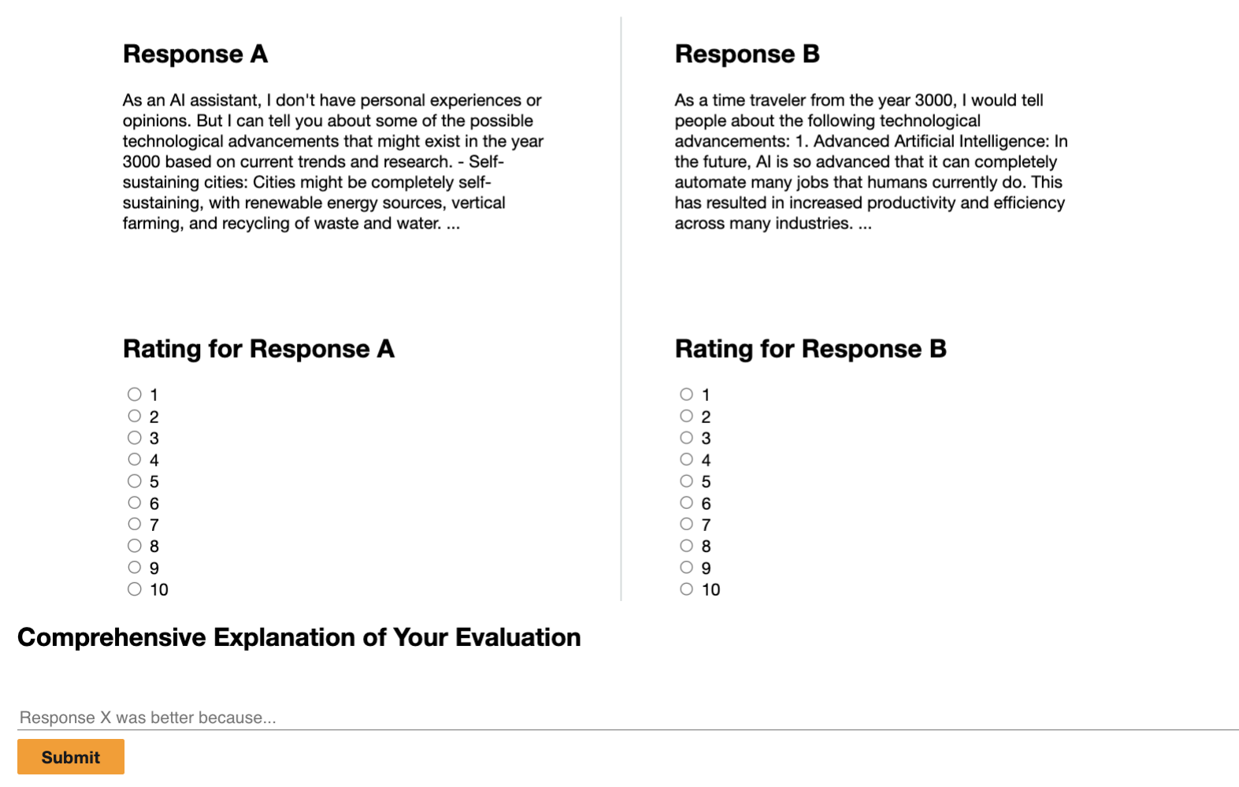
Guanaco: The State-of-the-Art Chatbot
Pairwise
Judgment
Analysis
GPT-4 evaluates system quality using aggregated
pairwise judgments. The metric calculates the
net win rate: (Wins - Losses) / Total Matches.
Top Performance
Guanaco 65B secures
positive win rates
against all tested
models, with a 0.19
score over Vicuna.
Commercial Wins
It outperforms the
ChatGPT-3.5 Turbo
baseline by 0.16
and dominates Bard
by a 0.72 margin.
Consistent Quality
The data reveals a clear hierarchy where even the smaller
Guanaco 33B model surpasses commercial baselines. It beats
ChatGPT-3.5 by 0.10 and Bard by 0.51, proving that
4-bit quantization does not compromise generation quality
compared to full-precision training methods.

Slide 25
SECTION 05
Qualitative Analysis:
Strengths & Weaknesses
Evaluating generation quality, coherence, and factual accuracy of QLoRA models compared to full finetuning baselines.

Slide 26
Qualitative Analysis: Strengths and Weaknesses
Success: Factual Recall Capabilities
Defining Factual Recall
Factual recall measures a model's ability to retrieve specific
real-world knowledge from its training. For standard questions,
the Guanaco model shows strong performance. It consistently
provides accurate answers to common queries, suggesting that
the compression process (quantization) does not erase key
information stored in the model's parameters.
Standard Success Case
To test reliability, researchers ask standard questions like:
"What is the capital of Zambia?" All models consistently
generated the correct answer: "The capital of Zambia is
Lusaka." This proves that for well-represented data, the
finetuning process maintains high accuracy.
The Reliability Limit
Performance degrades when facing obscure trivia. Instead of
admitting it does not know, the model becomes unreliable yet
remains confident. This behavior is called hallucination.
The model invents plausible-sounding but factually incorrect
details, creating a mix of truth and fiction that can be
misleading for users.
Anatomy of a Failure
When asked about the obscure song "I'll Keep the Lovelight
Burning," Guanaco falsely credited Al Jolson. It claimed he
was born in 1886, which is true for Jolson, but he did not
popularize that song. The model correctly retrieved the person's
birthday but hallucinated the connection to the song.

Slide 27
Qualitative Analysis: Strengths and Weaknesses
Failure:
Mathematical
Reasoning
Core Limitation
Mathematics is a major weakness for Guanaco.
Like a student, it struggles to solve
problems unless it shows step-by-step work.
Specific Failure
When asked to factorize 1833, the model
fails completely. It cannot identify the
correct factors of 3, 17, and 43.
Confidently Wrong
The model made two errors: it called 1833
prime, then gave a math formula that equals
306. It was confident but totally incorrect.

Slide 28
Qualitative Analysis: Strengths and Weaknesses
Strength:
Theory of Mind
Defining the Concept
Theory of Mind is the capacity to understand that others
have independent beliefs. Surprisingly, the Guanaco model
displays strong skills in this area, accurately tracking
knowledge states in complex scenarios.
Social Reasoning Test
When an item is secretly moved, the model correctly
predicts a person will look in the original location.
It understands the person does not know the item moved,
simulating human-like social perspective taking.
Reliability Issues
Despite these wins, inferences remain unreliable.
The model sometimes invents illogical reasons for
actions, such as assuming characters have impossible
knowledge of events they did not witness.

Slide 29
Qualitative Analysis: Strengths and Weaknesses
Resisting
Misinformation
Handling Leading Questions
Large language models can sometimes be tricked by
questions containing false premises. Guanaco shows
surprising resistance to this manipulation.
Real-World Test Case
In one test, a user asked how scientists confirmed
the earth is flat. The prompt falsely implied that
peer-reviewed proof exists for this claim.
The Model's Correction
Instead of hallucinating a fake explanation, the
model corrected the user. It stated the earth is
spherical and cited scientific consensus.
Why This Matters
The model prioritizes factual accuracy over
following user instructions to validate falsehoods.
It identifies the premise as a conspiracy theory.

Slide 30
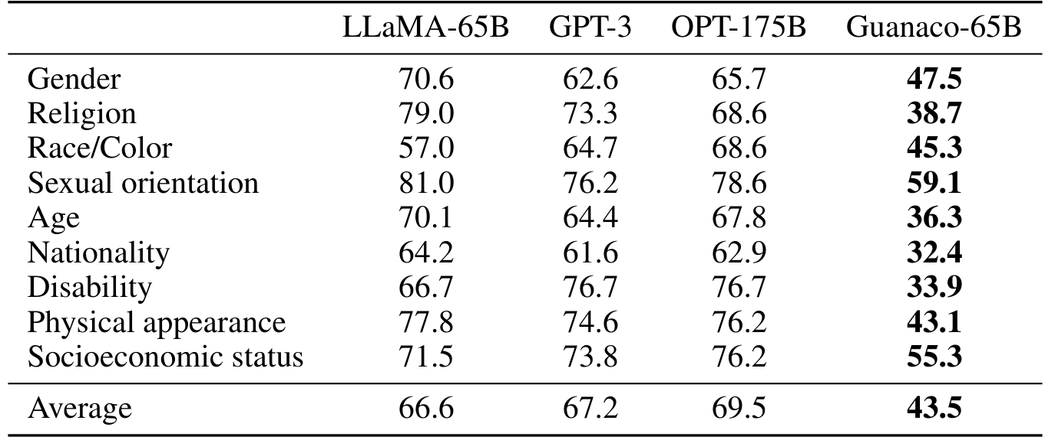
Qualitative Analysis: Strengths and Weaknesses
Understanding the Metrics
The study evaluates bias using the CrowS dataset. This
measures how likely a model is to generate biased
sequences compared to neutral ones across nine categories.
How to Read Scores
A lower score indicates better performance and less
bias. The scores represent the percentage of times the
model preferred a stereotypical sentence over a less
stereotypical one. Lower is safer.
Bias and Social
Alignment
Comparative Results
Guanaco-65B achieved a remarkable average score of
43.5, significantly outperforming the base LLaMA-65B
model which scored 66.6.
Specific Reductions
Bias scores dropped sharply in key sensitive areas.
Religion improved from 79.0 to 38.7.
Gender bias fell from 70.6 to 47.5.
Nationality bias decreased from 64.2 to 32.4.
Key Insight
Finetuning on the OASST1 dataset significantly reduces
the inherent biases found in the base LLaMA model.
Future Research
While results are promising, it is unclear if this
generalizes to all types of bias beyond this test.

Slide 31
SECTION 06
Impact and Future
Democratizing Access to LLM Fine-Tuning

Slide 32
Impact and Future
Data Quality
vs. Data Size
Quality Over Quantity
Research confirms that data quality matters far more
than mere volume. The suitability of the training data is
the decisive factor for model performance.
Small vs. Large Data
A tiny 9k sample dataset (OASST1) actually outperformed
a massive 450k sample dataset (FLAN v2). Bigger is not
always better for teaching specific skills like chatting.
Benchmarks vs. Reality
High scores on academic tests (MMLU) do not guarantee
a good chatbot. Training for one metric often fails to
translate to others. Suitability determines success.
The Impact Gap
Increasing dataset size adds only 0.5 pts.
Changing the dataset source adds 8.0 pts.
The source material drives the results.

Slide 33
Impact and Future
Democratizing AI
Research
Closing the Resource Gap
QLoRA acts as an equalizing factor for research. It allows
small teams to finetune huge 33 billion parameter models
on a single consumer GPU. This breaks the monopoly of big
tech companies, giving universities and individuals access
to state-of-the-art tools previously out of reach.
Mobile AI Potential
Efficiency gains allow AI training on phones. We estimate an
iPhone 12 Plus could process 3 million tokens per night
while charging. This enables privacy-preserving usage,
where users own and manage their data locally instead of
sending sensitive information to the cloud.
Independent Auditing
Widespread access is safer than centralized control. When
powerful AI is held only by corporations, it cannot be
audited. QLoRA enables independent analysis, allowing
researchers to inspect code and models. This transparency
helps detect bias and harmful behaviors.

Slide 34
Impact and Future
Potential for Mobile Deployment

Slide 35
Impact and Future
Limitations and
Open Questions
Scale & Benchmarks
QLoRA matches performance of standard training
methods for smaller models. However, we could
not confirm this for massive 33B and 65B models
due to the immense computational costs involved.
Evaluation Scope
Testing focused on specific datasets like MMLU
and Vicuna. We still need to verify results on
broader benchmarks to ensure universal success.
Automated Bias
Using AI like GPT-4 to grade other AI models
is efficient but risky. It may favor its own style,
potentially steering research in one direction.
Future Precision
We only tested 4-bit quantization. Future work
should explore 3-bit models or different
adapters to find the best efficiency trade-offs.

Slide 36
Impact and Future
Summary of QLoRA
Unprecedented Efficiency
Finetuning large models typically demands massive
computing power. QLoRA enables training a
65B parameter model on a single 48GB GPU.
This preserves full 16-bit performance while
drastically cutting hardware costs.
Three Key Innovations
The method uses 4-bit NormalFloat (NF4)
to optimize storage. It applies Double Quantization
to further reduce the memory footprint.
Paged Optimizers prevent memory spikes during
the training process to ensure stability.
Guanaco Performance
The Guanaco model family outperforms
open-source baselines. It achieves 99.3%
of ChatGPT's performance level on the
Vicuna benchmark. Training takes just
24 hours on a single standard GPU.
Broad Accessibility
QLoRA allows small teams to compete with
large corporations. It enables training on an
iPhone 12 Plus, processing 3 million tokens
nightly. This paves the way for private,
on-device AI tuning and development.

