Slide 1
Meta AI Research, FAIR
April 5, 2023
Segment Anything:
Foundation Model for Vision
An Overview of the Task, Model, and Dataset
Alexander Kirillov et al.

Slide 2
Table of Contents
Introduction to the Segment Anything Project
03
The Promptable Segmentation Task
06
The Segment Anything Model (SAM)
09
The Data Engine
12
The SA-1B Dataset
15
Performance and Experiments
21
Conclusion
28

Slide 3
SECTION 01
Introduction to the
Segment Anything Project
A Foundation Model for Computer Vision

Slide 4
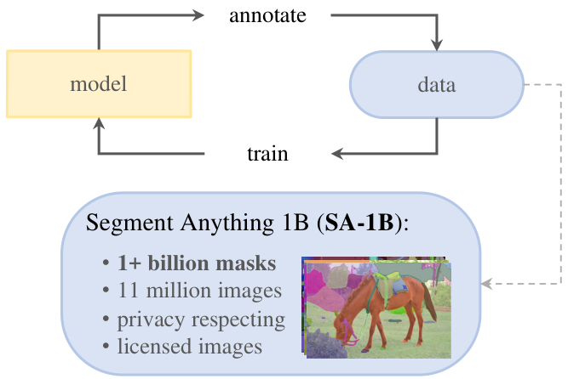
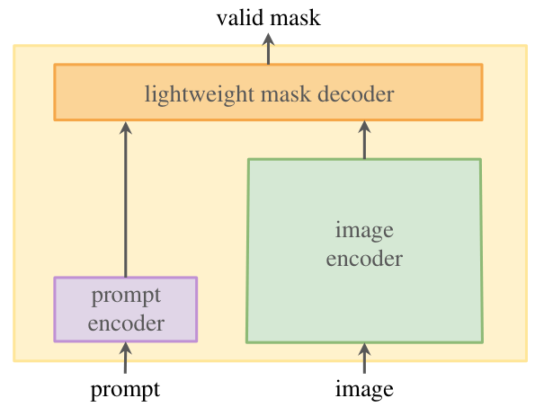
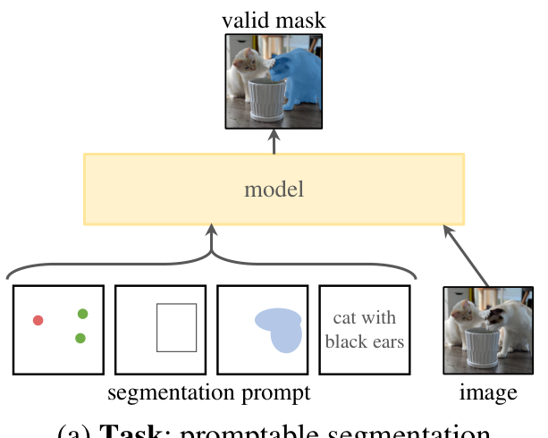
Introduction to the Segment Anything Project
Project Overview: Task,
Model, and Data

Slide 5
Introduction to the Segment Anything Project
What is a
Foundation
Model?
Core Definition
Foundation models are trained on broad data to
adapt to many downstream tasks. Unlike specialized
models built for one specific object, they possess
generalized knowledge useful for many problems.
The GPT Analogy
Similar to how GPT works for text, SAM works
for computer vision. It learns universal visual
patterns during pre-training, allowing it to
understand images it has never seen before.
Zero-Shot Capability
Using prompt engineering, users tell the model
what to find (like clicking a point) without
retraining it. This enables zero-shot transfer
to completely new image distributions and tasks.

Slide 6
SECTION 02
The Promptable Segmentation Task
Defining a general task to enable zero-shot generalization via prompt engineering.

Slide 7
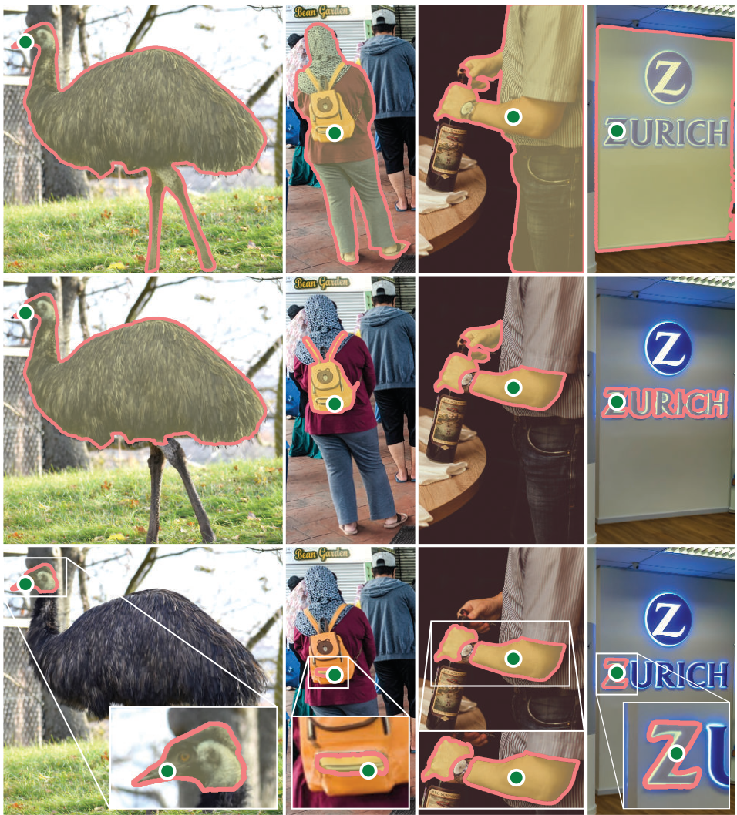
Segment Anything: A Foundation Model for Computer Vision
Promptable Segmentation
Defining the Prompt
A prompt acts as a user's hint to the
AI model. It can be a foreground point,
a box, or text. This input tells the
system exactly what specific object
to isolate within the image.
Handling Ambiguity
A single green point can be ambiguous.
Does it mean the whole person or just
their bag? The model is trained to
return a valid mask for at least one
reasonable interpretation.
Whole Objects vs. Parts
In the emu example, a dot on the eye
allows the AI to select the whole bird
or focus only on the head. Similarly,
a dot on the yellow backpack can
select the hiker or just the bag.
Fine-Grained Detail
The Zurich sign demonstrates precision.
One prompt can select the full sign
or narrow down to just the Z logo.
This flexibility allows users to
select objects at any scale.

Slide 8
The Promptable Segmentation Task
Solving the
Ambiguity Problem
The Ambiguity Challenge
In computer vision, a single point prompt
is often unclear. A click on a torso
could mean the shirt or the person.
Standard models often guess incorrectly.
The Three-Mask Solution
To fix this, the model predicts three
valid masks for every prompt: a whole
object, a specific part, or a subpart.
This handles prompts at different levels.
Ranking with Confidence
The model assigns a confidence score
to each predicted mask. It ranks them
automatically to present the user with
the most likely intended result.

Slide 9
SECTION 03
The Segment Anything Model (SAM)
A Foundation Model for Computer Vision

Slide 10
The Segment Anything Model (SAM)
SAM
Architecture
Overview
1. Image Encoder
The image encoder acts as the heavy
lifter of the system. It processes the
image once using a Vision Transformer
to create a compact mathematical
summary. This step happens only one
time per image to save computing power.
2. Prompt Encoder
This component translates user inputs
into data the model understands. It
accepts points, boxes, and text
to guide the segmentation process.
3. Mask Decoder
The decoder maps the image summary and
user prompts to a final mask. It is
lightweight and runs in a browser in
~50 milliseconds on a standard CPU.
Smart Disambiguation
Ambiguous prompts (like a shirt vs.
person) are handled by predicting
3 valid masks at once: the whole,
the part, and the sub-part.

Slide 11
The Segment Anything Model (SAM)
Deep Dive: The Components
Image Encoder
Motivated by scalability, we use a Vision Transformer.
It is minimally adapted to process high-resolution inputs.
This heavyweight encoder runs just once per image.
Its pre-training uses MAE methods for strong performance.
Prompt Encoder
We consider two sets of prompts: sparse points and dense masks.
Points and boxes use positional encodings for location.
Text prompts use an off-the-shelf encoder from CLIP.
Dense mask prompts are embedded using convolutions.
Lightweight Mask Decoder
This component efficiently maps embeddings to a valid mask.
It uses a modified Transformer decoder block with attention.
The design allows for real-time interaction in the browser.
It computes the final mask probability at each pixel location.
Efficiency & Ambiguity
Given the image embedding, the decoder runs in ~50ms on CPU.
This speed enables seamless, interactive prompting.
The model predicts 3 masks to resolve potential ambiguity.
This handles cases like separating a whole object from a part.

Slide 12
SECTION 04
The Data Engine
Segment Anything: A Foundation Model for Computer Vision

Slide 13
The Data Engine
The 'Data Engine'
Concept
The Data Scarcity Problem
Training a foundation model requires massive data. Existing
datasets were too small, and manual labeling was too slow.
The Data Engine Solution
Researchers built a loop where the AI helps create its own
training data. The model assists annotators, gets smarter,
and eventually learns to generate data automatically.
Stage 1: Model-Assisted
Annotators used a tool powered by SAM to click objects.
The model instantly predicted the mask shapes for them.
Stage 2: Semi-Automatic
SAM labeled easy objects automatically. Humans focused on
finding the harder, missing objects to improve diversity.
Stage 3: Fully Automatic
Finally, SAM scanned images with a grid of points to label
everything, creating ~100 masks per image without help.
The Result: SA-1B Dataset
This process created the largest segmentation dataset ever.
It contains 1.1 billion masks derived from 11 million licensed
privacy-preserving images.
Scale Comparison
SA-1B has 400x more masks than any previous dataset.
This massive scale allows the model to work on new images
"out-of-the-box" without extra training.

Slide 14
The Data Engine: Building the Dataset
Stage 1
Manual
Stage 2
Semi-Auto
Stage 3
Automatic
Assisted-Manual
To start, no large dataset existed.
Human annotators used a browser
interface where the AI helped them
draw masks (object outlines).
As the AI learned from this data,
it became efficient, helping humans
work 6.5x faster than before.
This cycle ran 6 times, creating
4.3 million masks to train on.
Semi-Automatic
Next, the AI could automatically
detect "easy" confident objects.
We showed these pre-filled masks
to annotators, asking them to
label only the un-labeled items.
By focusing humans on the "hard"
examples, we greatly increased
the diversity of the dataset.
Fully Automatic
In the final stage, the model was
powerful enough to work alone. It
places a 32x32 grid of points
over an image to find objects.
Crucially, the model is now
ambiguity-aware: it can validly
label overlapping objects (like
a person vs. the shirt they wear)
without getting confused.
The SA-1B Dataset
This engine generated 1.1 billion
high-quality masks from 11 million
images. This is 400x larger than
any existing segmentation dataset.
99.1% of these masks were made
completely automatically, proving
the power of this data engine.

Slide 15
SECTION 05
The SA-1B Dataset
Featuring 1 billion masks and 11 million images.

Slide 16
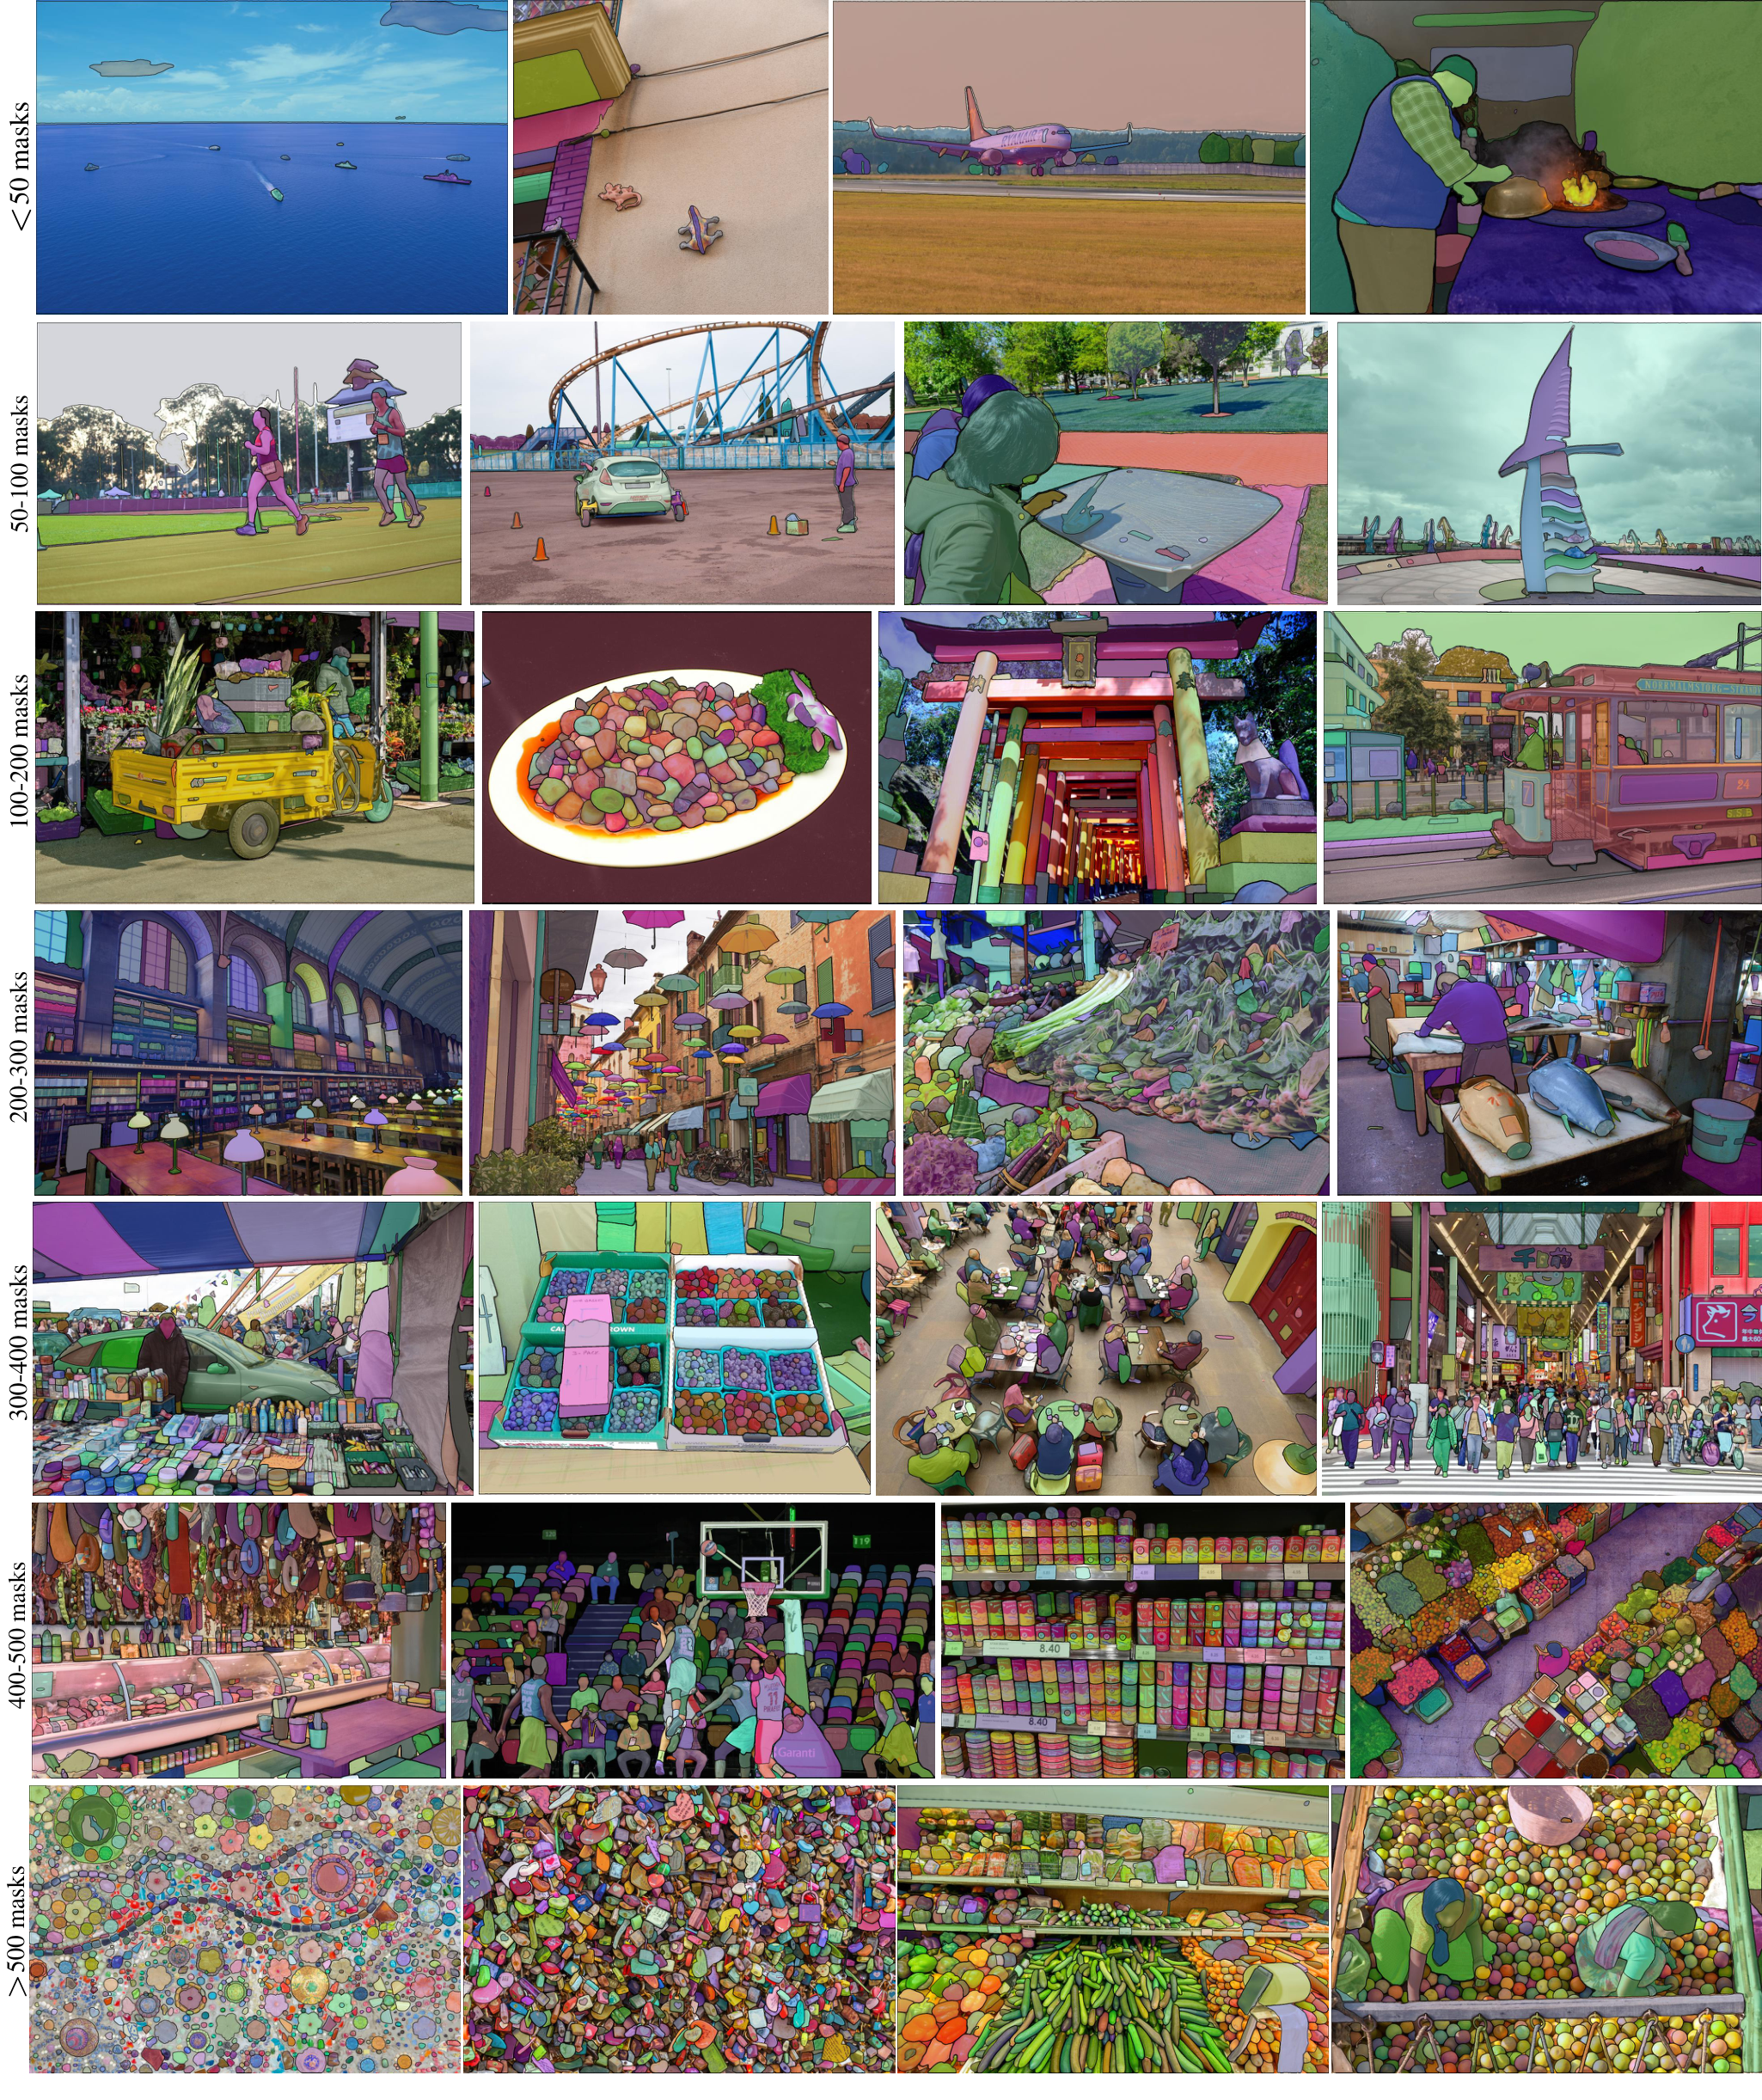
The SA-1B Dataset
Visualizing the
SA-1B Dataset
Dataset Scale
SA-1B contains 11M
high-res images and
1.1B masks.
Diverse Scenes
Includes diverse, real-
world scenes with
varying complexity.
Visual Ranges
Rows show mask counts
increasing from <50
to >500 masks.
Model Power
Even in dense scenes
like market stalls,
SAM segments distinct
objects automatically.

Slide 17
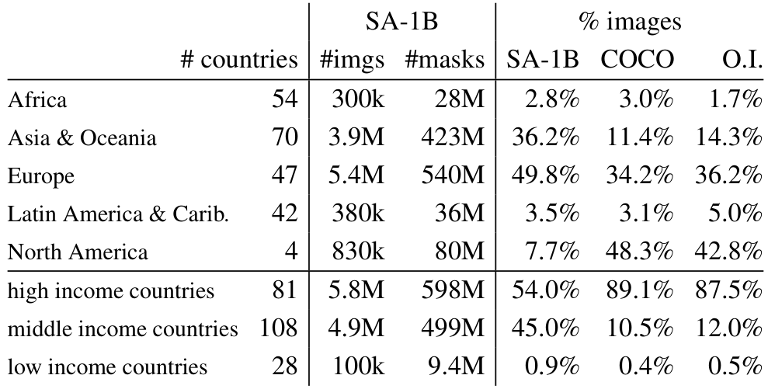
The SA-1B Dataset
Comparing
Dataset Scale
SA-1B contains 11M images and 1.1B masks. It
features 11x more images and 400x more masks
than the next largest dataset, Open Images.
Massive Scale
SA-1B contains
11M images,
which is
11x more than
the Open Images
dataset.
Mask Density
The dataset has
1.1B masks,
which is
400x more
than existing
segmentation
Geographic & Economic Diversity
While COCO is dominated by North America (48%), SA-1B
has only 7.7% from there, favoring Europe (49.8%) and
Asia (36.2%). Additionally, SA-1B has 45% of images
from middle-income countries, unlike COCO's 10.5%.
This shift significantly reduces Western-centric bias.

Slide 18
The SA-1B Dataset
Mask Properties
Analysis
Spatial Distribution
Common photographer bias clusters objects in the center.
Unlike COCO or Open Images, SA-1B provides
significantly greater coverage of image corners.
Objects appear throughout the scene, ensuring models
learn to detect targets anywhere, not just at the
focal point. This mimics real-world visual diversity.
Unprecedented Scale
SA-1B contains 11x more images and 400x more masks
than Open Images. We observe a shift toward capturing
small and medium masks, rather than just large
prominent ones. This density allows the model to
understand fine details, with significantly more
masks per image than any existing dataset.
Shape Complexity
We analyzed concavity to measure shape detail.
Despite being auto-generated, SA-1B masks are as
complex as manual annotations in COCO and ADE20K.
The data engine preserves structural details without
artificial simplification. This proves that automatic
generation can produce the high-quality shapes
required for professional computer vision tasks.

Slide 19
The SA-1B Dataset
Geographic
Representation
Global Scale
To build a robust model, we verified image origins by
inferring locations from captions using standard methods.
This prevents the model from only learning Western contexts.
Key Findings
The top three image sources come from distinct global
regions: Russia, Thailand, and the USA.
Additionally, most countries contributed over 1,000 images
each, ensuring broad coverage rather than just a few
dominant sources driving the model's learning.
Major Regional Shifts
Compared to previous standard datasets like COCO,
SA-1B shifts focus away from North America, which dropped
to just 7.7% of the total images.
Increased Coverage
Europe now comprises 49.8% of images, while
Asia & Oceania rose to 36.2%. This creates a
more globally balanced view compared to earlier datasets,
which were often heavily dominated by imagery from
the United States.
Addressing Gaps
Regions like Africa and Latin America remain
underrepresented in terms of percentage, roughly matching
the trends seen in older datasets.
The Volume Advantage
However, the sheer size of SA-1B transforms this reality.
Even with low percentages, Africa provides ~28 million
masks. This represents 10x more absolute data than
the total masks found in any previous segmentation dataset,
enabling better performance in these regions.

Slide 20
The SA-1B Dataset
Fairness and Responsible AI
Auditing for Fairness
Researchers audited the model for potential bias to ensure
it is equitable. They tested the Segment Anything Model
(SAM) on images of people, analyzing performance across
perceived gender, age group, and skin tone.
Measuring Accuracy
They used a metric called mIoU, which scores how perfectly
the digital cutout matches the person. A higher number
means better precision. Tests simulated user interactions
with 1 and 3 clicks to guide the segmentation tool.
Gender Consistency
Results show similar performance regardless of gender.
For females, the model achieved a score of 54.4, while
for males it scored 55.7. This small difference confirms
the model treats groups equally.
Age Group Analysis
Tests covered young, middle-aged, and older groups.
Surprisingly, it performed best on older people (62.9%)
compared to younger people (54.2%). This is unusual,
as AI typically struggles with older demographics.
Skin Tone Equity
The audit used the Fitzpatrick scale, ranging from type 1
(lightest skin) to type 6 (darkest skin). The results
found no significant difference in accuracy.
Inclusive Performance
Type 1 skin scored 52.9 and Type 6 scored 56.7.
Statistical analysis shows these scores are comparable.
This consistency is critical for real-world global use,
ensuring the tool works reliably for all complexions.

Slide 21
SECTION 06
Performance and
Experiments

Slide 22
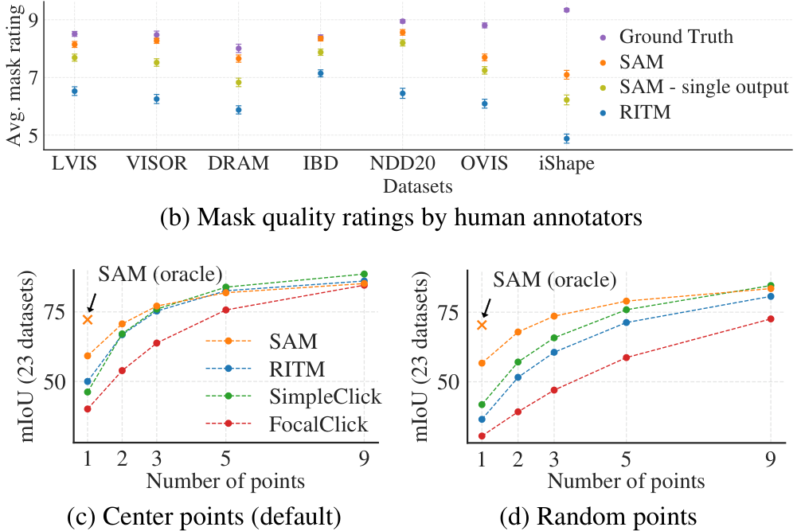
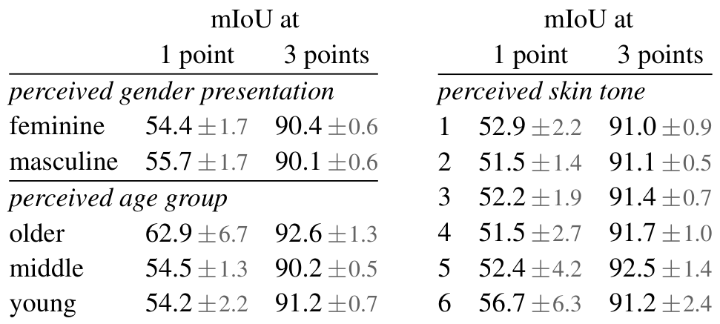
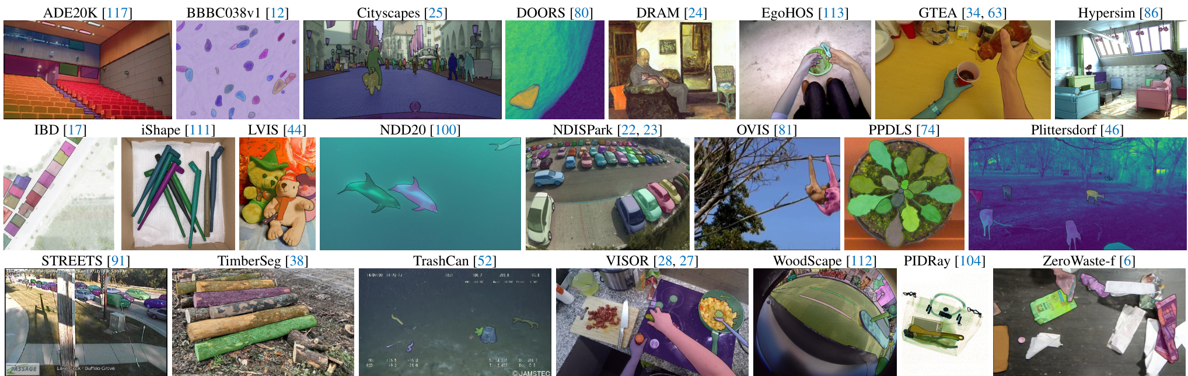
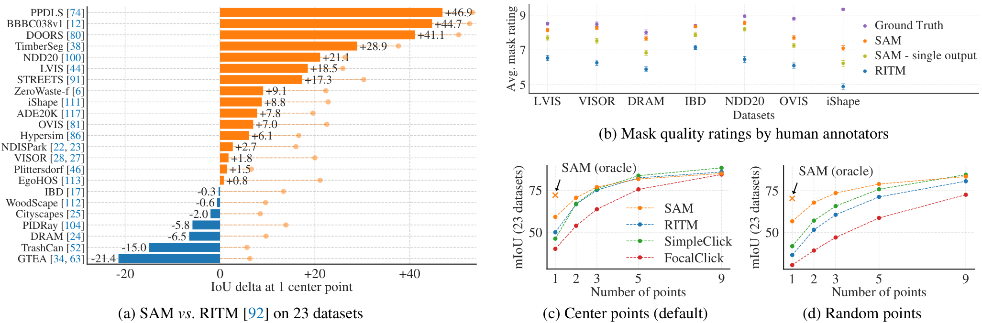
Performance and Experiments
We define zero-shot transfer as testing the model on 23 new datasets it never saw, ensuring no memorization.
From aerial maps to microscopy, the model identifies objects in diverse domains without needing fine-tuning.
Results show it outperforms the strong RITM baseline on 16 of 23 tasks, validating its generalized understanding.
23 Datasets
Diverse Data
Zero Training
Fairness Test
Gender & Age
Consistent
16/23 Wins
Beats RITM
High mIoU
Smart Masks
1-Click Use
Top Quality

Slide 23
Performance and Experiments
Performance: Segmentation from Points
The Single-Point Test
We evaluated the model by providing just a single point on an
object and asking it to identify and mask the entire shape.
Defining the Metric
We measure success using mIoU (mean Intersection over Union).
Think of this as "overlap accuracy"—calculating how perfectly
the model's predicted shape matches the real ground truth.
SAM vs. Strong Baselines
Compared to RITM (a top existing model), SAM achieved higher
accuracy scores on 16 of the 23 tested datasets.
Solving Ambiguity
One point can be ambiguous (e.g., clicking a shirt vs. person).
When we allow SAM to offer 3 options and pick the best one,
it outperforms the baseline on all 23 datasets.
Human Quality Ratings
Automated metrics can miss context, so we asked humans to rate
mask quality from 1 (worst) to 10 (best).
Superior Results
Evaluators consistently gave SAM high scores between 7 and 9.
This range signifies "identifiable objects" with rare errors.
Humans preferred SAM even when computer metrics were lower.
Scaling with More Points
We tested performance as users add more points (from 1 to 9).
This simulates a user correcting a mask by adding clicks.
The "One-Click" Advantage
SAM's lead is largest with just 1 point, showing strong
initial intuition. As more points are added, the task becomes
easier for all models, narrowing the performance gap.

Slide 24
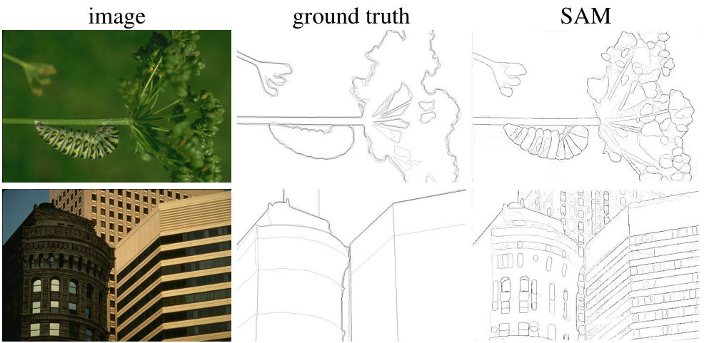
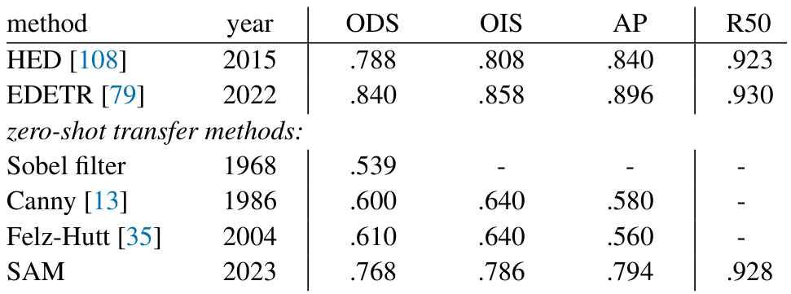
Application: Zero-Shot Edge Detection
Qualitative Results
SAM produces sharp edge maps zero-shot. In the visual,
SAM outlines the caterpillar's body segments and plant
details more precisely than the ground truth. For the
buildings, it captures intricate structure like windows
and bricks that manual annotations smooth over. This
granular output confirms SAM understands object boundaries.
Quantitative analysis on the BSDS500 benchmark confirms
SAM's strong performance against established baselines.
SAM achieves an ODS score of .768, surpassing classic
methods like Canny (.600) and Felz-Hutt (.610).
Its recall is exceptional (R50: .928), nearly matching
the state-of-the-art supervised model EDETR (.930).

Slide 25
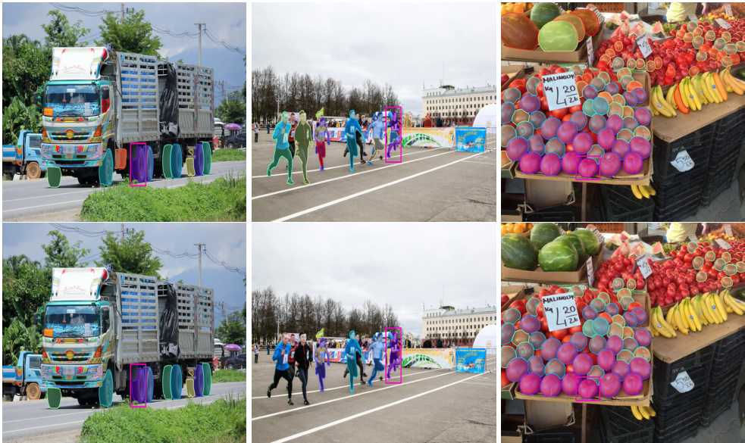
Method: Using ViTDet boxes to prompt SAM for segmentation.
SAM
Isolates
Runners
& Fruits
With
Crisp
Edges

Slide 26
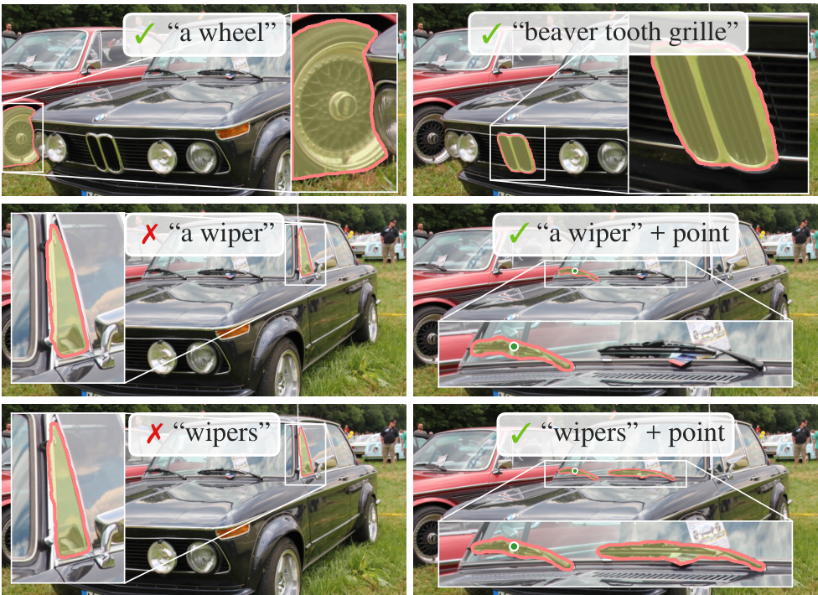
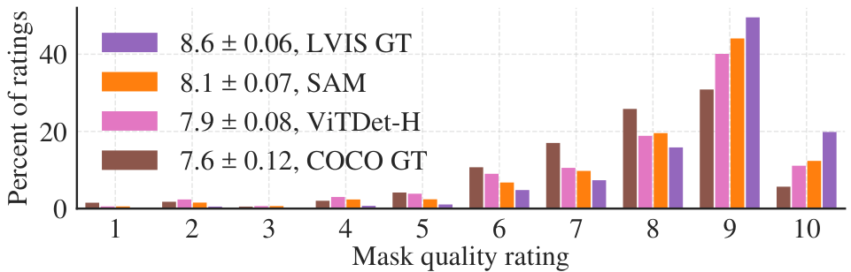
Performance and Experiments
Zero-Shot
Text-to-Mask
The Concept
SAM can find objects using just words.
It requires no text-specific training.
The Method
We use CLIP to link text and images.
It turns prompts like "wheel" into
visual signals that SAM understands.
Visual Proof
Images show SAM correctly outlining
complex parts like a grille or wheel.
Handling Ambiguity
Text is not always precise. Visuals
show SAM mistaking a pillar for a wiper.
The Solution
Adding one click guides SAM correctly.
See the "+ point" success images.
High Quality
The chart shows human ratings. SAM
bars (orange) peak at a 9/10 score,
outperforming standard models.

Slide 27
Performance and Experiments
The Impact of
Data Volume
on Model
Performance
The Ablation Study
Researchers tested performance by removing
data to understand training efficiency.
Key Finding: 10% is Enough
Training on just 1 million images (10%)
matches the performance of the full dataset.
Automatic vs. Human
Using fully automatic masks works almost
as well as human data. This makes scaling
much easier and faster.
Why It Matters
We do not need infinite human effort. The
data engine allows for massive scaling
for future foundation models.

Slide 28
SECTION 07
Conclusion
Summary & Future Directions

Slide 29
Conclusion
Summary and Future Impact
Foundation Model Era
We successfully built a foundation model for segmentation. It
adapts to new tasks by using broad, large-scale training data.
Three Core Pillars
The project success relies on a new task (prompting), a
robust model (SAM), and the massive SA-1B dataset with
over 11 million images to power this technological leap.
Open for Research
We released the full model and over 1 billion masks to the
public. This open approach allows the global research
community to build upon our work freely.
Future Standard
Whether SAM becomes the absolute industry standard
remains to be seen, but it paves the path ahead for
future computer vision advancements.
Visual Limitations
While SAM is versatile, it is not flawless. It can sometimes
miss fine structures or mistakenly "hallucinate"
disconnected parts that do not actually exist in the image.
Boundary Quality
Object edges are not always as crisp as those from slower
methods. Dedicated tools that "zoom in" may still produce
sharper, more precise segmentation lines.
Performance Constraints
The model processes user prompts quickly, but the overall
system is not fully real-time when using the heaviest
image encoders.
Specialized Domains
While SAM has breadth, specific tools (like in biology) may
still outperform it. Text-to-mask features are also currently
experimental and need more robust development.

