Slide 1
Meta AI Research, FAIR
arXiv:2304.02643v1 [cs.CV]
5 Apr 2023
Segment Anything:
Research Breakdown
A Comprehensive Research
Breakdown for Beginners

Slide 2
Table of Contents
Introduction to Segment Anything
03
The Task and Method
08
The Data Engine
15
The SA-1B Dataset
20
Zero-Shot Transfer Experiments
26
Ablations and Deep Analysis
35
Conclusion
39

Slide 3
SECTION 01
Introduction to
Segment Anything
Segment Anything: Research Breakdown

Slide 4
Introduction to Segment Anything
Understanding Image Segmentation
What is Image Segmentation?
Image segmentation is the digital process of identifying and
isolating specific pixels that belong to an object. Unlike
simple detection which places a box around items, segmentation
traces exact outlines. This precision allows computers to
understand the granular shape of the physical world.
The Specialized Trap
Traditionally, vision models were specialists. A system trained
to recognize specific objects, like cats, failed completely on
unseen items like cars. This required training a new model
from scratch for every distinct task, creating a major
bottleneck for scaling computer vision technologies.
Building a Foundation
Research aims to build a Foundation Model that adapts to
any segmentation task. This is analogous to upgrading from a
specialized tool that only turns Phillips-head screws to a
universal screwdriver kit. The system uses prompts to solve
new problems without needing retraining.
Unprecedented Scale
Success relies on three pillars: task, model, and data. The
team built the largest dataset ever, containing over 1 billion
masks on 11 million images. This vast data enables
zero-shot transfer, allowing the model to segment novel
objects immediately upon release.

Slide 5
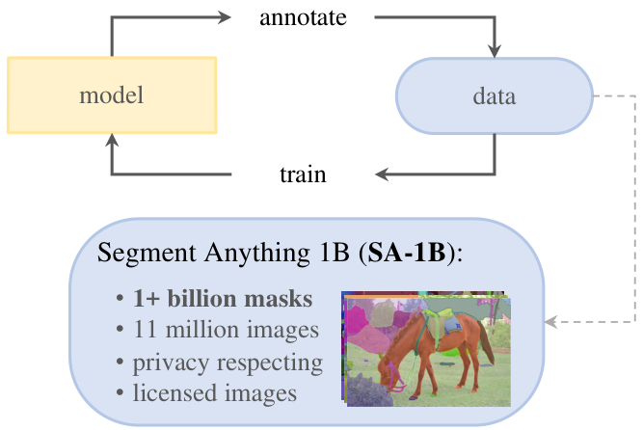
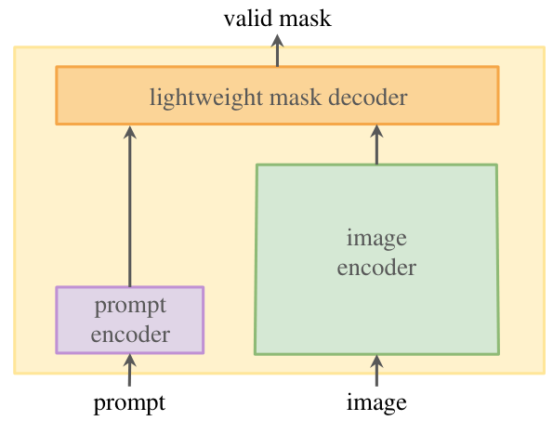
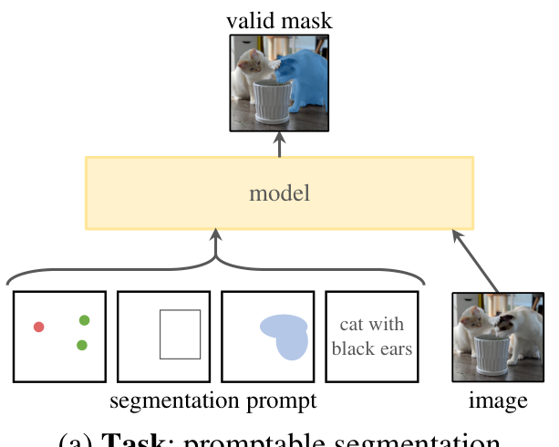
Introduction to Segment Anything
Segment
Anything
Project
Core Components
The project combines a new task, the SAM model, and the data.
This approach creates a foundation for solving any segmentation job.
How It Works
The model is promptable: you guide it with points, boxes, or text.
It enables zero-shot transfer, working on new images without retraining.
Massive Scale
To power this, Meta AI released SA-1B with 1+ billion masks.
It uses 11 million images to teach the model to 'see' everything.

Slide 6
Introduction to Segment Anything
CORE
PILLARS
1. TASK
2. MODEL
3. DATA
1. The Task
We define a promptable segmentation
task. Just like asking a chatbot a
question, we ask the vision model to
isolate an object.
How It Works
A user gives a prompt—like a click,
a box, or text ("cat")—and the system
returns a valid mask (outline).
Zero-Shot Power
This allows the model to solve new
problems on the fly without needing
extra training.
2. The Model
The Segment Anything Model
is built for efficiency. It splits
the work into two parts: a heavy
image encoder and a light prompt
encoder.
Real-Time Speed
Because image processing happens
once, adding prompts is instant.
This allows real-time use in a
web browser.
3. The Data
Data is the fuel. To train such a
capable model, the team built a
Data Engine.
The "Engine" Loop
1. Model assists human annotators.
2. Model learns from new data.
3. Model becomes fully automatic.
The Result: SA-1B
This process created the largest
dataset ever: 1+ billion masks on
11 million images.
Research Goal
To build a foundation model for
computer vision like GPT for text.

Slide 7
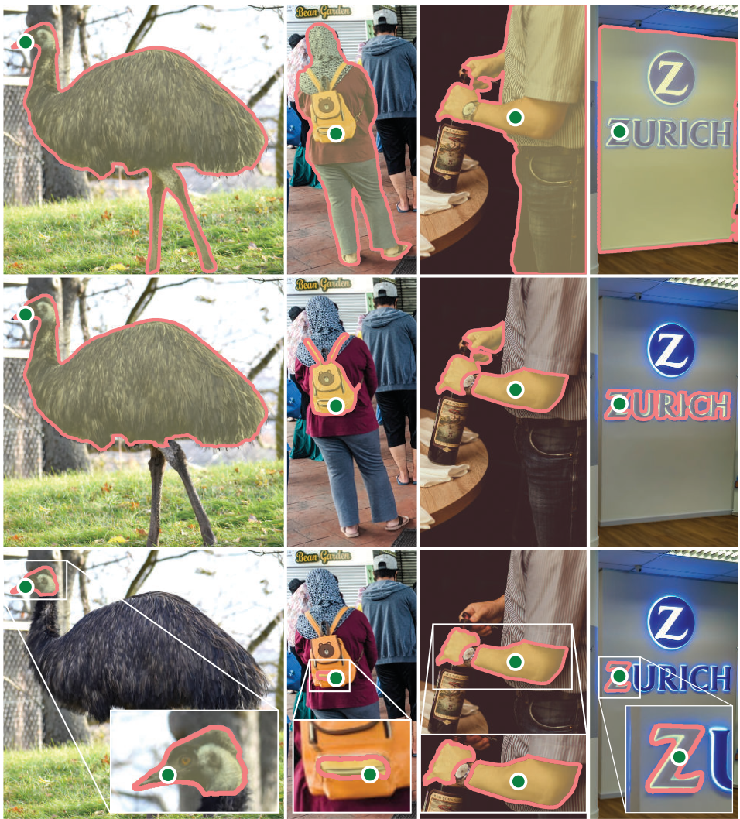
Introduction to Segment Anything
Promptable
Segmentation
Promptable Task
Like NLP models, SAM
takes a prompt (e.g.,
a click) and returns
a valid mask output.
Valid Output
It guarantees a
mask for at least
one valid object.
Visual Proof
Images show how one
green dot creates
multiple valid masks.
Ambiguity
A click on the sign
captures the whole
board, the logo, or
just the text.

Slide 8
SECTION 02
The Task and Method
Defining promptable segmentation and the model architecture.

Slide 9
The Task and Method
Defining the Segmentation Task
The Core Objective
The goal is to generate a valid mask for any prompt. Unlike
old systems requiring specific categories, this model responds
to spatial cues like points, boxes, or text descriptions.
Handling Ambiguity
Real-world prompts can be unclear. A single point on a shirt
might refer to the shirt or the person. The model is
designed to output a valid mask for at least one valid object.
Flexible Pre-training
The model is trained on a sequence of prompts. This
prepares it for a promptable segmentation task, allowing it
to solve new problems without needing specific retraining.
Real-Time Performance
Speed is critical for interactive tools. The system separates
image processing to predict masks in ~50 milliseconds,
enabling use directly in a standard web browser.

Slide 10
The Task and Method
One
Click
Can
Target
Three
Distinct
Object
Levels
Visual Ambiguity
A single input prompt is often
unclear. If a user clicks on a
backpack strap, the user's intent
is fundamentally ambiguous.
Interpreting Intent
Does the user want the strap, the
whole backpack, or the person
wearing it? In the real world, all
three are valid answers.
The Averaging Failure
Standard models try to "average"
these conflicting options, creating
a muddy, invalid result. SAM avoids
this by predicting all valid options.
Predicting Multiple Masks
To resolve ambiguity, SAM predicts
three valid masks simultaneously
for every single prompt. This ensures
at least one output is correct.
The Three Hierarchies
The outputs typically correspond to
three logical layers: the whole
object, a part, and a sub-part.
This covers most nesting cases.
Confidence Scoring
The model assigns a confidence score
(IoU) to each mask. This allows
systems to automatically select or
rank the most probable object.

Slide 11
The Task and Method
Image
Encoder
Prompt
Encoder
Mask
Decoder
One-Time Processing
The system splits the work into
two steps. First, a powerful
Image Encoder analyzes the photo.
It performs the complex math to
create a digital map, or embedding.
This heavy step runs once per image.
Efficiency Design
Because the hard work is done
upfront, the system does not need
to re-scan pixels for every click.
This separation allows for a
seamless, instant user experience.
Lightweight Prompts
The Prompt Encoder translates user
clicks, boxes, or text inputs
into computer-readable signals.
Fast Decoding
Finally, the Mask Decoder combines
signals to draw the object shape.
This runs directly in a browser
in just ~50 milliseconds.
Solving Ambiguity
If a prompt is vague, the model
predicts 3 valid masks (whole,
part, or sub-part) so the user
can select the best match.

Slide 12
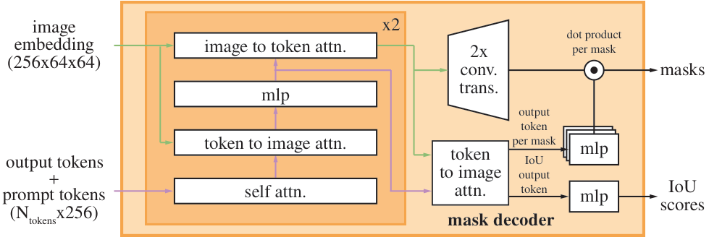
The Task and Method
Component 1:
The Image Encoder
ViT Architecture
Runs Once Only
Input Processing
The encoder transforms a 1024x1024 image into a
compact 64x64 embedding. This grid captures all
essential visual details needed for segmentation.
ViT Technology
We use a Vision Transformer (ViT) pre-trained with
Masked Autoencoders (MAE). It learns by predicting
missing parts of images, creating robust features.
Efficiency Profile
This is a heavyweight step but it runs only once.
The output is reused for all subsequent prompts,
allowing for real-time interaction in the browser.

Slide 13
The Task and Method
Prompt Encoder
and Mask Decoder
The Prompt Encoder
This tool translates user inputs like
clicks, boxes, or text into vector
embeddings. For text, it uses an
off-the-shelf CLIP model.
The Mask Decoder
This maps image and prompt embeddings
to a final mask. It employs efficient
attention blocks to update the image
data with prompt info in real time.
Speed & Efficiency
Designed for speed, these components
run in a web browser on a CPU. The
process takes just ~50ms, enabling
seamless interactive prompting.

Slide 14
The Task and Method
Efficiency and
Real-Time
Performance
Speed Metrics
The model is designed for seamless interaction. Once an
image is loaded, predicting a mask takes only ~50 milliseconds.
This occurs faster than a blink of an eye, ensuring there
is no frustrating lag between a user click and the result.
Browser Capability
Remarkably, the interactive part of the system runs
directly in a web browser on a standard computer CPU.
It does not require heavy, expensive graphics hardware
(GPUs) to function, making the tool widely accessible.
Enabling the Dataset
This efficiency was critical for the Data Engine. Because
the tool ran in real-time within a browser, human
annotators could label images extremely fast. This speed
allowed the team to scale up and create the massive
1.1 billion mask dataset.

Slide 15
SECTION 03
The Data Engine
Building the SA-1B dataset via model-assisted annotation.

Slide 16
The Data Engine
The Data
Scarcity
Problem
The Scale Challenge
Foundation models need massive data scales to
generalize. Text models use the entire internet
for training, but image masks are scarce.
The Missing Link
Unlike text, there was no existing "web-scale"
dataset for segmentation masks. The team had
to build their own source from scratch.
The Data Engine Solution
They built a cycle where the model assists in
creating data, which then improves the model.
Execution Strategy
To reach 1.1 billion masks, the team scaled
up operations in three distinct phases:
manual annotation, semi-automatic help, and
finally a fully automatic generation stage.

Slide 17
The Data Engine
Stage 1:
Assisted-Manual
Annotation
Methodology
The Annotation Tool
Professional annotators used a browser-based tool powered by
SAM to label images in real-time. Instead of drawing complex
outlines manually, they simply clicked points on objects.
Refining Masks
When the AI's initial guess needed help, humans used pixel-
precise "brush" and "eraser" tools to fix edges. This hybrid
workflow allowed for rapid, high-quality data collection.
Iterative Training
SAM started with public datasets but was re-trained 6 times
using new manual data. The model architecture scaled up from
smaller versions (ViT-B) to huge ones (ViT-H) as it learned.
Speed Improvements
Annotation time dropped from 34 to 14 seconds per mask.
This is 6.5x faster than traditional COCO mask annotation,
proving that AI-assisted workflows are significantly more
efficient than purely manual labeling methods.
Stage 1 Results
This phase collected 4.3 million masks from 120k images.
As SAM improved, the average masks per image rose from 20
to 44, showing that better AI tools lead to denser data.
Labeling Freedom
Annotators labeled both specific objects ("things") and
general textures ("stuff"). They prioritized prominent items
and moved to new images if a mask took over 30 seconds.

Slide 18
The Data Engine
Stage 2:
Semi-Automatic
Mask
Annotation
Targeting Diversity
The primary goal of Stage 2 was to increase mask diversity by
teaching the model to segment anything, not just
prominent objects.
The Workflow
We used a semi-automatic approach to aid humans. First, the
model automatically detected confident masks. We then
showed these pre-filled images to annotators and asked them
to label any remaining unannotated objects.
Generic Detection
To enable automation, we trained a bounding box detector on
Stage 1 masks using a single generic "object" category.
This allowed the system to spot confident regions.
Annotation Challenge
Interestingly, human annotation time rose to 34 seconds per
mask (excluding automatic ones). This increase occurred
because the remaining unflagged objects were significantly
harder to identify and label.
Data Collection Results
This approach successfully scaled our dataset. We collected
an additional 5.9 million masks across 180,000 images.
Improved Density
The collaboration between human and AI proved effective. The
average mask density jumped from 44 to 72 masks per image.
This metric confirms that the model learned to recognize the
"long tail" of less obvious objects.

Slide 19
The Data Engine
Stage 3: Fully
Automatic
Annotation
The Innovation
Annotation became fully automatic. Two key upgrades made this
possible: a model trained on diverse human data and a new
ambiguity-aware capability for complex cases.
Grid Prompting
We prompted SAM with a 32x32 point grid.
For each point, the model predicted a set of masks to identify
every valid object, part, and subpart in the image.
Filtering Quality
Since the model generates many masks, we filter strictly.
We keep only confident masks based on prediction scores
and stable masks that stay consistent even when
threshold settings change slightly.
Removing Duplicates
To clean up overlaps, we applied Non-Maximal
Suppression (NMS). This removes duplicate masks
while keeping the highest quality ones.
Zooming for Detail
To improve quality for smaller objects, we processed
multiple overlapping zoomed-in crops.
This allowed the model to see fine details clearly.
Final Scale
This engine ran on 11 million images.
It produced 1.1 billion masks,
making up 99.1% of the total dataset.

Slide 20
SECTION 04
The SA-1B Dataset
Segment Anything: Research Breakdown

Slide 21
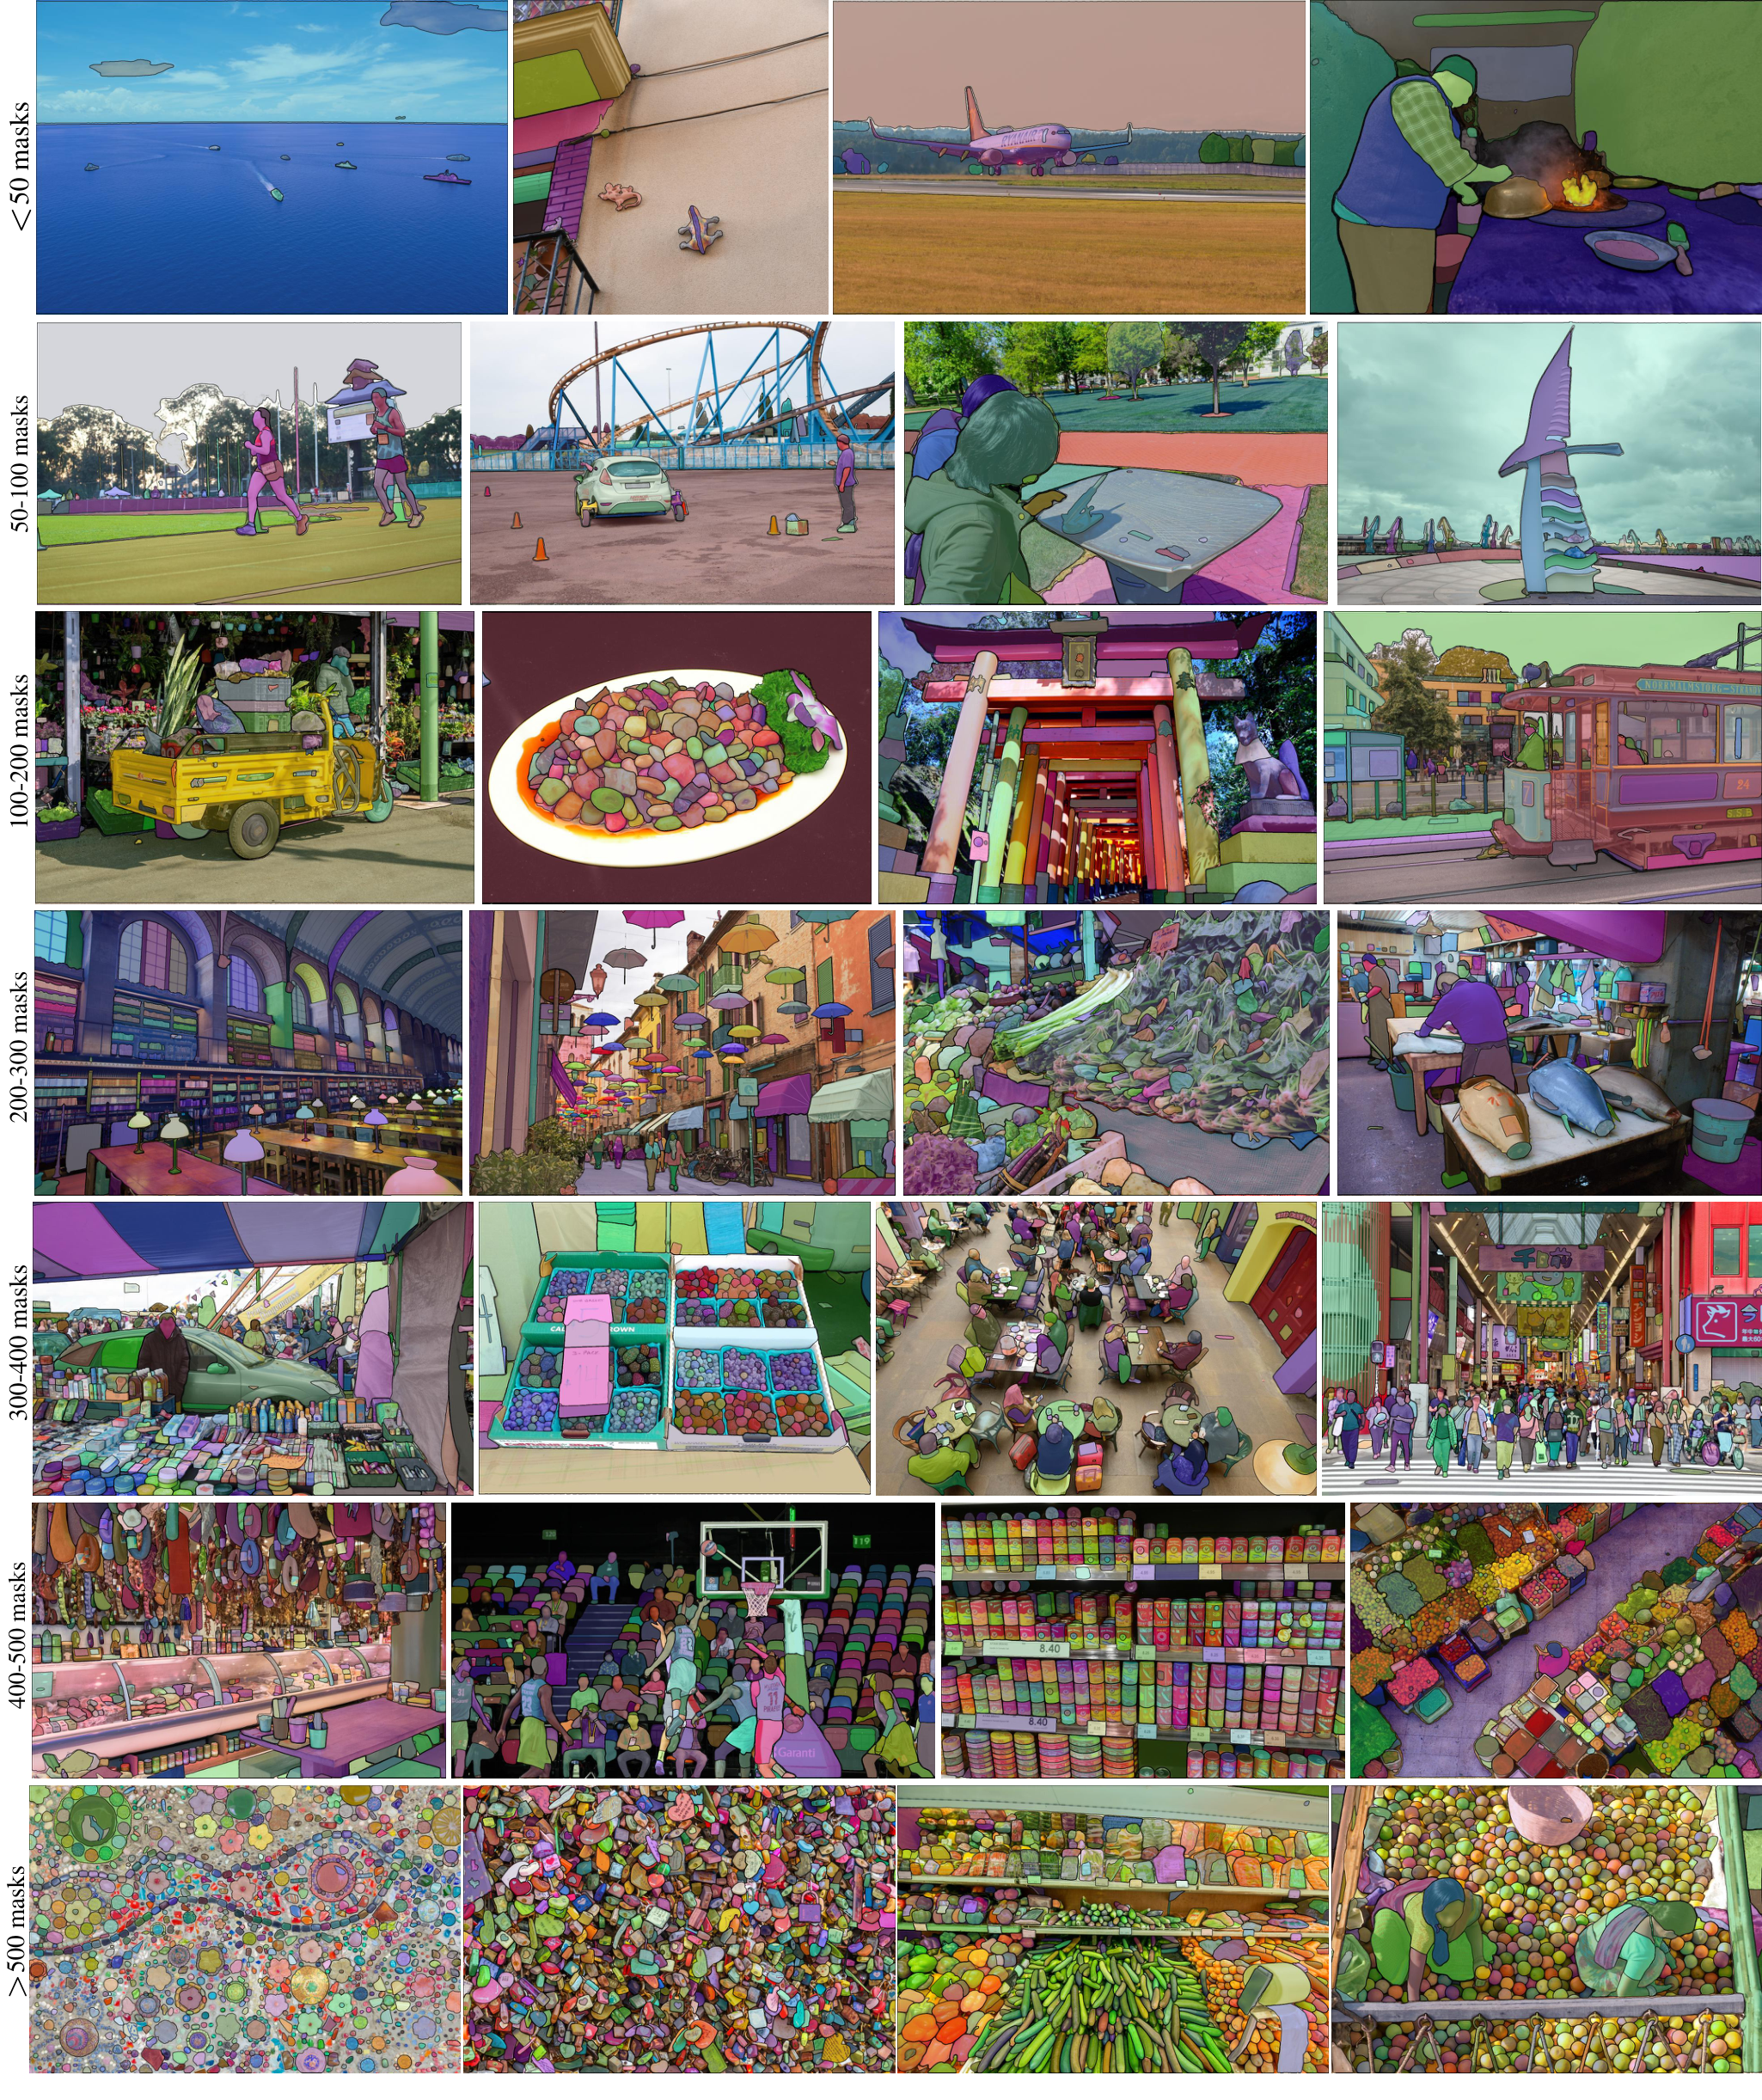
The SA-1B Dataset
Dataset Overview:
SA-1B
Massive Scale
SA-1B features 11 million images and
1.1 billion masks, averaging ~100 per image.
Fully Automated
A breakthrough 99.1% of masks were generated
automatically, removing the need for human labeling.
Visual Diversity
Scenes range from simple (<50 masks) to highly
complex (>500 masks) as shown in the grid.
Privacy Focus
All faces and license plates are blurred
to protect individual privacy in every photo.

Slide 22
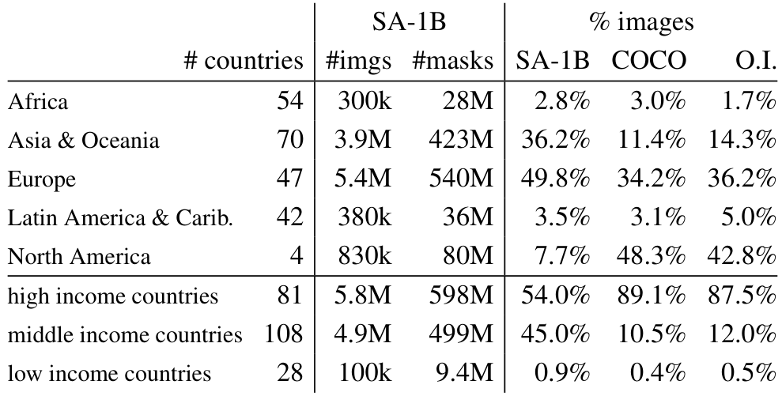
The SA-1B Dataset
Comparing Dataset Scale
SA-1B contains 11 million images and over
1.1 billion masks, setting a new standard.
This is 400x larger than existing datasets.
Unprecedented Size
SA-1B has 11x more
images than rivals.
It features 400x
more masks overall.
Total: 1.1 billion.
Global Diversity
Middle income nations
contribute 45%.
COCO has only 10%.
Better representation
for generic objects.
Reducing Western Bias
Previous datasets like COCO were 48% North American.
SA-1B is only 7.7% North American, prioritizing global
variety. Europe and Asia contribute 86% of all images.
Even Africa has 28M masks, which is 10x more than
the total count of any previous segmentation dataset.

Slide 23
The SA-1B Dataset
1.1 Billion
High-Quality
Masks Generated
Automatically
Spatial Distribution
Most image datasets have center bias, where photographers
focus on the middle. The SA-1B dataset differs by having
even coverage across the entire image, including corners.
This creates a more challenging and realistic training
environment than datasets like COCO, ensuring models can
detect objects located anywhere in a visual scene.
Complex Shapes
SA-1B isn't limited to simple blobs. Analysis of concavity
(shape complexity) shows it captures difficult structures
comparable to manual datasets. It also focuses on detail,
containing a higher percentage of small and medium masks.
With 36x more masks per image than Open Images, it
provides denser, more detailed supervision for AI models.
Human Verification
Since 99.1% of masks were generated automatically, we
verified quality using human experts. Annotators refined
masks in 500 images. The result was 94% pair agreement
(>90% overlap) between the model and humans. This proves
the automatic engine produces professional-quality data
indistinguishable from expensive manual annotation.

Slide 24
The SA-1B Dataset
Global Reach:
Reducing Bias
Across The
World Stage
Correcting Regional Bias
Standard datasets like COCO were heavily skewed, with
over 48% of images from North America. SA-1B corrects
this by reducing the North American share to just 7.7%.
Eurasian Growth
Representation for Europe surged to 49.8%, while Asia &
Oceania grew to 36.2%. This ensures AI models learn
from a more realistic global distribution of scenes.
Economic Representation
Older datasets were 89% sourced from high-income
countries. SA-1B reduces this to 54%, while boosting
middle-income representation to 45%.
African Data Volume
While Africa remains underrepresented by percentage
(about 2.8%), the massive scale of SA-1B means it
contains 28 million masks from the region—10x more
than any prior dataset.
Diverse Contributors
The top three contributing countries—Russia, Thailand,
and USA—hail from completely different continents,
highlighting the dataset's wide-ranging coverage.
Consistent Density
Regardless of location, image complexity is stable. The
average number of masks per image stays between 94
and 108 across all regions and income levels.

Slide 25
The SA-1B Dataset
Fairness
Analysis
Key
Metrics
Gender
Age
Skin Tone
Equity
Methodology
The team used the MIAP dataset to test
segmentation across demographic groups.
Gender Consistency
Performance was tested on perceived
female and male presentations.
Results showed minimal difference:
Females: ~54.4 mIoU (1-point).
Males: ~55.7 mIoU (1-point).
SAM treats perceived genders equitably.
Age Groups
Evaluated across young, middle, and
older perceived age groups.
Performance was stable, with slightly
higher scores for older individuals
(62.9 mIoU) compared to others.
Skin Tone Analysis
Tests used the Fitzpatrick scale,
ranging from Type 1 (lightest) to
Type 6 (darkest skin tone).
Results found no significant
difference in segmentation quality
across the entire spectrum.
Scores ranged from 51.5 to 56.7.
Fairness Conclusion
While the underlying training data
contains inherent societal biases,
SAM generally provides equitable
segmentation performance across
different protected groups.

Slide 26
SECTION 05
Zero-Shot Transfer
Experiments

Slide 27
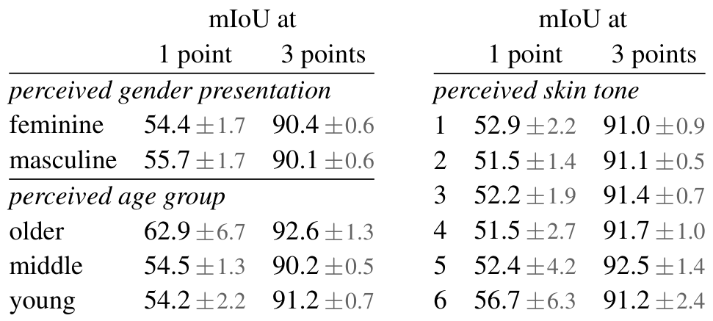
Zero-Shot Transfer Experiments
Consistent
Accuracy
Across All
Demographics
What is Zero-Shot?
It means performing new tasks without specific training.
SAM adapts because it learned to segment anything first.
Diverse Testing
We evaluated SAM on 23 unique datasets not seen before.
These included underwater, medical, and aerial images.
The Challenge
A single point is ambiguous, yet SAM must guess the shape.
Fairness Analysis
We measured performance across gender, age, and skin tone.
The data confirms consistent accuracy for all groups.
Visual Data Insights
With just 3 points, scores exceed 90% in every category.
The older age group reached a peak score of 92.6.
Scores for 6 skin tones ranged tightly from 91.0-92.5.

Slide 28
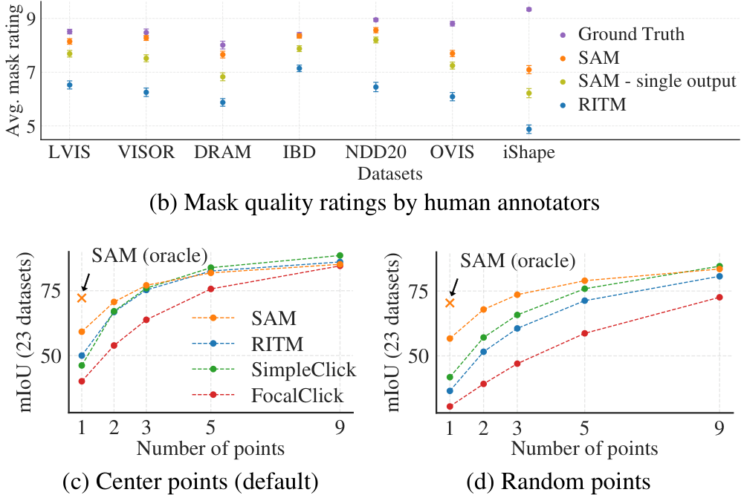
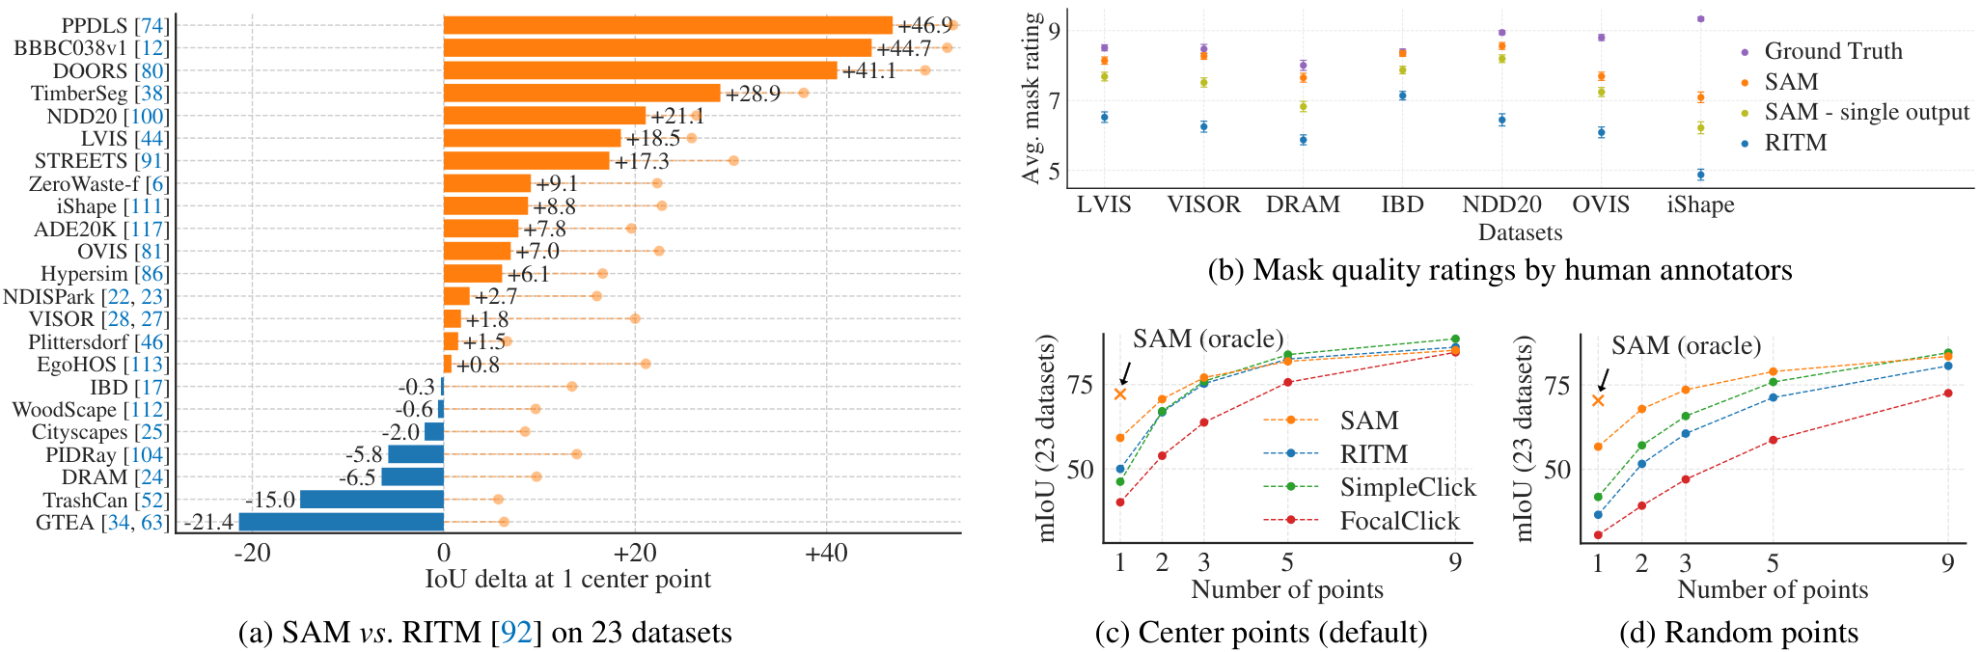
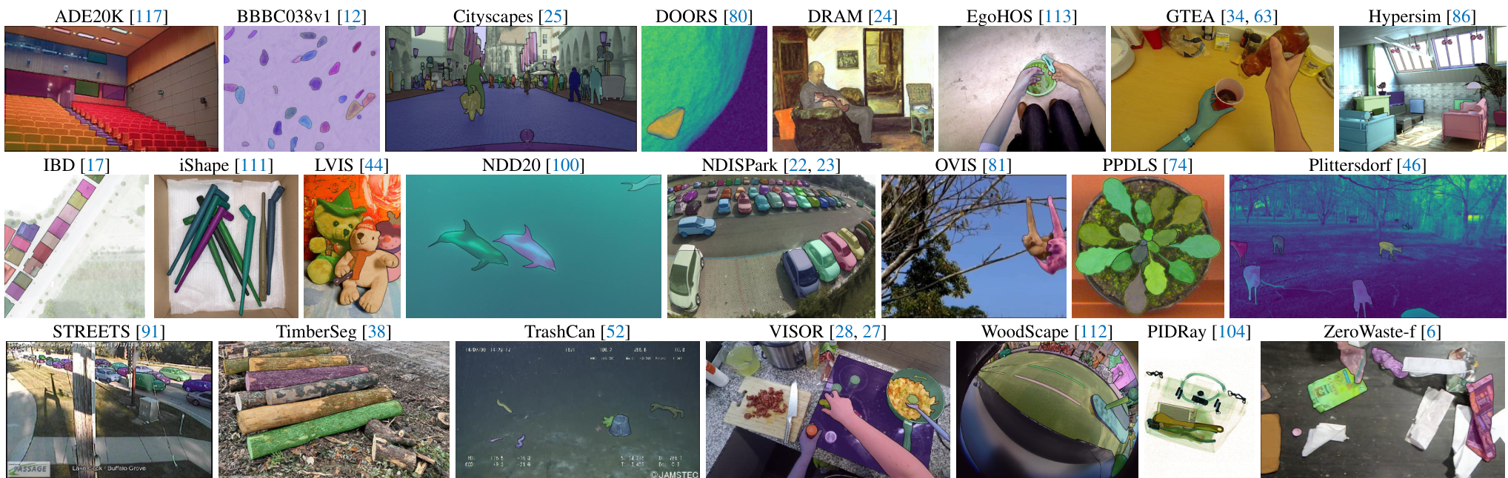
Zero-Shot Transfer Experiments
Single Point
Evaluation
The "Single Point" Task
Users provide just one click to identify an
object. This is tricky because a single
point is ambiguous (e.g., shirt vs person).
Experimental Setup
We tested SAM on 23 diverse datasets,
ranging from microscopy to underwater
photos. We compared results against RITM,
a strong interactive segmentation model.
Key Performance Results
SAM beats the baseline on 16 of 23 datasets. Human raters
consistently score SAM masks 7-9 vs RITM at 5-6.
At 1 click, SAM achieves ~58 mIoU accuracy compared to
just ~48 mIoU for RITM, showing robust transfer.

Slide 29
Zero-Shot Transfer Experiments
Automated Metrics
Can Be Misleading
Human Ratings
Tell True Story
The Ambiguity Problem
Standard metrics assume one correct answer. If a prompt is
ambiguous, like a shirt vs. person, the model might
be right but get a low score for picking the "wrong" object.
This makes automated tools unreliable for complex real scenes.
Human Study Setup
Since metrics struggle, researchers asked humans to rate mask
quality from 1 to 10. A high score of 7-9 means the
object is identifiable with only rare, small errors.
Consistent Quality
Humans consistently rated SAM's masks significantly higher
than the baseline RITM model, validating its superior
performance in real-world visual tasks.
Key Discrepancy
On datasets like DRAM and IBD, automated metrics
suggested SAM performed poorly. However, human evaluators
rated SAM consistently higher on these exact datasets.
The Conclusion
Automated metrics undervalue SAM because they don't account
for ambiguity. Human eyes confirm SAM handles complex,
ambiguous scenes better than baselines.

Slide 30
Segment Anything: Research Breakdown
Performance with Multiple Points
The Interactive Scenario
In practical use, a human might click once to select an
object. If the mask is wrong, they click again to correct
it. Researchers tested how well models adapt when users
provide anywhere from 1 to 9 distinct input points.
Universal Improvement
As the number of points increases, the segmentation task
becomes easier. All tested models showed a clear upward
trend. Accuracy (mIoU) metrics consistently improved,
climbing from roughly 50% to over 80% with 9 points.
SAM vs. The Specialists
At 1 point, SAM holds a strong lead over specialized
tools like RITM. As points increase to 9, the performance
gap shrinks. Even with many points, SAM remains on par
with models built specifically for interactive tasks.
Efficiency Without Specialization
Unlike baselines such as FocalClick which are optimized
solely for this interaction, SAM is a generalist model.
It achieves competitive results in this specific mode
while retaining its broad zero-shot capabilities.

Slide 31
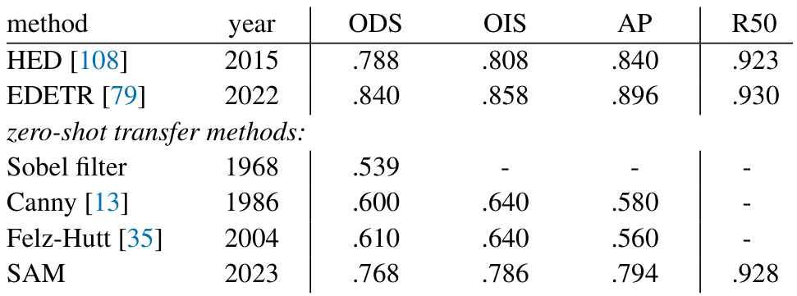
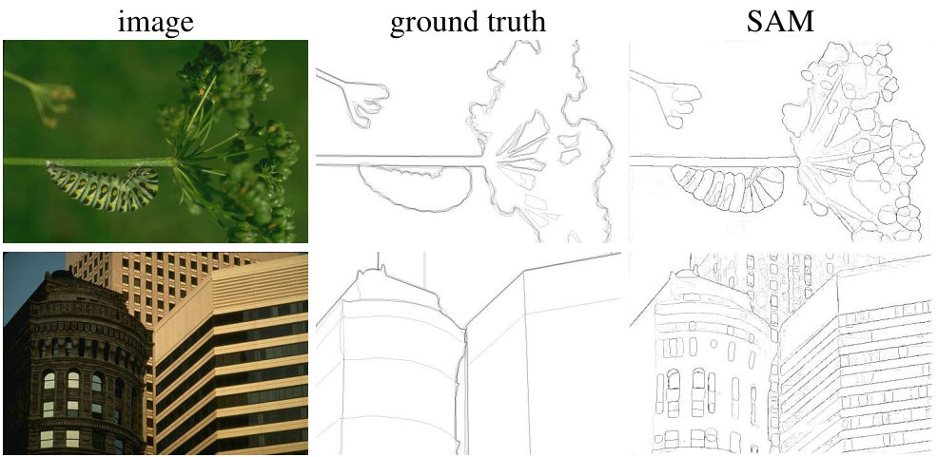
SAM (right) detects fine details often missed by humans (center).
The Method
SAM prompts a
16x16 point grid
to find edges.
Key Results
It achieves a
.928 Recall
score (R50).
Comparison
It beats classic
Canny filters.

Slide 32
Zero-Shot Transfer Experiments
Task 3:
Object
Proposals
The Challenge
Object proposal generation finds likely objects in an image.
It creates a list of locations where objects might exist.
This helps detection systems find specific items later.
SAM's Approach
We used a modified version of SAM's automatic mask pipeline.
It generates masks for the image without any extra training.
SAM acts in a "zero-shot" mode, meaning it never saw the
specific LVIS dataset used for testing.
A Strong Baseline
We tested SAM against ViTDet-H, a system trained on LVIS.
ViTDet-H is highly specialized and knows the data biases.
Key Successes
SAM beat the baseline on medium objects (81.6 vs 80.8).
It also won on rare objects (65.8 vs 58.3), showing
it generalizes better than the specialized model.
Room for Improvement
SAM lagged on small objects (45.5 score vs 51.7).
The baseline learned specific data biases that SAM ignores
because it is a general-purpose tool, not a specialist.
Why Ambiguity Matters
SAM predicts multiple masks to handle ambiguous objects.
A "single output" version performed significantly worse.
This proves that acknowledging uncertainty is critical.

Slide 33
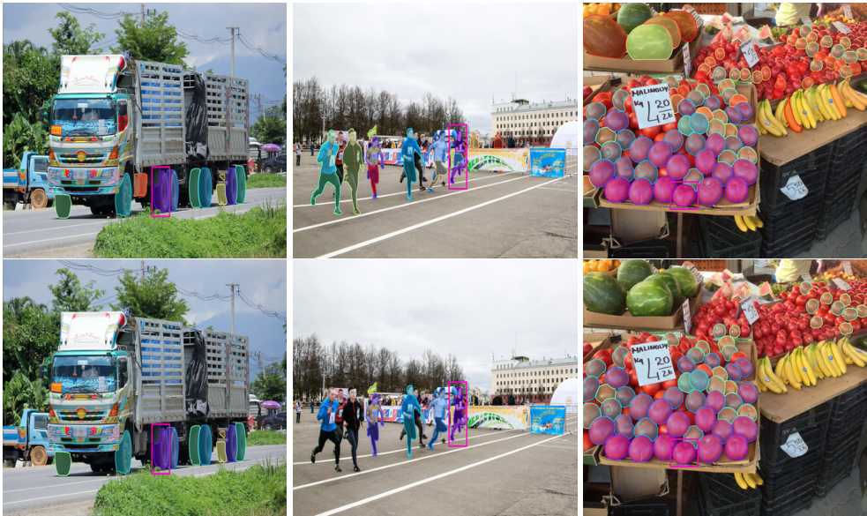
Zero-Shot Transfer Experiments
Zero-Shot
Segmentation
The Method
We used a ViTDet detector to find boxes,
then prompted SAM to segment the objects.
Results & Limits
SAM yields crisper boundaries but misses
specific dataset rules (like mask holes)
since it cannot learn training biases.

Slide 34
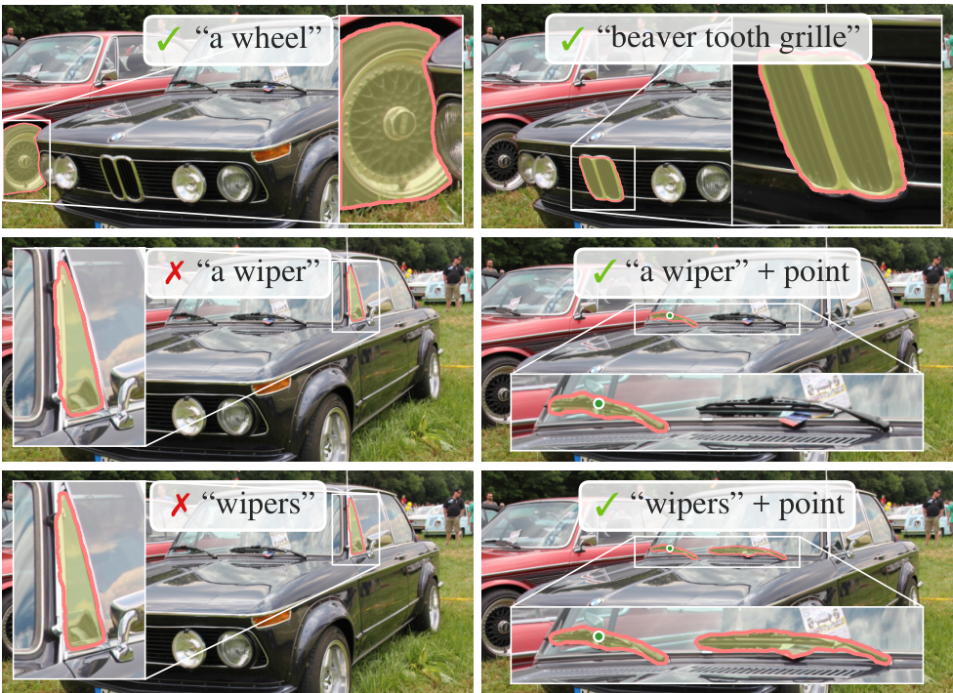
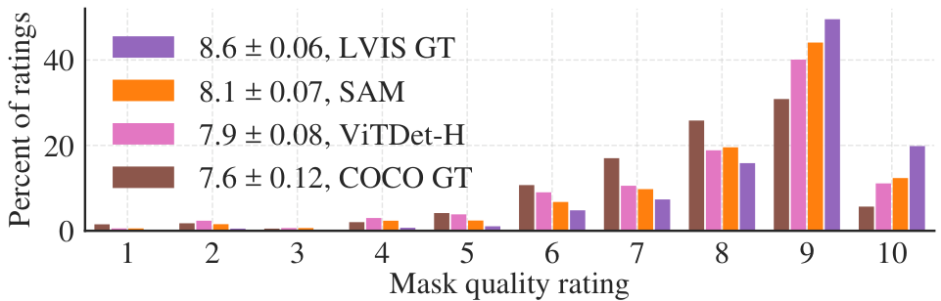
Zero-Shot Transfer Experiments
Task 5:
Text-to-Mask
Capabilities
Text Only
Simple
prompts
like
"a wheel"
work well.
But vague
terms
fail.
Mistakes
window.
With Points
Adding a
point
fixes
ambiguity.
Target
becomes
clear.
Wipers
found.

Slide 35
SECTION 06
Ablations and
Deep Analysis
Detailed evaluation of model components, data scaling laws, and zero-shot performance benchmarks.

Slide 36
Impact of Training Data Volume
Automatic
Data
Engine
Is
Highly
Effective
For
Training
Data Stages
We gathered masks in three distinct
stages: manual, semi-automatic, and
fully automatic. Each new stage added
valuable data that improved the model's
accuracy, measured by mean IoU.
Automatic Power
Surprisingly, training with only the
automatically generated masks yielded
results nearly identical to using the
full human-verified set. The drop in
performance was marginal, around
0.5 mIoU. This proves the auto-data
engine is highly effective on its own.
Volume Efficiency
We tested training on subsets of the
full SA-1B dataset, which contains
11 million images. Reducing data to
just 0.1 million caused a sharp drop
in segmentation quality.
The 10% Sweet Spot
However, training on just 1 million
images (about 10% of the total) gave
results comparable to the full set.
This subset still includes roughly
100 million masks, making it a
practical setting for many research
and industry use cases.

Slide 37
Ablations and Deep Analysis
Impact of
Model Size
Testing Model Scale
The team tested three sizes of the
Image Encoder (the AI's eyes). They
compared ViT-B (91M params),
ViT-L (308M), and ViT-H (636M)
to see if bigger always means better.
Performance Results
The largest model, ViT-H, performed
best. It showed a clear accuracy
jump compared to the smallest
Base model on the 23-dataset suite.
Diminishing Returns
Surprisingly, the gains slowed down.
ViT-H was only slightly better than
ViT-L. Adding massive complexity
yielded only marginal improvements.
Speed vs. Accuracy
Smaller models like ViT-B are much
faster. For real-time tools, users
often prefer the speed of a smaller
model over the tiny accuracy boost
of a huge one.

Slide 38
Ablations and Deep Analysis
Inside the Latent Space
The Semantic Question
Does SAM understand what objects are, or just where they are?
The model was trained strictly on segmentation—isolating
shapes—without any labels like 'cat' or 'car'. We investigated
if it secretly learned to categorize the world on its own.
The Investigation Method
Researchers analyzed the 'latent space'—the model's internal
mathematical thought process. They extracted mask embeddings,
which are digital signatures for each object. They then tested
if the signatures of similar objects were mathematically close.
Visual Findings
The results in Figure 17 are clear. When the model looks at a
mask of a person, its internal math links it to other people.
When shown a fruit, it links it to other fruits. It groups
semantically related items together automatically.
Key Conclusion
SAM achieved semantic understanding purely by learning to
segment images. Without any teacher providing labels, it
discovered that objects of the same type share fundamental
features. It built its own concept of the world from scratch.

Slide 39
SECTION 07
Conclusion

Slide 40
Conclusion
Current Model
Limitations
Fine Structures
While generally accurate, SAM is not perfect. It can
miss very thin structures in complex images.
Sometimes it disconnects components that should
be logically joined together.
Hallucinations
The model occasionally produces small, nonsensical
blobs known as hallucinations.
This happens when it identifies a shape where no
distinct object actually exists.
Real-Time Speed
SAM processes user prompts instantly. However, the
underlying image encoder is computationally heavy.
This creates a bottleneck for video applications.
Hardware Needs
Achieving true real-time performance often requires
specialized, powerful hardware.
Without it, the heavy image encoder slows down
the overall processing loop significantly.
Semantic Limits
SAM proposes masks but does not name them. It knows
that a region is an object, but lacks the semantic
knowledge to label it as a 'cat' or 'chair'.
Specificity
Designed for generality, SAM may be outperformed by
dedicated tools in specific fields.
Domain-specific models can still offer higher
precision in niche areas like biology.

Slide 41
Conclusion
Summary and Future Impact
Principal Contributions
The project delivers three key innovations: a promptable
segmentation task, the Segment Anything Model (SAM), and the
SA-1B dataset. This creates a massive resource for the
community, containing over 1 billion masks across
11 million licensed images.
A Foundation for Vision
Like GPT in language, SAM is designed as a foundation model
for computer vision. It is trained on broad data to adapt
to new tasks. By using prompt engineering, it solves
downstream segmentation problems on new data distributions
without retraining.
System Composability
SAM's ability to accept prompts allows it to act as a
component in larger AI systems. For example, it can pair
with object detectors or wearable devices that detect gaze
points to segment specific objects instantly.
Future Research Impact
The release of the 1B mask dataset significantly lowers
barriers for computer vision research. By standardizing the
promptable segmentation task, it encourages the community
to build even more powerful, generalizable models.

