Slide 1
LLaMA: Open and Efficient Foundation Language Models
Research Breakdown

Slide 2
Table of Contents
The LLaMA Project Overview
03
The Training Data Diet
08
Architectural Innovations
13
Training & Efficiency
18
General Performance Analysis
22
Specialized Capabilities
28
Safety, Bias, and Truth
33
Environmental Impact & Conclusion
38

Slide 3
SECTION 01
The LLaMA Project Overview
Open and Efficient Foundation Language Models

Slide 4
2302.13971-easy
Meet LLaMA: A New Foundation for AI
Understanding LLaMA
LLaMA (Large Language Model Meta AI) is a collection of
foundational AI models ranging from 7 billion to 65 billion
parameters. These parameters act like digital synapses,
determining the model's complexity. Meta released this suite
to provide a standard, open foundation for researchers.
Democratizing Access
Most powerful AI models require massive data centers to run.
However, the LLaMA-13B model is efficient enough to run on a
single GPU, enabling academic researchers to study LLMs
without needing industrial-grade infrastructure. This shifts
focus from training budgets to inference efficiency.
Public Data Transparency
Unlike competitors that rely on secret, proprietary data,
LLaMA proves that state-of-the-art results are possible using
exclusively publicly available datasets.
This approach solves the "black box" problem, allowing
scientists to fully audit the source of the model's knowledge.
Efficiency Over Size
Bigger isn't always better. LLaMA-13B outperforms the famous
GPT-3 (175B) on most benchmarks despite being 10x smaller.
At the high end, the 65B model rivals massive systems like
Chinchilla-70B and PaLM-540B, proving that training on
more data yields better results than just adding parameters.

Slide 5
The LLaMA Project Overview
Rethinking
Efficiency:
Training vs.
Inference
Prior 'Hoffmann laws' optimized only for
training costs, suggesting a 10B model
should use just 200B tokens. This approach
ignores the high cost of running the model.
LLaMA prioritizes the inference budget.
We train smaller models on significantly
more data (trillions of tokens), making
them faster and cheaper to use daily.
Evidence shows a 7B model improves even
after 1T tokens. LLaMA-13B outperforms
the massive GPT-3 (175B) while being
10x smaller, enabling single-GPU use.

Slide 6
The LLaMA Project Overview
David vs. Goliath: Performance Claims
The 13B Benchmark
In the world of AI, size usually equals power. However, the
LLaMA-13B model outperforms the famous GPT-3 (175B)
on most benchmarks despite being over 10x smaller.
This efficiency proves that clever architecture and training
quality matter more than just raw parameter count.
Competing with Giants
At the high end, the LLaMA-65B model stands toe-to-toe
with the industry's most powerful proprietary systems.
It matches the performance of Chinchilla-70B and Google's
massive PaLM-540B, demonstrating that open research
models can rival the best closed-source technology.
Democratizing Access
Historically, studying top AI required millions in hardware.
A critical breakthrough is that the 13B model fits on a
single standard GPU (graphics card). This allows universities
and small labs to study these powerful systems directly,
shifting power away from just big tech companies.
Smarter Scaling Strategy
The focus is on the inference budget—the cost to run the
model daily. By training a smaller model on more data,
LLaMA becomes much cheaper and faster to use than larger
competitors. Even after 1 trillion tokens, performance
continued to improve, validating this data-rich approach.

Slide 7
The LLaMA Project Overview
Transparent
Open Science
Methodology
The Proprietary Problem
Competitors like GPT-3 and PaLM rely on undocumented or
proprietary data (e.g., private social media conversations).
This creates a "black box" where results cannot be verified.
The Public Data Shift
LLaMA uses only public data like CommonCrawl and Wikipedia.
This ensures compatibility with open-sourcing and allows
the entire community to reproduce our training results.
Democratizing Access
Massive LLMs typically require expensive industrial hardware.
However, LLaMA-13B is efficient enough to run on a
single consumer GPU, making it accessible to universities.
Why This Matters
By sharing the model weights, we empower smaller labs to
study these systems. This fosters innovation rather than
keeping AI development locked behind corporate doors.
Studying Limitations
All foundation models struggle with hidden biases
and toxicity.
Proprietary models often hide these flaws behind API walls.
We release LLaMA so the responsible AI community can map
these risks accurately.
Transparent Safety
We believe transparency is the only way to solve safety
issues. Researchers must be able to inspect the model
directly.

Slide 8
SECTION 02
The Training Data Diet

Slide 9
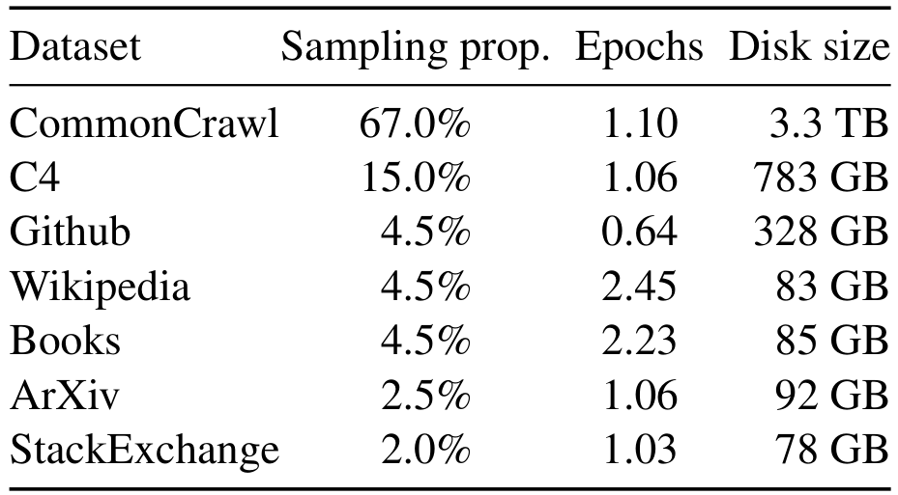
The Training Data Diet
What Does
LLaMA Read?
The Main Ingredient
The diet is mostly CommonCrawl (67%),
a massive 3.3 TB archive of the web.
Quality Over Quantity
Complex text like Wikipedia and Books
is rarer (4.5%) but read twice.
This ensures the model learns facts.

Slide 10
The Training Data Diet
Processing the Web: CommonCrawl & C4
The CommonCrawl Foundation
This massive source represents 67% of the total data. It
combines five snapshots of the internet taken from 2017 to 2020.
To handle this scale, the team used the CCNet pipeline for
cleaning. This includes line-level deduplication, which removes
repetitive sentences to prevent the model from memorizing loops.
The Role of C4 Data
The team added the C4 dataset, making up 15% of the mix.
Early tests proved that using diverse web sources improved
results. Unlike the main web dump, this dataset adds variety,
preventing the AI from learning only one type of writing style.
Ensuring High Quality
A smart filter, or classifier, removes low-quality text. It was
trained to recognize reliable content by analyzing Wikipedia
references. Web pages that did not resemble these trusted
sources were discarded to maintain high academic standards.
Heuristic Filtering
Instead of complex AI filters, C4 uses heuristics, or simple
rules. It validates text based on basic signs like punctuation
and word counts. This lighter touch preserves useful data that
stricter filters might miss, aiding generalization.

Slide 11
The Training Data Diet
Academic and
Literary Knowledge
Wikipedia [4.5%]
We utilized Wikipedia dumps from the June-August 2022
period, covering 20 languages across Latin and Cyrillic
scripts. This provides a diverse factual foundation.
Cleaning Process
Raw web data is messy. We processed the text to remove
hyperlinks, user comments, and formatting boilerplate,
leaving only high-quality encyclopedic content.
Books [4.5%]
To teach long-form narrative structure, we combined two
massive corpora: Project Gutenberg (public domain works)
and Books3 (a modern dataset from ThePile).
Quality Control
We performed deduplication at the book level. Any book
with more than 90% overlap with another was removed to
prevent the model from memorizing repeated text.
ArXiv Papers [2.5%]
We processed ArXiv scientific papers to add rigorous
academic knowledge. We used raw Latex source files to
preserve mathematical formulas and technical definitions.
Processing Steps
We stripped out bibliographies and comments unrelated to
the content. Inline definitions were expanded to ensure
the model understands complex scientific terms.

Slide 12
The Training Data Diet
Technical
Proficiency:
Code & Q&A
Github Code Repository
We sourced public code distributed under
permissive licenses like Apache, BSD, and
MIT. To ensure high training quality, we
filtered out files with low line counts or
sparse alphanumeric characters. This cleans
up "junk" code and removes boilerplate.
Stack Exchange Q&A
This captures diverse expert knowledge from
the 28 largest websites, covering topics
ranging from Computer Science to Chemistry.
We cleaned the text by removing HTML tags
and sorted answers by score (highest first).
This method prioritizes the most helpful,
community-verified solutions for the model.

Slide 13
SECTION 03
Architectural
Innovations
Modifications to the standard Transformer architecture.

Slide 14
2302.13971-easy
The Transformer
Backbone
Pre-normalization
To ensure stable learning, LLaMA adopts a GPT-3 technique.
Standard models normalize data at the output. LLaMA normalizes
the input of each layer instead. This prevents errors.
RMSNorm
It uses a specific function called RMSNorm to smooth out
mathematical spikes in data, making the training process much
more efficient and reliable.
SwiGLU Activation
Activation functions act like neurons firing in a brain.
They decide what information passes forward. LLaMA replaces
the standard ReLU function with SwiGLU.
Performance Boost
Inspired by the PaLM model, this upgrade helps the AI
understand complex patterns. It keeps more detail than older
methods, directly improving accuracy.
Rotary Embeddings
To understand language, an AI must know word order.
Old models used fixed position markers. LLaMA uses a new
approach called Rotary Positional Embeddings (RoPE).
How It Works
Adopted from GPT-Neo, RoPE uses rotation math to link words.
This helps the model understand connections between words
regardless of how far apart they are in a sentence.

Slide 15
Architectural Innovations
Improvement 1:
Pre-normalization
(RMSNorm)
Inspired by GPT-3
To improve training stability, we adopted a key
architectural choice from the GPT-3 model design.
Input vs. Output
Standard transformers normalize data at the output.
Instead, we normalize the input of each sub-layer.
This subtle shift creates a more stable foundation
for the model to learn complex patterns effectively.
Using RMSNorm
We utilize Root Mean Square Normalization, or RMSNorm.
This specific function was introduced by Zhang & Sennrich.
It was originally published in their 2019 research.
Simplified Calculation
RMSNorm simplifies calculations compared to older
normalization methods like LayerNorm.
It rescales numerical values efficiently, which is
critical when processing billions of parameters.
Why This Matters
Training massive AI models is mathematically risky.
Signals can vanish (become zero) or explode (get too
huge), causing the training process to fail.
The Outcome
Pre-normalization acts as a stabilizer.
This allows for smoother training of deep networks.
We can train on 1.4 trillion tokens without crashing.

Slide 16
Architectural Innovations
Improvement 2:
SwiGLU Activation
Smarter Activation
Neural networks process data using activation
functions. We replaced the standard ReLU
method with SwiGLU to improve learning.
Think of SwiGLU as a smoother, more precise
dimmer switch compared to ReLU's simple toggle.
Inspired by PaLM
Following Google's PaLM model, we adopted
SwiGLU to boost performance. Research by Shazeer
(2020) proves it yields better results than ReLU.
Technical Efficiency
To balance complexity, we use a dimension of
2/3 * 4d instead of the full 4d used in PaLM.
This keeps the model powerful yet efficient.

Slide 17
2302.13971-easy
Improvement 3:
Rotary Embeddings
(RoPE)
Inspiration
This innovation was adopted from GPT-Neo to improve how
the model handles positional information and word order.
The Switch
We removed absolute positional embeddings. Instead, we added
Rotary Embeddings (RoPE) at each layer of the network.
How It Works
Traditional methods stamp a fixed number on each word. RoPE
encodes position by rotating the vector in space.
Visual Analogy
Think of it like a clock face. The position of a word is
defined by the angle of the hand, rather than a static tag.
The Advantage
This method allows the model to understand the
relative distance between words much better.
Flexibility
It works well regardless of sequence length. Whether a text
is short or very long, the relationships remain clear.

Slide 18
SECTION 04
Training & Efficiency

Slide 19
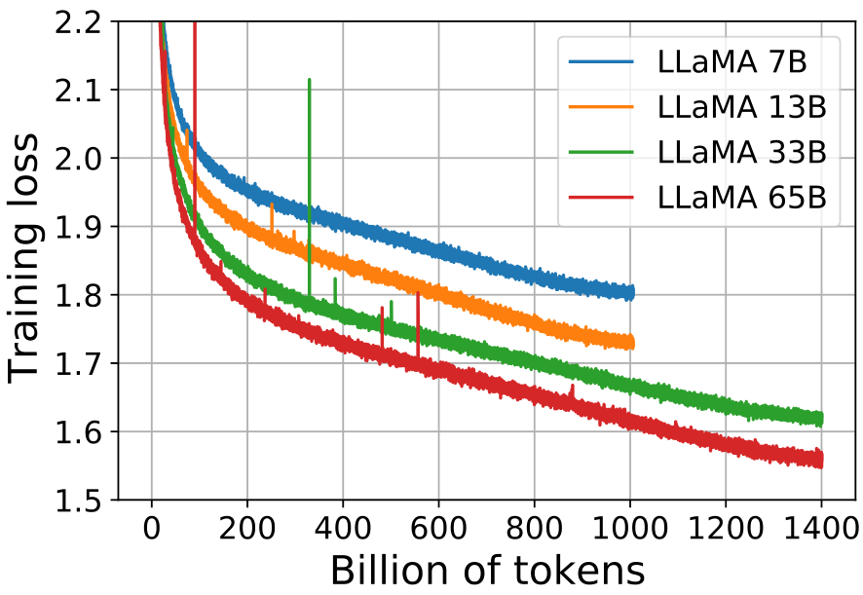
Visual Data: 65B model reaches lowest loss (~1.5) on 1.4T tokens.
The Optimization
Recipe
AdamW optimizer uses beta1=0.9, beta2=0.95 and
cosine schedule decaying to 10% of max rate.
This ensures stable and efficient training.
Hyperparameters
Weight decay: 0.1
Gradient clip: 1.0
AdamW Settings
Beta1 set to 0.9
Beta2 set to 0.95
Training Scale
Batch size: 4M
Tokens: 1.4T
Warmup: 2,000
Loss Trend
Loss drops fast
then stabilizes.

Slide 20
Training & Efficiency
Speeding Up:
Efficient
Implementation
Smart Optimization
We use the xformers library to skip "masked"
future words the model shouldn't see yet. This
avoids storing unnecessary weights in memory.
Efficient Checkpointing
We save heavy calculations (linear layers) from
the forward pass. This reduces the work needed
during the "backward" learning phase.
Real-World Speed
With 2,048 A100 GPUs, we process 380 tokens
per second on each unit. Training the 65B model
on 1.4T tokens took roughly 21 days.

Slide 21
Training & Efficiency
Visualizing
Progress:
Training Loss
The Y-axis shows training loss, which
measures prediction error. Like a golf
score, lower values indicate better
performance and higher accuracy.
Larger models like the 65B (red line)
learn faster than smaller ones like the 7B
(blue line). Size drives efficiency, reaching
lower error rates with fewer training steps.
Improvement continues even after 1.4T
tokens. The curves do not flatten out,
suggesting these models are not saturated
and could still learn from more data.

Slide 22
SECTION 05
General Performance Analysis

Slide 23
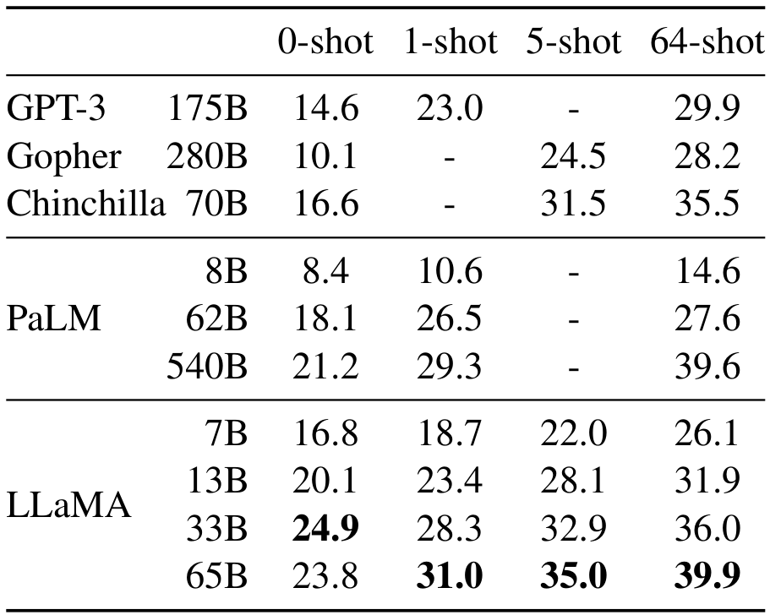
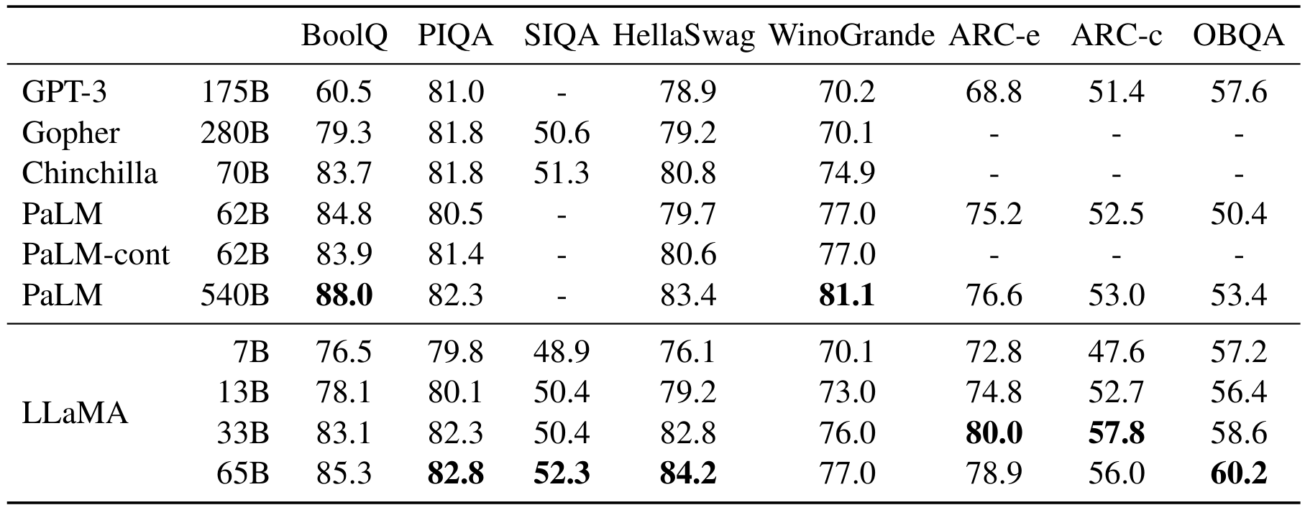
Common Sense Reasoning Benchmarks
LLaMA-65B
Outperforms
PaLM-540B
On Reasoning
We evaluated models on 8 datasets
measuring logical reasoning types like
common sense (PIQA) and context (BoolQ).
Tasks range from completing sentences to
answering questions about daily events.
The LLaMA-13B model outperforms
GPT-3 (175B) on most metrics, despite
being 10x smaller. On BoolQ, it
scores 78.1, far exceeding the
GPT-3 score of 60.5. Smaller is capable.
LLaMA-65B beats Chinchilla-70B
across the board. It also surpasses
PaLM-540B on benchmarks like PIQA
(82.8) and HellaSwag (84.2), proving that
efficiency can overcome massive size.
Performance scales linearly with size.
The 65B model leads with top scores:
82.8 on PIQA and 60.2 on OBQA.
Optimized training data allows for
state-of-the-art reasoning results.

Slide 24
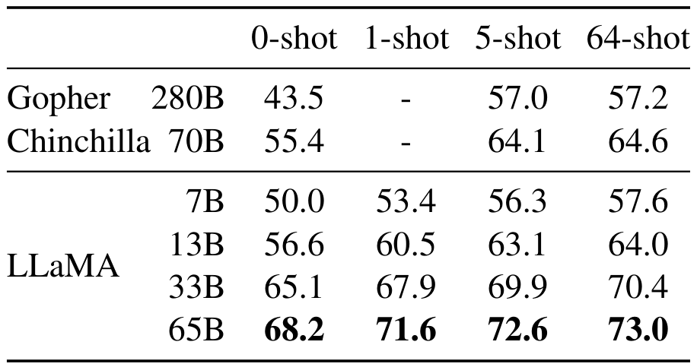
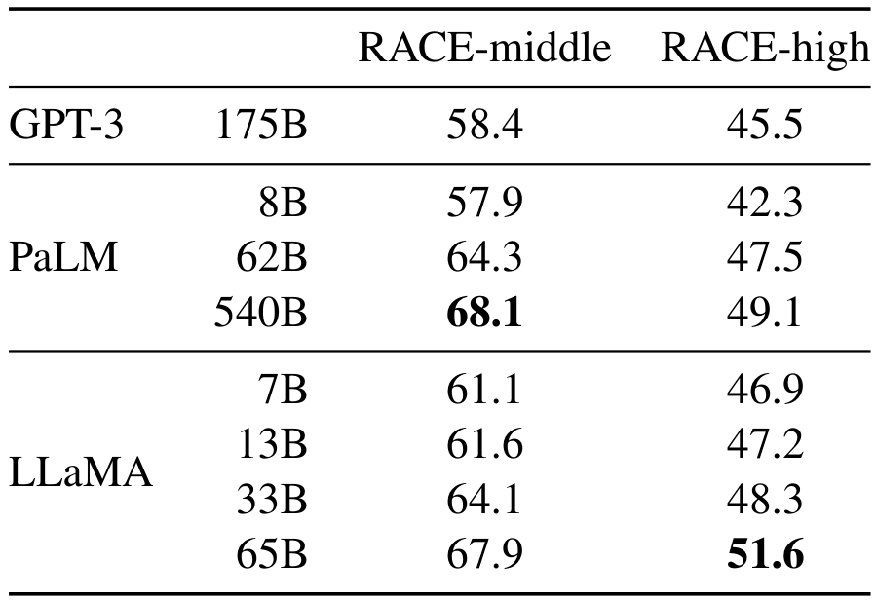
Models answer using only memorized knowledge (Closed-Book setting).
TriviaQA:
Record High
73.0%

Slide 25
General Performance Analysis
Reading
Comprehension
Skills
Understanding RACE
We use the RACE benchmark, consisting of
English exams for Chinese middle and high
school students. Models must answer
questions based on long reading passages.
Top-Tier Performance
LLaMA-65B is competitive with the massive
PaLM-540B. On high school tasks, LLaMA
leads with 51.6% accuracy versus 49.1%.
Doing More With Less
Despite being 10x smaller, LLaMA-13B
outperforms GPT-3 by several percentage
points. This proves that training quality
matters more than just parameter count.

Slide 26
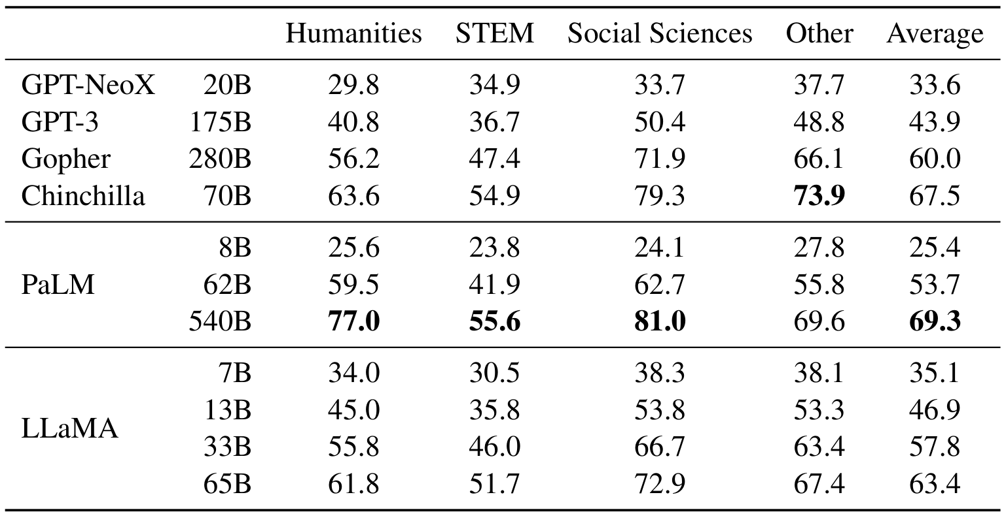
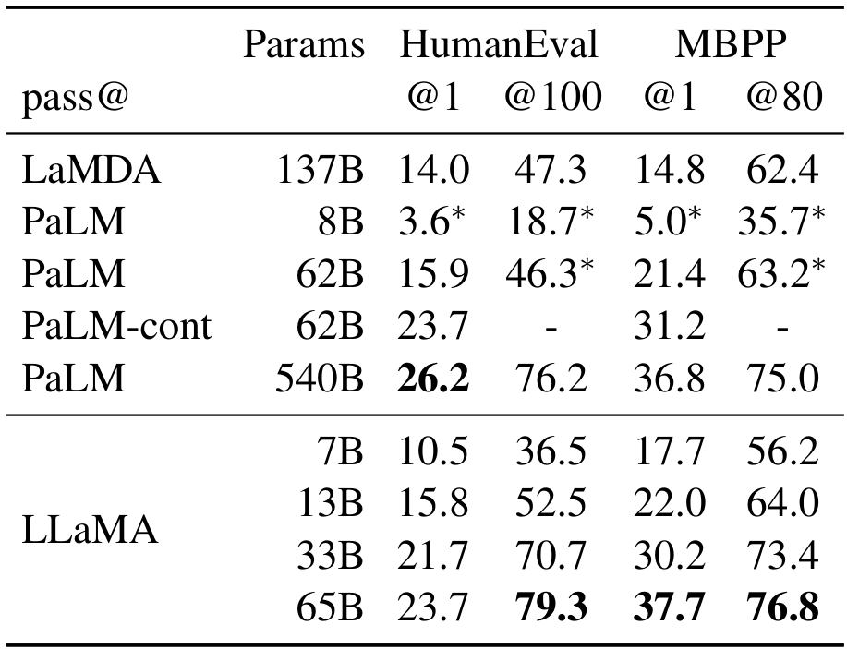
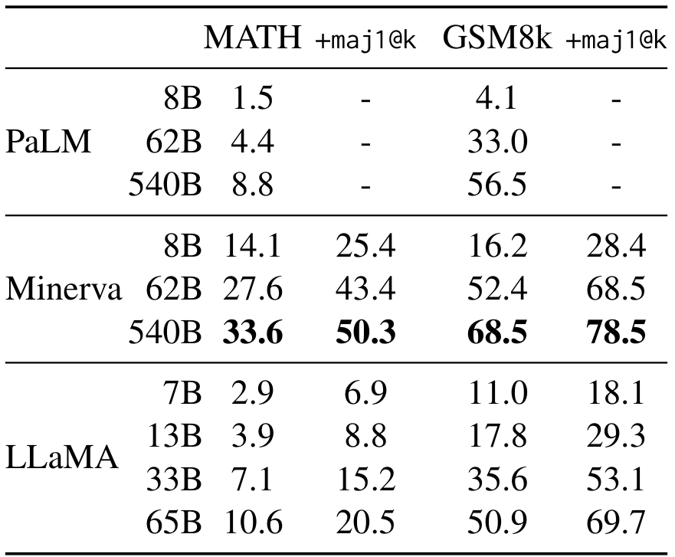
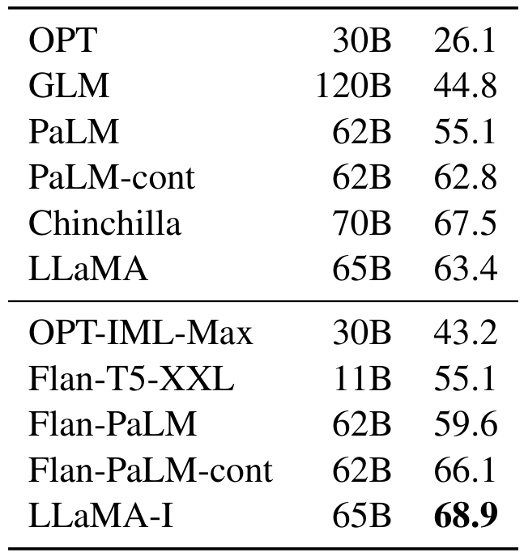
General Performance Analysis
MMLU measures knowledge across humanities, STEM, and social sciences.
LLaMA-65B performs well but lags slightly behind the largest models.
This is likely due to limited academic book data in training.
LLaMA-65B scores 63.4% avg,
trailing PaLM-540B (69.3%).
It beats GPT-3 (43.9%).
Our training set had 177GB
of books, while others used
over 2TB of book data.
Simple tuning creates LLaMA-I
which scores 68.9% on MMLU,
beating Flan-PaLM (66.1%).

Slide 27
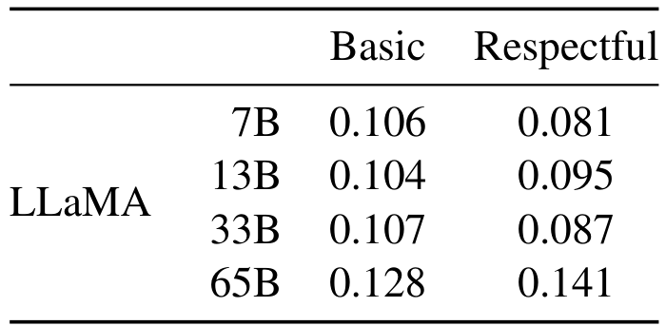
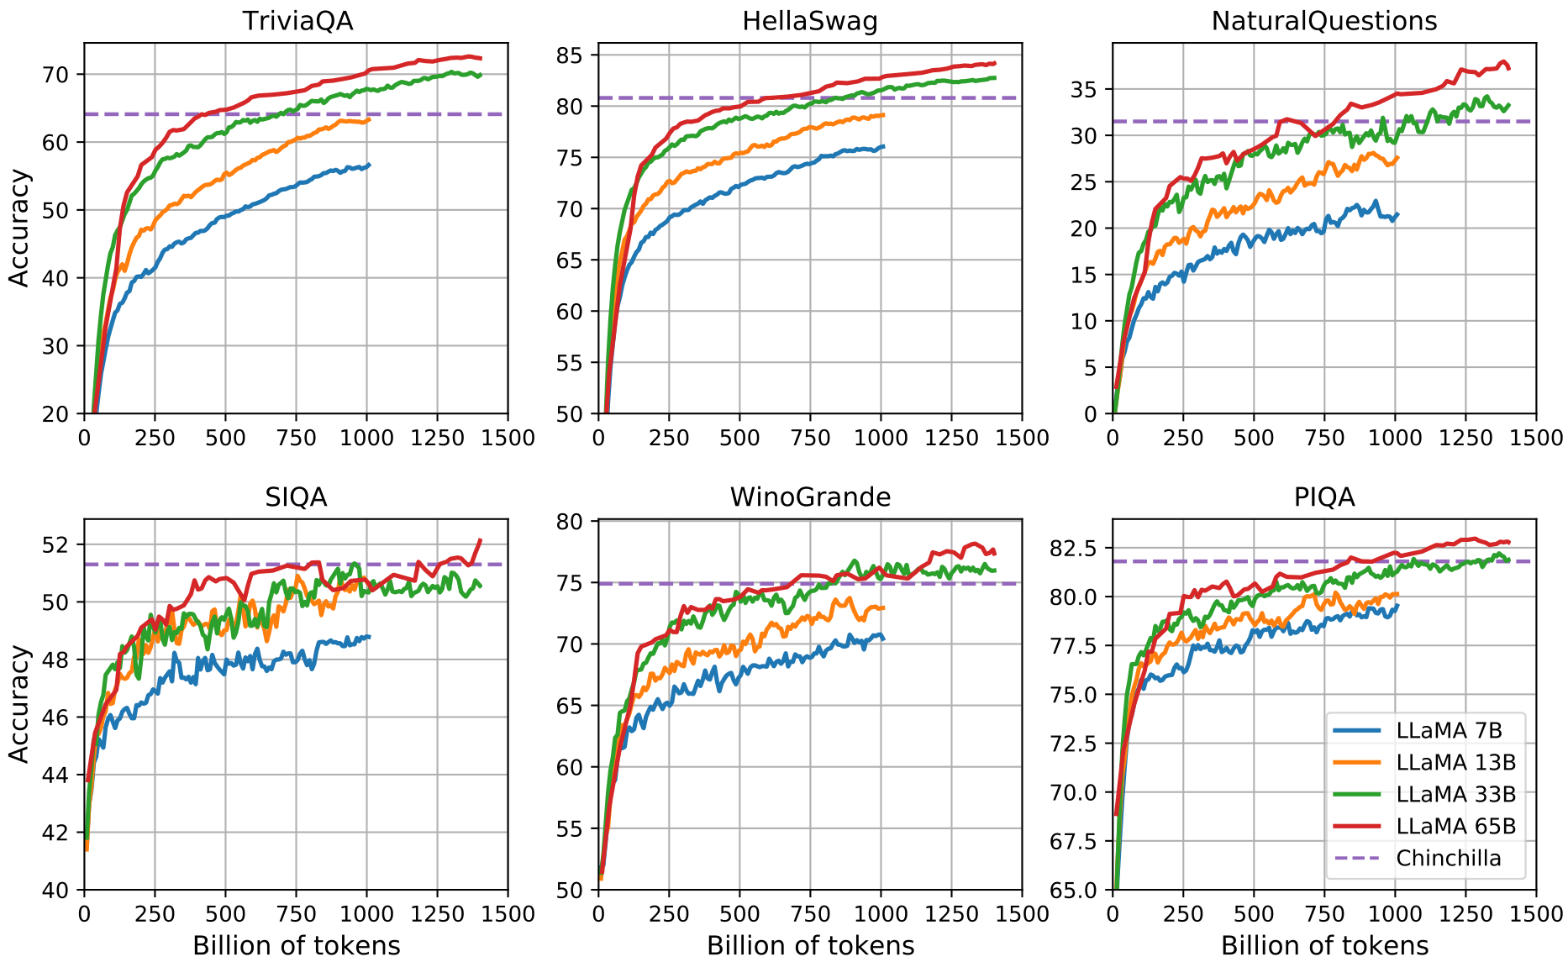
General Performance Analysis
Learning
Over Time
Training Volume
Models ingest up to
1.4 trillion tokens
to build knowledge.
Model Scale
The 65B model (red)
consistently scores
the highest accuracy.
Performance Trends
Most tests show steady
gains, but tasks like
SIQA fluctuate wildly.
This variance helps
map when specific
complex skills emerge.
Competitive Edge
The 65B model surpasses
the Chinchilla baseline
(purple line) on all
tasks. More training
data clearly drives
higher accuracy.

Slide 28
SECTION 06
Specialized Capabilities

Slide 29
Evaluation on MATH and GSM8k Benchmarks
LLaMA-65B (69.7%) outperforms
specialized Minerva (68.5%)
on GSM8k middle school math
despite lacking any specific
training on math datasets.

Slide 30
Specialized Capabilities
Writing Code
The Code Challenge
Models must write valid Python code from text descriptions.
We test on HumanEval and MBPP benchmarks.
Evaluation Method
Prompts include a function signature and test cases.
Performance is measured by pass@1 scores.
This checks if the generated code passes unit tests.
Beating Larger Models
LLaMA outperforms general models like LaMDA and PaLM.
These baselines were not specifically tuned for code.
Efficiency Win
LLaMA-13B scores higher than LaMDA 137B on all tests.
It achieves this with over 10x fewer parameters.
Pass@1 on HumanEval: LLaMA-13B (15.8%) vs LaMDA (14.0%).
Top Tier Results
LLaMA 65B achieves 23.7% on HumanEval and 37.7% on MBPP.
It beats PaLM 62B (15.9% / 21.4%) by a wide margin.
Scale Comparison
LLaMA 65B even outperforms the massive PaLM 540B on MBPP.
PaLM 540B scores 36.8% on MBPP versus LLaMA's 37.7%.
Both models trained on similar code token counts.

Slide 31
Specialized Capabilities
Instruction Tuning
Unlocks Potential
in LLaMA-65B
The Instruction Concept
Researchers created LLaMA-I by briefly finetuning the base
LLaMA-65B model on specific instruction data. This process
teaches the AI to better understand and follow user commands.
Even a small amount of this specialized training rapidly
improves the model's ability to execute complex tasks.
Performance Gains
On the MMLU benchmark, the model's score jumped from
63.4% to 68.9% after tuning. This simple update allows
LLaMA-I to outperform moderate-sized alternatives like
Flan-PaLM (59.6%) and OPT-IML (43.2%).
Strategic Implications
While LLaMA-I beats similar models, it still trails the
state-of-the-art GPT code-davinci-002 at 77.4%.
However, this experiment proves that basic instruction tuning
effectively unlocks the base model's latent potential without
requiring complex or heavy training protocols.

Slide 32
Specialized Capabilities
Generative Capabilities: Examples
Creative Roleplay
The model generates coherent creative text. It wrote a
"dragon feeder" recommendation letter for a fantasy corporation,
inventing details about knights and dragon weaknesses. It also
scripted a humorous dialogue where the Sun explains Pluto's
demotion, capturing an informal and emotional voice.
Programming Proficiency
LLaMA acts as a coding assistant. It successfully wrote
Python code to solve quadratic equations, correctly calculating
discriminants. It also generated JavaScript for HTTP requests
using both XMLHttpRequest and the modern Fetch API, utilizing
proper syntax and comments.
Explanatory Reasoning
The model identifies patterns and provides context. Given a
raw number sequence, it recognized the Fibonacci sequence,
explained its origin (Leonardo of Pisa, 1202), and connected
it to its original mathematical study of "idealized rabbit
population growth."
Style Adaptability
These examples highlight the model's range. It moves fluently
from casual dialogue (Pluto cursing at the Sun) to technical
precision (writing complex Regex to parse HTML). This shows it
captures both human nuance and rigid logical structures without
needing specific training for each task.

Slide 33
SECTION 07
Safety, Bias, and Truth

Slide 34
Safety, Bias, and Truth
Measuring
Toxicity
in AI Models
The Benchmark
The RealToxicityPrompts dataset contains
100,000 sentence starts designed to trigger
toxic outputs like insults, threats, or hate speech.
How We Measure It
We use PerspectiveAPI to score model outputs
from 0 (safe) to 1 (toxic). It acts as an
automated judge for evaluating safety at scale.
Key Findings
Toxicity generally increases with model size.
The largest LLaMA 65B model scored 0.128,
while the smaller 7B version scored 0.106.
Bigger models are smarter but also riskier.
Industry Context
Scores align with other top models like
Chinchilla (0.087), indicating a common
industry-wide safety challenge to solve.

Slide 35
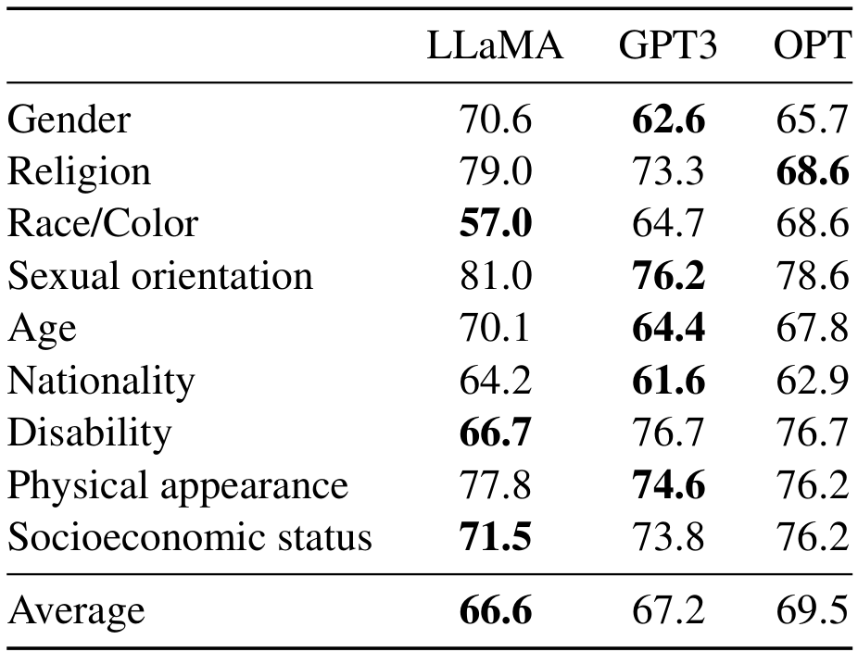
LLaMA averages 66.6 on CrowS-Pairs, surpassing GPT-3 and OPT models.
Stereotype
Detection
Measuring Model Bias
The benchmark tests if a model favors stereotypical
sentences over anti-stereotypical ones across nine
social categories like gender, race, and religion.
Performance Results
LLaMA achieves the lowest bias score of 66.6,
beating GPT-3 (67.2) and OPT (69.5).
While overall bias is low, LLaMA struggles in
Religion (79.0), scoring 10 points worse
than OPT. Conversely, it performs best in the
Race/Color category with a score of 57.0.

Slide 36
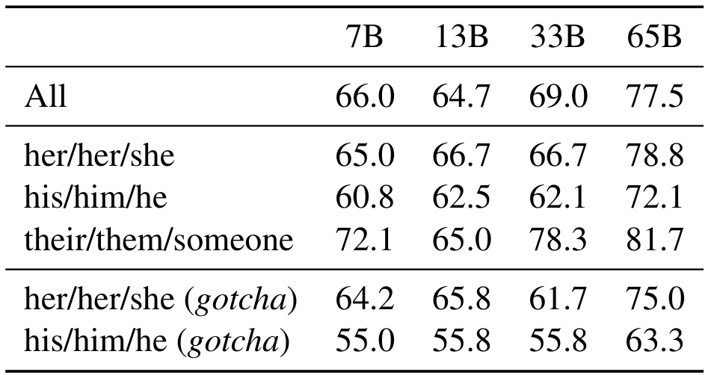
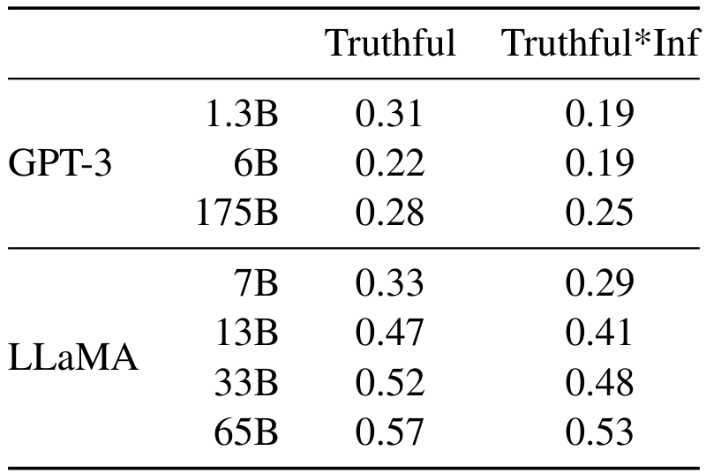
Gender Bias Analysis
WinoGender
Benchmark
Key Data
Analysis
The Core Task
The model must link pronouns
like her or him to the correct
person. WinoGender tests if
stereotypes cause errors.
Neutral Pronouns
The model performs best with
neutral their/them inputs.
Accuracy peaks at 81.7 for
65B, beating gendered sets.
Stereotype Bias
Scores drop on gotcha cases.
For his/him, the 65B score
falls from 72.1 to 63.3 when
roles defy gender norms.
Size Impact
Larger models resist bias.
On hard cases, 65B scores
63.3, beating the smaller
7B model which scores 55.0.

Slide 37
Safety, Bias, and Truth
Truthfulness and Hallucinations
The TruthfulQA Benchmark
Researchers use the TruthfulQA benchmark to measure safety.
It tests if models mimic human falsehoods or generate
misinformation. The goal is to determine if the AI can
distinguish literal truth from common misconceptions.
Comparative Performance
LLaMA scores higher than GPT-3 in both truthful and
informative categories. LLaMA-65B reached a score of 0.57,
nearly double the 0.28 score achieved by GPT-3-175B.
Defining Truth
The study defines truth as literal facts about the real
world, excluding belief systems. Questions are adversarial,
designed to trick the AI into confirming popular myths
or superstitions rather than factual reality.
Persistent Hallucinations
Despite improvements, the correct answer rate remains low.
With scores under 60%, the model is still prone to
hallucinations—confidently stating incorrect facts.
Reliable truthfulness remains a significant challenge.

Slide 38
SECTION 08
Environmental Impact & Conclusion

Slide 39
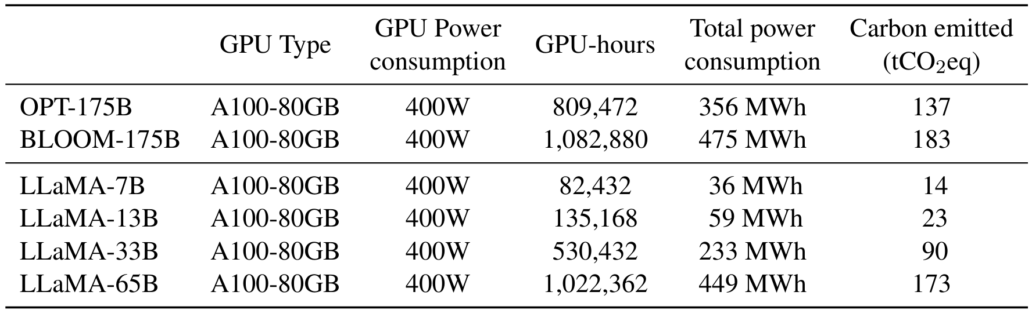
Environmental Impact & Conclusion
Understanding the Cost
Training foundation models requires massive compute power.
We measure this in GPU-hours and total energy in MWh.
Scaling Effects
Table 15 shows a clear trend: larger models need more power.
Emissions jump from 14 tons for 7B to 173 tons for 65B.
The LLaMA-65B model used over 1 million GPU-hours.
This highlights the environmental price of higher accuracy.
Training Carbon
Footprint Data
The "Green" Benefit
Despite the high initial cost, releasing models openly is
environmentally strategic. It acts as a carbon offset.
Thousands of researchers can use LLaMA-65B directly.
This prevents the need for redundant training runs globally.
Future emissions are significantly reduced because the
community shares the one-time carbon cost of training.
Training LLaMA-65B consumed 449 MWh of total energy.
This resulted in 173 tons of carbon emissions (CO2eq).
This is comparable to the 183 tons emitted by BLOOM-175B.
Calculations assume a Power Usage Effectiveness (PUE) of 1.1.
We utilized specific US national average carbon factors.

Slide 40
Environmental Impact & Conclusion
LLaMA-13B Beats
GPT-3 Despite
Being Over 10x
Smaller.
Performance Breakthrough
The LLaMA-13B model outperforms the massive GPT-3
(175B) on most benchmarks despite being more than 10x smaller.
This redefines performance on consumer-grade hardware.
Scaling Laws Validated
We show that training smaller models on more data yields
better results than just increasing model size. The LLaMA-65B
model rivals Chinchilla-70B and PaLM-540B, proving
the efficiency of refined scaling laws.
Open Research Access
We release models to the public to accelerate research into
robustness and mitigate risks like toxicity and bias.
Unlike competitors, LLaMA achieves state-of-the-art results
using strictly publicly available data (no proprietary data).
Future Directions
We observed that finetuning on instructions leads to
promising results. We plan to release larger models trained
on larger pretraining corpora to further improve performance.
Reduced Carbon Footprint
Training LLaMA-13B emitted only 23 tCO2eq, which is
significantly lower than OPT-175B (137 tCO2eq) and
BLOOM-175B (183 tCO2eq). This efficiency is vital.
Power Efficiency Metrics
We calculate emissions using a national US average intensity
of 0.385 kg CO2e per KWh. The LLaMA-7B model consumed
just 36 MWh of power on A100-80GB GPUs, making high
performance AI research more environmentally sustainable.

Slide 41
Limitations and Future Work
Advancing
Open Research
& Addressing
Limitations
Scaling Potential
We observed a constant improvement in model performance
as we scaled up the size of the training data. This suggests
that training on even larger datasets could yield
better results. Unlike previous assumptions, data quality
and quantity remain key drivers of model accuracy.
We plan to release these larger models to the public soon.
Instruction Tuning
Preliminary experiments with instruction finetuning have
shown promising results for improving model capability.
This process involves training the model to follow specific
user commands rather than just predicting text. We plan to
investigate this further to enhance how the model responds
to direct tasks, similar to findings by Chung et al.
Bias and Toxicity
Like all large language models, our system still faces
challenges with toxicity and bias in its outputs.
These issues remain unsolved across the field today.
By releasing our models openly, we aim to help the research
community study these flaws. Future work will focus on
improving robustness and developing mitigation methods.

Slide 42
Environmental Impact & Conclusion
LLaMA Verdict: Top-tier AI is
now accessible, reproducible,
and runs on a single GPU.
It shifts focus from massive
scale to open efficiency,
empowering research for all.

