Slide 1
November 26, 2023
Stanford University
ControlNet: Spatial Control
for AI Image Generation
Spatial Control for Image Diffusion
Lvmin Zhang, Anyi Rao, Maneesh Agrawala

Slide 2
Table of Contents
Introduction to Controlled Generation
03
How ControlNet Works: The Architecture
06
Training Dynamics
10
Capabilities and Flexibility
13
Performance and Evaluation
19
Applications and Conclusion
24

Slide 3
SECTION 01
Introduction to
Controlled Generation
ControlNet: Adding Spatial Control to AI Image Generation

Slide 4
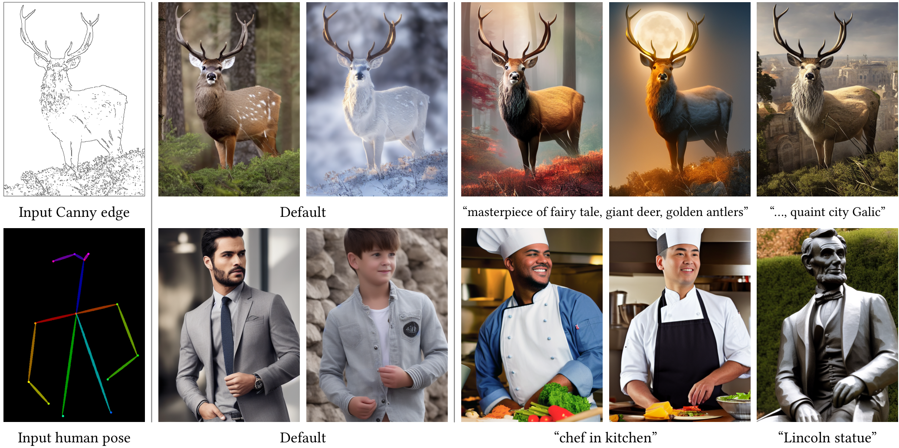
Introduction to Controlled Generation
The Challenge
with Text-to-
Image Models
Current AI creates stunning images but
lacks precision. Describing the exact
shape of a Canny edge deer or the
rigid structure of a human pose with
words alone is nearly impossible.
Spatial Solution
ControlNet locks the layout. As shown,
the human pose input generates a
Lincoln statue or chef while
keeping the exact same posture.

Slide 5
Introduction to Controlled Generation
Introducing
ControlNet
The Spatial Control Problem
Standard text-to-image models often struggle with spatial
composition. Describing complex layouts or exact poses via
text prompts leads to endless trial-and-error cycles.
The ControlNet Solution
ControlNet is a neural network architecture that adds precise
spatial conditions to existing models. It allows users to
provide visual guides—like sketches or edge maps—alongside
text prompts for precise generation.
The Locking Mechanism
To preserve image quality, the system "locks" the production-
ready diffusion model. It creates a trainable copy of the
encoding layers to learn new controls without damaging the
original model's capabilities trained on billions of images.
Zero Convolutions
These layers connect via "zero convolutions"—layers
initialized at zero. They progressively grow parameters
from zero, ensuring no harmful noise affects the
fine-tuning process.
Visual Capabilities
Users can control generation using diverse inputs. A Canny
edge map can turn a sketch into a detailed "giant deer."
A human pose skeleton can guide the AI to generate a
"chef in kitchen" with exact posture matching the reference.
Broad Application
Beyond poses, it supports segmentation maps, depth, and
normals. This robust training allows ControlNet to work
with both small datasets (<50k) and large ones (>1m).

Slide 6
SECTION 02
How ControlNet Works:
The Architecture
Deep dive into the neural structure and zero-convolution layers.

Slide 7
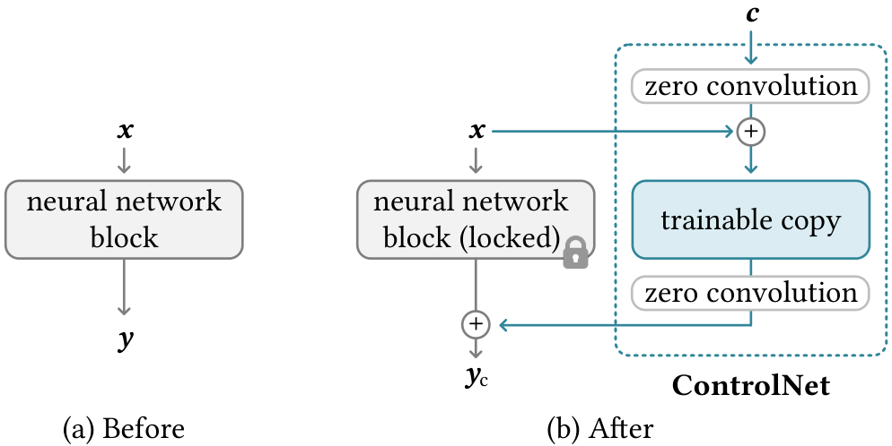
How ControlNet Works: The Architecture
The 'Locked
Copy' Strategy
ControlNet avoids retraining massive models
from scratch. It locks the original parameters
to save computing power and prevent
damaging the pre-trained neural network.
The diagram shows the base block is locked
(padlock icon). This ensures the model
retains its learned capability to generate
high-quality images without degradation.
A trainable copy (in blue) learns the new spatial control
conditions. It connects via zero convolution layers
that start with zero weight, ensuring the model's training
begins securely without breaking the original output.

Slide 8
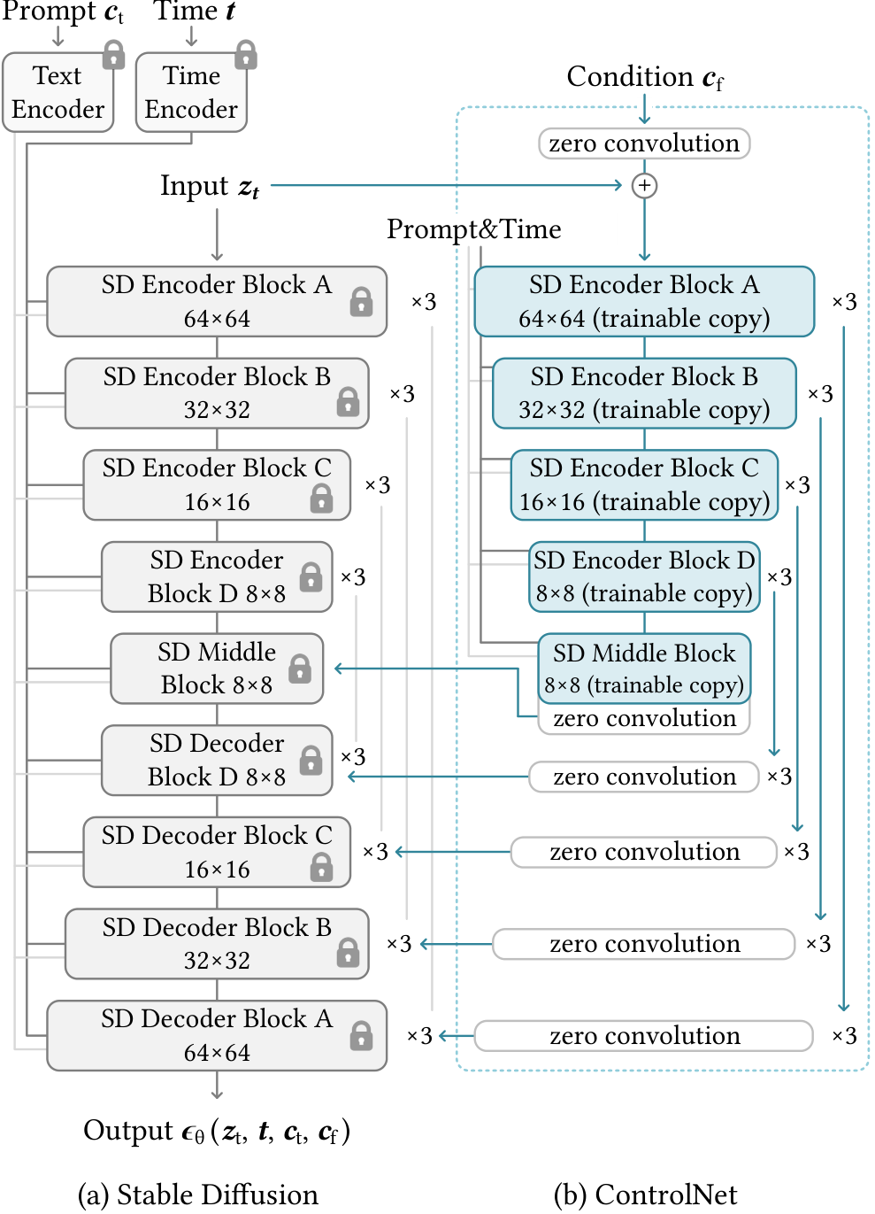
How ControlNet Works: The Architecture
The Role of Zero
Convolutions
The Noise Risk
Adding new network layers
typically introduces
random signals or noise.
Why It Matters
This disrupts the pre-
trained model's ability
to generate quality images.
The Solution
ControlNet uses unique
layers initialized with
weights of zero.
Safe Learning
The control starts off,
keeping the base model
safe. It gradually learns
to turn influence on.

Slide 9
How ControlNet Works: The Architecture
Integrating with Stable Diffusion
The U-Net Architecture
Stable Diffusion functions as a U-Net with an encoder,
a middle block, and a decoder. The full model contains
25 blocks total. This includes 12 encoder blocks that
process inputs and 12 decoder blocks that build images.
Block Composition
The architecture relies on 4 ResNet layers and 2 Vision
Transformers (ViTs) per block to understand context.
Attaching ControlNet
ControlNet creates a trainable copy of the 12 encoder
blocks and the 1 middle block. These copies learn to
interpret specific control signals like sketches.
Locked vs. Trainable
The original parameters are locked (frozen) to keep
the production-ready capabilities. Only the copied
layers are updated during the training process.
Information Flow
Input conditions (like depth maps) are fed directly
into the trainable copy. This structure allows the
model to accept spatial guidance without retraining.
Zero Convolutions
The trainable copy connects back to the main model
via zero convolution layers. These ensure harmful
noise does not disrupt the pretrained backbone.
Resource Efficiency
Since the locked copy is frozen, no gradient computation
is required for the original encoder. This saves massive
computational power during the fine-tuning phase.
Hardware Impact
Optimizing Stable Diffusion with ControlNet requires
only about 23% more GPU memory compared to the
base model. This fits on a single NVIDIA A100 GPU.

Slide 10
SECTION 03
Training Dynamics
Learning spatial conditions with zero convolutions.

Slide 11
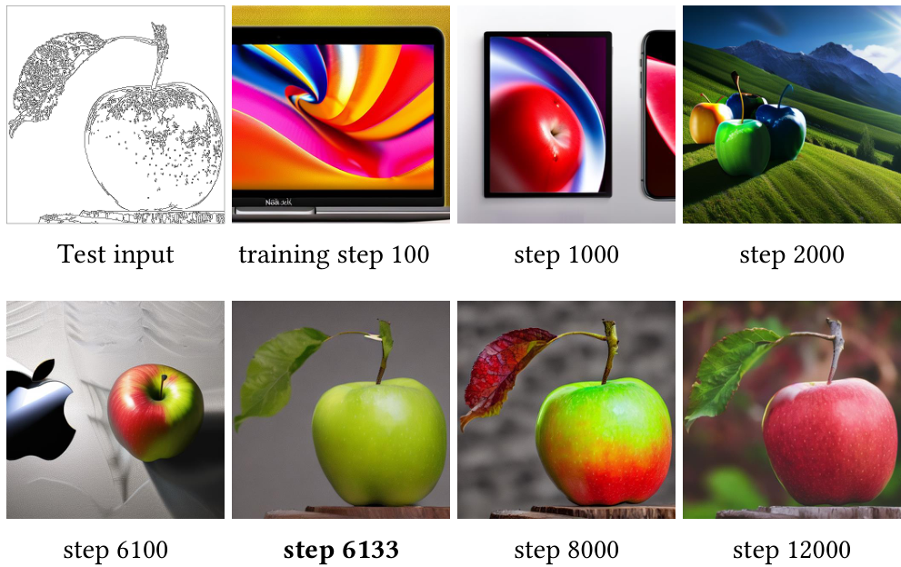
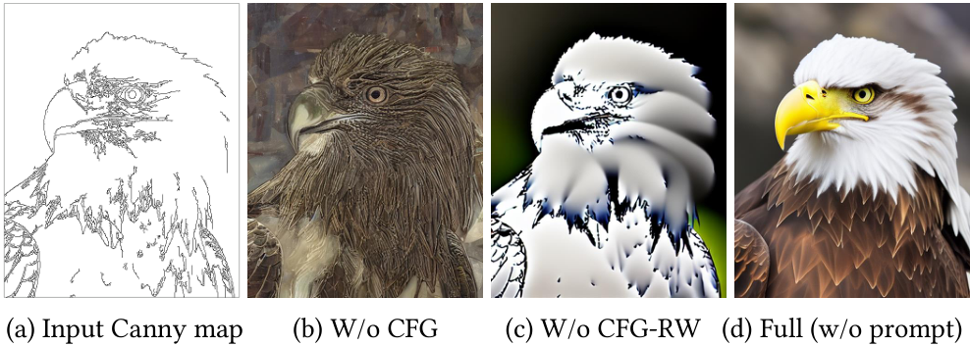
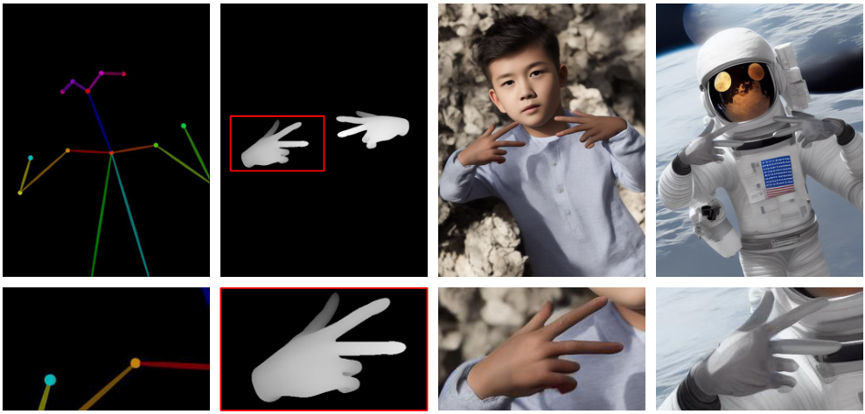
Training Dynamics
The 'Sudden Convergence'
Phenomenon
Initial Behavior
Due to Zero Convolutions, the model initially acts exactly
like the original generator. It creates high-quality art but
ignores the input sketch, as seen in steps 100-6100.
Sudden Convergence
Learning is not gradual. The model abruptly "snaps" into
understanding the control map. This usually happens in
less than 10,000 optimization steps.
Visual Evidence
Notice step 6133 in the grid: the apple suddenly aligns
perfectly with the sketch, whereas step 6100 did not.

Slide 12
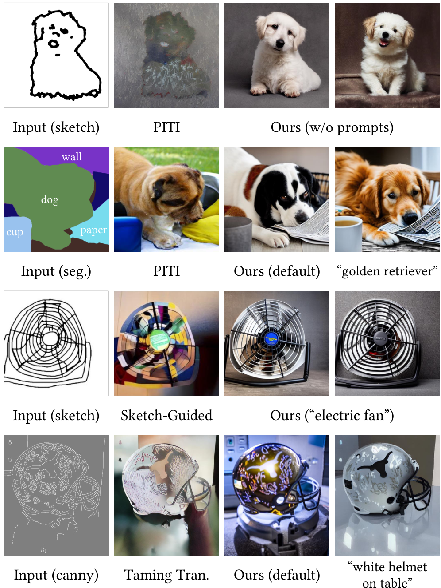
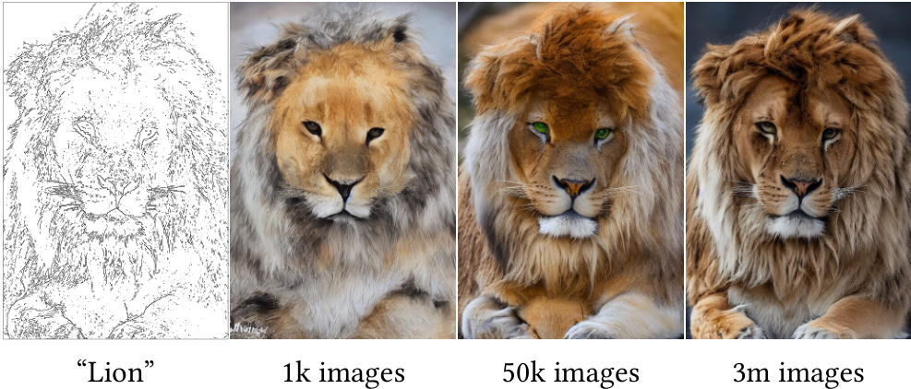
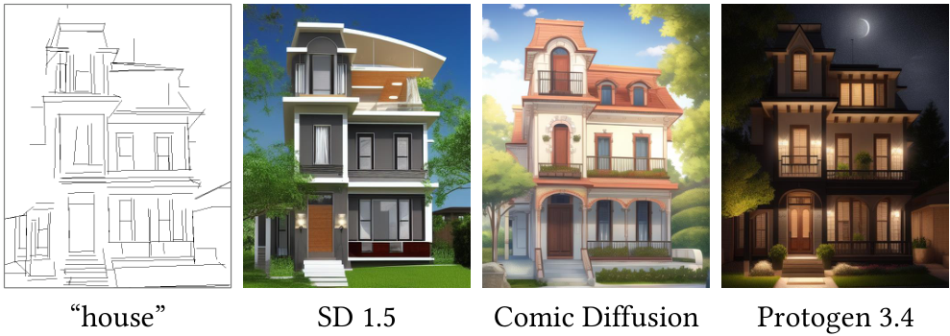
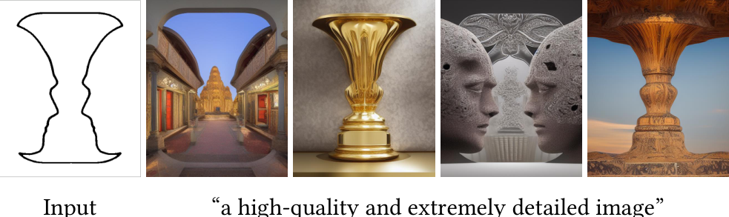
Training Dynamics
Efficiency with Small Datasets
Achieves sharp
results on
diverse inputs.
No collapse
with only
1,000 images.
Applies to
community
models freely.
Visual Proof
Analysis

Slide 13
SECTION 04
Capabilities and Flexibility
Versatile control for diverse inputs and conditions.

Slide 14
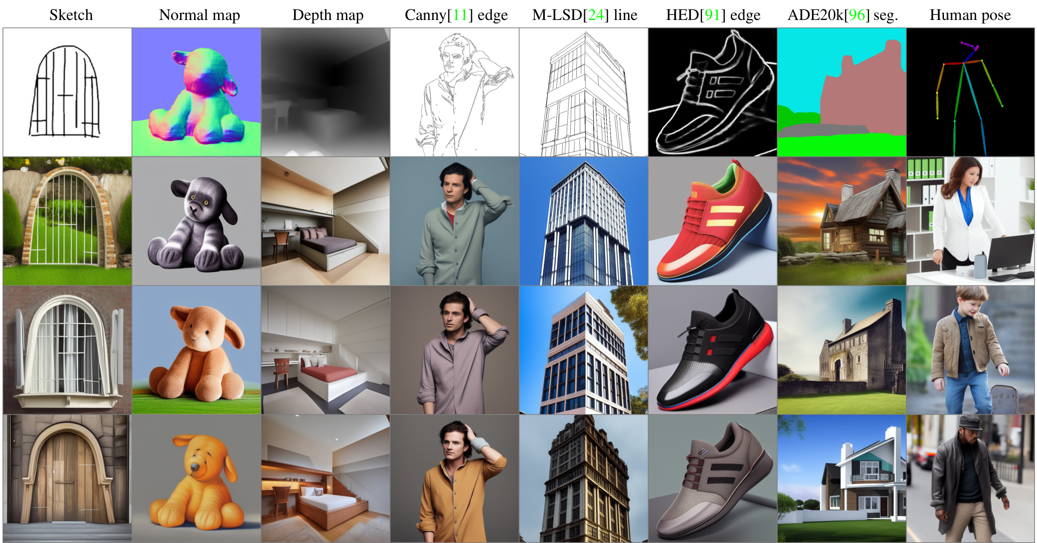
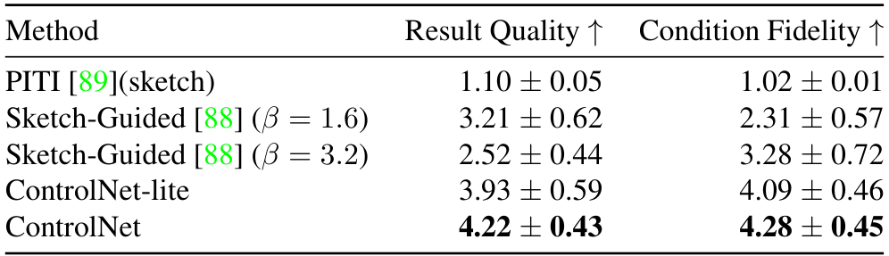
ControlNet creates high-fidelity images (4.28) without text prompts.
No Text Needed
Shapes drive
the meaning.
Input Variety
Depth, edges,
and poses work.
Top Results
Achieves high
4.28 Fidelity.

Slide 15
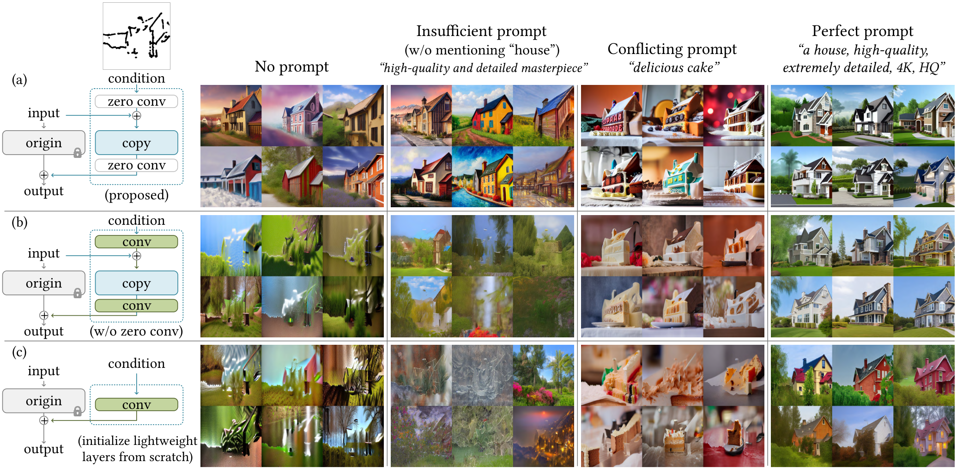
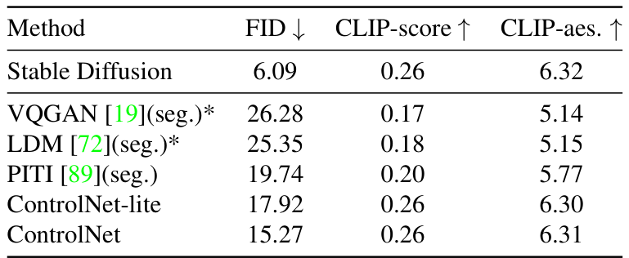
Capabilities and Flexibility
Visuals guide form
while text defines
object details.
House sketch plus
a cake prompt
makes cake houses.
Proposed model
keeps 0.26 CLIP,
matching the base
Stable Diffusion.

Slide 16
Capabilities and Flexibility
Interpreting
Ambiguous
Inputs
Handling Ambiguity
Visual inputs are often vague or incomplete.
A user might provide only a rough sketch or
basic outline without specific details.
Intelligent Interpretation
ControlNet analyzes these shapes to infer
missing information. It acts like a skilled
artist interpreting a rough concept sketch.
From Shape to Object
As shown in Figure 11, a simple blocky shape
is automatically interpreted as a detailed
vase. The model recognizes the structural
semantics (meaning) of the shape even
without detailed prompts. This enables high-
quality art from even simple user sketches.

Slide 17
Capabilities and Flexibility
Combining
Multiple
Controls
ControlNet supports Multi-Control inputs.
This allows users to provide several spatial
guides at once, rather than relying on just
a single input sketch or body posture.
In the example, a pose skeleton sets the
stance, while a depth map adds 3D volume.
The model fuses these distinct conditions
without requiring any extra model training.
This enables complex scene composition.
The system generates distinct images like a
boy or astronaut that rigidly follow
the combined hand and body spatial rules.

Slide 18
Capabilities and Flexibility
Fine-Tuning Control Strength (CFG)
Understanding CFG
Stable Diffusion relies on Classifier-Free Guidance (CFG) to
generate high-quality images. It runs the model twice: once
with a prompt and once without. The mathematical difference
between these outputs guides the AI toward the user's intent,
filtering out generic noise in favor of specific details.
The Integration Challenge
ControlNet introduces a spatial conditioning image, such as
an edge map. Researchers had to decide where to inject this
data in the diffusion equation. It can be added to the
conditional part (εc), the unconditional part (εuc), or
both parts simultaneously.
The Cancellation Effect
Adding the control image to both parts creates a specific
problem. Since guidance is based on the difference between
parts, adding the same value to both cancels it out. This
removes the guidance effect completely (Figure 5b), resulting
in images that fail to follow the structure.
The Over-Control Risk
Applying control only to the conditional part causes the
opposite issue. It creates an extreme contrast, making the
guidance very strong. This forces the model to follow the
guide too rigidly (Figure 5c), often ruining the image
aesthetic with oversaturated artifacts.

Slide 19
SECTION 05
Performance and Evaluation
Assessment of generative capabilities and control accuracy.

Slide 20
Performance and Evaluation
Comparison with
Previous Methods
Legacy Limitations
Previous methods like PITI often failed
to produce coherent images from sketches.
They frequently distorted the input shapes
or generated blurry, unrecognizable artifacts.
ControlNet's Precision
ControlNet achieves sharp, clean results
by tightly following the spatial conditions.
Unlike competitors, it does not ignore the
user's guide or warp the structural layout.
Visual Proof
In the "electric fan" example shown here,
older models messed up the wiring pattern.
ControlNet preserved the exact geometry
while rendering realistic details perfectly.

Slide 21
Performance and Evaluation
User Preference
Study Results
Study Methodology
Researchers conducted a study asking 12 users
to rank 20 different image groups. This
approach measures subjective human
preference rather than just automated code.
Defining the Metrics
Participants rated results on a 1-to-5 scale:
1. Quality: Is the image realistic and high
resolution? (Does it look professional?)
2. Fidelity: Does it respect the input?
(Does it match the sketch lines exactly?)
Superior Results
ControlNet achieved a ~4.2 average score
across both categories. In contrast, prior
methods like Sketch-Guided scored below 3.3.
This ~25% gap shows that ControlNet is the
first to truly solve spatial control without
sacrificing the quality of the generated art.

Slide 22
ControlNet: Adding Spatial Control to AI Image Generation
Methodology
Key Metric
Outcomes
The Dataset
We validated the model using the
ADE20K dataset. This is a rigorous
standard in computer vision containing
thousands of complex, segmented scenes.
It tests if the AI can handle real-
world complexity, not just simple
sketches or shapes.
Defining IoU
To measure success, we calculated
Intersection over Union (IoU).
This metric quantifies overlap.
Imagine placing a stencil over a
drawing. If the drawing stays inside
the lines perfectly, the score is
high. If it spills over, the score
drops. Higher is better.
Quantitative Results
The data shows a clear winner.
ControlNet achieved 0.35 on the
IoU benchmark. This score
significantly surpasses baselines
like PITI (0.26) and
VQGAN (0.21).
It even approaches the upper bound
defined by ground truth data.
Interpretation
These numbers confirm a major
breakthrough: ControlNet is not
just guessing based on prompts.
It faithfully respects the spatial
conditions provided by the user,
offering precise control where
previous models often failed.

Slide 23
Performance and Evaluation
ControlNet
FID Score:
15.27
Beats PITI
(19.74)
What is FID?
FID (Frechet Inception Distance) is
a metric that compares AI images to
real photos to measure realism.
Like a golf score, lower is better.
A low FID means the image looks
natural and free of visual errors.
Our Results
ControlNet achieved an FID of 15.27.
This was the lowest (best) score,
beating all competing methods by a
significant margin.
Competitor Comparison
Other methods struggled to match
our quality. The PITI model scored
19.74, while VQGAN scored 26.28.
These higher numbers indicate less
realistic image generation.
Aesthetic Quality
Adding control often reduces beauty,
but not here. ControlNet scored
6.31 in aesthetics, matching the
original Stable Diffusion (6.32).

Slide 24
SECTION 06
Applications and Conclusion
Real-world use cases and future outlook.

Slide 25
Applications and Conclusion
Transferring ControlNet
to Community Models:
It adapts to styles
like Comic Diffusion
and Protogen without
any retraining needed.

Slide 26
ControlNet: Adding Spatial Control to AI Image Generation
Summary and
Key Impact
The Core Solution
ControlNet adds a "steering wheel" to AI generation. It uses a
locked copy of a pre-trained model to keep its knowledge
safe, while a trainable copy learns new spatial instructions.
These two parts connect via Zero Convolutions, special layers
that eliminate noise during training. This allows the AI to
follow layout guides without forgetting how to draw well.
Smart Interpretation
The model is robust. Even if a user's prompt is vague, it
analyzes input shapes to guess the object. For example, it
can interpret a rough outline as a detailed vase.
Training Efficiency
It works with small datasets of just 1,000 images without
collapsing. Performance scales up efficiently as more data
is provided, proving the architecture is highly scalable.
Universal Compatibility
ControlNet is plug-and-play. Because it respects the
original network structure, it works with community models
like Comic Diffusion and Protogen without retraining.
This lets artists apply spatial control to any visual style.
Final Verdict
It is a flexible, high-quality tool that turns rough
sketches into polished art, solving the AI control problem.

