Slide 1
ControlNet Explained
Understanding Conditional Control for Text-to-Image Models

Slide 2
Table of
Contents
Introduction to the Problem
03
The Core Mechanism
07
Fine-Tuning Control
14
Visual Capabilities Showcase
20
Comparisons and Evaluations
27
Conclusion and Future
34

Slide 3
SECTION 01
Introduction to the Problem
2302.05543-easy: ControlNet Explained

Slide 4
Introduction to the Problem
The Promise of AI
Image Generation
Capturing Inspiration
Many of us experience flashes of visual inspiration that
we wish to capture. Before AI, this required manual skill.
Today, text-to-image diffusion models bridge this gap.
Users can generate complex, visually stunning images
simply by typing a text prompt describing the scene.
This technology allows anyone to visualize mental imagery
without needing to draw or paint manually.
Technological Power
Modern systems like Stable Diffusion act as production-
ready engines. They are trained on billions of images
to learn deep visual patterns. This massive dataset serves
as a strong backbone for understanding the world.
As seen in Figure 1, users can generate a chef in kitchen
or a "Lincoln statue" with high fidelity and detail.
The AI progressively refines pixels to match your text.
Tools and Workflow
Key tools include Stable Diffusion, DALL-E, and
Midjourney. While revolutionary, they have limits.
Generating an image that accurately matches specific
mental imagery is challenging. It often requires cycles of
"trial-and-error" editing of the prompt text.
Precise control over spatial composition is difficult
using words alone, creating a need for better methods.

Slide 5
Introduction to the Problem
The Limitation: Lack of Spatial Control
The Text Prompt Barrier
Modern AI creates stunning art from text, but words have limits.
It is hard to describe exact spatial composition, like where
objects sit or how they are arranged. Text is often too vague
to capture a complex mental blueprint.
The Trial-and-Error Trap
Users get stuck in a loop of prompt engineering.
You type a prompt, check the image, fail, and try again.
This guessing game happens because the AI guesses the layout
instead of following a strict plan.
Precision is Impossible
How do you describe a specific human pose in words?
Describing complex shapes and forms is notoriously difficult.
Precise layouts often become a mess because the model cannot
visually 'see' what you mean via text alone.
Solution: Visual Conditioning
We need more than words. Conditioning images like
edge maps (outlines) or pose skeletons (stick figures)
act as blueprints. They tell the model exactly how to
structure the image before filling in the details.

Slide 6
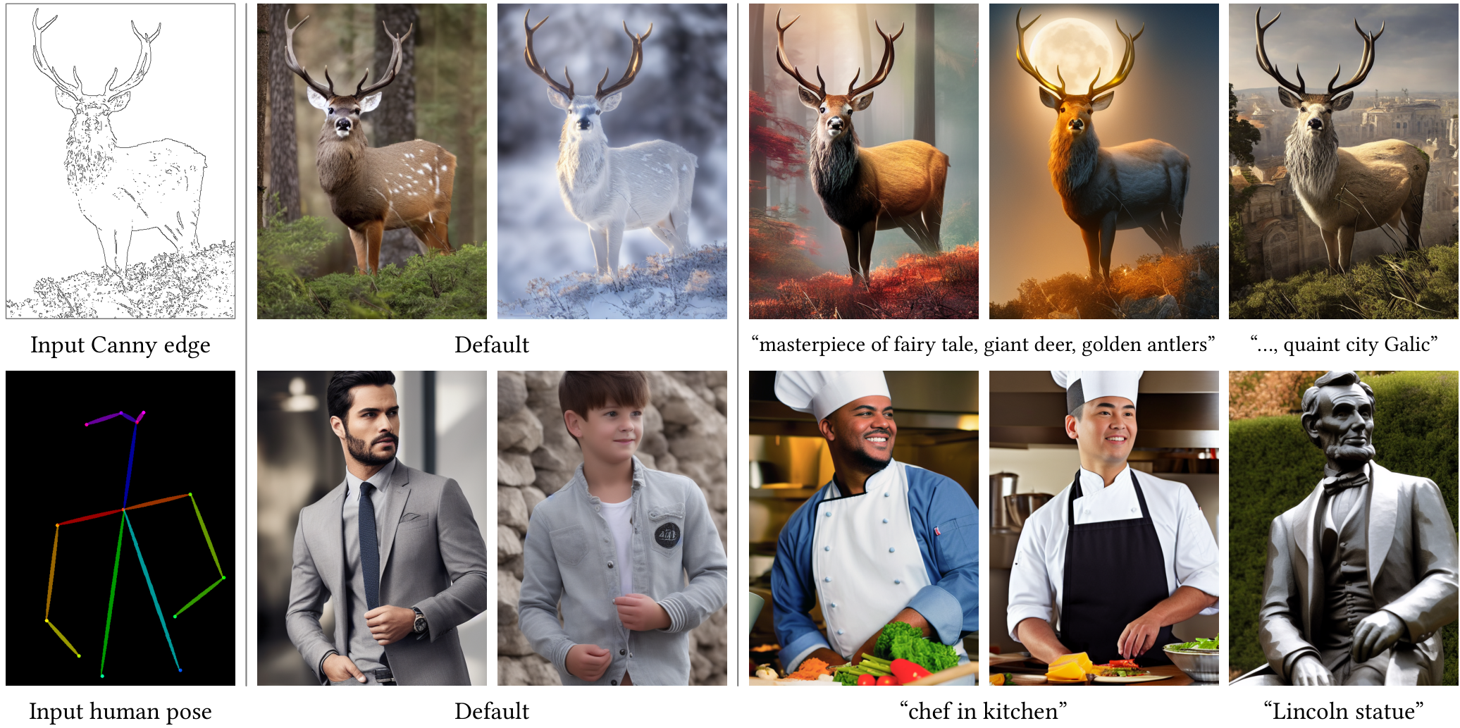
Introduction to the Problem
Introducing
ControlNet
The Challenge
Standard AI models struggle to define
precise spatial layouts and shapes.
The ControlNet Solution
This architecture adds spatial control
by locking base weights. Note how the
deer's outline (top) and human pose
remain fixed across all diverse outputs.

Slide 7
SECTION 02
The Core Mechanism

Slide 8
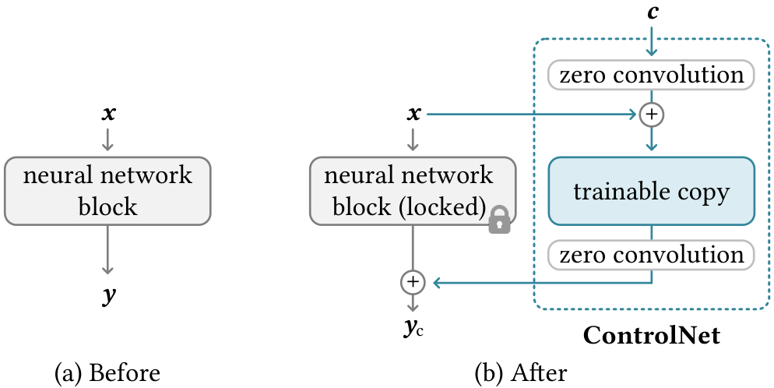
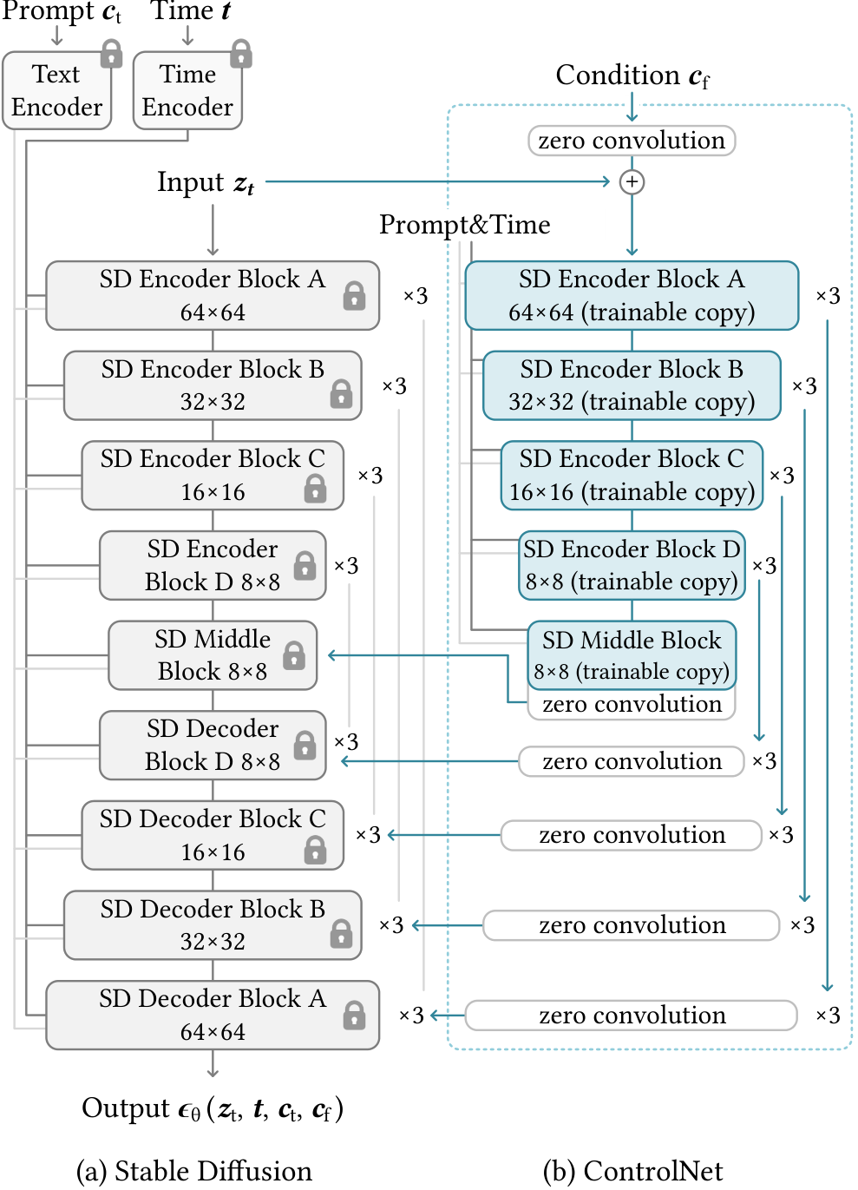
The Core Mechanism
The Neural Block
Structure
Original Block
Processes feature map
x. Trained on billions
of images to learn.
Locked Layer
We freeze the original
weights to preserve
prior knowledge.
Trainable Copy
A cloned layer learns
the condition c.
It adapts to new tasks
like depth or edges
without breaking the
production model.
Zero Convolution
Weights start at zero.
This adds nothing at
first, ensuring safe
training. The model
slowly learns to
inject control.

Slide 9
The Core Mechanism
The Role of Zero Convolutions
Defining Zero Convolutions
ControlNet connects the locked model to the
trainable copy using a specialized layer called a
zero convolution. Technically, this is a standard
1×1 convolution layer with a unique property:
both its weight and bias parameters are initialized
to mathematical zero. This differs from standard
methods that use random numbers.
Mathematical Logic
Before training starts, the zero convolution
outputs exactly zero. When added to the original
signal, the result is y_c = y. This means the
trainable copy has zero influence initially. The
neural network behaves exactly as if the
ControlNet does not exist, preserving all
capabilities of the pre-trained production model.
Preventing Harmful Noise
Standard initialization fills layers with random
numbers. If applied here, this randomness would
act as harmful noise that scrambles the features
of the pre-trained model. By starting at zero,
we eliminate random gradients in the first
training step. This protects the backbone from
being distorted by untrained layers.
Progressive Learning
The parameters do not stay at zero. Once
fine-tuning begins, gradients gradually adjust
the weights to non-zero values. This allows for
progressive growth: the model slowly learns to
incorporate new conditions (like edges or depth)
without forgetting its original training on
billions of images.

Slide 10
2302.05543-easy: ControlNet Explained
Integrating with Stable Diffusion
The U-Net Architecture
Stable Diffusion relies on a U-Net structure with three main
parts: an encoder, a middle block, and a decoder. In total,
the model contains 25 distinct blocks. The encoder compresses
the image into latent features, while the decoder reconstructs
it. The diagram shows the encoder on the left (down-sampling)
and decoder on the right.
Cloning the Encoder
ControlNet creates a trainable copy of the 12 encoder blocks
and the single middle block (shown in blue). The original
blocks (in gray) remain locked or frozen. This ensures the
model retains its pre-trained knowledge from billions of
images while the new copy learns to interpret the specific
control signal, such as an outline or pose.
Connecting the Layers
The trainable copy processes the extra condition. Its outputs
are connected back to the main model using zero convolution
layers. These connections occur at 4 different resolutions
(64×64 down to 8×8). The processed control signal is added to
the original model's skip-connections, guiding the image
generation process without overriding the base capabilities.
Computational Efficiency
Since the original model parameters are frozen, no gradient
computation is needed for that vast section during training.
This saves significant resources. Tests on an NVIDIA A100
show that adding ControlNet requires only about 23% more
GPU memory. This makes it feasible to train powerful
conditional models without requiring massive compute clusters.

Slide 11
The Core Mechanism
Computational
Efficiency
Benefits
Frozen Parameters
To add ControlNet to a pretrained model, we
lock (freeze) the original parameters.
This prevents the need for complex calculations
called gradients on the massive original model.
Why It Matters
By avoiding these calculations, the system
drastically reduces the computational power
needed to learn new controls.
Memory Footprint
Testing on an NVIDIA A100 PCIE 40GB
shows that ControlNet is surprisingly lightweight.
It requires only about 23% more GPU memory
than running the standard model alone.
Practical Impact
This low overhead means researchers can train
on consumer hardware rather than supercomputers.
Training Speed
The training process is also efficient. Each
step takes just 34% more time
compared to optimizing the base model.
Preserved Capabilities
Since the original model is frozen, it retains
all its robust capabilities while the small
trainable copy learns the new conditions.

Slide 12
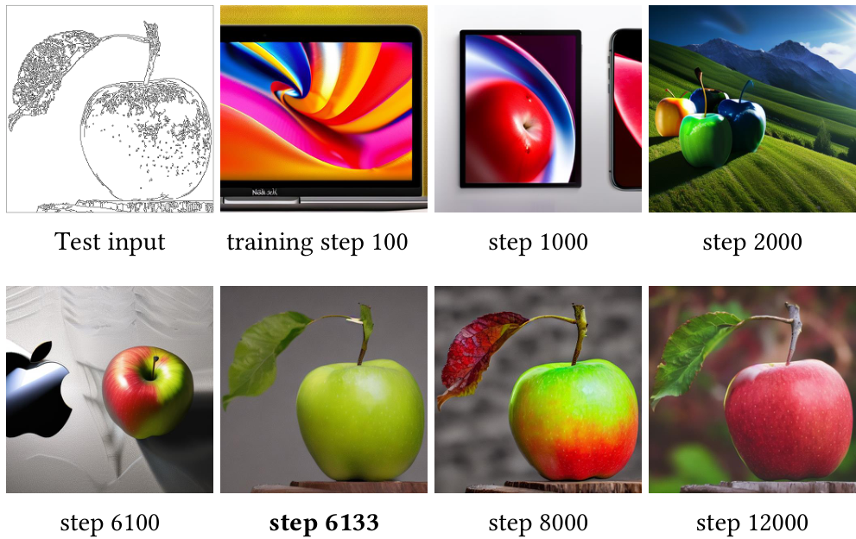
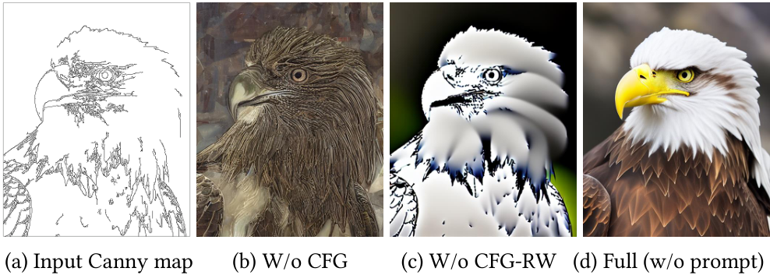
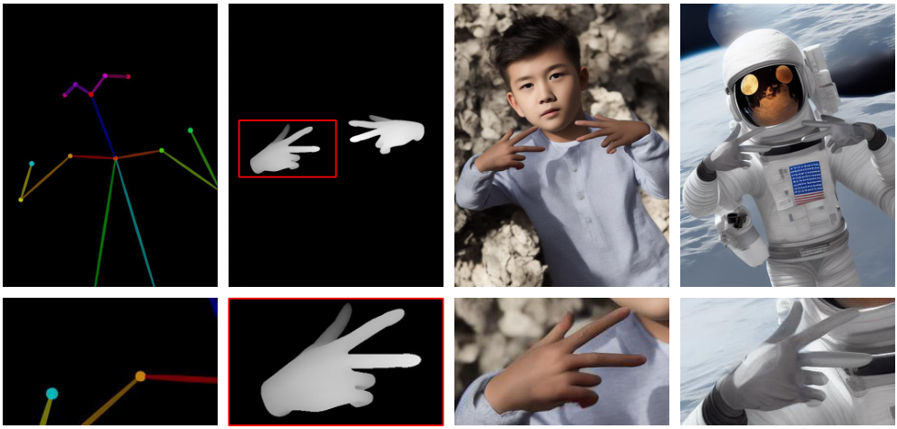
The Core Mechanism
The Sudden Convergence Phenomenon
Initial Training Phase
ControlNet uses zero-convolution layers to protect the
stable diffusion model's pre-trained capabilities.
In early steps (e.g., 2000), it generates high-quality
images but completely ignores the input sketch.
The "Sudden Convergence"
Alignment does not happen gradually. It happens abruptly.
At step 6133, the output suddenly locks onto the shape.
This critical shift occurs in less than 10,000 steps.
Once locked in, later steps (12,000) only refine the
color and texture, transitioning from green to red.

Slide 13
The Core Mechanism
Encoding Image Conditions
Understanding Input Conditions
ControlNet accepts visual inputs known as conditioning images,
such as edge maps, poses, or depth. These inputs typically
begin as standard 512 × 512 pixel images. Since Stable
Diffusion operates in a compressed "latent space" rather than
pixel space, these large inputs cannot be used directly.
They must be translated into a format the model understands.
The Tiny Encoder Network
To perform this translation, the system employs a tiny network
composed of four convolution layers. This network uses specific
4 × 4 kernels and 2 × 2 strides to process data. As the
image passes through, the channel depth grows from 16 to 128,
while the spatial resolution is compressed. This network is
trained jointly with the full model to ensure accuracy.
Matching Stable Diffusion
The output is a compact 64 × 64 feature space vector.
This size is chosen specifically to match the 64 × 64 latent
dimensions of Stable Diffusion. Because the sizes align
perfectly, the conditioning information can be mathematically
added to the model's processing. This allows the generated
image to strictly follow the guidance of the input condition.

Slide 14
SECTION 03
Fine-Tuning Control
Mechanisms for robust conditional control

Slide 15
Fine-Tuning Control
Classifier-
Free
Guidance
(CFG)
Basics
Understanding CFG
Stable Diffusion uses Classifier-Free
Guidance (CFG) to generate crisp,
high-quality images. It acts like a
filter to sharpen the AI's output.
The Core Mechanism
The model makes two simultaneous
predictions during generation:
1. Unconditional: The AI's pure
imagination without any prompt.
2. Conditional: The AI specifically
trying to match your text prompt.
How Guidance Works
The system subtracts the "free" guess
from the "guided" one. This isolates
key features. Multiplying this by a
scale (beta_cfg) amplifies quality.
The ControlNet Problem
ControlNet introduces a third input:
a visual condition (like edges/depth).
This creates a dilemma: where should
we inject this new signal?
Scenario A: Add to Both
If added to both unconditional and
conditional parts, the difference
cancels out. The guidance vanishes,
and the model ignores your prompt.
Scenario B: Add to One
If added only to the conditional part,
the guidance becomes too strong.
The result is often rigid, over-
saturated, or "fried" looking images.
We need a smarter way to balance
these competing signals.

Slide 16
Fine-Tuning Control
CFG Resolution Weighting Strategy
Understanding CFG
Stable Diffusion uses Classifier-Free Guidance (CFG) to
generate high-quality images. It amplifies the difference
between a prompt-conditioned output and an unconditional one.
The Conflicting Signals
When adding ControlNet, we must decide where to inject the
extra control. Adding it to both outputs removes the guidance
effect (Figure 5b). Adding it only to the conditional output
overwhelms the system (Figure 5c).
Resolution Weighting
The solution is a strategy called CFG Resolution Weighting.
Instead of a binary on/off connection, the model scales the
control signal based on the pixel resolution of each layer.
Balancing the Network
This approach adds the conditioning image to the conditional
output but scales it down. It ensures the guidance remains
effective without letting the control signal dominate the
generation process or destroy the image structure.
Analyzing the Data
Figure 5 compares the methods on an eagle generation task.
The standard approaches fail: one yields a flat, unguided
image (5b), while the other creates a "fried" texture (5c).
Superior Convergence
The proposed weighting strategy (5d) achieves
stable convergence. It successfully follows the Canny
edge map (5a) while rendering realistic feathers and
lighting, proving that controls can coexist with strong
text guidance.

Slide 17
Fine-Tuning Control
Composing Multiple
Conditions
ControlNet enables the powerful capability to use multiple
conditions simultaneously for image generation. For instance,
a user can combine pose detection (stick figures) with
depth mapping (3D distance info) to guide one image.
This allows for highly complex compositions. Instead of
relying on just text, you can constrain the diffusion
process with several distinct visual guides at once.
This ensures the final output matches a complicated mental
image perfectly, respecting both the subject's posture and
the scene's physical structure without errors.
The technical method for this composition is remarkably
straightforward. The model uses direct addition of feature
outputs from different ControlNet units. This means there is
no need for complex weighting or interpolation math to
mix these signals artificially. The image generation model
naturally accepts the sum of these condition vectors.
It integrates them into the final picture seamlessly,
treating the combined input as a unified set of instructions
rather than conflicting constraints.
We can see this result in Figure 6, which shows a "pose
and depth" experiment. The system receives two inputs: a
stick figure pose and a hand signal depth map. When
prompted with "boy" or "astronaut," the model generates
distinct images that respect both rules. The "boy" follows
the pose and hand shape exactly, as does the "astronaut."
This proves that multiple controls can be layered to
achieve stable, versatile results without the inputs
fighting each other during the creation process.

Slide 18
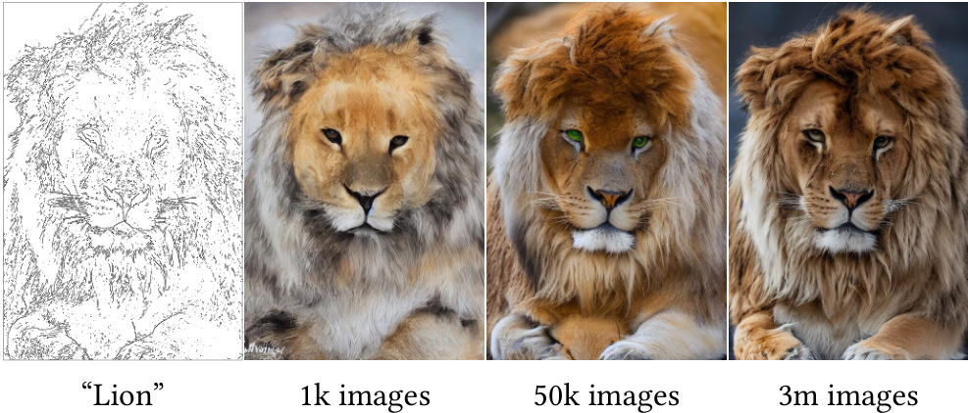
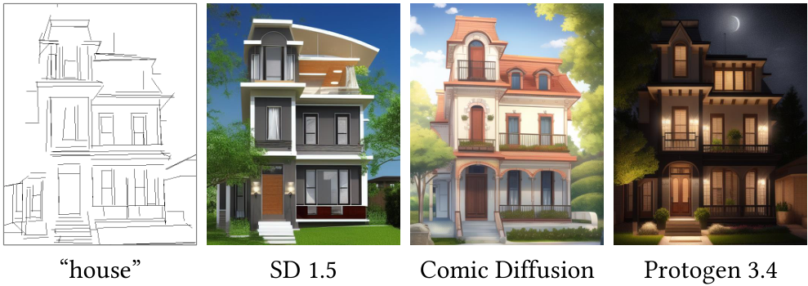
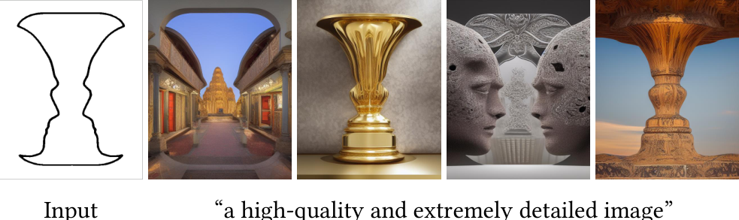
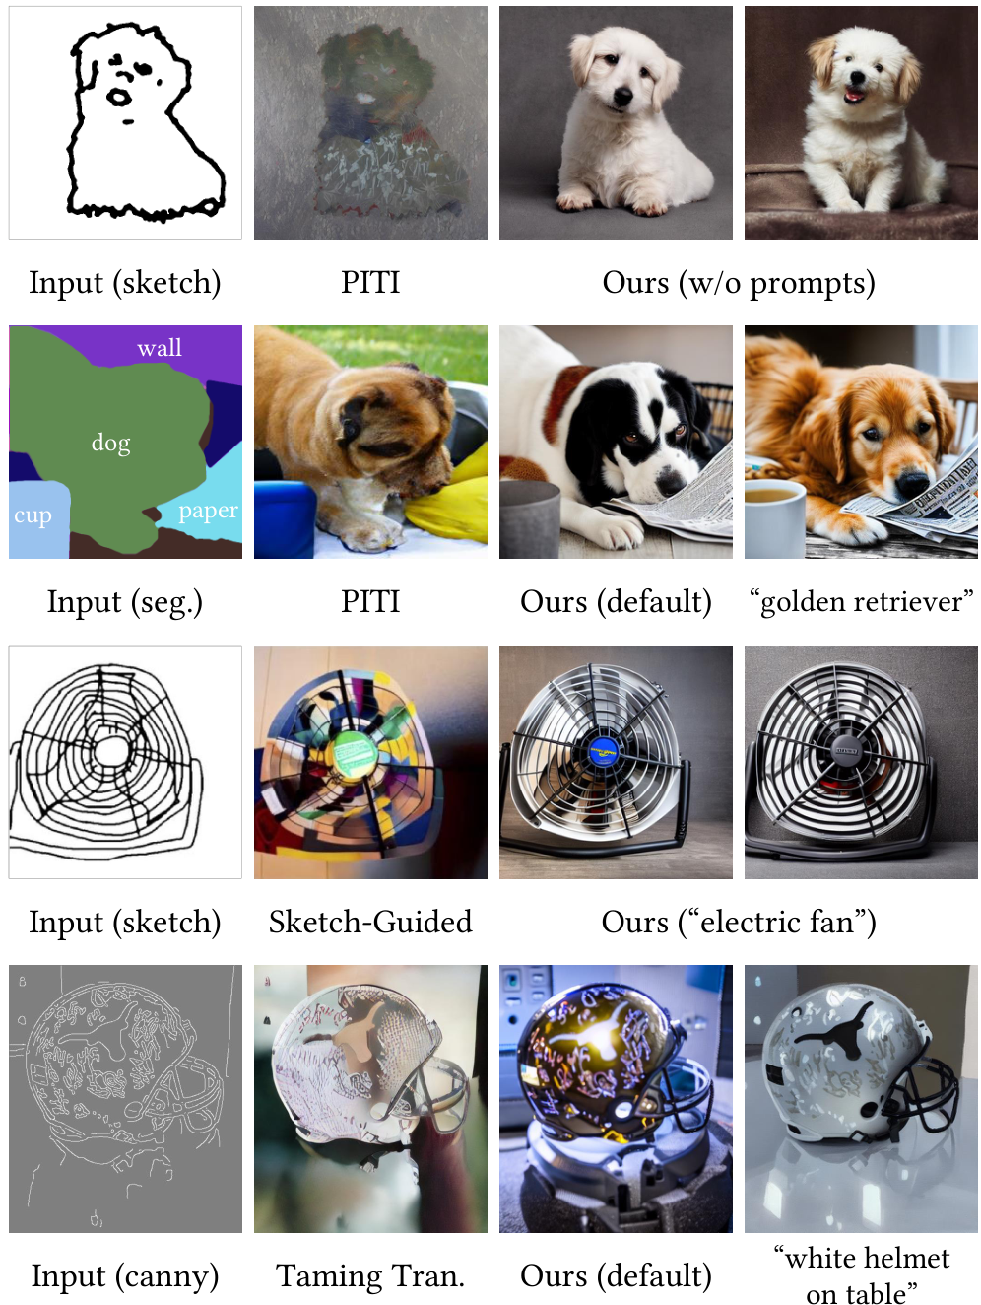
Fine-Tuning Control
When presented with ambiguous inputs like the Rubin vase illusion, the model autonomously interprets the semantic shape.
Without explicit prompts, it resolves the blocky outline into diverse forms: a golden vase, stone faces, or a temple.
This proves the ability to generate high-quality details even when the input lacks specific semantic information.
Generating detailed scenes from
ambiguous abstract inputs.

Slide 19
Fine-Tuning Control
Transferability to
Community Models
Universal Compatibility
ControlNet works with custom community models like
Comic Diffusion or Protogen. These are specialized
versions of Stable Diffusion built for specific
artistic styles, such as anime or photorealism.
No Retraining Required
Because the underlying network topology (structure)
remains the same, you do not need to retrain the
ControlNet for each new model. It acts as a
universal plug-in for the entire ecosystem.
Visual Evidence
Figure 12 shows one sketch controlling distinct
outcomes. The same line drawing creates a realistic
house in SD 1.5, a stylized illustration in
Comic Diffusion, and a detailed render in
Protogen 3.4.

Slide 20
SECTION 04
Visual Capabilities Showcase
Demonstrating generation results using diverse spatial conditions, including Canny edges, Hough lines, scribbles, and human pose estimation.

Slide 21
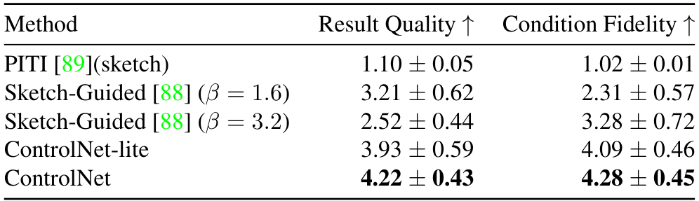
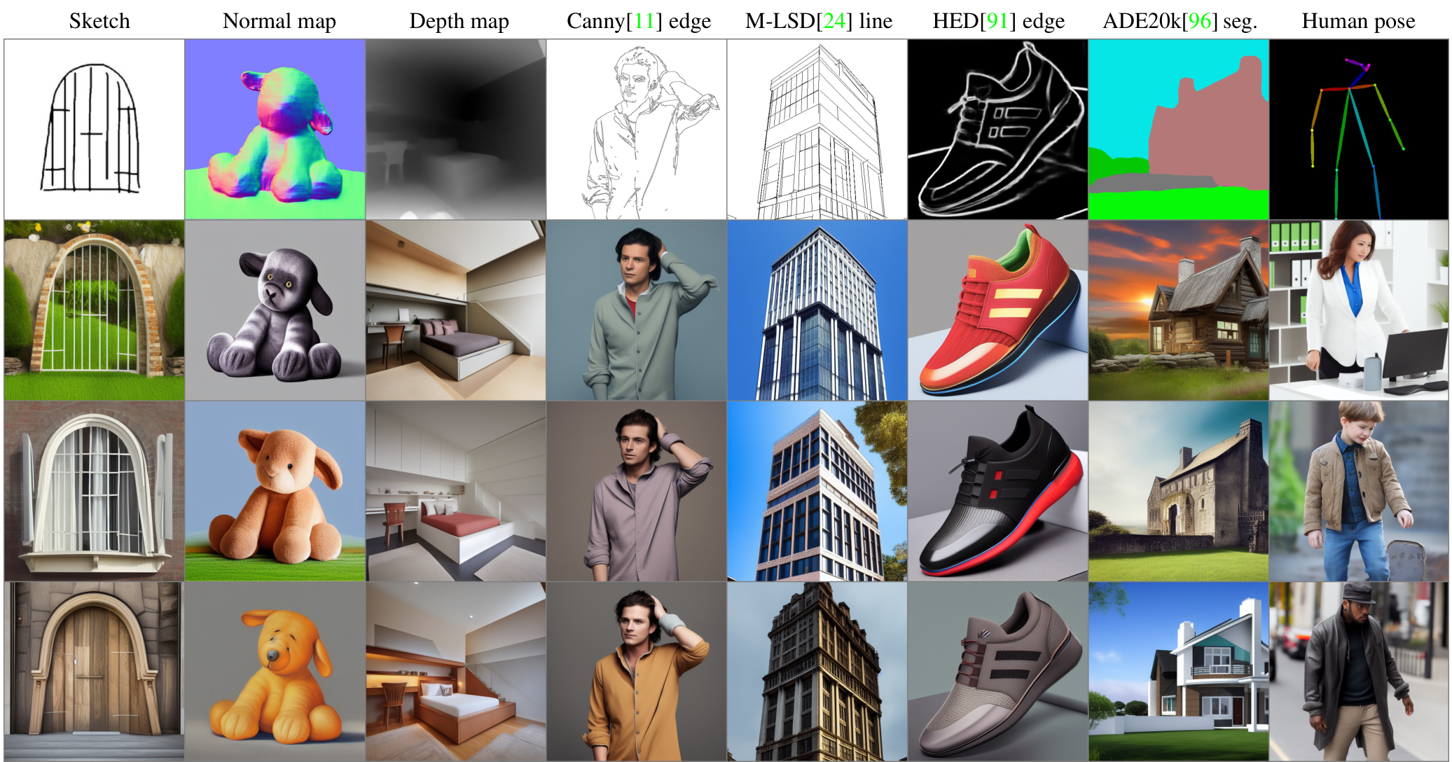
Visual Capabilities Showcase
Control
Capabilities
Versatile Inputs
ControlNet accepts diverse inputs like Canny edges,
sketches, and depth maps. It converts abstract
lines into detailed, photorealistic images.
Structural Consistency
As seen in the Human Pose column, a single stick
figure guides the creation of consistent characters
across different styles (Rows 2-4).
Top-Tier Performance
ControlNet achieves the highest Result Quality (4.22) and
Condition Fidelity (4.28) scores. It significantly
outperforms baselines like PITI (1.10) while
maintaining robustness across tasks.

Slide 22
Visual Capabilities Showcase
Edge and Line Control
Structural Control (Canny)
The Canny Edge detector creates a strict map of outlines,
acting as a digital coloring book for the AI. In the source
examples, a simple line drawing of a man determines the
exact head pose and facial structure. The AI then paints
this structure with photorealistic details, generating
variations in lighting and appearance while locking the
pose. This proves that structural guidance can dominate
the image generation process.
Architectural Geometry (M-LSD)
Standard AI often warps straight lines. The M-LSD method
(Mobile Line Segment Detection) solves this by identifying
only the straight structural lines in an image. As shown
in the visual data, it successfully converts a sparse
wireframe into a coherent, solid building. This is
critical for interior design and architecture, ensuring
that walls, frames, and horizons remain perfectly
vertical and realistic.
Soft Edges (HED)
For complex objects like the shoe in the source image,
HED Soft Edges capture gradients and fine details that
simple lines miss. This preserves texture and depth.
Prompt-Free Understanding
Crucially, these results were achieved without text prompts.
The research shows the model is robust enough to interpret
the semantics of an image solely from its shape. It
recognizes object types directly from the edge map.

Slide 23
Visual Capabilities Showcase
Human Pose
and Keypoints
Skeletal Mapping
The system utilizes OpenPose skeletons to guide image
generation. An OpenPose skeleton is a simplified stick-
figure map of human joints (elbows, knees, head). Unlike
text prompts which struggle to describe precise postures,
this method allows creators to dictate exact body
language. The model ensures the generated person follows
this structure perfectly, regardless of clothing or
background. This solves the issue of 'pose hallucinations'
seen in other AI models.
Visual Consistency
Figure 7 demonstrates the ability to separate pose from
identity. The top row provides a single skeletal input for
sitting or walking. The model generates diverse variations—
from a woman in a dress to a person in a winter coat.
Despite these visual differences, every generated image
adheres to the exact same physical stance. The AI robustly
interprets the semantic meaning of the skeleton, filling in
realistic details like hands and feet.
Practical Applications
This tool is vital for character design and storytelling.
Artists can create consistent characters across different
scenes by providing visual maps instead of complex text
descriptions. This allows for precise gestures that are
typically hard for AI to guess. Performance metrics in
Table 1 show a Condition Fidelity score of 4.28,
confirming that the output strictly follows the input pose
while maintaining high image quality.

Slide 24
Visual Capabilities Showcase
Sketch & Scribble
Interpretations
Beyond Text Prompts
ControlNet revolutionizes generation by accepting rough
hand-drawn sketches directly. It does not rely solely on
text descriptions to understand user intent.
Semantic Understanding
As seen in Figure 7, the model works without prompts.
It interprets content semantics from lines alone,
identifying objects like bags or animals purely from
rough geometry and user scribbles.
From Sketch to Reality
The first column of Figure 7 shows a rough handbag sketch.
The model generates diverse outputs—from leather bags
to creative turtle designs—while keeping the shape.
Balancing Control
This demonstrates robust interpretation. The system
preserves the spatial layout of the user's drawing
while allowing for artistic freedom in texture and style.
User Preference Ranking
Table 1 compares ControlNet against methods like PITI
and Sketch-Guided. Users rated results from 1 to 5.
Key Performance Data
ControlNet achieved a Result Quality score of 4.22,
far surpassing the PITI score of 1.10. For accuracy,
it reached a Condition Fidelity score of 4.28,
proving it strictly follows user input lines.

Slide 25
Visual Capabilities Showcase
Depth &
Normal
Maps
Understanding Depth
A depth map converts a 3D scene into
a greyscale image. Lighter pixels are
close to the camera, while darker
pixels represent far-away backgrounds.
This creates a distance map.
Spatial Awareness
ControlNet uses this to understand
the 3D structure of an image.
Instead of guessing shapes, the AI
knows the exact volume of objects.
As shown in Figure 7, the bear's
shape is preserved perfectly because
the depth map locks the geometry.
Surface Details
Normal maps (often blue/purple) define
the orientation of surfaces. They tell
the computer how light should bounce
off curves, bumps, and textures.
This captures fine detail beyond
simple outlines.
Re-Rendering Scenes
These tools are powerful for updating
visuals. You can take a basic 3D model
and use ControlNet to "repaint" it
with realistic materials. The result
keeps the original geometry but changes
the style entirely, without needing
complex text prompts.

Slide 26
Visual Capabilities Showcase
Generating
Without
Prompts
The "Empty Prompt" Test
Usually, AI generators need text to know what to
create. In this study, researchers fed the model
completely empty text strings. This forced the AI to
rely 100% on the visual "control image" (like a
sketch or depth map) to figure out the subject.
Visual Understanding
The results demonstrate robust semantic awareness.
Without words, the model correctly identified a
rough shape as a teddy bear, a depth map as a
furnished room, and a stick figure as a person.
Why It Matters
This proves ControlNet understands the meaning
of visual structures. It does not blindly copy
lines; it interprets what those lines represent
conceptually, even without textual guidance.

Slide 27
SECTION 05
Comparisons and Evaluations

Slide 28
Comparisons and Evaluations
Comparison
to Previous
Methods
Cleaner
Results
Diverse
Conditions
Analyzing Baselines
We compared ControlNet against three
other AI systems: PITI,
Sketch-Guided Diffusion, and
Taming Transformers. These provide a
benchmark for conditional generation.
The Challenge
Older methods often struggle with
complex inputs. For instance, the
PITI model relies on an older
technology called GLIDE.
This limits its ability to generate
images with high resolution or fine
details compared to modern Stable
Diffusion models. The difference is
clear in how they handle edges.
Superior Fidelity
ControlNet achieves sharp and clean
results across diverse inputs.
It handles sketches and edge maps
robustly, interpreting the user's
intent even when the input is simple.
Visual Evidence
Compare the electric fan images.
Previous methods created a messy,
colorful blob without structure.
ControlNet drew the wire grid
perfectly. Similarly, the white
helmet example shows smooth,
photorealistic textures, avoiding
the blocky, pixelated artifacts
seen in Taming Transformers.

Slide 29
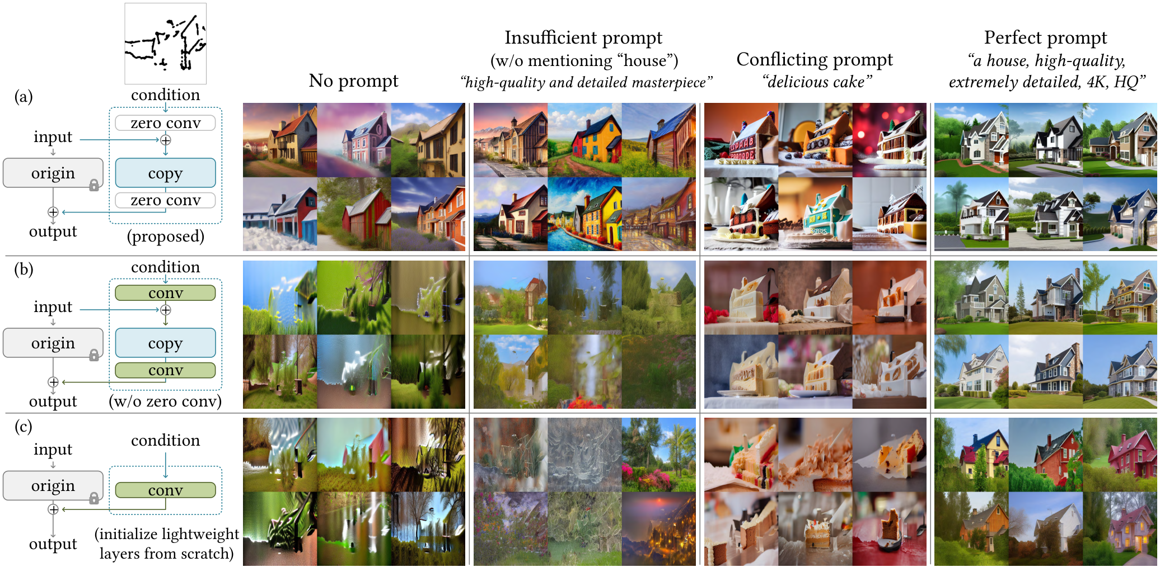
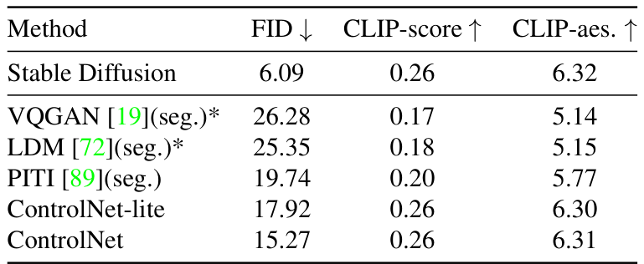
Ablation Study: Architecture Variants
Visual Evidence
Sketch Fidelity
The proposed model (row a) uses zero convolutions to
lock onto the sketch. When prompted for a "delicious cake",
it generates house-shaped cakes. Without these layers
(row b), the model fails to connect the sketch to the
image, resulting in broken or abstract outputs.
Metric Analysis
Table 3 compares image quality (FID) and text alignment.
ControlNet (15.27 FID) outperforms the simplified
ControlNet-lite (17.92), validating the full design.
It also beats methods like VQGAN (26.28), proving it
delivers higher quality results closer to Stable Diffusion.

Slide 30
Comparisons and Evaluations
User Preference Study Results
Survey: 12 users, 20 groups
Scale: 1 (worst) to 5 (best)
ControlNet achieves top rank
Quality: 4.22, Fidelity: 4.28

Slide 31
Comparisons and Evaluations
Semantic
Segmentation
Accuracy
Testing Spatial Fidelity
We tested how well the AI obeys the input layout.
Does the image match the segmentation mask?
Metric: Intersection over Union
We use the ADE20K benchmark to measure overlap.
Higher scores mean better adherence to the plan.
Superior Performance
ControlNet scores 0.35, surpassing VQGAN
( 0.21) and LDM (0.31). It beats competitors.
For reference, real images score 0.58.

Slide 32
Comparisons and Evaluations
Image Quality Metrics
Measuring Realism
Scientists use the Frechet Inception Distance (FID) to
score realism. Lower numbers indicate images that
look more natural and real to the human eye.
Superior Performance
ControlNet achieves a best-in-class FID of 15.27,
beating methods like VQGAN (26.28) and LDM (25.35).
This proves it generates higher quality results while
strictly following the layout conditions.
Preserving Beauty
The CLIP Aesthetic Score measures artistic appeal.
ControlNet scores 6.31, matching the original
Stable Diffusion (6.32). It adds precise control
without sacrificing the model's artistic capabilities.

Slide 33
Comparisons and Evaluations
Dataset
Size
&
Impact
The Experiment
To test robustness, the authors trained
ControlNet on a sketch-to-image task
using three dataset sizes:
1k, 50k, and 3M images.
Small Data Stability
Remarkably, training with just 1k
images does not fail or collapse.
The model still attempts to match the
input sketch, though results are rough.
Learning to See
Increasing to 50k images allows
the model to learn concepts.
It successfully generates a distinct
Lion, proving it can link sketches
to object semantics with moderate data.
Massive Scale
When the dataset grows to
3 million images, the difference
is clear. The lion becomes
photorealistic, showing that the model
continues to learn and improve.
What is Scalability?
Scalability means the method grows
stronger as you give it more resources.
ControlNet is highly scalable:
- Works on small data (Robustness)
- Masters details on big data (Quality)
Why it Matters
This allows researchers to use
ControlNet for both niche tasks
(small data) and general purpose
tools (huge data) effectively.

Slide 34
SECTION 06
Conclusion and Future

Slide 35
Conclusion and Future
Comparison with
Industrial Models
Resource Efficiency
Industrial models like SDv2-D2I require a massive
NVIDIA A100 cluster and thousands of GPU hours.
They utilize huge datasets with over 12M images.
Low-Cost Training
In contrast, ControlNet uses a single RTX 3090Ti.
It completes training in only 5 days with just
200k training samples.
Blind User Study
Participants were taught to distinguish models using
100 sample images generated by each system.
After this training, they evaluated 200 new images.
The task was to identify the source model for each
image without any labels or hints.
Key Results
The average user precision was 0.52 ± 0.17.
Since 0.50 represents random guessing, this means
users could not tell the difference.
Visual Quality
ControlNet produces quality indistinguishable from
resource-heavy industrial models.

Slide 36
Conclusion and Future
The "Zero Convolution" Innovation
What is Zero Convolution?
A zero convolution is a unique 1×1 neural layer initialized
completely to zero. Unlike standard layers that start with
random numbers, these layers mathematically output a zero signal
at the very start of training. This acts like a "volume knob"
set to silent, allowing the system to gradually learn new
patterns without overriding the original data.
Protecting Original Knowledge
ControlNet creates a trainable copy of the neural network
weights while keeping the original model locked. The zero
convolution layer connects these two parts. Because the layer
starts at zero, the trainable copy initially has no effect.
This ensures the vast knowledge of the original model is
never lost or damaged during the fine-tuning process.
Eliminating Harmful Noise
Standard training adds random "noise" that can break a model's
capabilities. Zero convolution prevents this entirely.
The trainable branch slowly learns to add influence, starting
from a neutral state rather than disrupting the system with
random signals. This guarantees that training is stable
and the model's performance only improves over time.
A Reusable Foundation
This innovation is a universal pattern for future AI design.
It allows developers to reuse massive, expensive pre-trained
models like Stable Diffusion for specific tasks. By adding a
small, trainable ControlNet, we avoid the prohibitive cost
of training a new model from scratch, democratizing access to
advanced generative AI capabilities.

Slide 37
Conclusion and Future
Implications for
Generative AI
Democratized Training
Training advanced AI usually requires millions of
images. However, ControlNet demonstrates extreme
robustness, learning effectively with as few as
1,000 images without model collapse. This
efficiency lowers the barrier to entry, enabling
fine-tuning on standard consumer hardware.
Universal Compatibility
Because ControlNet preserves the topology of the
base model, it is highly transferable. Controls
trained on one model can be directly applied to
community variations like Comic Diffusion
or Protogen without retraining. This allows
structure and style to be mixed freely.
Safe Architecture
The system employs a zero convolution layer
strategy. These layers start with weights at zero,
preventing harmful noise from destroying the
pre-trained model's capabilities during early
training. This protects the vast knowledge of
large models while enabling new controls.

Slide 38
Conclusion and Future
Final Summary
What is ControlNet?
A neural network structure that adds spatial
control to diffusion models. It lets users define
structure via outlines, poses, or depth maps.
How It Works
It keeps a locked copy of the model and adds a
trainable copy. "Zero convolution" layers connect
them, progressively learning new controls without
damaging the pre-trained knowledge.
Key Advantages
Training is efficient even with small datasets
(<50k images). The controls transfer easily to
other Stable Diffusion models, enabling flexible
creative applications.

